Slide 1
Tritium problems in the J-PARC neutrino beamline
Yuichi Oyama (KEK/J-PARC)
Jun-26-2020(JST)/Jun-25-2020(CDT)
This presentation file was originally prepared for the US-Japan workshop at Fermilab on March 11 2020. The workshop was unfortunately cancelled by the coronavirus problem. In this file, some internal discussion and change in recent three months are added at the end.

Slide 2
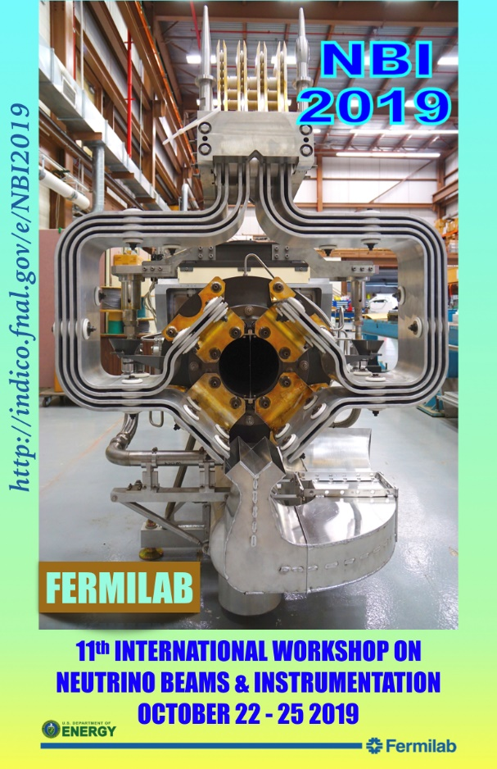
A new ³H problem – summary of my talk in NBI2019
“NuMI experience says majority of the tritium produced in the steel shielding can come out, when shielding gets hot at high beam power”. (by Prof. Jim Hylen)
J-PARC neutrino beamline also has similar “³H from steel wall” problems.
³H from steel wall to water ³H concentration in the cooling water continuously increased by ~25Bq/cc per day even after the beam stop. We suspect that 0.20GBq/day of ³H come out from the steel wall to cooling water.
³H from steel wall to air After the beam in 2017, dry air was supplied to helium vessel to exhaust ³H rich air for the maintenance work. However, ³H concentration of the air in the Helium vessel did not reduced below 0.5Bq/cc. This saturation can be explained by 0.72GBq/day of ³H from the steel wall to the dry air.

Slide 3
A new ³H problem – summary of my talk in NBI2019
At present, contributions from ³H coming from steel wall is small. However, it might be extremely serious problems in the near future (2030s).
³H coming from steel wall to cooling water were reduced after 1 year. -25Bq/cc/day in September 2018 -12Bq/cc/day in August 2019 Effective “half life time” is ~1 year.
³H comes from steel wall to cooling water may become more than that generated from cooling water.
For safety maintenance works in helium vessel, air-line masks to supply fresh air will be needed for workers.
For more details, please visit my presentation file in NBI2019.
http://www-nu.kek.jp/~oyama/nbi2019.oyama.ppt
https://indico.fnal.gov/event/21143/session/9/contribution/37/material/slides/0.ppt

Slide 4
Progress after NBI2019
In NBI2019, we learned that not only neutrino beamline, but also other high power beam facilities have “³H from materials” problem. Especially, the muon beamline in J-PARC MLF has similar problem in their target as reported by Kawamura-san. https://indico.fnal.gov/event/21143/session/9/contribution/38/material/slides/0.pptx
Kawamura-san and his colleague collaborate with experts of ³H in University of Toyama for advice and ³H measurements.
The collaboration was extended to entire J-PARC facilities, and the neutrino group also learned suggestions from them. My presentation from here are partially based on suggestions from them.
Hydrogen Isotope Research Center, University of Toyama
http://www.hrc.u-toyama.ac.jp/en/
6 researchers in total, and 3 researchers among them are 3H experts.
25 students (master course of graduate, and undergraduate) .

Slide 5
Suggestions from ³H experts
If you can confine ³H in the steel for a reasonably long time, do confine. Otherwise, release as early as possible.
If the time scale of the release is > 10 years, we are very happy. Ten years is a nominal time scale of the entire experiment and the half life of tritium (τ_{1/2}=12.3years). Definitely we should confine ³H.
If the time scale of the release is < 1 month, we are happy. ³H can be released in a couple of months, and we can start the maintenance works afterward.
Unfortunately, we are just in between! The “half life time” of the ³H release is about 1 year!!
Can we change the time scale of the ³H release?
When we discuss the time of ³H release from a metal, we must evaluate 2 parameters, diffusivity and solubility.
A compilation of tritium Material interaction parameters in fusion reactor materials
F. Reiter, K.S. Forcey, G. Gervasini (1993)
https://op.europa.eu/en/publication-detail/-/publication/60f147a2-fdc8-49c8-8a87-7af6f09b0a61/language-en

Slide 6
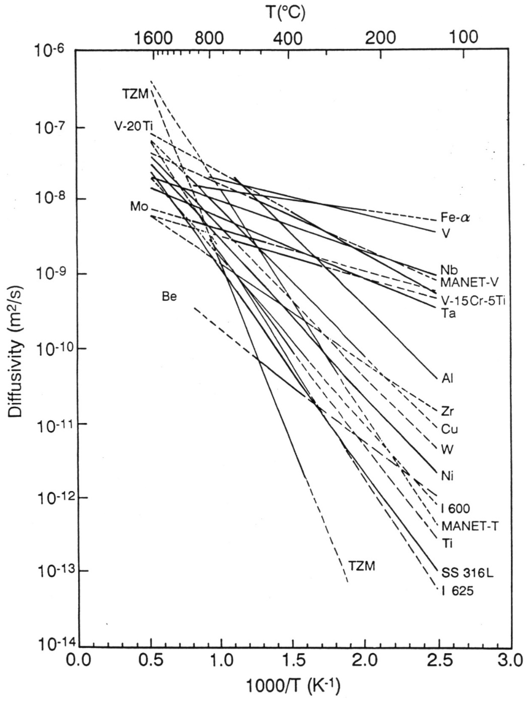
Tritium Diffusivities in materials
Diffusivity (D) is a parameter which indicates how fast ³H move in the metal.
The diffusion distance of ³H in a metal in time duration t sec can be written as L = (Dt)^{1/2} meter.
At room temperature, the ³H diffusivity in iron is D ~ 2 x 10⁻⁹ m²/s.
The ³H diffusivity in iron is larger than that in most of other metals. ³H can travel fast in iron.
From Reiter et al. (1993)

Slide 7
Diffusivity
The average travel distance of ³H in iron in one month is calculated to be L = (2x10⁻⁹ x 60 x60 x 24 x 30)^{1/2} = 0.07m = 7cm.
On the other hand, nominal thickness of the steel wall of Helium vessel is 10cm.
The nominal time scale that ³H reach to the surface of the iron surface is estimated to ~1 month.
On the other hand, the “half life time” of the ³H release is ~ 1 year.
This discrepancy might be explained if the ³H can reach to the iron surface, but it cannot be released to outside.

Slide 8
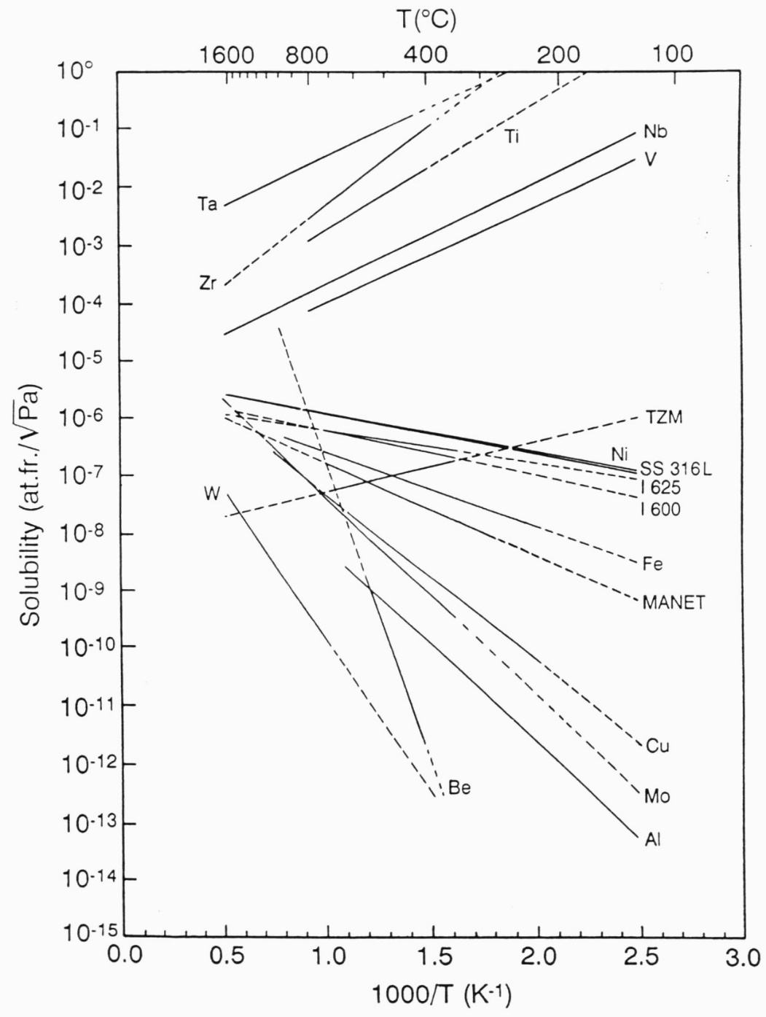
Tritium Solubilities in materials
Solubility means “capacity to hold tritium in the metal”. If the solubility is large, it can hold much tritium in the metal.
If the solubility of the metal which contact to outside water/vapor is large, it provide larger opportunity for ³H <->¹H exchange with outside water/vapor.
From Reiter et al. (1993)

Slide 9
Solubility
The steel wall can be coated with another metal. ³H release strongly depends on the solubility of the surface metal.
If metal of high solubility is used for coating, it can attract ³H from the inside steel because of the ³H concentration gradient.
For the enhancement, Pd might be only candidate. The solubilities of Ti (Titanium) and Zr (Zirconium) are also large, but their corrosion resistances are poor and cannot be used for coating. One serious problem is that Pd is expensive. A nominal price of Pd is about 1.5 times of the price of gold.
For the suppression, other possible candidates are Sn (Tin) and Zn (Zinc).
Recommendation from the ³H expert
To enhance the ³H release, coated with Pd (Palladium) is the best.
To suppress the ³H release, coated with Al (Aluminum) is the best.

Slide 10
What measurement should we do?
Prepare metal-coated iron blocks together with other control samples. -Iron block coated with Pd -Iron block coated with Al -Iron block coated with Sn, Zn, .......? -Bare iron block -Iron block coated with mill scale (black skin)
Since the thickness of the helium vessel is 10 cm, we prefer 10cm x 10cm x 10cm iron blocks, for example.
Expose the samples to neutron flux for certain time period.
bare iron
mill scale
Pd
Al

Slide 11
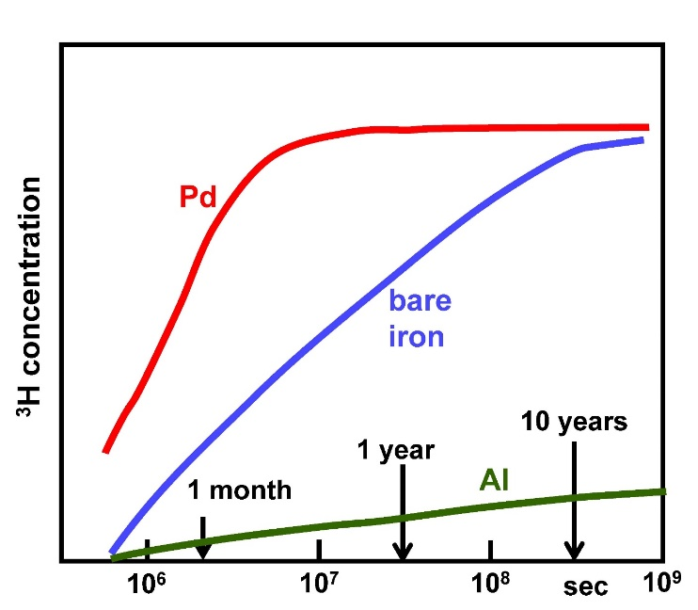
What measurement should we do?
After neutron irradiation, the samples are soaked in water. The water is occasionally collected, and ³H concentration is measured by the conventional liquid scintillation method.
We are very happy if we can obtain this kind of distribution.
There are still some open questions. -So far, there are no quantitative discussion at all. -Total irradiation needed must be evaluated. -Safe remote handling after irradiation must be considered -The method of the coating. “sputter deposition" and "electron beam evaporation” are possible candidate…….
Note
This is not data but an optimistic guess.

Slide 12
Who, When and Where
Honestly speaking, J-PARC neutrino beamline group have mild interest. Although the measurements will be very important for the future beamline design, we cannot incorporate it into J-PARC.
If LBNF group has strong interest, we can work together.
The measurements must be in time for the final design of the LBNF beamline. It is a strong constraint on the time of the measurement.
J-PARC neutrino beamline schedule……..

Slide 13
After March 2020……..
The next T2K beam period is fixed to early 2021. We will not open the helium vessel before the beam. We cannot install iron blocks in the helium vessel.
Next-next beam period will be in 2022. The iron blocks can be exposed in the 2022 beam, and the result of the test will be obtained around end of 2022 at earliest. Probably it will be too late to be incorporated into the LBNF design.
Should we give up to use the J-PARC neutrino beam line?

Slide 14
Q & A and Comment
The iron cubes of 10cm x 10cm x 10cm are too heavy for remote handling.
Yes, I agree. For example 5cm x 5cm x 5cm will be better.
Coated with Pd is scientifically interesting. However, Pd is very expensive and use of Pd in the beam line is not realistic.
Pd can be used only for close access area by workers to save money. All surface of iron wall are not needed to be coated with Pd.
In T2K, we can wait more that 1 month before the maintenance because the beam time is shared with hadron experiments and the shutdown period is relatively longer. However, the maintenance periods of NuMI and LBNF are short and they hope to start maintenance within one week from the beam stop. Accordingly, enhancement of the ³H release is not realistic in NuMI and LBNF.

Slide 15
Q & A and Comment
The diffusivity in the discussion is that for pure iron. Since SS400 is used for the steel wall in T2K, the diffusivity is smaller. Also radiation damage will reduce the diffusivity. The reduction of diffusivity will contribute to confinement of ³H in the steel.
We cannot install the iron blocks inside of the helium vessel because of the time schedule for 2021 beam. However, there are many places for neutron irradiation in J-PARC. Possible candidates are near the MLF target or near the beam window of the neutrino beam line. Quantitative calculation of the neutron fluxes and productions of ³H are needed.
“Sputter deposition" and "electron beam evaporation” are good methods for the coating for small portion of metals. However, other methods must be considered for the real beam lines.

Slide 16
End

