Slide 1
Data Acquisition (DAQ) system and software
Yuichi Oyama (KEK/J-PARC)
February 26 – March 4 2023 2nd Hardware Camp for Fast and Low-Light detection @ICISE, Quy Nhon, Vietnam
1

Slide 2
Introduction
In the yesterday's lecture, an electronics circuit in a small-scale test experiment is discussed in detail.
Real experiments require more sophisticated data acquisition (DAQ).
In this lecture, some topics related to the DAQ computer are presented.
Control of the electronics from DAQ computer
Data processing in the DAQ computer
Trends in DAQ electronics/computer
2

Slide 3
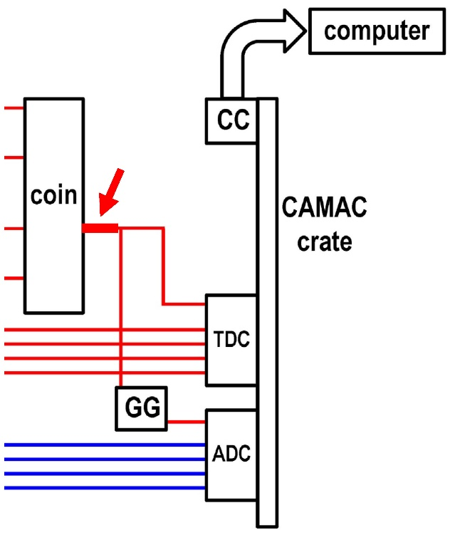
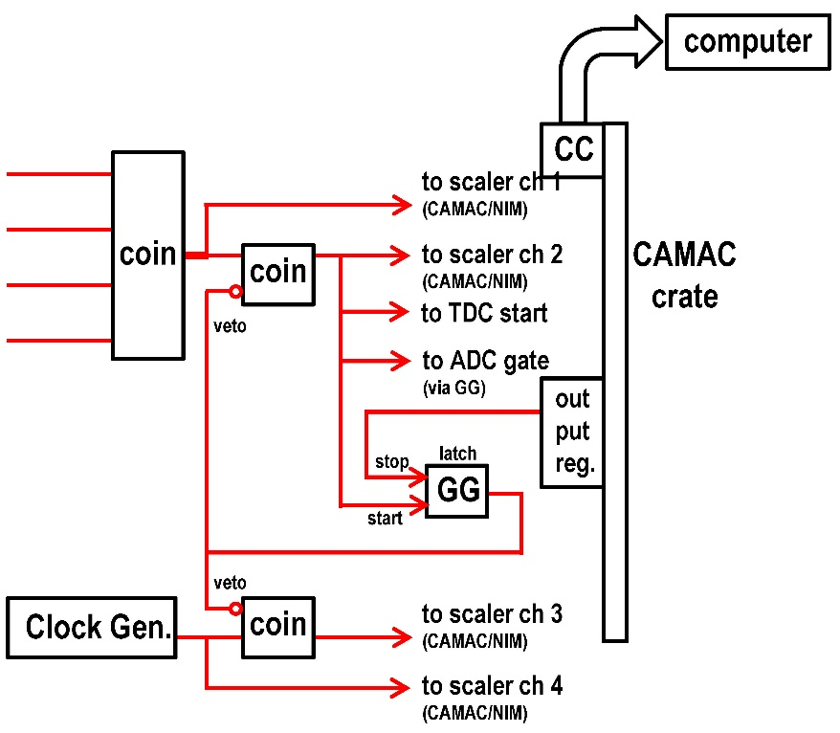
Trigger logic
The computer start the data acquisition by the trigger signal. Therefore, the trigger is the most upstream component of the data acquisition.
When the computer is reading the electronics data, next event cannot be accepted. Therefore, the trigger from the electronics should be disabled until the computer finish reading data.
In a real experiment, so-called "busy logic" must be added in the trigger logic, and it must be controlled by the DAQ computer.
With “busy logic”
signal for each ADC/TDC channel is omitted.
3

Slide 4
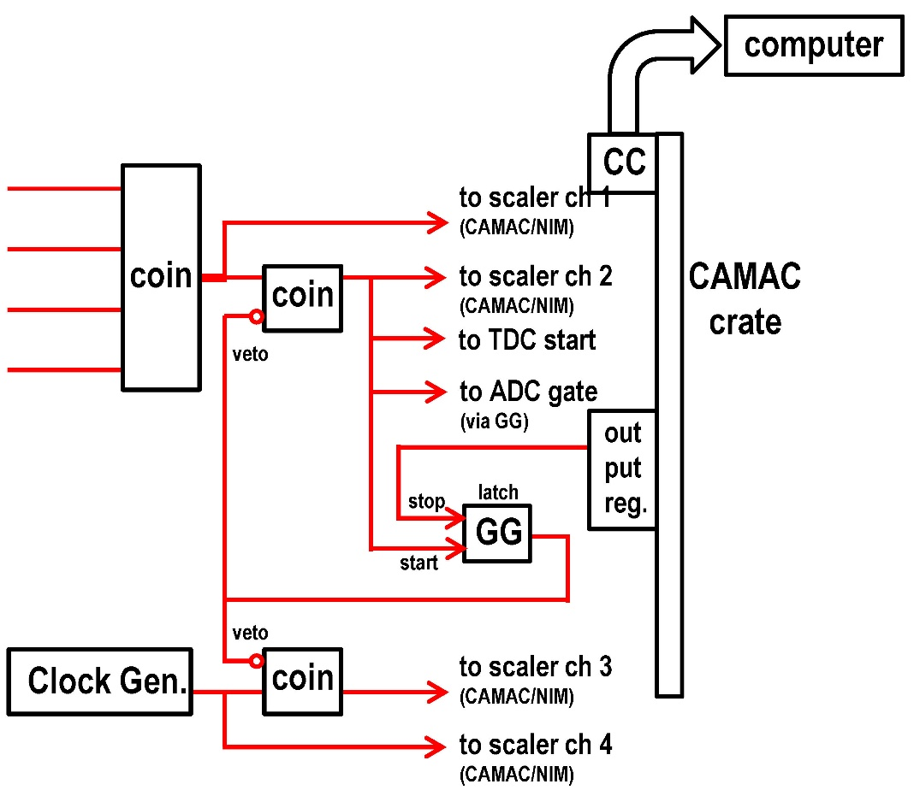
“Busy logic”
Immediately after the trigger signal, veto signal is generated from the gate generator. The gate generator is operated with “latch mode”; the signal with long gate width is generated until it receive stop signal.
After the computer finish reading data, it send latch stop signal to the gate generator.
Number of all trigger signals and number of trigger signals generated when the readout electronics are enable are counted by scalers. A clock generator and scalers are used to evaluate dead time of the data acquisition.
4

Slide 5


Output Register
The output register is module to send NIM level signals from the computer to electronics circuit.
In this electronics circuit, after the computer finish reading and clear the ADC/TDC data, the signal is sent to the gate generator. The signal notify that the CAMAC is ready for the next event.
Another typical usage of output registers is to switch the source of the trigger. When multiple kind of trigger sources are prepared in the system and data acquisition hope to use one of them, it enable one trigger source and disable all other sources.
Kaizuworks CAMAC output register KC3471
http://www.kaizuworks.co.jp/NEWPDF/KC3471.pdf
5

Slide 6
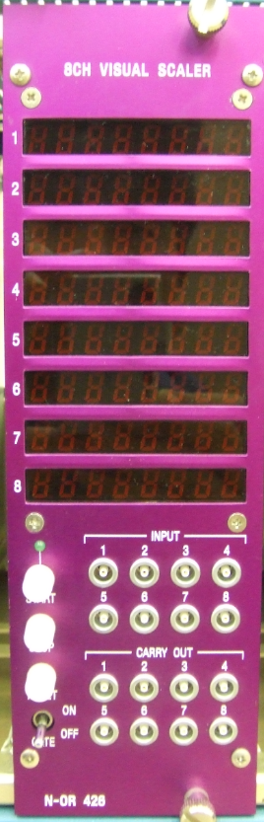

Scaler (CAMAC/NIM)
Scalers count number of input pulse signals for each channel.
The NIM scaler data are visually displayed for real time monitor. CAMAC scaler is read together with ADC/TDC data in event by event basis, but not is cleared throughout the data-taking.
In this electronics circuit, number of all triggers is recorded/displayed in ch. 1, and number of triggers during the DAQ alive is recorded/displayed in ch. 2.
(left) LeCroy CAMAC 12-Channel 100 MHz Scaler Model 2551
https://nuchem.iucf.indiana.edu/Instrumentation/Elec_Manual/Electronic_pdfs/2551-spec.htm
(right) Technoland 8CH 100MHz NIM Visual Scaler N-OR 426 http://www.tcnland.co.jp/archives/product_type/scaler_n-or_426
6

Slide 7
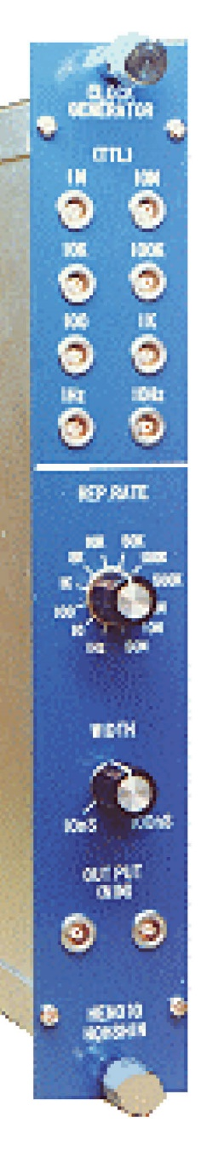
Clock Generator
From a clock generator, periodical NIM level output signals are generated automatically. The frequency can be changed from 1 Hz to 10 MHz discretely, (i.e. 1 Hz, 10 Hz, 100 Hz......10 MHz).
It is used to make a fake trigger signal for a test of DAQ system and for a pedestal data taking.
In this electronics circuit, it is used to measure a live time of the data taking. The ratio of the scaler data (ch.3)/(ch.4) is the live time fraction of the DAQ system.
The time efficiency obtained by the scaler data is important for the booking of the data-taking.
Hoshin 50MHz NIM Clock Generator module N010 https://www.kagaku.com/hoshin/n010.html
7

Slide 8
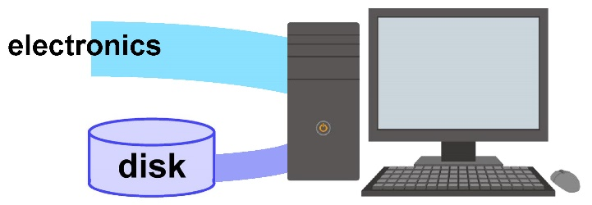
Program in the DAQ computer
The role of the DAQ computer is data processing. It includes
One trigger is generated and data are recorded in the electronics modules, the DAQ computer execute one (R->C->W) process.
To collect data effectively with small deadtime, we need to take full advantage of the computer's capabilities. It requires special techniques specific to data acquisition.
Read data from electronics module
Calculation about the data -convert (slot, address) to sequential channel number -subtract pedestal -zero suppression
Write the data to the output disk
8

Slide 9
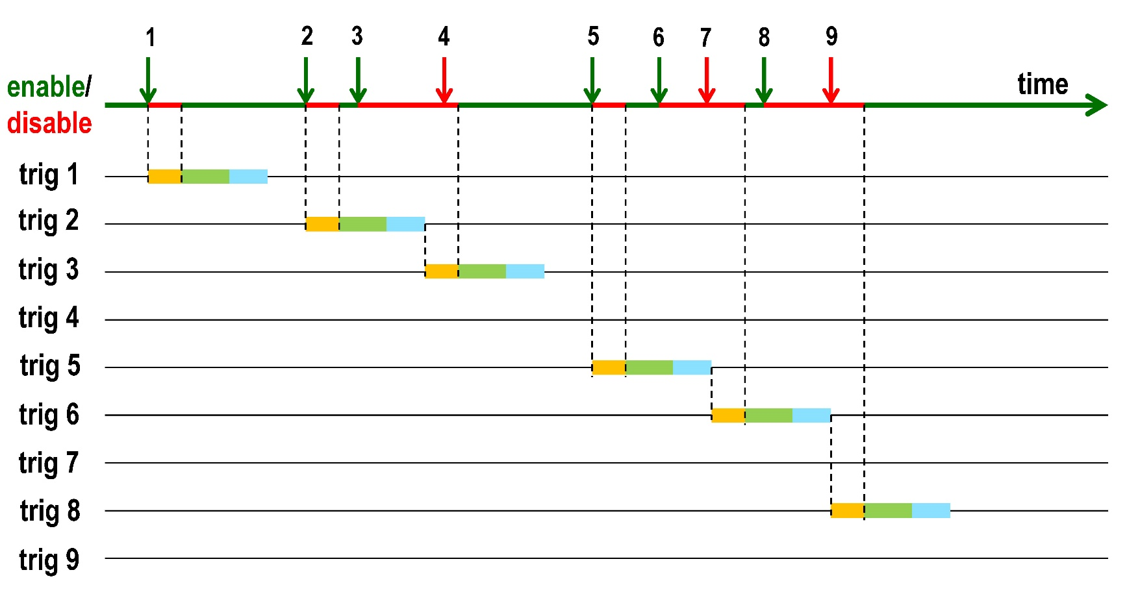
Time chart of data processing by a single program
The time chart when R+C+W are executed with a single program.
The time duration between the “trigger” and “stop veto” is a dead time. During the period, trigger is not accepted by computer.
In this case, trigger 4, 7 and 9 are not recorded.
R C W
9

Slide 10
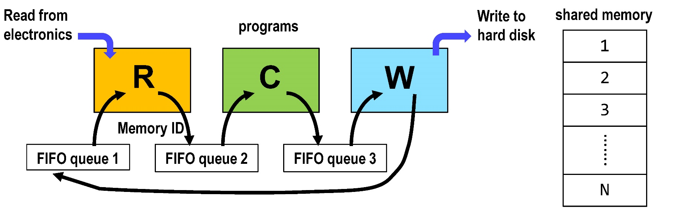
Data processing with multiple programs
To collect data more effectively, “data processing with multiple programs” is widely used in data acquisition software.
The data acquisition program is divided into three programs; R(Read), C(Calculate) and W(Write). Large number of memory space for data are prepared. The memory space is shared by multiple programs.
After program R read the data from the electronics module, it push the memory ID to the FIFO (First-In First-Out) queue 2. R get another memory space from the FIFO queue 1, and start the data collection from the electronics module.
Program C pop up the memory ID from the FIFO queue 2, and start the calculation. After the calculation, it push the memory ID to the FIFO queue 3.
10

Slide 11
Data processing with multiple programs
Program W pop up the memory ID from the FIFO queue 3, and start writing the data to the hard disk. It push the memory ID to the FIFO queue 1 after writing.
Priority of R is set to be the highest. When R resume working, other processes pause even when they are working. CPU power is used for R.
In addition, when R process is waiting for the response from the electronics module, it do not use CPU. During this time duration, another program can run simultaneously. Similarly, when W is waiting for response from the hard disk driver, another process can work simultaneously.
11

Slide 12
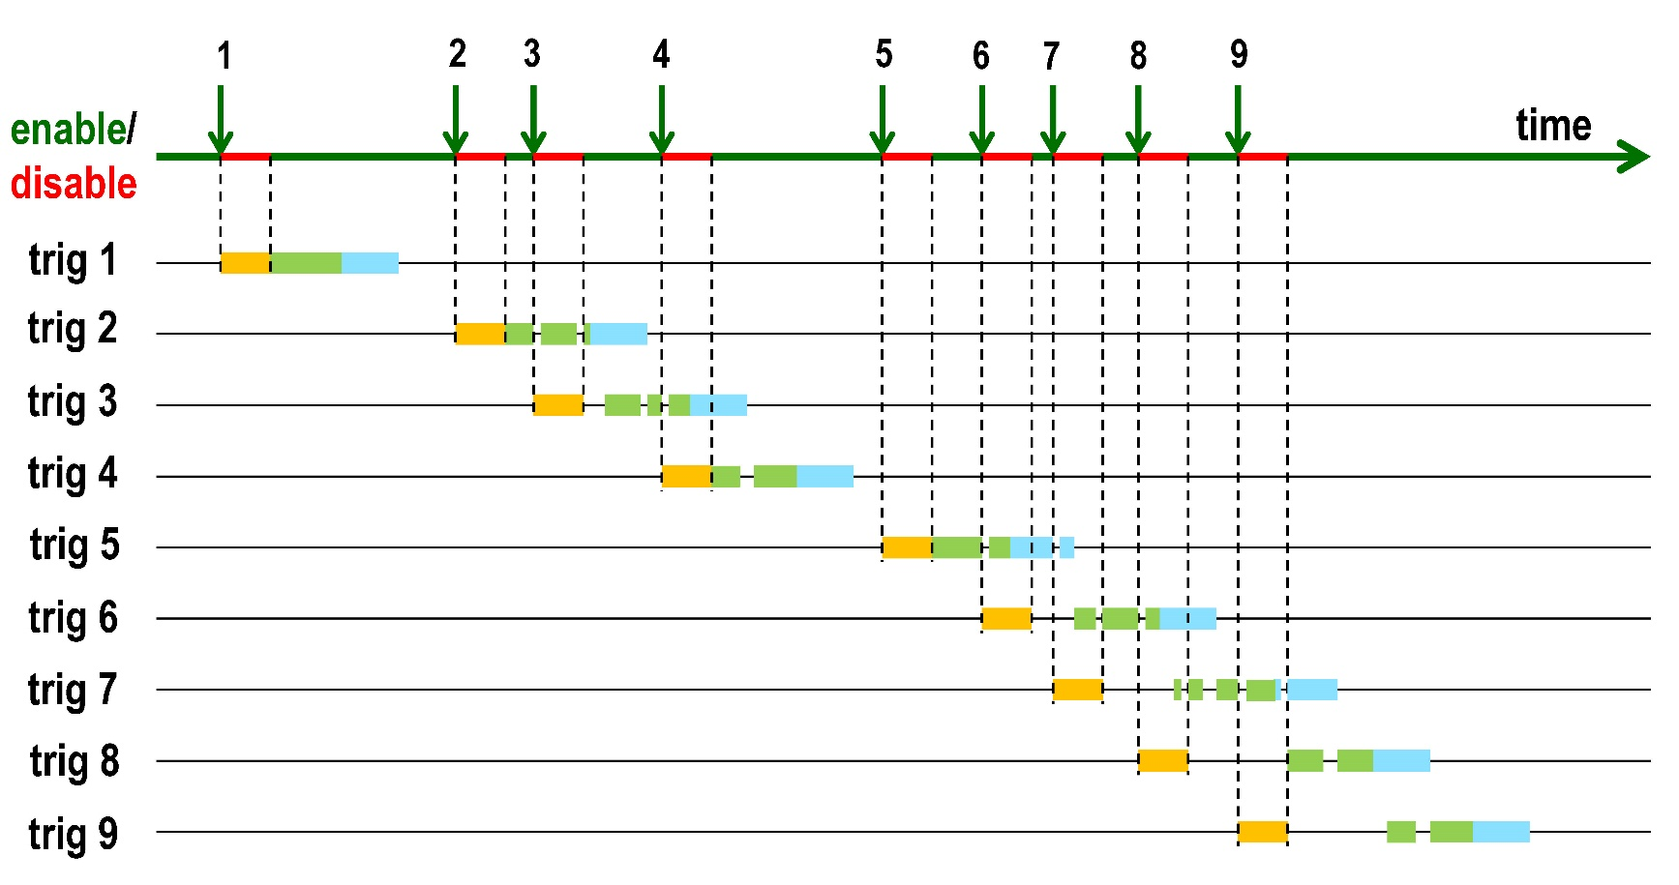
Time chart of data processing by multiple programs
The time chart when R, C and W are different program. R start reading data immediately after the trigger, even if another program is running.
When higher priority programs are waiting for response from the devices, the lower priority program can use CPU time. Programs can run in parallel.
All nine events can be successfully recorded.
12

Slide 13
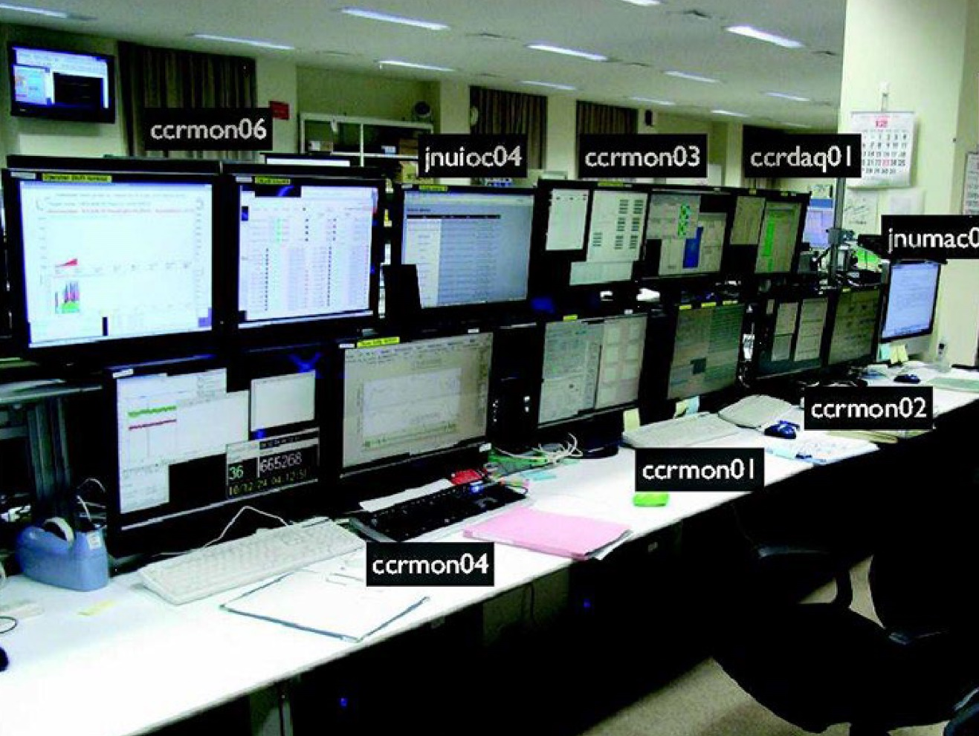
Monitor
During data acquisition, events are displayed graphically on the terminal periodically. Basic histograms such as trigger rates and hit maps are also shown.
This is a very effective way for shift members to quickly detect possible problems during the experiment.
Example of shift room (photo from Sakashita-san's slide
in the first hardware camp).
A lot of screens are used for monitor. (For monitor screens, screen saver is always off.)
13

Slide 14
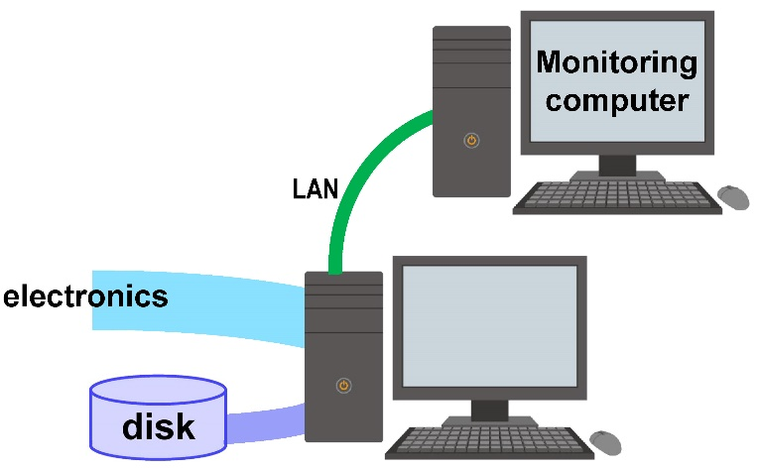
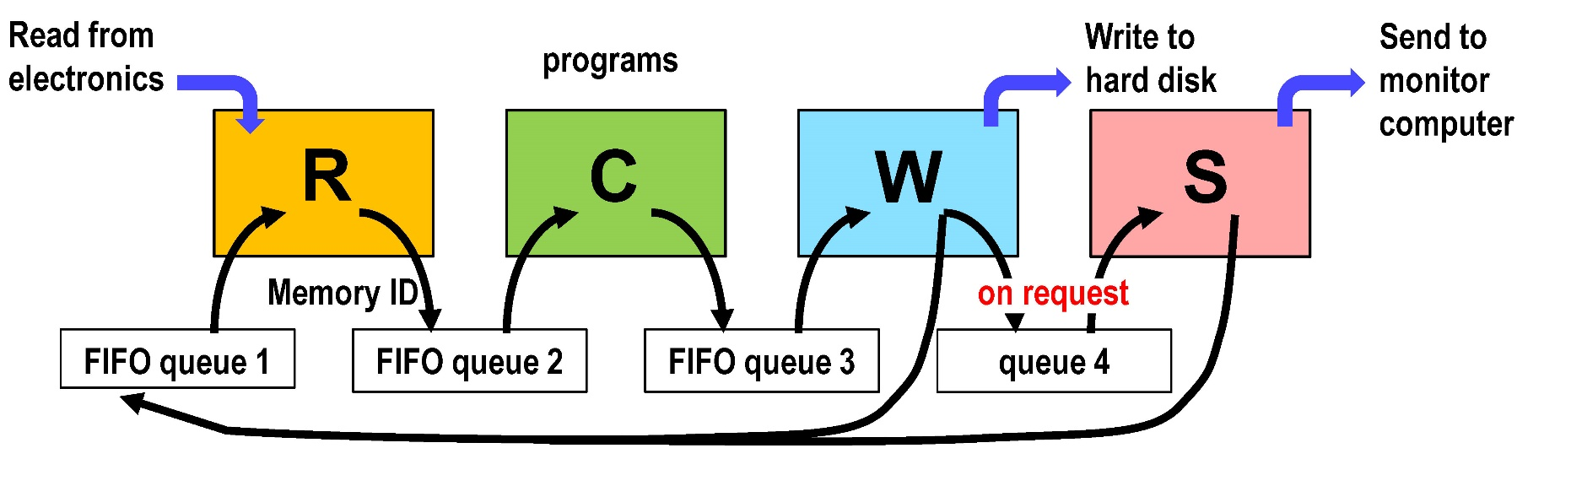
Send data to monitoring computer
The monitor programs must not disturb the data processing R, C and W. In usual, the data monitoring processes are operated in separate computers connected by a local area network.
The lowest priority program S(Send) runs in the data acquisition computer as the interface. It is not necessary to send all data to the monitoring computer. Only when S receive a request from the monitoring computer, it request one data buffer to W and send the data to the monitoring computer.
14

Slide 15
Trend in the DAQ electronics/computer
The number of total channels in high energy experiment is getting larger and larger.
To processing large number of channels in high speed with small costs, many efforts are being made.
use of commercially available products
Distributed processing
15

Slide 16
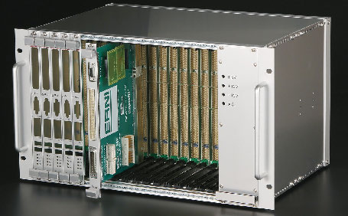
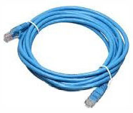
①Use of commercialｌｙ available products
Commercially available products are widely used in many fields of industry and society. Relevant technologies are well developed and many peripheral components are also in store. The products are mass-produced and therefore can be purchased at a low cost.
They are, for examples,
Widely used Windows PCs are employed as data taking computers by installing Linux OS.
The VME bus is widely used in the industrial world. Its specification is used as the framework of the DAQ electronics. Front end VME electronics modules can be designed using commercially available chips.
The LAN cables and their standards are used to transfer data between electronic modules.
16

Slide 17
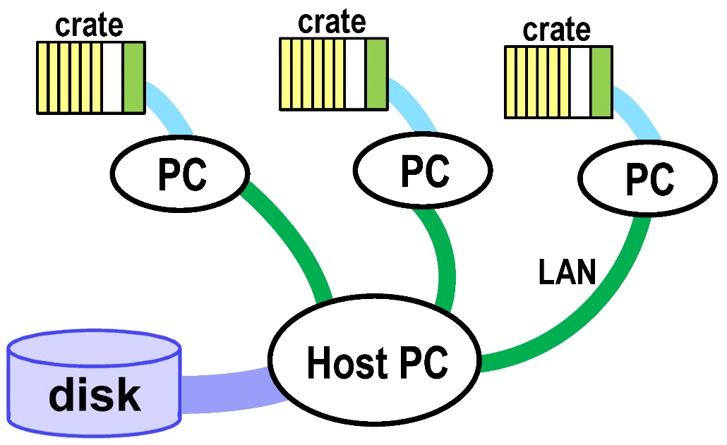
②Distributed processing – example 1
Data are collected by multiple computers independently, and are sent to the host computer by a local area network. The host computer combine all data (namely “event build”), and write to the hard disk.
If detectors are located over a wide area, and/or many different kind of detector components are made by different subgroups, this type of distributed processing is convenient.
17

Slide 18
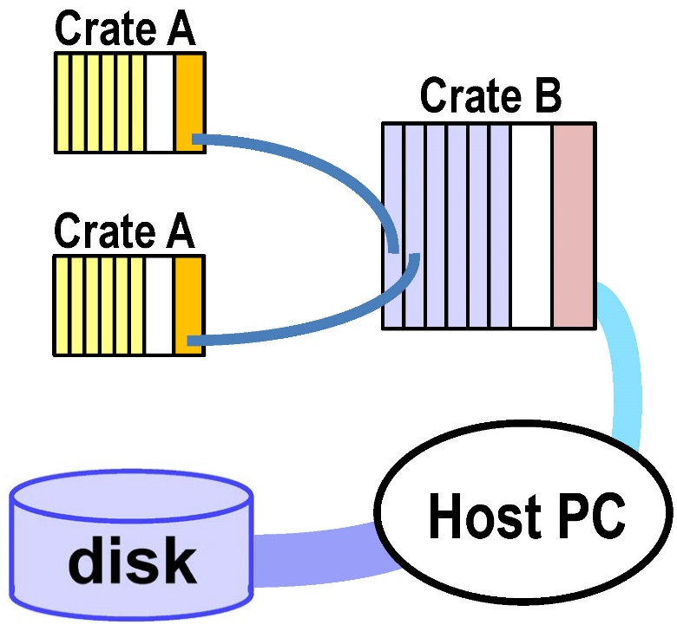
②Distributed processing – example 2
The crate controller in Crate A automatically collects data from front end modules, and sends the data to the memory modules in crate B.
The host computer simply collect the data from memory modules in crate B by data transfer.
Large-capacity memory chips in electronic modules, and actual data acquisition in the upstream crate are certainly a trend of the data acquisition.
18

Slide 19
Finally……
Computer innovation is very fast. It is not advisable for physicists to follow it.
Instead, when you will start your own experiment, please ask possible design of data acquisition system to experts in large high energy experiment laboratories.
I was involved in data acquisition more than 20 years ago, and I regret that I cannot give you a detailed introduction to data acquisition for current experiments.
Instead, you will learn specific data acquisition system in real experiments such as Super-Kamiokande and T2K in other lectures.
19

Slide 20
back up
20

Slide 21
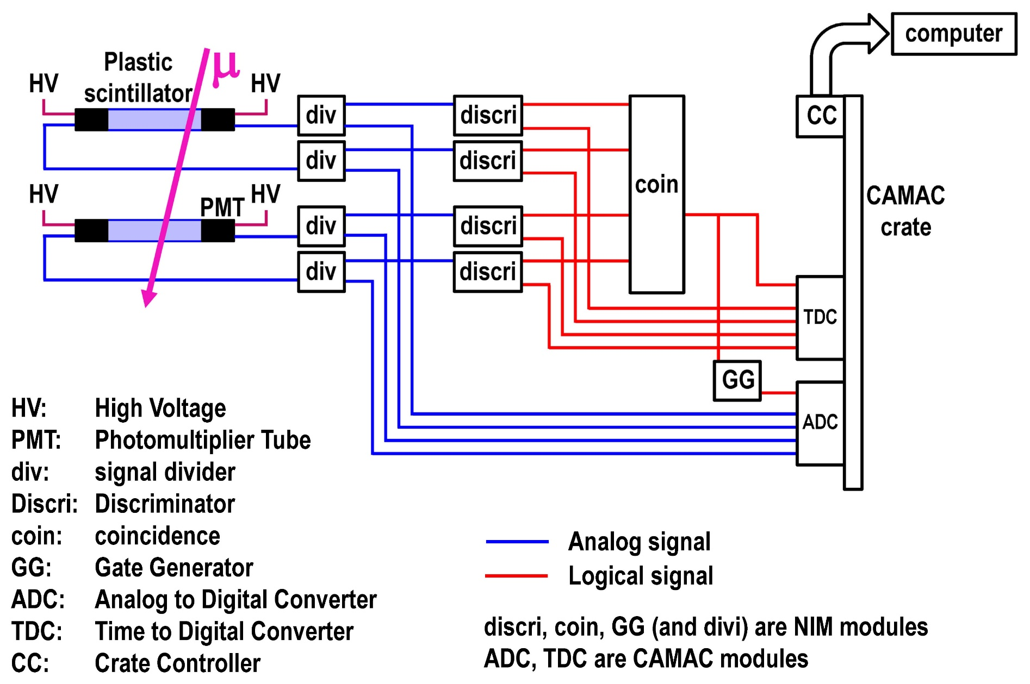
In the first lecture…..
I think you understand this setup perfectly.
21

Slide 22
end
22

