Slide 1
Cosmic ray muons and muon radiography
Yuichi Oyama
(KEK/J-PARC)
March 2-8, 2025
4th Hardware Camp for Fast and Low-Light detection
@ICISE, Quy Nhon, Vietnam
1

Slide 2
Introduction
One of the goal of this hardware camp is to detect cosmic-ray muons with your hand-made detectors.
In this short lecture, I will provide basic knowledge about cosmic-ray muons following Suzuki-san’s lecture.
Suzuki-san’s lecture is mainly about primary cosmic ray protons, which are the parent particles of cosmic ray muons.
My lecture will focus on:
Energy distribution and angular distribution of cosmic ray muon flux
Muon energy loss in matter and muon range
Muon radiography

Slide 3
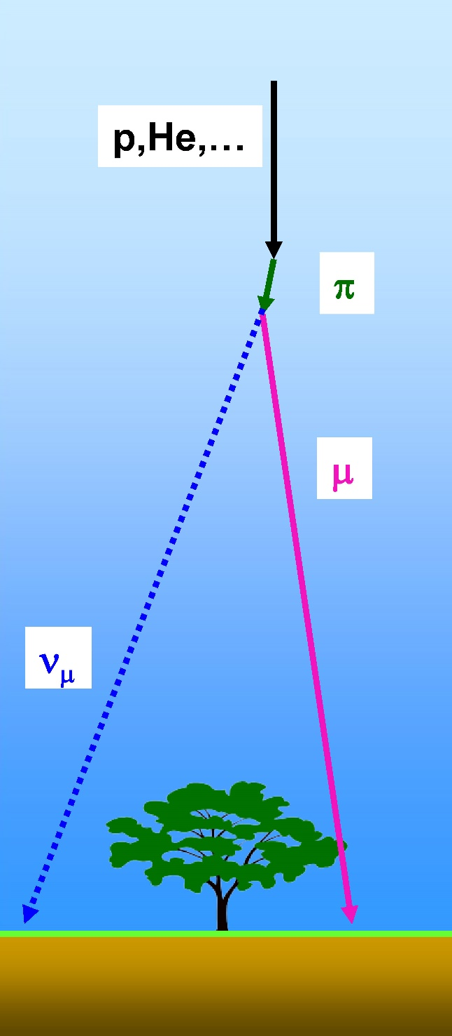
Cosmic ray muons
Primary cosmic rays (p, He,…) collide with upper atmosphere and charged pions are produced. A charged pion decays into one muon and one muon neutrino.
Cosmic ray muons travel to the ground level. The nominal rate is ~ 1 muon/cm²/min at a horizontal plane. Or ~ 1 muon/palm/sec.
Cosmic ray muons are widely used as "natural beam" in high energy physics experiment. Especially, they are very convenient beam for small scale test experiments or calibration of detectors.
Recently, cosmic ray muons are also used for muon radiography experiments.
π μ + ν_{μ}
3

Slide 4
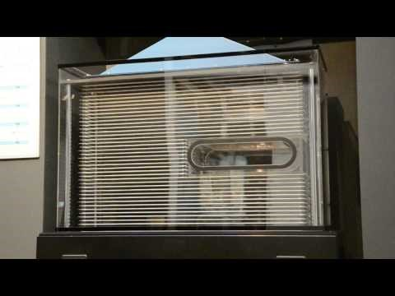
Cosmic-ray Muons by a spark chamber
You can see cosmic-ray muons by using a spark chamber. It is demonstrated in KEK open house.
The movie is uploaded in Youtube.
Visitors can insert their palms in the center space, and confirm that cosmic
ray muons penetrate their palms
https://www.youtube.com/watch?v=gdk2kBKcuNY
Sorry! Explanation about the spark chamber is out of scope of this lecture.
4

Slide 5
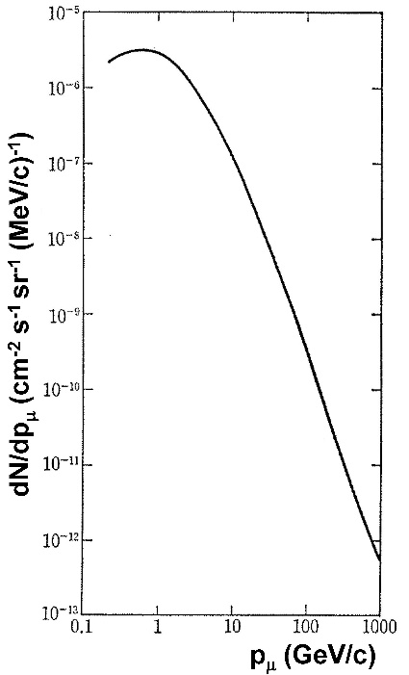
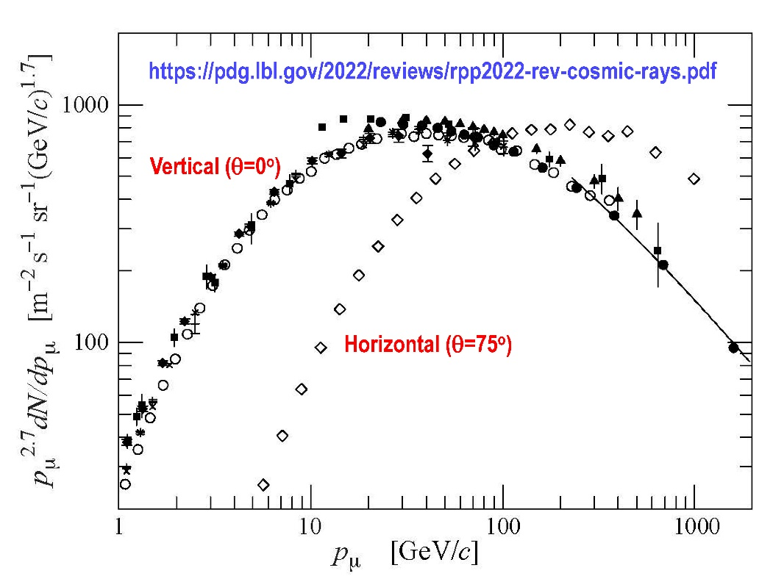
Momentum spectrum of
cosmic ray muons
The cosmic ray muon flux have a momentum
dependance of ∝p^{-2.7}.
It reflects the energy spectrum of primary cosmic
ray protons. p_{μ}~ 1/10 p_{P} is very rough but useful
relation between the momentum of the parent
protons and that of daughter muons.
The vertical axis p^{2.7}(dN/dp) is
occasionally used instead of
(dN/dp) , because it closesup
the precise structure of the flux.
One important feature is that
the vertical flux is larger than
the horizontal flux when
momentum is low (< 100GeV).
The horizontal flux is larger when
the momentum is high(> 100GeV).
5

Slide 6
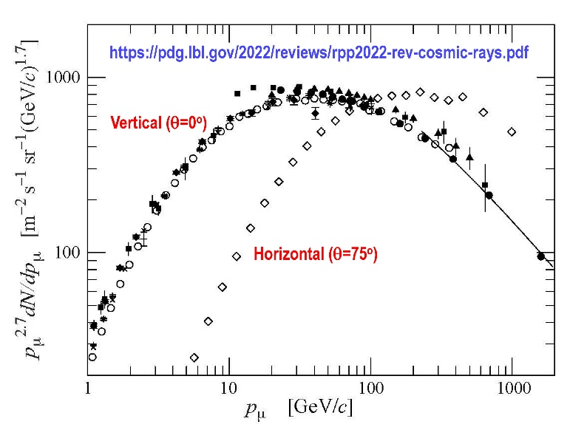
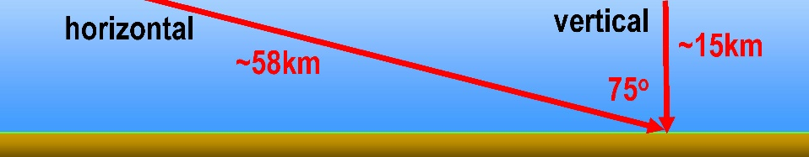
Vertical vs Horizontal
The feature is explained by the travel
distances of pion and muon. To be
observed as muon, the pion must decay
before reaching the ground level, and
muon must not decay before reaching
the ground level.
The travel distance is calculated by
In low energy, some horizontally traveling muons decay before reaching the ground level. In high energy, some vertically traveling pions cannot decay before reaching the ground level.
π μ + ν_{μ}
e + ν_{e} + ν_{μ}
d = (E/m)・τ ・c.
If you do not understand
this, study the special
theory of relativity again!
m_{π} ~ 139.6 MeV
m_{μ} ~ 105.7 MeV
τ_{π} ~ 2.6×10⁻⁸ s
τ_{μ} ~ 2.2×10⁻⁶ s
E_{π}/E_{μ} | 20GeV/ 10GeV | 200GeV/ 100GeV | 2000GeV/ 1000GeV
d_{π} | 1.1 km | 11 km | 110 km
d_{μ} | 62 km | 620 km | 6200 km
E_{π} ~ 2 x E_{μ}
(E~p in this energy range).
6

Slide 7
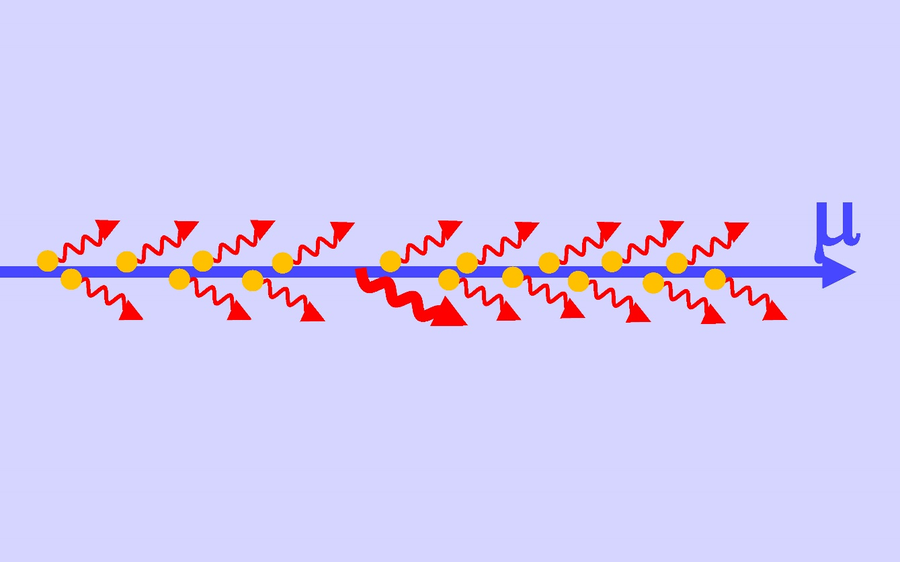
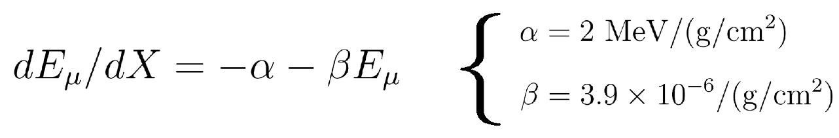
Muon energy loss in matter
When muons travel in the matter, they loose their energy.
For E_{μ} > 1GeV, the energy loss can be roughly written as
where X(g/cm²) is (the travel distance (cm) x matter density (g/cm³)).
The first term corresponds to ionization loss, and the second term corresponds to radioactive process.
Muon ionize orbital electrons of the matter. This ionization loss causes constant energy loss of the muon.
High-energy muons occasionally interact with nuclei through radioactive process, such as bremsstrahlung or pair production. This causes a large energy loss of the muon.
7

Slide 8
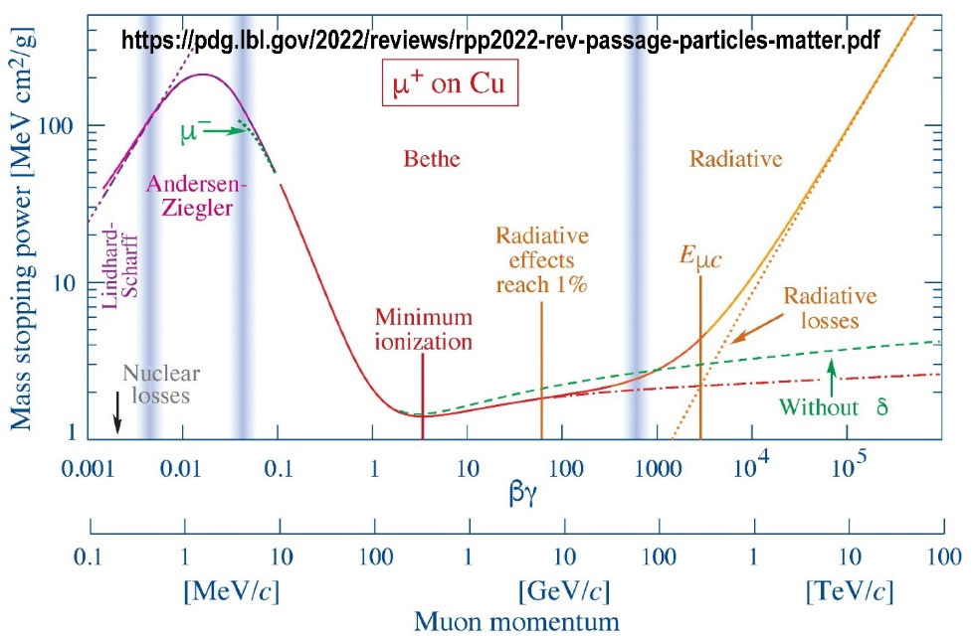
Muon energy loss in matter
More precise description and plot of muon energy loss as a function of muon energy can be found in, for example, the Particle Data Book.
It includes many other physics processes.
Constant ~2MeV/(g/cm²) energy loss
by ionization loss in 1 GeV < E < 100 GeV
Large energy loss
by radioactive process
in high energy
Large energy loss in
E < 1 GeV. Muon stop immediately
2
(Sorry, but the complete explanation about the muon energy loss is out of scope of this lecture……)
8

Slide 9
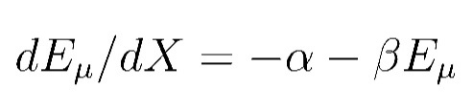
Muon energy loss and passage in material
On the earth’s surface, cosmic-ray muons of energy less than ~100GeV is dominant. Therefore, the -βE term of is negligible.
“Muon energy loss 2MeV for passage of 1 (g/cm²) material”
is well known number.
Exercise 1: Calculate the muon energy loss in 100 cm of iron.
The density of iron is ρ = 7.8g/cm³).
E_{loss} = 7.8(g/cm³) x 100 cm x 2 MeV = 1560 MeV.
Therefore, muon energy loss in 100 cm of iron is 1.56 GeV.
100 cm
Iron (ρ = 7.8g/cm³)
μ
9

Slide 10

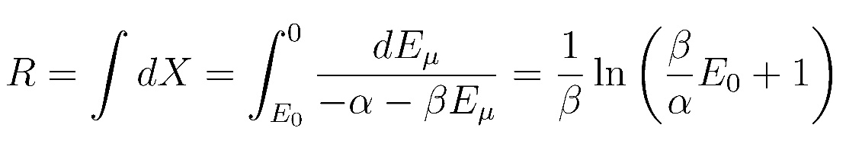
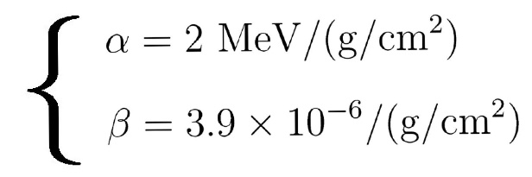
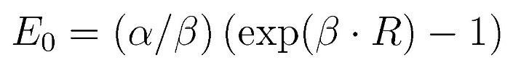
Muon range and minimum initial energy
The muon range R(g/cm²) is defined as the muon travel distance until it loose the energy and completely stop. It is calculated from .
where E₀ is the initial muon energy.
Solving this equation for E₀, an equation
can be obtained. This equation is interpreted as
It is convenient to evaluate muons in underground laboratories.
To pass through material of R(g/cm²), muons need the initial energy E₀
or
Only muons with energy larger than E₀ can pass through the material
of R(g/cm²)
10

Slide 11
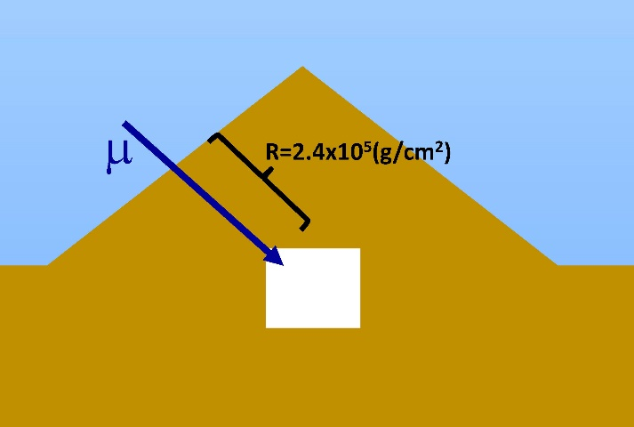

Minimum muon energy to reach underground experimental site
Cosmic-ray muons are serious background for neutrino experiments.
Most of neutrino detectors are constructed in underground laboratory because the cosmic ray muon flux drastically reduced by the rock overburden.
Exercise 2: Calculate minimum muon energy to
reach the Super-Kamiokande (SK).
The rock overburden of the SK site is
R ~ 2400 m.w.e = 2.4x10⁵ (g/cm²) .
Use following equation
Corresponding initial energy is
E₀ = (2/(3.9x10⁻⁶)) MeV x ((exp((3.9x10⁻⁶) x (2.4x10⁵))-1) ~ 800 GeV.
Cosmic ray muons with energies larger than ~800 GeV at the ground level can reach the detector site.
(m.w.e : meter water equivalent)
11

Slide 12
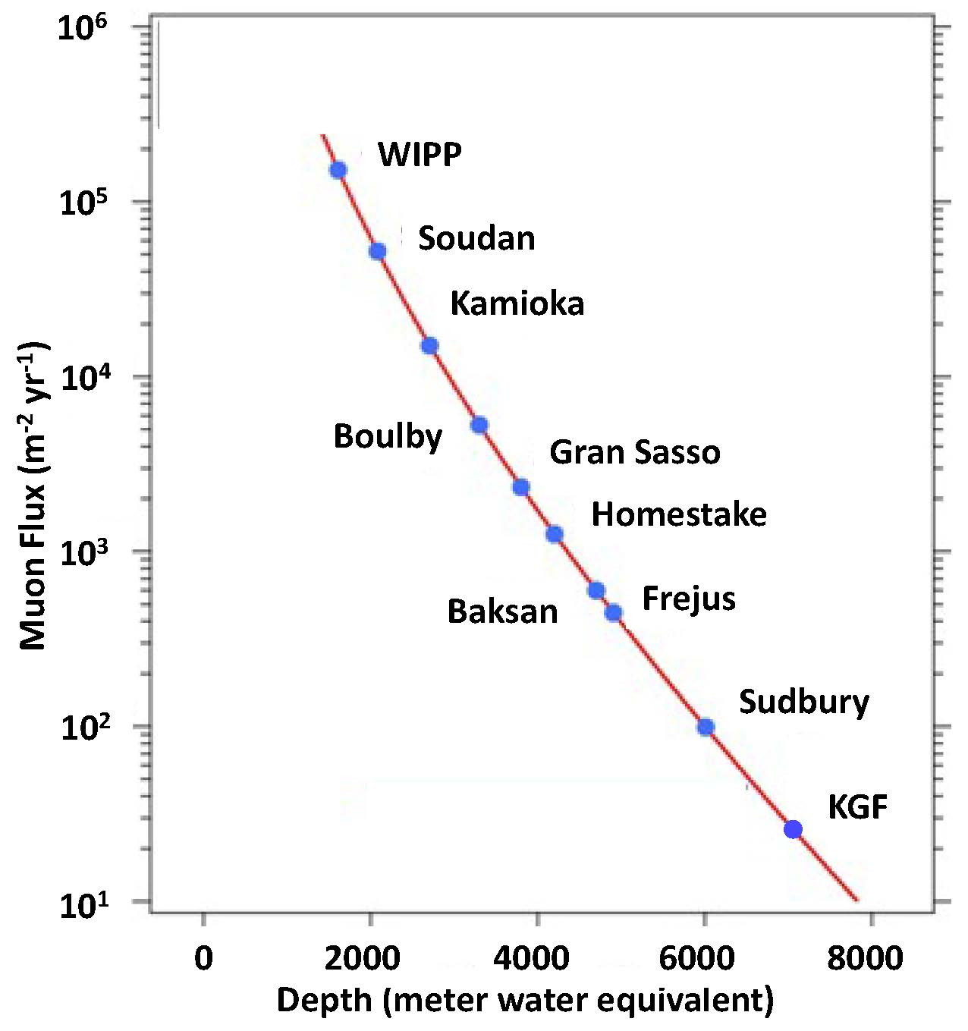
Cosmic-ray muon flux in Underground Laboratories
As given in the previous exercise, cosmic ray muon of energy larger than
~800 GeV at the ground level can reach to the Super-Kamiokande site.
The cosmic ray muon flux is
reduced by factor ~300000, and
cosmic ray muon rate in Super-
Kamiokande detector is~ 2Hz.
Depth in m.w.e. and muon flux in
underground laboratories are
shown in the plot.
muon flux in underground laboratories
800 GeV
Reach to
the SK site
5 x 10⁹ m⁻²yr⁻¹ at the surface
12

Slide 13
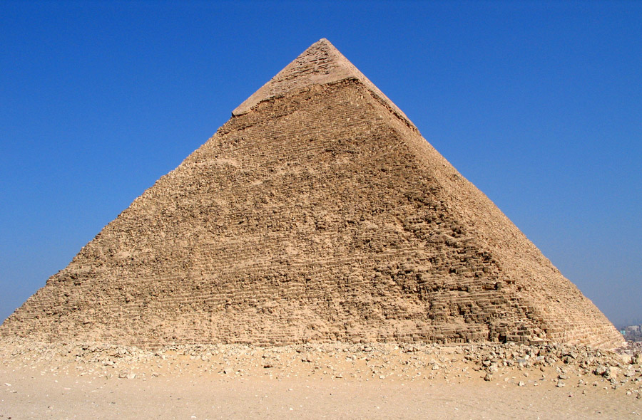
Muon radiography
Cosmic ray muons can be used to study the density of inaccessible or hidden objects. If the cosmic-ray muon flux is larger (smaller) than expected, the interior of the object is made of lighter (heavier) material.
Muon radiography has been performed in various occasion in recent years. The target objects include interior of volcano, the internal structure of nuclear reactors or archaeological heritage.
One of the most famous achievements is the discovery of a big void in Khufu’s pyramid.
13

Slide 14
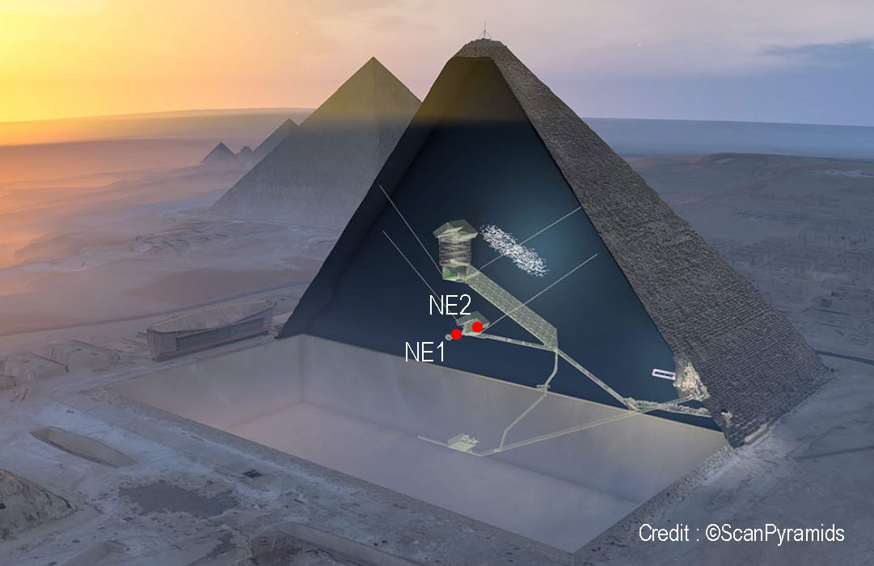
Void in Khufu’s Pyramid
Between 2015 and 2017, observations were made with three different types of detectors. Nuclear emulsion films and a plastic scintillator
array were installed inside the pyramid. Micro-pattern gas detectors were installed outside the pyramid.
Cosmic ray muon flux data were compared with expectations obtained from simulations. The simulations were based on an assumption that interior of the pyramid is filled with stones except for known voids.
A new void was observed by the nuclear emulsion films, and was confirmed by other two detectors.
NE1 and NE2 are the locations
of nuclear emulsion films,
about 10 m away from each other.
void
Discovery of a big void in Khufu’s Pyramid
by observation of cosmic-ray muons
K. Morishita et al., Nature volume 552, 386(2017)
https://www.nature.com/articles/nature24647
14

Slide 15
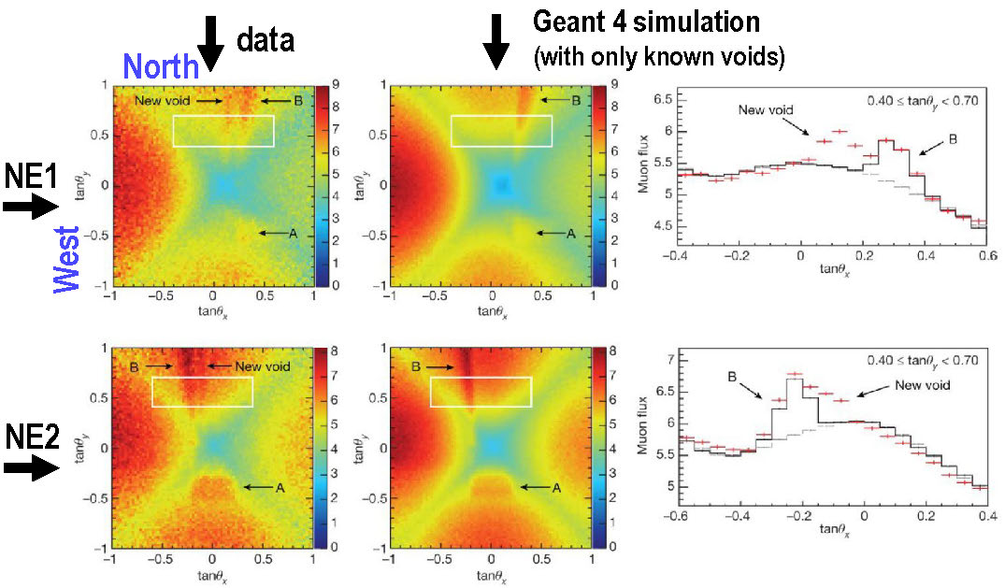
Results from the nuclear emulsion data
A significant (> 10σ) excess was found from the north direction.
The results show that the new void has an estimated length of more than 30 m and is located between 40 m and 50 m away from the detector positions, 21 m above the ground level.
15

Slide 16
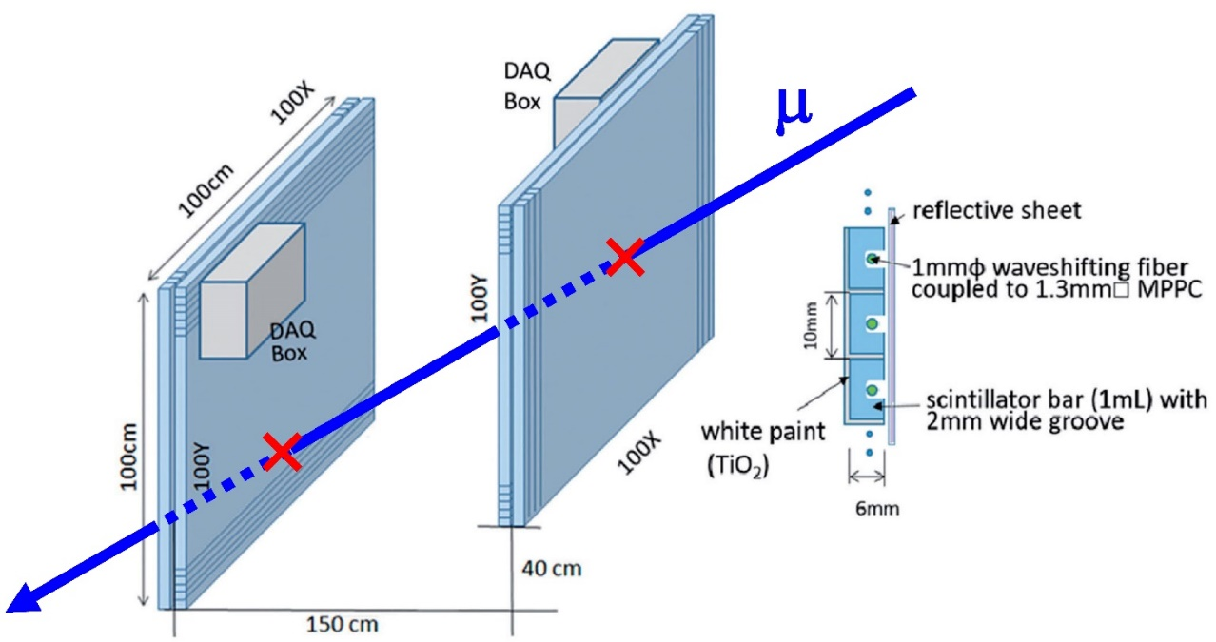
Plastic scintillator array detectors
Plastic scintillator array detectors are frequently used for muon radiography. It was employed in the Khufu's pyramid project.
A schematic view of a typical detector system is illustrated.
It consists of two XY plane units which apart some distance.
Each plane contains scintillator bars. Muon track can be obtained
from two sets of XY positions.
“Plastic scintillator + wavelength-shifting fiber + MPPC” is exactly what students are working on in this hardware camp !
Sorry. This detector is different from
that for the Pyramid project, but
it was made by the same group for
another experiment
Detection of on-surface objects with an underground
radiography detector system using cosmic-ray muons,
H.Fujii et al., Prog. Theor. Exp. Phys 2017, 053C01(2017)
16

Slide 17

Muon radiography project !
The Vietnam neutrino group has potential capability to conduct similar experiments. Is there any suitable target objects?
I told Son-san that “Yes, you have ideal target archaeological heritage in Quy Nhon!”
Cham towers
A practical investigation of the experiment has just been started.
If you are interested in, please join the Vietnam Neutrino Group.
17

Slide 18
Finally……
In the "Hands-on Act" program of the camp, you will detect cosmic ray muons. If you have time, please try followings.
Have a good hands-on act program!
Confirm that the nominal muon rate is ~ 1 muon/cm²/min
at a horizontal plane.
Compare vertical muon rate and horizontal muon rate quantitatively. Compare with expectations.
Prepare heavy material, and examine the reduction of
the muon rate behind the material. Compare with expectations.
18

Slide 19
end

