Slide 1
Electronics for cosmic ray muon detection
Yuichi Oyama (KEK/J-PARC)
March 8-14, 2026 5th Hardware Camp on Fast Radiation Detection and Imaging @ICISE, Quy Nhon, Vietnam
1

Slide 2
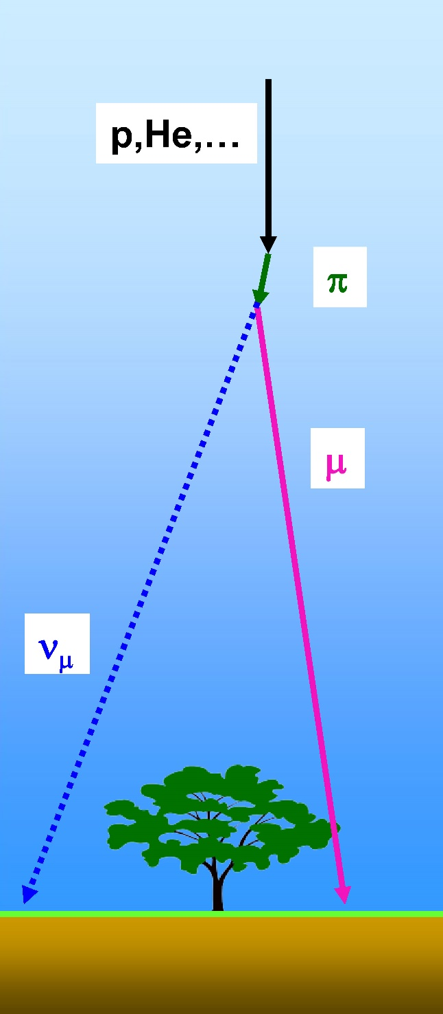
Cosmic ray muons
Primary cosmic rays (p, He,…) collide with upper atmosphere and charged pions are produced. A charged pion decays into one muon and one muon neutrino.
Cosmic ray muons travel to the surface of the earth. The nominal rate is ~ 1 muon/cm²/min at a horizontal plane. Or ~ 1 muon/palm/sec.
Cosmic ray muons are widely used as "natural beam" in high energy physics experiment. Especially, they are very convenient beam for small scale test experiments or calibration of detectors.
Recently, cosmic ray muons are also used for muon radiography experiments.
π μ + ν_{μ}
2

Slide 3
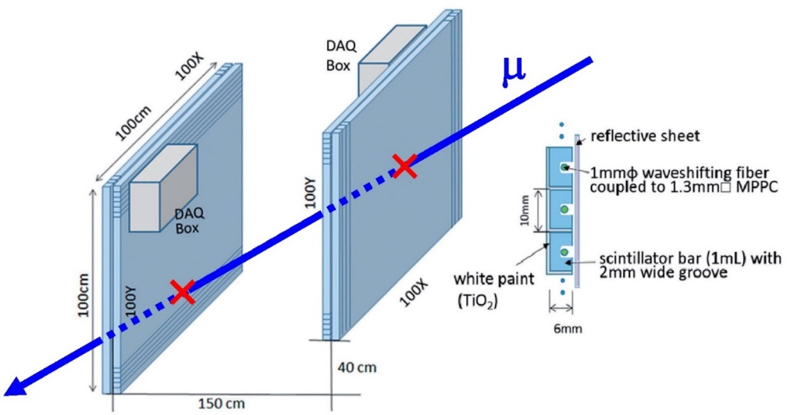
About this lecture
As already presented, coincidence of two plastic scintillator layers is one of most popular experimental method to detect cosmic ray muons. It is done as an exercise in high-energy experiments. It is also used in muon radiography experiments.
In this lecture, a very simple experimental configuration is given, and all components are explained one by one.
Some components such as PMT, CAMAC are slightly old. They have recently been replaced by MPPC, VME or others. However, these traditional components are still widely used. The basic concept is common with newer components. It is a really worth for studying.
Unfortunately, some of the modules are not available in the Vietnam Neutrino Group. However, you can learn similar hand-on experience in the training course.
3

Slide 4
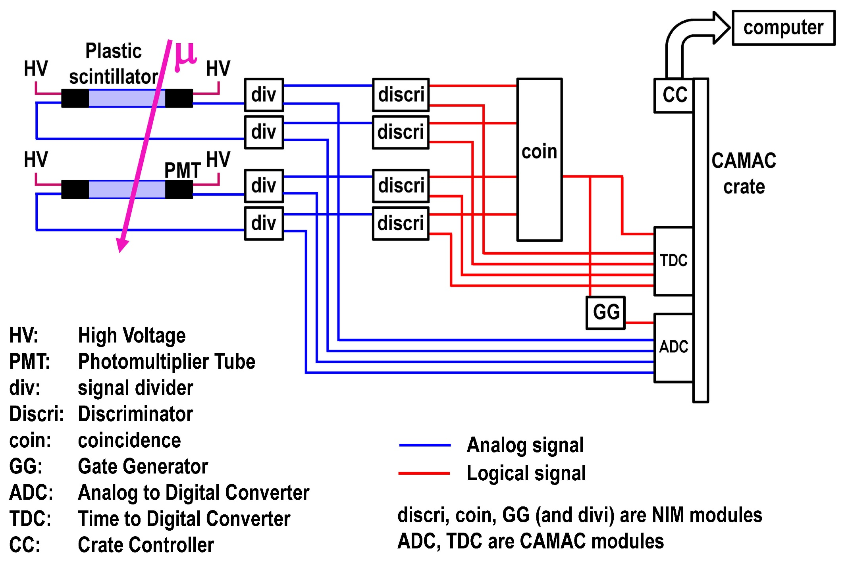
The experimental setup
4

Slide 5

Upstream
5

Slide 6

Plastic scintillator
Plastic scintillators are made of plastic material mixed with a fluorescent substance.
When a charged particle pass through plastic scintillators, scintillation lights of blue wavelength are effectively emitted. The nominal numbers of lights from 1 cm charged particle passage is ~300 photons.
In usual, plastic scintillators are used with black light shield.
6

Slide 7
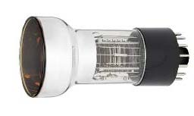
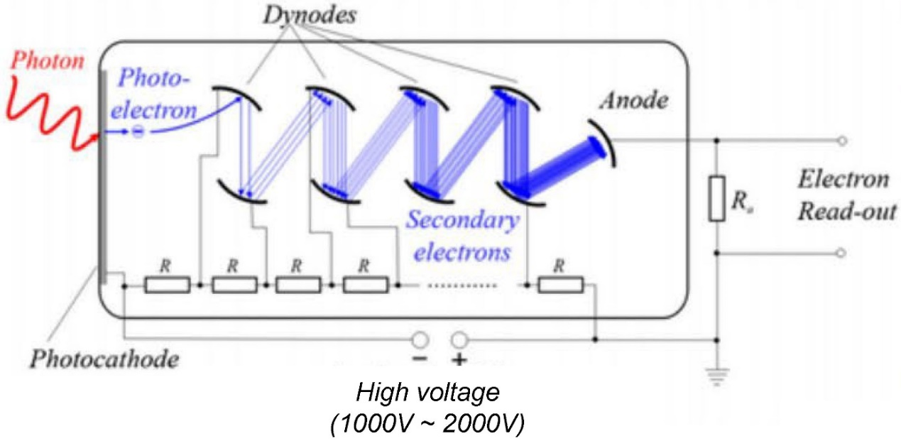
PMT (Photomultiplier tube)
A photon hits the photocathode, and a photo-electron is emitted by photo-electric effect. The quantum efficiency (the probability that a photo-electron is emitted) is typically, 10%~30%.
The inside of the tube is a vacuum. The first photo-electron is focused into the first dynode.
The typical voltage between dynodes is ~100V. The number of electrons are multiplicated with many dynodes.
A typical multiplication factor of one dynode is 2~3. For example, with 13 dynodes, the multiplication becomes 3¹³ ~ 10⁶. This multiplication factor is called “Gain”.
The electrons are extracted to the cable as an electronic signal.
7

Slide 8
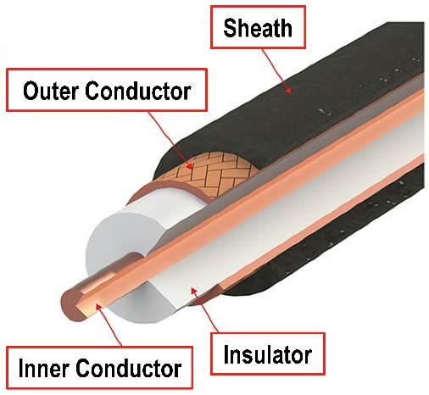
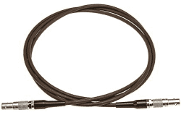
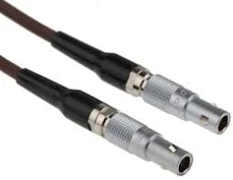
Lemo cable
Lemo cables are coaxial cables which are widely used for signals (both for analog signals and logic signals) in high energy physics.
The outer conductor is grounded. Signal (electrons) travels in the inner conductor with the velocity ~20 cm/ns. It is 2/3 of the light velocity. The length of Lemo cables are occasionally expressed in ns unit.
The impedance of the cable is 50 Ω.
Lemo cable
Lemo connectors
Cross sectional view of Coaxial Cable
8

Slide 9
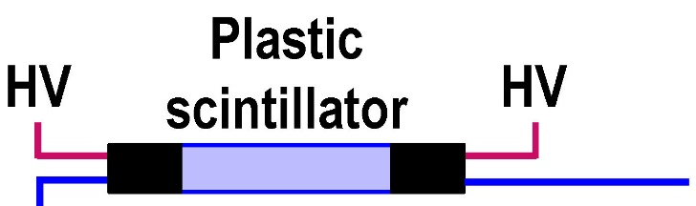
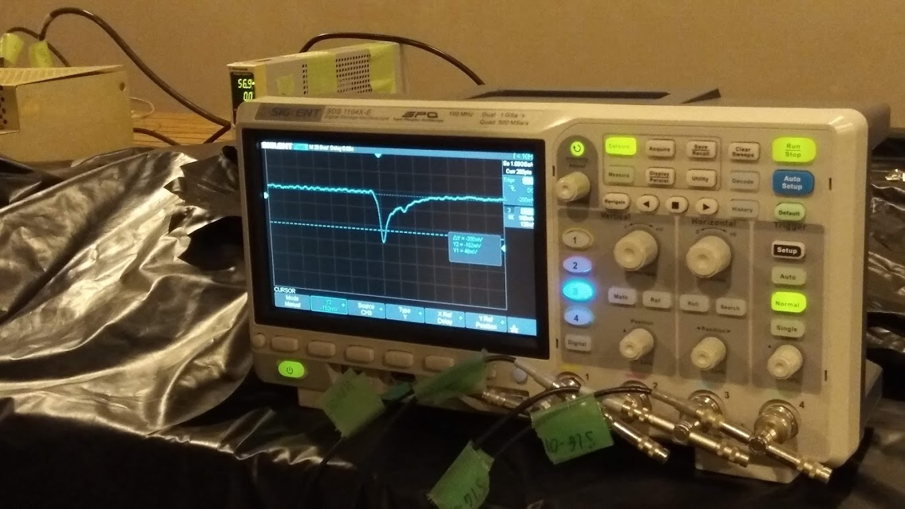
Oscilloscope
When you apply the high voltage to PMTs, watch the raw signal from the PMT by an oscilloscope.
Watch this signal!
An oscilloscope of the Vietnam Neutrino group.
This photo is borrowed from the students’ presentation in the hardware camp in 2022.
Sorry that the signal is not from a PMT but from a MPPC.
9

Slide 10
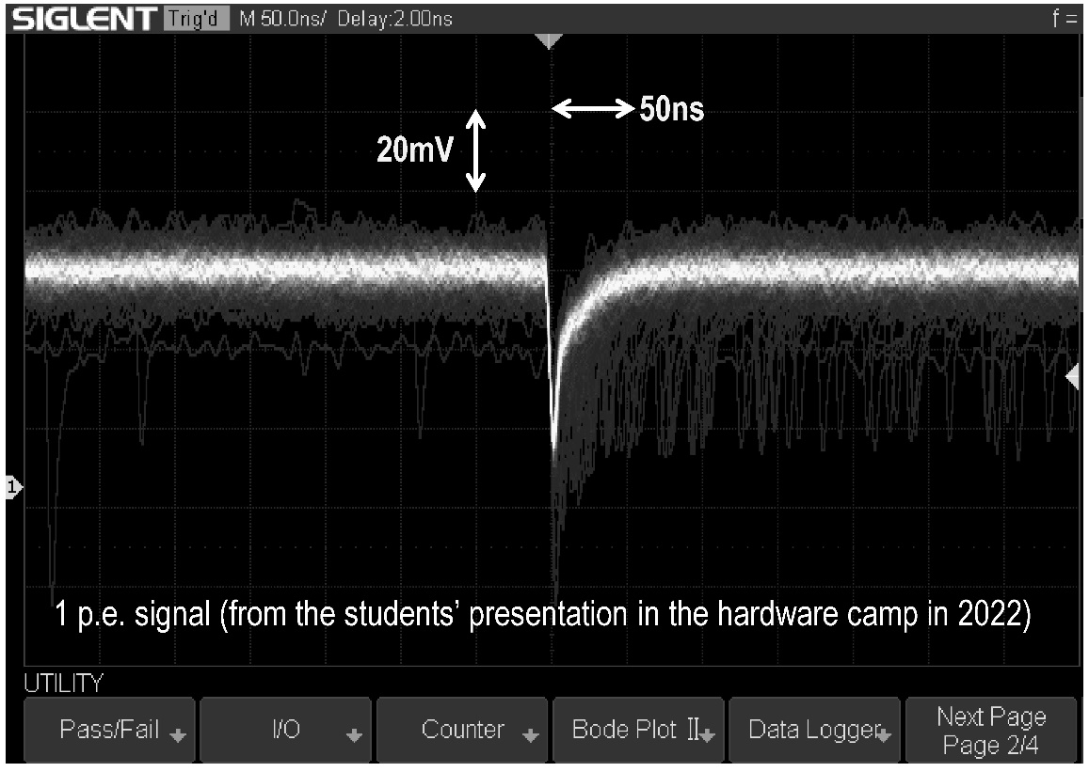

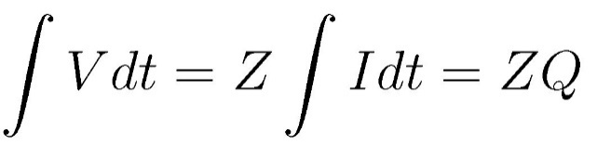


Confirm the Gain from the oscilloscope signal
From the oscilloscope view, you can calculate number of electrons in the signal. And you can confirm the gain of the photo senser (+amplifier).
V: voltage (V)
I: Current (A)
Z: Impedance (Ω)
Q: Charge (C) N_{e}: number of electrons
e: elementary charge = 1.6 x 10⁻¹⁹ C
1 electron is amplified to
2 x 10⁸ electrons
10
⇒ The gain is 2 x 10⁸.

Slide 11
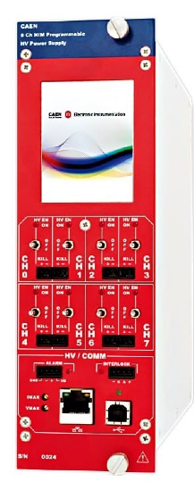
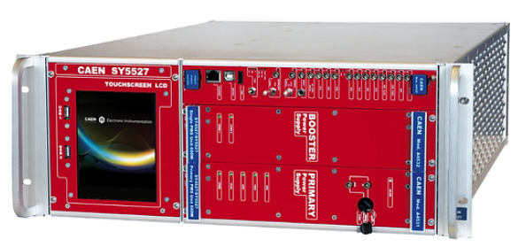
High-Voltage Power Supply (HVPS)
High-voltages (1000 V~ 2000 V) are applied to PMTs using high-voltage power supplies, distributors and cables.
In an experiment, the gain of each PMT must be the same. The applied high-voltage for each PMT must be adjusted carefully in PMT by PMT basis. Such calibration is needed before the experiment.
NIM 8 channel High-voltage power supply
High-voltage power supply/distributor for large (> 100 channel) scale experiment
11

Slide 12
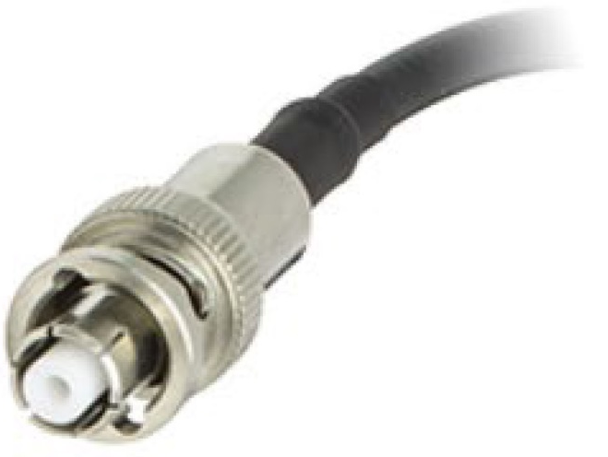
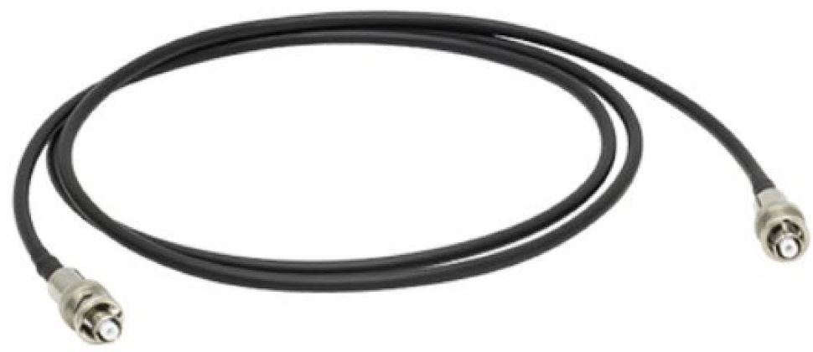
High-Voltage cable
The high-voltage cables are much thicker than signal cables, and they have high electric-shock proof connectors. The SHV connectors are widely used.
High-Voltage cable
SHV connectors
Two cables are connected to a PMT. From the high-voltage cable, ~kV power is applied. And from the signal cable, a ~mV signal is extracted. The difference is ~6 orders of magnitude! “Apply high-voltage and extract small signal” is common for many kinds of sensors in high-energy physics.
12

Slide 13
Midstream
13

Slide 14
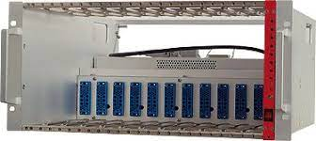
NIM and NIM Crate
“NIM” is a module specification which is widely used in high-energy experiment. NIM Crate supply electric power to NIM modules from the backplane.
The standard cables used for most of NIM modules are Lemo cables.
The standard logic signal of the NIM modules is "NIM level", which is 0.0V for OFF and -0.8V for ON.
OFF
0V
ON
- 0.8V (NIM level)
14

Slide 15
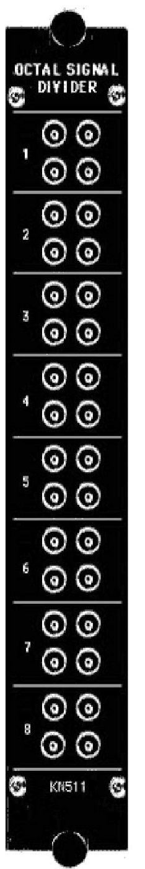
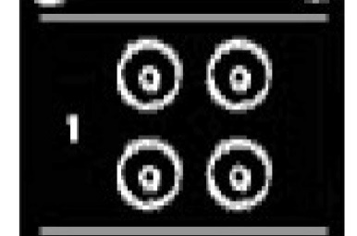
Signal Divider
NIM standard single-width module, but no power supply is needed.
Cables of 50 Ω impedance can be connected
An input signal is divided into the other cables. The output pulse height become smaller accordingly.
Kaizuworks octal signal divider KN511
15

Slide 16
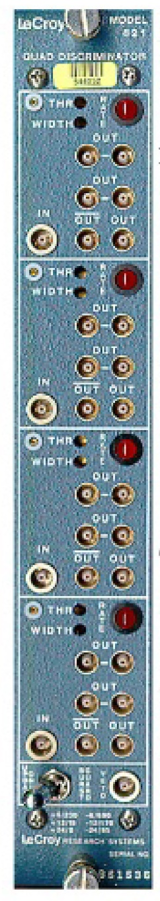
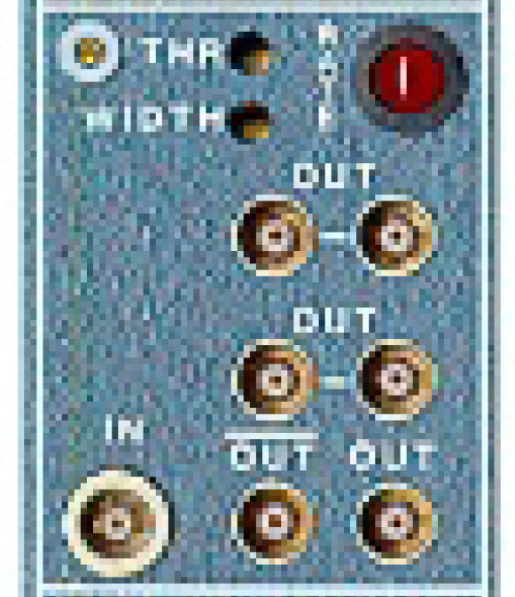
Discriminator
Adjust threshold
Adjust width
0V
Threshold level
- 0.8V (NIM level)
output pulse width
When pulse height of the input analog signal exceed the threshold, NIM level output signals are generated.
The threshold level and pulse width of the output NIM level signal are important parameters, and are adjustable.
The threshold level must be carefully adjusted by considering the definition of "hit" in the experiment.
The pulse width is directly correlated to the coincidence width.
LeCroy NIM Quad discriminator Model 821
https://wwwusers.ts.infn.it/~rui/univ/Acquisizione_Dati/Manuals/LRS%20821%20Specifications.pdf
16

Slide 17
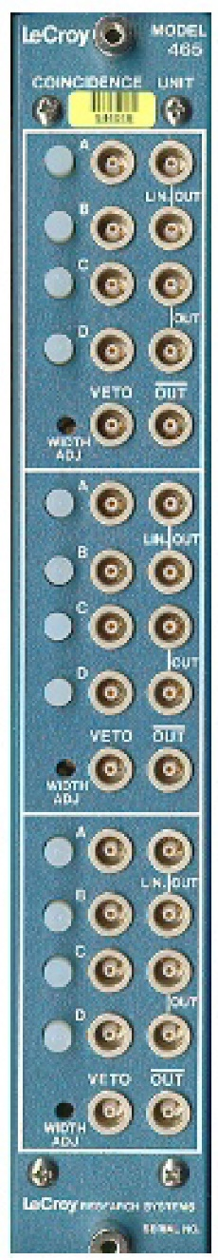
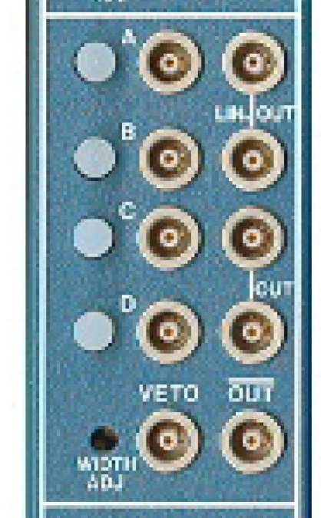
Coincidence
OUT
A
OUT
A
B
B
Enable/Disable switch (Unused input connectors must be disabled)
When all input signals are "ON“ simultaneously, output signals are generated.
The coincidence time window is controlled by the signal width of the input from the discriminator.
LeCroy NIM Triple 4-Fold coincidence Model 465 https://siliconpr0n.org/media/camac/CAMAC3/465-spec.htm
17

Slide 18
Coincidence Width
The signal width from discriminators must be carefully adjusted considering the size of the detector. The coincidence time window should be enough longer than (nominal detector size)/(light velocity).
Assume that the length of the plastic scintillator is L cm. When a muon pass though the edge of the plastic scintillator, the difference of the arrival time of the photon to the PMT is
Therefore, the width of the discriminator signal must be much larger than 5 ns.
“Nominal size of the detector in ns unit” is very important concept when we adjust the timing of the electronics circuit.
μ
HV
Plastic scintillator (L cm)
HV
signal
signal
Δt = L/(c/n) ~ 5ns.
L: length of plastic scintillator, L=100cm
c: light velocity c~30cm/1ns
n: refraction index of light in plastic, n~1.5
18

Slide 19
Downstream
19

Slide 20
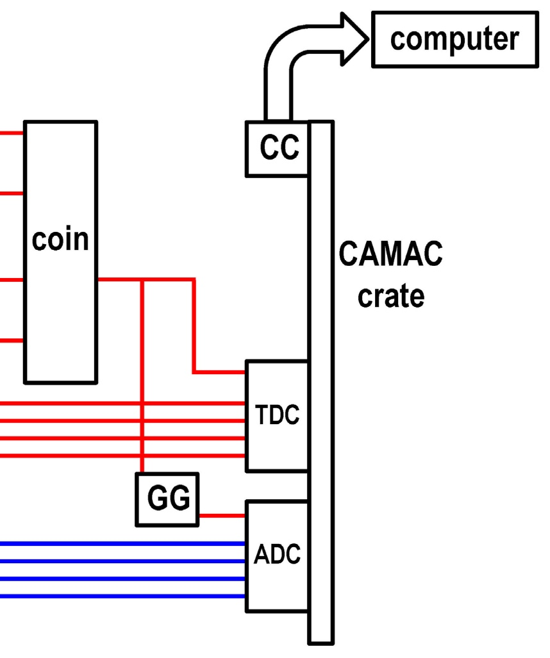
Trigger
In this electronics circuit, all data acquisition by the online computer start by this coincidence signal. Therefore, this signal is a key signal in this circuit, and is called trigger signal for the data acquisition.
In usual experiment, trigger rate is continuously monitored by CAMAC/visual scaler module because it gives most primitive confirmation that the upstream hardware is working without any serious problem.
20

Slide 21
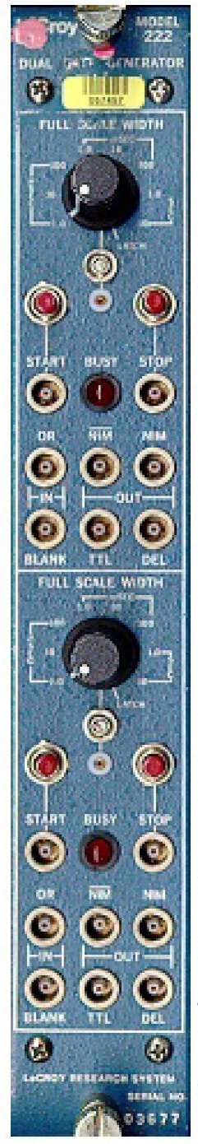
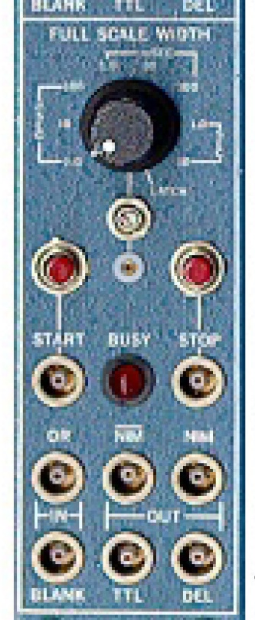
Gate Generator
potentiometer
Range switch
INPUT
OUT
Gate Width
For Input NIM level signal, adjustable time width of OUTPUT NIM level signal is generated.
The time width of the OUTPUT signal (Gate Width) can be adjusted continuously from < 100 ns to > 10 s by the range switch and screwdriver-adjustable potentiometer.
LeCroy NIM Dual Gate Generator Model 222 https://nuchem.iucf.indiana.edu/Instrumentation/Elec_Manual/Electronic_pdfs/222-spec.htm
21

Slide 22
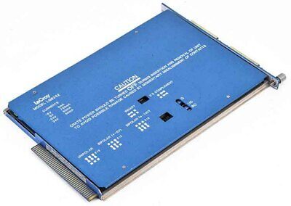
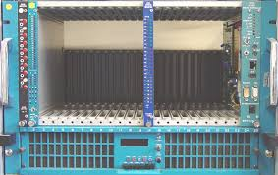
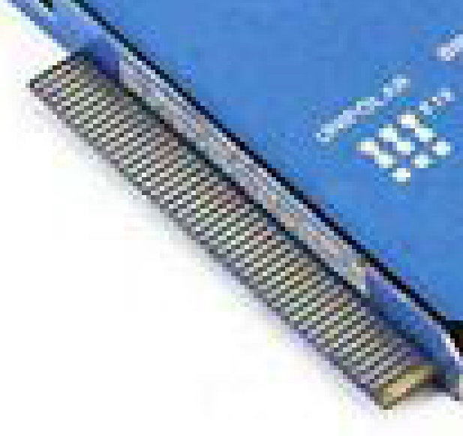
CAMAC and CAMAC Crate
“CAMAC” is a module specification which can be controlled from computers. It is widely used in high energy physics.
CAMAC modules are inserted into a CAMAC Crate. The CAMAC Crate supplies electric power to CAMAC modules from backplane. Digital data are transferred from using backplane.
Each slot of CAMAC crate has slot number. From the computer, the slot number is used to identify the module.
CAMAC module
CAMAC Crate
The back connector of CAMAC module has data lines.
22

Slide 23

Crate Controller
A CAMAC Crate Controller is inserted into the rightest slot of the CAMAC Crate, and it is connected to a computer with a cable.
The Crate Controller is a interpreter between CAMAC and the computer.
The CAMAC specification does not change for ~50 years. On the other hand, development of computer technology is very fast. When a new, cheap and high-specification computer is widely used on a commercial basis, physicists hope to used such computer for the data acquisition.
If there is profitable demand, new CAMAC crate controller for new computer is developed. Engineers of the company or staff of electronic workshop of large high-energy laboratories support the operation of new CAMAC controller.
Users do not need to learn details between the connection between CAMAC and the computer. That can be a black box.
23

Slide 24
ADC (Analog to Digital Converter)
Gate Width
Gate
NIM level
Signal1
Signal2
The NIM level signal from the gate generator is input to the GATE connector.
The analog signal to each channel during the gate period are integrated, and total charge are obtained as a digital data and stored in the memory of the module.
LeCroy CAMAC 12 channel ADC model 2249A https://www.fnal.gov/projects/ckm/jlab/2249a-spec.htm
24

Slide 25
ADC (Analog to Digital Converter)
The gate width and timing relative to signal must be adjusted carefully so that the all input signals are within the gate. An oscilloscope can be used for the adjustment.
The most important specification of ADC is full scale range and number of bits of the data. For example, 2249A has the full scale range of 256 pC and the data is 10 bits. Accordingly, the resolution of the data corresponds to 256pC/2¹⁰ = 0.25pC.
The input signal must be adjusted to this full scale range by adjustment of applied high voltage and/or pre-amplifier.
When "read data" is requested from the computer via the Crate Controller, the digital data is sent to the computer via the Crate Controller.
Total energy deposit in the detector can be calculated from the ADC information in the data analysis.
LeCroy CAMAC 12 channel ADC model 2249A https://www.fnal.gov/projects/ckm/jlab/2249a-spec.htm
25

Slide 26
TDC (Time to Digital Converter)
Common Start
(NIM level)
t₁
Stop1 (NIM level)
t₂
Stop2 (NIM level)
The NIM level common start signal is input to the COM START connector.
The NIM level signals from each channel from the discriminator are input to STOP connectors. The time differences between the common start and stops are obtained as digital data and temporally stored in the memory of the module.
LeCroy CAMAC Octal TDC model 2228A https://www.https://www.fnal.gov/projects/ckm/jlab/2228a-spec.htm
26

Slide 27
TDC (Time to Digital Converter)
The most important specification of TDC is full scale time range and number of bits of the data. For example, 2228A provides 11-bit digital data, and the full-scale time ranges are 100, 200 or 500 ns, which are switch-selectable. The time resolutions are about 50, 100, 250 ps respectively, because (100 ns)/2¹¹ ~ 50 ps, for example.
The full-scale time range must be selected carefully so that all time difference between the common start and stop signals are within the range. The nominal size of the detector strongly correlated to the full-scale time range.
When "read data" is requested from the computer via the Crate Controller, the digital data is sent to the computer via the Crate Controller.
The time difference of the TDC data, such as t₂-t₁, is arrival time difference of the photons to each photo sensors. This information can be used in physics analysis. The time difference is sometimes converted to position information of the common light source.
LeCroy CAMAC Octal TDC model 2228A https://www.https://www.fnal.gov/projects/ckm/jlab/2228a-spec.htm
27

Slide 28
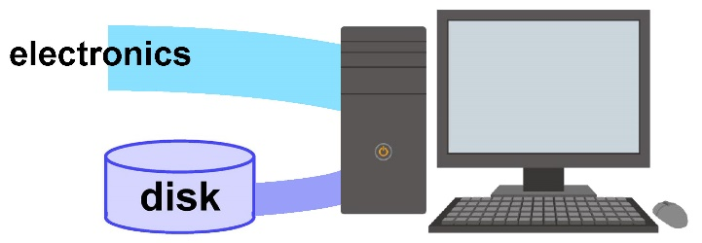
DAQ computer
DAQ (Data Acquisition) computer read data from electronics and write data to output file (or send to another downstream computer). It also control the data taking operation.
In the hardware camp 2023, I also gave a 30 minutes lecture on “DAQ system and software” and explained details about the computers. The topics in the lecture were
However, I regret that the lecture was too specialized for the students, and many students slept well....
After that, I do not give the lecture on DAQ. If you are interested, please visit the slides used in 2023. https://www-nu.kek.jp/~oyama/HardCamp2023.DAQ.oyama.pptx
Control of the electronics from DAQ computer
Data processing in the DAQ computer
Trends in DAQ electronics/computer
28

Slide 29
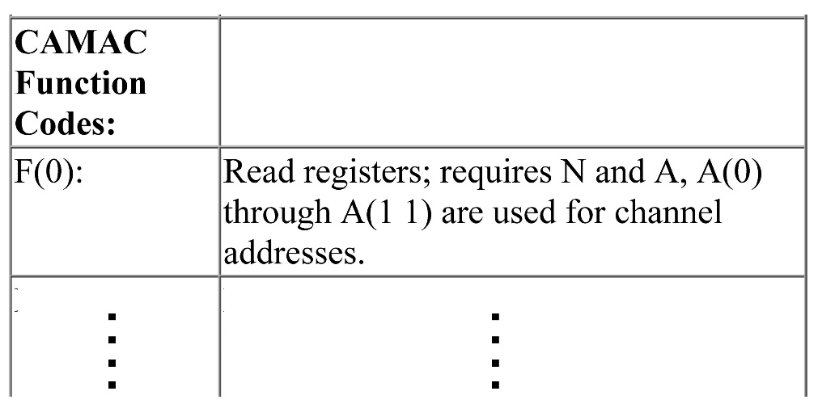
Read from computer
A template program will be prepared from experts. Users can write program based on the manual of each electronics module.
From LeCroy 2249A ADC manual
Example
Assume that LeCroy 2249A ADC is installed in slot 9 of the CAMAC crate.
According to the 2249A manual, the function to “read data” is 0.
To read the data of address 3, you can call a subroutine “camac” with input arguments (slot, address, function)=(9,3,0).
Corresponding FORTRAN program is shown.
integer*4 n,a,f,naf,data,iq,ix
external naf
n=9
a=3
f=0
call camac(naf(n,a,f),data,iq,ix)
write(*,*)data
Terribly sorry but I am FORTRAN generation!
29

Slide 30
In addition……
For a real experiment, there are additional important modules, concept and frequently used procedure.
The module/component shown by red are explained in the “DAQ system and software” slides.
You will also learn most of them when you will work on a real experiment.
The NIM modules are -Pre-amplifier -Clock generator -Visual scaler
The CAMAC modules are -Output register -Scaler
Concepts in the circuit are -Veto -Latch mode
Procedure in the data treatment are -Pedestal subtraction for ADC data -TQ map for TDC data
30

Slide 31

Summary
Let me show you the experimental setup again. I hope that you understand this setup perfectly.
31

Slide 32
end
32

