Slide 1
Hints for making slides
Yuichi Oyama (KEK/J-PARC)
March 8-14, 2026 5th Hardware Camp on Fast Radiation Detection and Imaging @ICISE, Quy Nhon, Vietnam
1

Slide 2
Introduction
Before the final presentation on March 14, let me give you some hints for making slides.
They are
They are based on my personal experience, and some other people may not agree. Therefore, it is just hints.
I hope that you will establish your own style based on your experience in future.
Estimate the number of your slides
Start from your own work
One figure and its explanation in one slide
Write sentences, not words
Use translation software, but start from English
Contents should be prepared first
Use large and clear fonts
2

Slide 3
①Estimate the number of your slides
When you make a presentation file, estimate the number of your slides, first.
You should have your own number for "how many minutes per slide". It depends on your presentation style. A typical number is ~2 min/slide. If the time of presentation is 30 minutes, the number of slides will be about 15.
Once you estimate the total number of your slides, you can arrange the structure of your slides.
Example
1 slide for the title
2 slides for introduction
2 slides for the experimental setup
4 slides for the data
5 slides for analysis, results and discussion
1 slide for conclusion
3

Slide 4
②Start from your own work
One of typical poor presentation slides consists of a very long introduction (or theoretical background) and a small allocation for their own work, which must be the main part of the presentation. Obviously, it is due to lack of time for making slides of their own work.
When you make slides, start from your own work.
The strategy "start from your own work" is available not only for making slides, but also for writing reports.
Example
1 slide for the title
2 slides for introduction
2 slides for the experimental setup
4 slides for the data
5 slides for analysis, results and discussion
1 slide for conclusion
In this case, start from “the experimental setup”
4

Slide 5
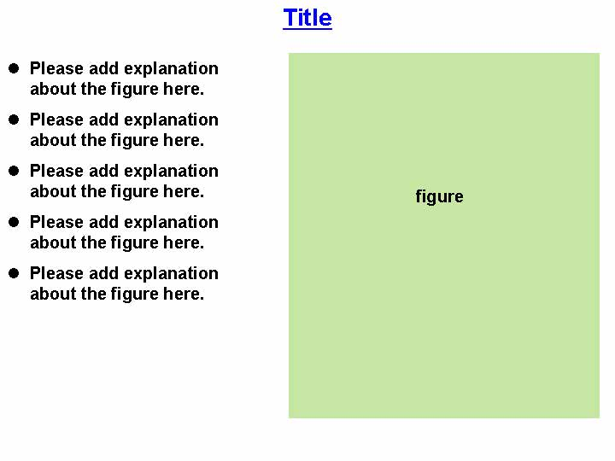
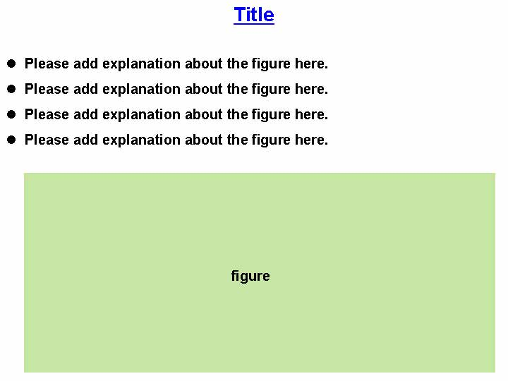
③One figure and its explanation in one slide
When making a slide, one figure and its explanation in one slide is ease to understand for audience.
Figure-only slide is not recommended. Do not forget to add its explanation in the slide.
Such slides can be easily reused in your other presentation.
5

Slide 6
④Write sentences, not words
If English is not your native language, write complete sentences, not words, on your slides.
Native speakers can speak very fluently with only words. On the other hand, non-native speakers sometimes lose their words and become panic. If this happens, read the sentences slowly to recover from the panic.
Reading sentences while pointing with a pointer is not a dramatic presentation. However, it is very easy for the audience to understand.
The slides will be uploaded to the web. Those who did not attend the meeting can read them. In this case, writing whole sentences is very useful for the reader's understanding.
For native, this is OK.
For non-native, this is much better.
Super-Kamiokande -water Cherenkov detector -Kamioka mine -1000 m underground -50 kton water -11146 20-inchΦ PMT
Super-Kamiokande is a water Cherenkov detector located at 1000 m underground in the Kamioka mine.
A total of 50 kton water is view by 11146 20-inchΦ photomultiplier tube (PMT).
6

Slide 7
⑤Use translation software, but start from English
If English is not your native language, and you are not comfortable with writing academic English sentences, you can use translation software.
However, never start from your native language.
The following procedure is recommended to improve your English skills.
First write in English and then translate it into your native language using the translation software.
You can check to see if your English sentence successfully expresses what you want to express.
Then, the sentence translated into your native language should be translated back into English by the software.
Minor grammatical errors may be pointed out and/or alternative expression can be found.
7

Slide 8
⑥Contents should be prepared first
Assume that you are working on a PowerPoint file directly without any preparation. You must concern with the contents (e.g., physics) and the design (e.g., layout/size/font/color) at the same time. That might be very difficult for most of people.
Prepare figures or tables or photos. And write texts in the plain text file, such as Notepad in Windows. In these processes, you can concentrate on the contents.
Then you can paste them on the slide. You can concentrate on the design.
8

Slide 9
⑦Use large and clear fonts
When you write texts, use large fonts. It is strongly recommended to use fonts larger than 20 pt.
Use vivid colors. Do not use light colors.
Some fonts are not friendly for senior audience. A typical example of non-friendly font is times font. The horizontal lines are thin and difficult to read.
Due to the same reason, do not use 明朝体, but use ゴシック体 for Japanese.
Use vivid colors.
Use vivid colors.
Use vivid colors.
Do not use light colors.
Do not use light colors.
Do not use light colors.
9

Slide 10
Summary
Let me summarize my advice for making slides.
Estimate the number of your slides
Start from your own work
One figure and its explanation in one slide
Write sentences, not words
Use translation software, but start from English
Contents should be prepared first
Use large and clear fonts
Good luck!
10

