Slide 1
Reexamination of Kamiokande-II data
in 1987
Yuichi Oyama
(KEK/J-PARC) yuichi.oyama@kek.jp
http://www-nu.kek.jp/~oyama/
October 23-27, 2023
XX International Workshop
on Neutrino Telescopes @ Venice
1

Slide 2
Introduction
Three new topics from old Kamiokande-II experiment are presented.
A ~50 minutes version of the presentation file can be found at
https://www-nu.kek.jp/~oyama/kam30yrs.oyama.210422.pptx
Why data of more than 30 years ago. Why now ?
--- Please visit my backup slide
SN1987A neutrino burst
Y.Oyama, Astrophys. J. 922, 223(2021)
https://doi.org/10.3847/1538-4357/ac374b
High energy neutrinos from SN1987A
Y.Oyama, Astrophys. J. 925, 166(2022)
https://doi.org/10.3847/1538-4357/ac4269
Correlation of two successive events
2

Slide 3
①SN1987A neutrino burst
3

Slide 4
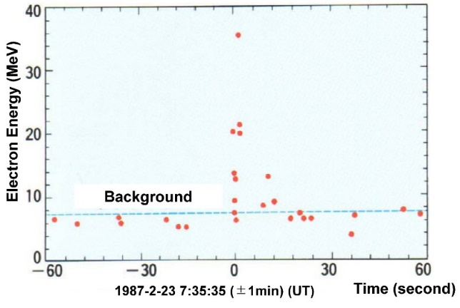
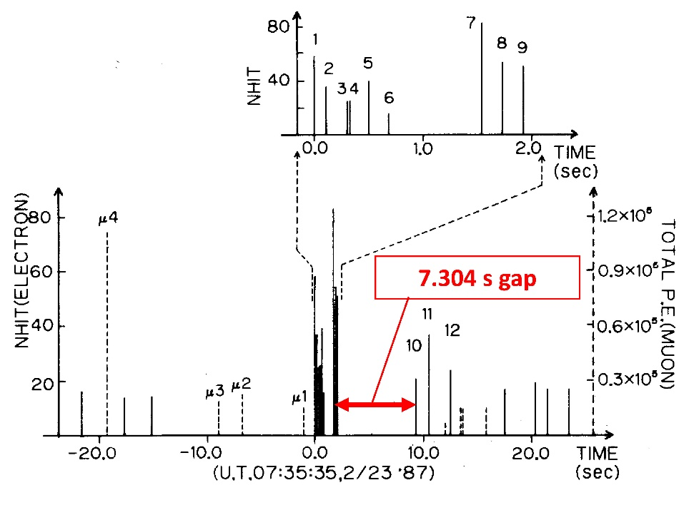
Neutrino burst from SN1987A – seven second gap
The Kamiokande-II collaboration successfully
observed the neutrino burst from SN1987A.
Eleven neutrino events are detected during
13 seconds.
In the Kamiokande-II original paper, another
time-energy plot are shown instead the
famous plot.
In this plot, the 7.304s time gap
between the 9th event and the 10th
event is very clear.
Why there was a gap?
The "seven seconds gap problem".
Let me pull your attention to the gap
again ! In the 7.304s gap, you can find
no cosmic ray muon events, whose
rate is ~0.37Hz. Surprisingly, no cosmic ray muon event was detected
in ~13 seconds of the supernova neutrino period!
In addition, you can find no low energy background events (mostly coming from radio activities) , whose rate is ~0.15Hz.

Slide 5
Chance Probability
The chance probability for “no SN1987A neutrino” and
“no cosmic ray muon” and “no low energy background”
in Δt=7.304s is calculated..
The chance probability is P < 0.05 x 0.067 x 0.334 = 0.00112.
The chance probability 0.112% cannot be accepted.
Is there dead time of the Kamiokande-II detector?
 | Rate | Expected # in 7.304s | Calculation | Probability of 0 event
SN1987A neutrino |  |  | K.S.Hirata* | <0.05
Cosmic ray muon | ~0.37Hz | 2.70 | Poi(0|2.70) | 0.067
low energy B.G. | ~0.15Hz | 1.10 | Poi(0|1.10) | 0.334
Poisson distribution : Poi(n|λ)=λ^{n}e^{-λ}/n!
*K. S. Hirata, Master thesis, Univ. Tokyo, 1988
Above discussion is based on published results.
Everybody can obtain similar results.
5

Slide 6
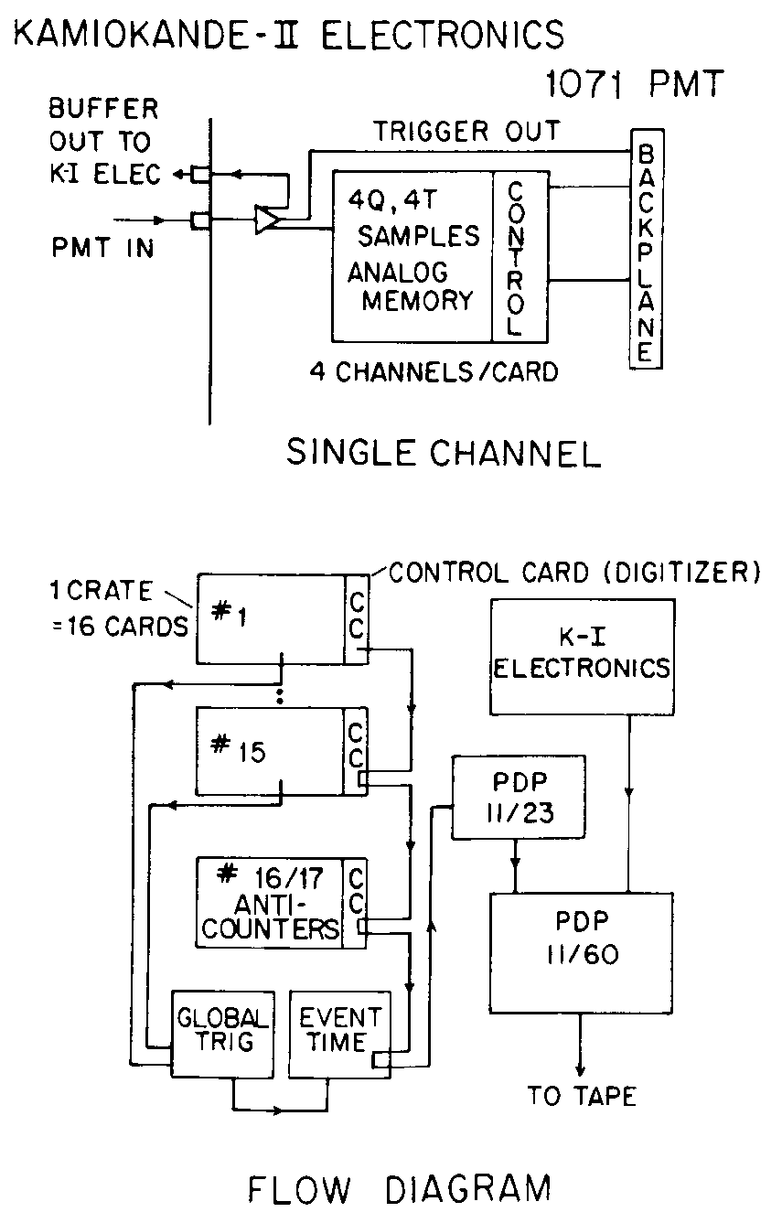
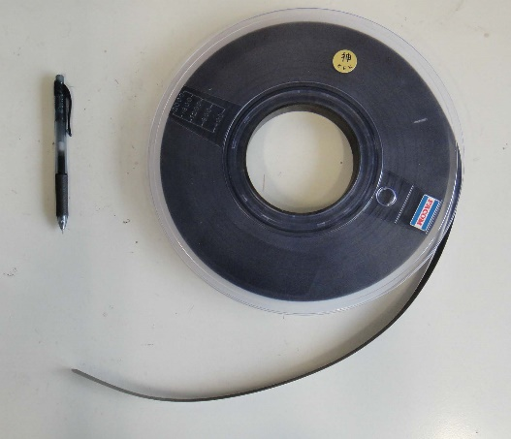
What happened during the seven seconds?
“Is there any reasonable explanation for the 7.304s dead time?”
It was a longstanding question for me.
One day (after Prof. Koshiba's Nobel prize), I happened to see one figure that caught my attention. It was the block diagram of the Kamiokande-II electronics shown in the SN1987A full paper.
K.S.Hirata et al., Phys.Rev.D 38,448(1988)
Data were recorded to MT directly!
MT (magnetic tape)
2400ft, 6250 bpi
180 MByte
6

Slide 7
Write error and retry
When the data were recorded to MT, "write error” occasionally happened. Partial rewind and retry were automatically done, and it took ~10 seconds for the recovery. During that time, the data buffer in the computer memory was full, and no new data could be accepted.
In fact, “Kamiokande-II shift manual” had following instruction:
To avoid frequent "write error", clean the head of the MT recorder
by isopropyl alcohol when you mount the MT.
The “write error and retry” might explain the cause of possible “seven seconds gap”. Of course, nothing can be verified.
MT
7

Slide 8
Summary ①
The chance probability for “no SN1987A neutrino” and “no cosmic ray muon” and “no low energy background” in 7.304s is 0.112%.
There exists a reasonable explanation for the seven seconds dead time. It is “write error and retry” during writing to MT.
We cannot deny the possibility that “seven seconds gap” during the SN1987A neutrino burst was “seven seconds dead time” of the Kamiokande-II detector.
8

Slide 9
②High energy neutrinos from SN1987A
9

Slide 10
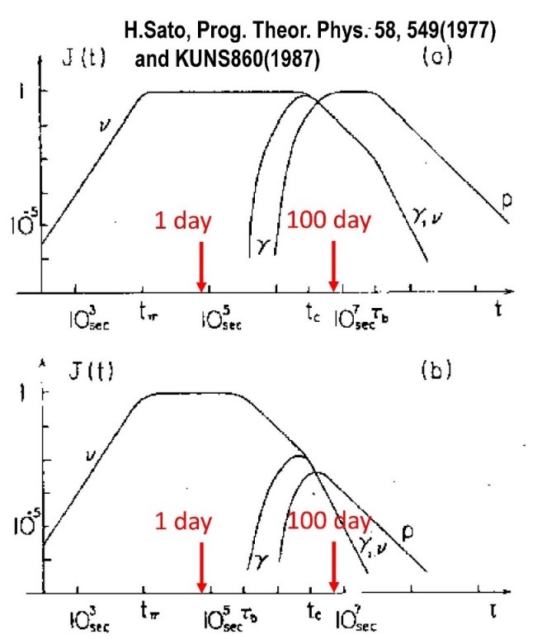
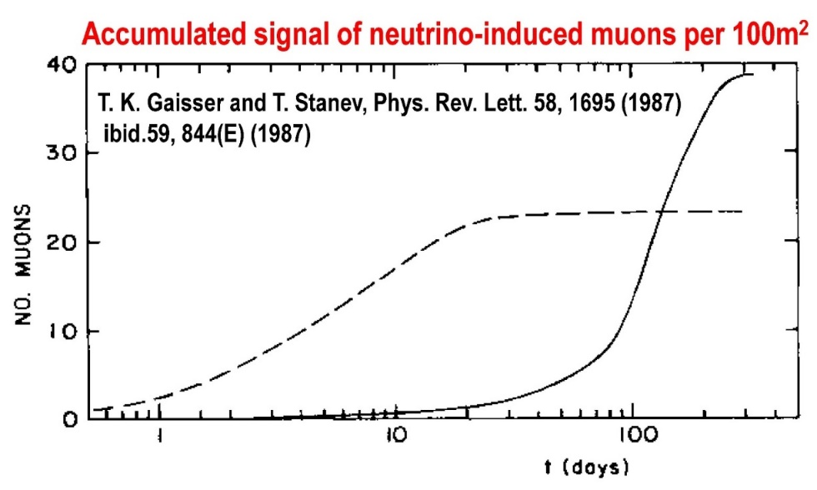
High energy neutrinos from SN1987A
High energy (> GeV) neutrinos could be generated from supernova remnants just after the explosion.
Target material is thick gas which initially
comprised the envelope of the progenitor
and later diffused at the supernova explosion.
Number of high-energy neutrino events from
SN1987A and their time structure were
calculated by theorists.
They are strongly mode-dependent, but 10~100
upward-going muon events could be observed
within one year from the explosion.
μ
π
p
10

Slide 11
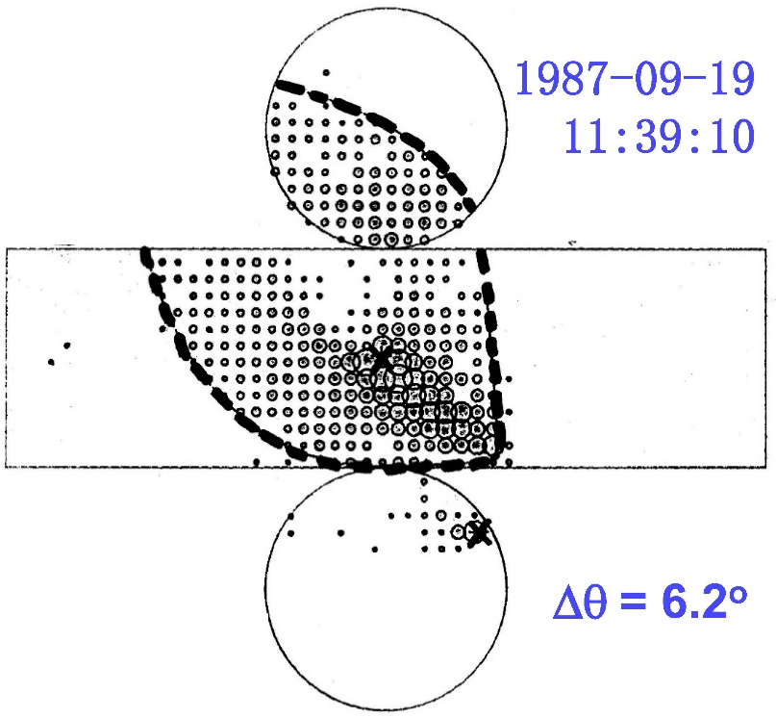
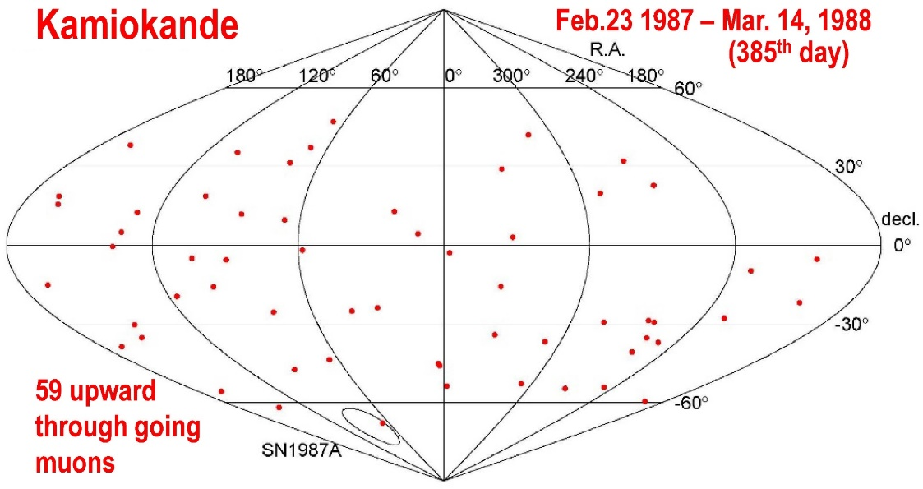
“Published” Kamiokande results
Y. Oyama et al., Phys.Rev.Lett. 59,2604(1987), Feb. 23, 1987 – Sep. 1, 1987 (191st day)
Y. Oyama, Ph.D thesis, ICR-Report-193-89-10, Feb. 23, 1987 – Mar. 14, 1988 (385th day)
From the Δθ=7.0º angular window, only 1 upward through-going muon event was found.
Expected background from atmospheric neutrino is ~0.4.
No significant signal was found.
SN1987A celebrated Koshiba’s birthday?
11

Slide 12
Upward stopping muon events
It was not published, but we found
2 upward stopping muon events
from the SN1987A direction.
They are upward-going muons
which do not pass through the
detector but stopped in the tank.
We did not analyze upward stopping
muon events systematically
because of following reasons;
through-going stopping
The event rate is ~ 1/5 of upward through-going muons, and only ~11 events/year are expected. Statistics is very poor.
Angular correlations between parent neutrino and produced muon are poor. It means that the angular resolution is poor in the directional neutrino astronomy.
The event selection was difficult, and the human power for the analysis was absent.
12

Slide 13
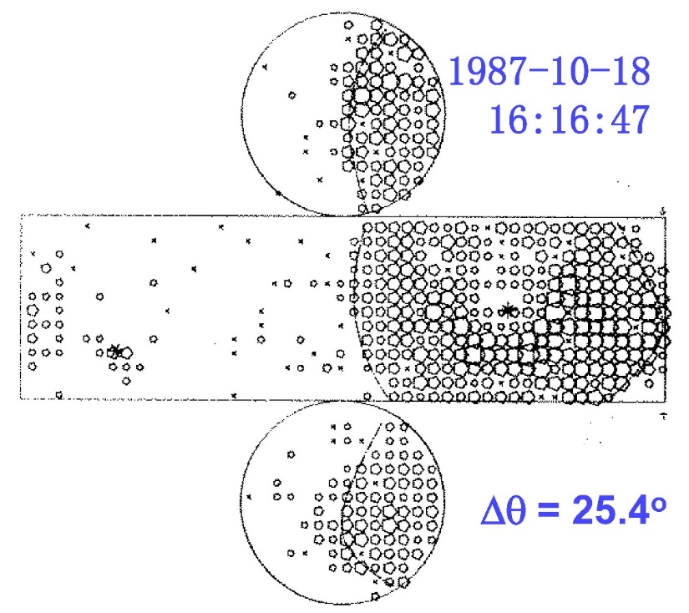
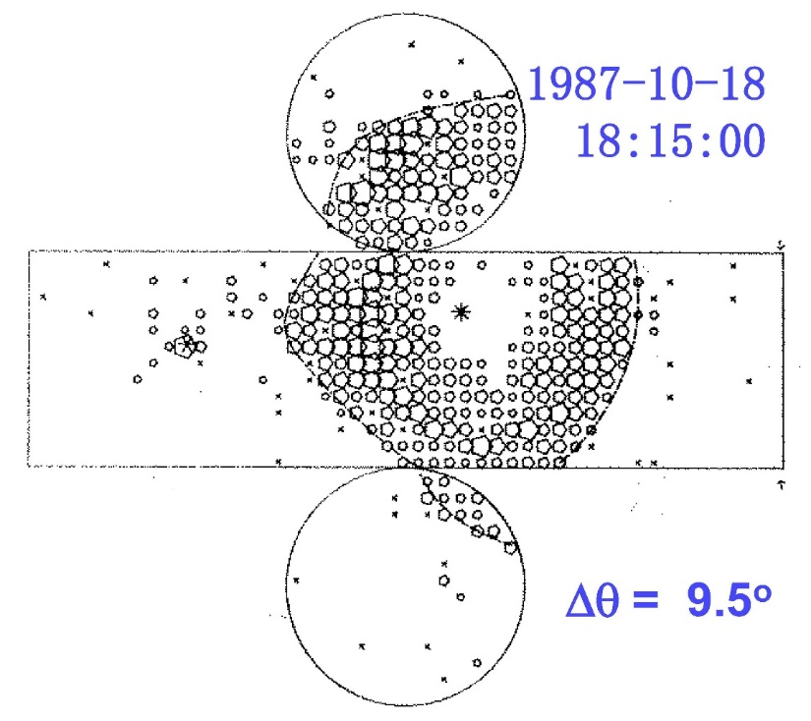
Upward stopping muon events
We can sometimes find upward stopping muon events during the
event selection of upward through-going muons by visual scan because of similar event topology.
We found 2 upward stopped muons in ~2 hours time duration on
Oct. 18, 1987. Note that angular resolution is poor for stopped muons.
Even we combine with the upward through-going candidate, it is difficult to claim possible signal from SN1987A………
13

Slide 14
Combine with IMB data !
IMB experiment is the other water Cherenkov detector which was operated in 1987. Many IMB members joined the Super-Kamiokande experiment later.
When we worked together in Kamioka in 2004, they told us they also found some upward-going muon events from SN1987A direction around that period, but they are not statistically significant.
They gave me the lists of the IMB upward-going muon events.
- 666 through-going events (Sep. 1982 ~ Dec. 1990).
- 34 stopping events (May 1986 ~ Feb. 1990).
(Thank you, Prof. John G. Learned !)
The IMB data was combined with Kamiokande-II, and we have 6 events.
 | Date/Time (UT) | (RA,δ) | Δθ_{SN} | cosΔθ_{SN} | category
1 | 1987-08-12 5: 8:27 | (97.1º,-67.5º) | 5.2º | 0.996 | IMB-thru
2 | 1987-09-19 11:39:10 | (67.2º,-67.9º) | 6.2º | 0.994 | KAM-thru
3 | 1987-10-16 10:17:49 | (60.0º,-73.9º) | 8.7º | 0.988 | IMB-thru
4 | 1987-10-18 16:16:47 | (18.8º,-63.5º) | 25.4º | 0.903 | KAM-stop
5 | 1987-10-18 18:15:00 | (95.9º,-61.2º) | 9.5º | 0.987 | KAM-stop
6 | 1988-01-13 3:23:27 | (67.4º,-64.0º) | 8.4º | 0.989 | IMB-stop
14

Slide 15
Let’s define angular-time window and
calculate the statistical significance!
The angular and time window are defined.
4 events remain in the angular-time window.
Δθ_{SN} < 10.0º
between 1987-08-11 and 1987-10-20 (71days)
 | Date/Time (UT) | (RA,δ) | Δθ_{SN} | cosΔθ_{SN} | category
1 | 1987-08-12 5: 8:27 | (97.1º,-67.5º) | 5.2º | 0.996 | IMB-thru
2 | 1987-09-19 11:39:10 | (67.2º,-67.9º) | 6.2º | 0.994 | KAM-thru
3 | 1987-10-16 10:17:49 | (60.0º,-73.9º) | 8.7º | 0.988 | IMB-thru
4 | 1987-10-18 16:16:47 | (18.8º,-63.5º) | 25.4º | 0.903 | KAM-stop
5 | 1987-10-18 18:15:00 | (95.9º,-61.2º) | 9.5º | 0.987 | KAM-stop
6 | 1988-01-13 3:23:27 | (67.4º,-64.0º) | 8.4º | 0.989 | IMB-stop
15

Slide 16
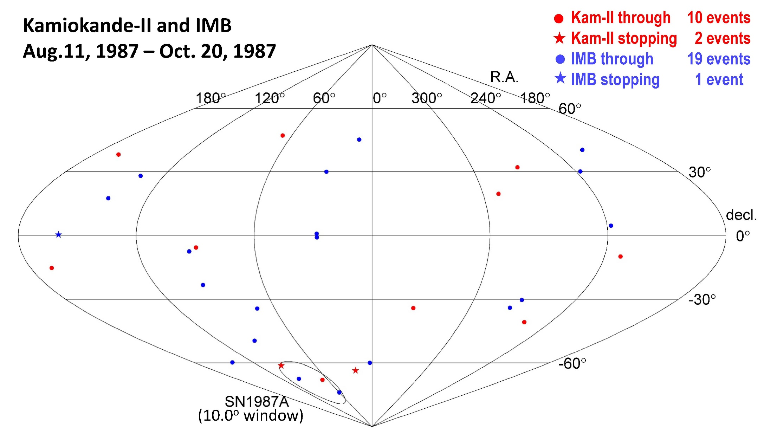
Celestial map of upward-going muon events
16

Slide 17
Chance coincidence of atmospheric neutrinos
Number of upward-going muon
candidates and expected
atmospheric neutrino background
are summarized in the table.
The probability that these signals
are chance coincidence of
atmospheric neutrinos is calculated.
The probability of “N _{Kam-thru} ≧ 1 and N _{Kam-stop} ≧ 1 and N _{IMB-thou} ≧ 2”
is obtained to be 0.27%.
It is difficult to claim a discovery, but it is certainly an evidence.
category | # of candidates | Expected atm. ν B.G.(λ)
KAM-thru | 1 | 0.127
KAM-stop | 1 | 0.026
IMB-thru | 2 | 0.315
IMB-stop | 0 | 0.029
Details of the calculation
The probability of the chance coincidence is:
P = (1-Poi(0|λ_{KAM-thru})) x (1-Poi(0|λ_{KAM-stop})) x (1-Poi(0|λ_{IMB-thru})-Poi(1|λ_{IMB-thru}))
x (385/71) x 4
= 0.119 x 0.026 x 0.040 x 5.42 x 4
= 0.0027
Poi(n|λ)=λ^{n}e^{-λ}/n!
x(385/71) : 385 days data was analyzed, and 71 days
time window was selected.
x4 : Among 4 event samples, 3 event samples
are used. ₄C₃=4!/(3!x(4-3)!)=4.
17

Slide 18
Summary ②
Upward-going muon events from the direction of SN1987A were searched for using data from Kamiokande-II and IMB.
From the time window between Aug. 11, 1987 - Oct. 20, 1987, and
angular window of Δθ=10.0º, 4 upward-going muon candidates were found.
The probability of the chance coincidence of atmospheric neutrinos
is 0.27%.
It might be the first evidence of high energy neutrinos from a supernova remnant just after the explosion.
Answers to the following FAQs are prepared to the backup slides
Q1: The definition of the time window is very intentional.
Q2: Is there any feedback to the model of the high energy neutrino
generation mechanism, if these upward-going muons are real
candidates from SN1987A?
18

Slide 19
③Correlation of two successive events
19

Slide 20
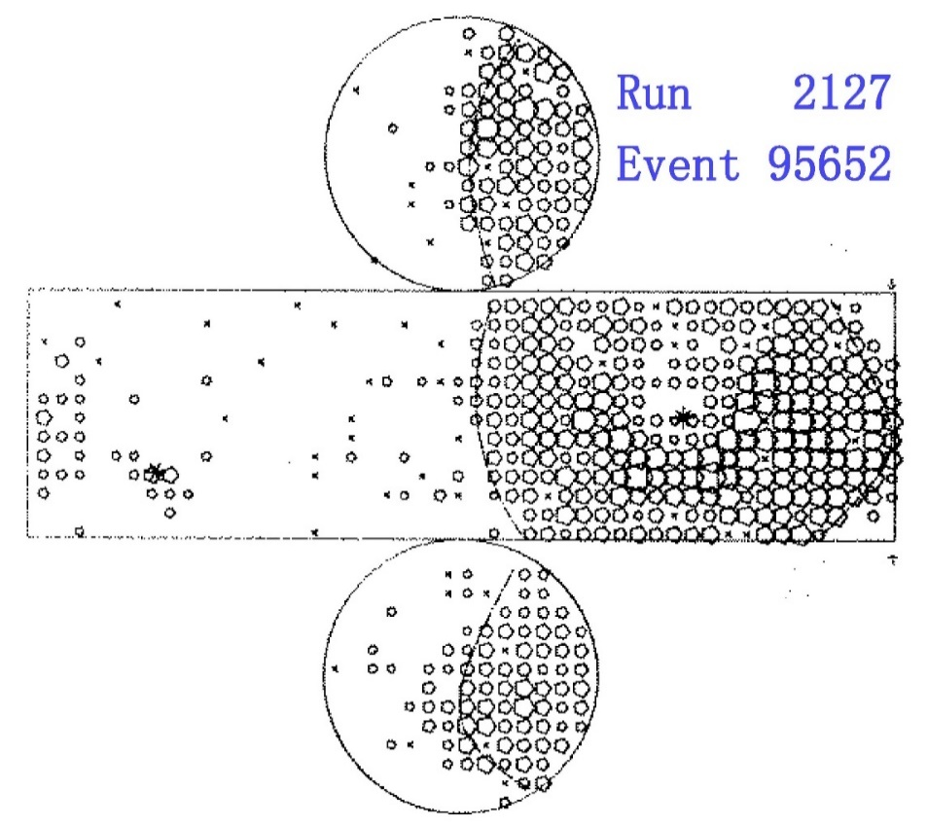
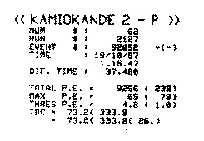
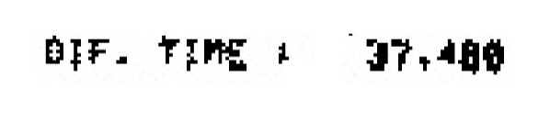
Run 2127 Event 92652
A curious event was found by chance: Run 2127 – Event 92652.
It was a upward stopping muon event.
(It was the first possible upward
stopping muon from SN1987A direction.
But that is probably irrelevant.)
The reason of the curiosity is
that the time interval from the
previous event is only
Δt = 37.48μsec,
although the trigger rate is less than 1 Hz.
This was pointed out
by Nakahata-san first.
Run2127
Ev 92651
Ev 92652
(upward stopping muon)
time
37.48μs
20

Slide 21
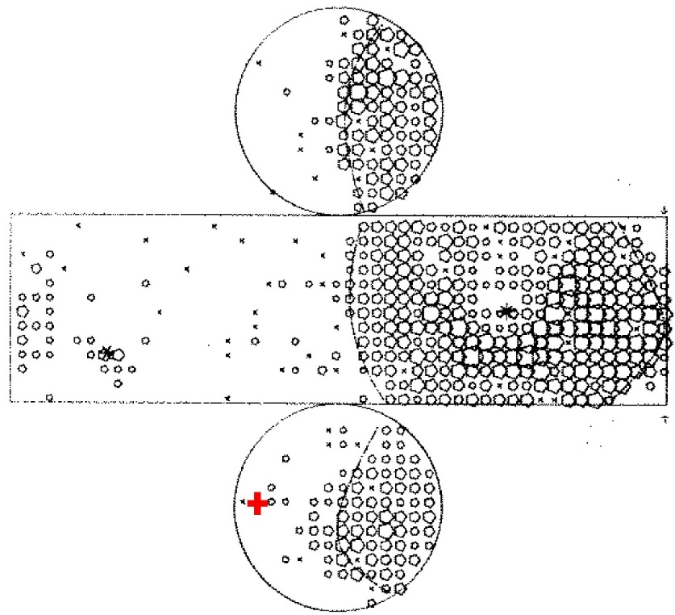
The preceding event (Run 2127 Event 92651)
Unfortunately, the event was recorded in a mine holiday.
The experimental site in the mine could not be accessed.
Because of limited MT capacity, the DAQ was in “holiday mode”, in which charge/time information of each PMT were not recorded for most of events.
Some information of the event were recorded.
All of these data well agree with that of
a typical cosmic ray muon which pass
through the detector with relatively long
travel distance in the detector.
Total photoelectron 15604 p.e.
Max Photoelectron 538 p.e.
Max PMT 906 (bottom)
Number of hit PMT 822
Position of Max PMT
for 92651 is superscribed
on 92652
I am not saying the entrance
position of the 2nd event is close
to the exit position of the 1st event.....
21

Slide 22
Is it chance coincidence?
The chance probability that the time interval from the preceding cosmic
ray muon is less than 37.48μs is P=1.39 x 10⁻⁵ .
Expected rate of (muon + upward-going muon) in such short time period is N_{exp}=0.00092 event-pairs/year.
Hard to believe that it is a chance coincidence!
It is natural to consider a causal relationship between two events.
If it is the case, it might be an evidence of new physics!
What should we do ? → Let's find another (muon + upward-going muon) pairs in short time interval from the data.
The details of the calculation
The cosmic ray muon rate is ~0.37Hz.
Number of cosmic ray muon events in 37.48μs is λ = 0.37 x 37.48x10⁻⁶s = 1.39x10⁻⁵.
The probability that more than one muon can be found in 37.48μs is
P = 1- Poi(0|λ) = 1-exp(-1.39x10⁻⁵) = 1.39 x 10⁻⁵ .
We have ~66 upward-going muon events in a year. Expected event rate of
(cosmic ray muon followed by upward-going muon within 37.48μs) is
N_{exp}=66 x (1.39x10⁻⁵) = 0.00092 event-pairs/year.
22

Slide 23
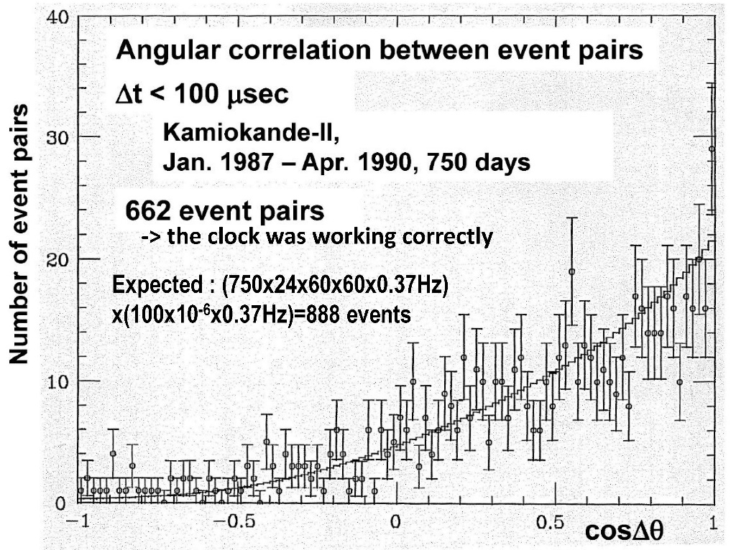
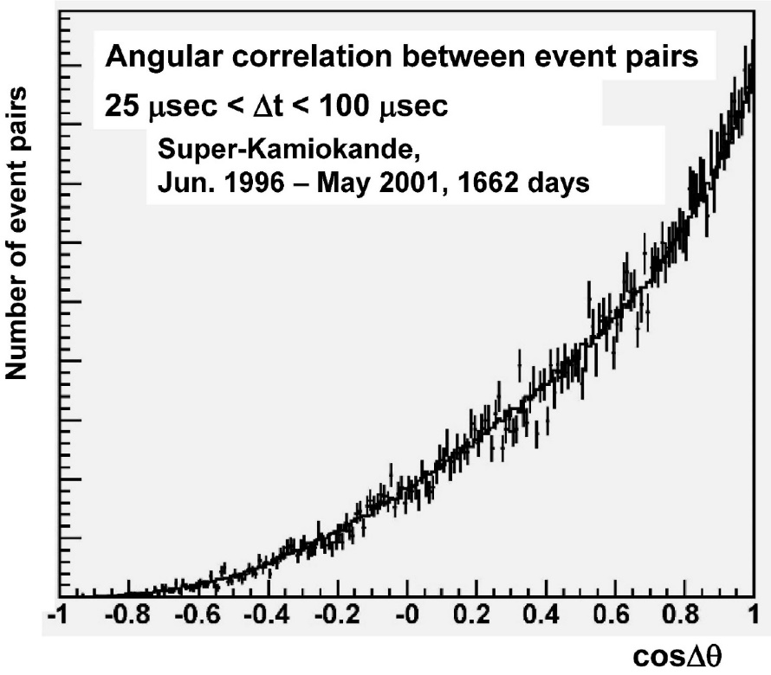
Let’s find similar event pairs!
No upward through-going muons in Kamiokande-II data have their preceding events within 10msec.
Event pairs are selected from a following criteria;
-Both events have total photoelectrons equivalent to muon tracks
-The time difference is less than 100μsec.
Angular correlation of two tracks are plotted.
No clear event pair was found near cosΔθ=-1 bin in Kamiokande-II data and in
Super-Kamionade I data. For more details, see backup slides.
Found to be noise
23

Slide 24
Summary ③
A curious event pair was happened to be found;
a (probably) downward through-going muon followed by an upward stopping muon. The time interval is 37.48μs.
Expected number of such event pairs by chance coincidence is
0.00092 event-pairs per year.
It is natural to consider a causal relationship between two events.
If it is the case, it might be an evidence of new physics!
However, similar event pair cannot be found in 3 years data in Kamiokande-II and 5 years data in Super-Kamiokande-I.
I apologize that I have not analyzed the data for the entire period.
We do not have enough person power to do this kind of very exotic analysis.
24

Slide 25

Finally…
I hope that you enjoyed these results.
And I will be happy if these results give some hints for your analyses
in your on-going experiments.
Thank you !
25

Slide 26
BACK UP

Slide 27
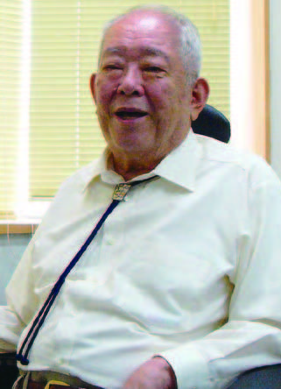
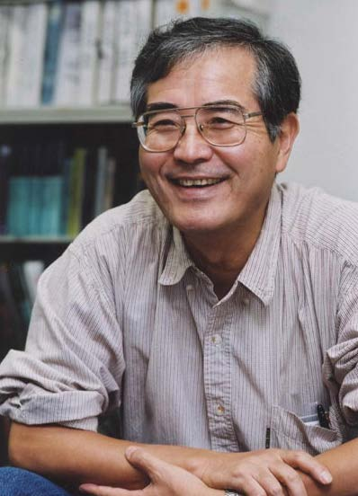
Why now?
It is more than 30 years from the experiment, and 30 years is reasonably long
time for disclosure.
The Kamiokande collaboration was managed with very primitive rule.
No collaboration council, no executive committee……..
If the spokesperson says “Yes”, the result become official.
It is extremely difficult for me to ask them “Can I make it official?”
Now both spokespersons passed away.
M. Koshiba, (1926 – 2020,
spokesperson until 1987)
Y.Totsuka, (1942 – 2008,
spokesperson from 1987)
27

Slide 28
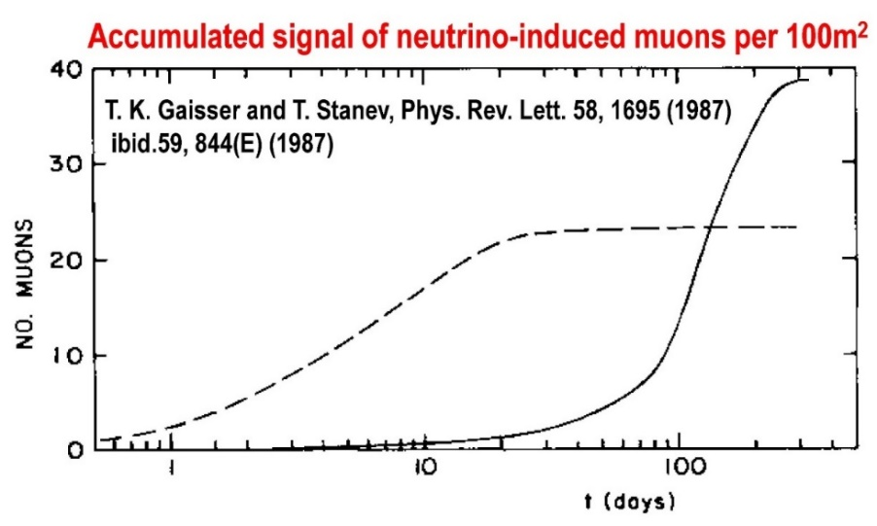
FAQ
Q1: The definition of the time window is very intentional.
A1:
The time structure of the neutrino events is not a priori known.
We must look for the neutrino period from the data.
To avoid too intentional time window selection, the window is not day by day basis but ~10 days bases, i.e., early (1~10), mid(11~20), and late (21~30 or 31) of the months.
The "trial factor" is properly
considered in the calculation of
the probability.
The time structure well agree with
the theoretical expectation.
The probability of the chance
coincidence was also confirmed by
a "fake event" analysis.
For details, see https://doi.org/10.3847/1538-4357/ac4269
28

Slide 29
FAQ(continued)
Q2: Is there any feedback to the model of the high energy neutrino
generation mechanism, if these upward-going muons are real
candidates from SN1987A?
A2: The characteristics of the candidates are;
-Two events are upward stopping muon events
-Relatively large angler deviations from SN1987A
They suggests that the energy of the parent neutrinos might be
10~100 GeV. It is much lower than the neutrino energy predicted by
the present theoretical models.
29

Slide 30
Details about the Kamiokande-II event clock
The interval of the event time played a critical role in the “Correlation of two successive events” analysis.
The trigger time information from electronics is recorded in event by event basis. It is a time clock, and one count corresponds to 20 nsec. This time information is combined with the DAQ computer clock, and full time information can be obtained with 20 nsec accuracy.
This time information is useful to study “stopping muon and Michel electron” or “cosmic ray muons and their spallation products”.
From the number of enrties in the left plot of the slide 23, it is verified that the event clock worked correctly.
30

Slide 31
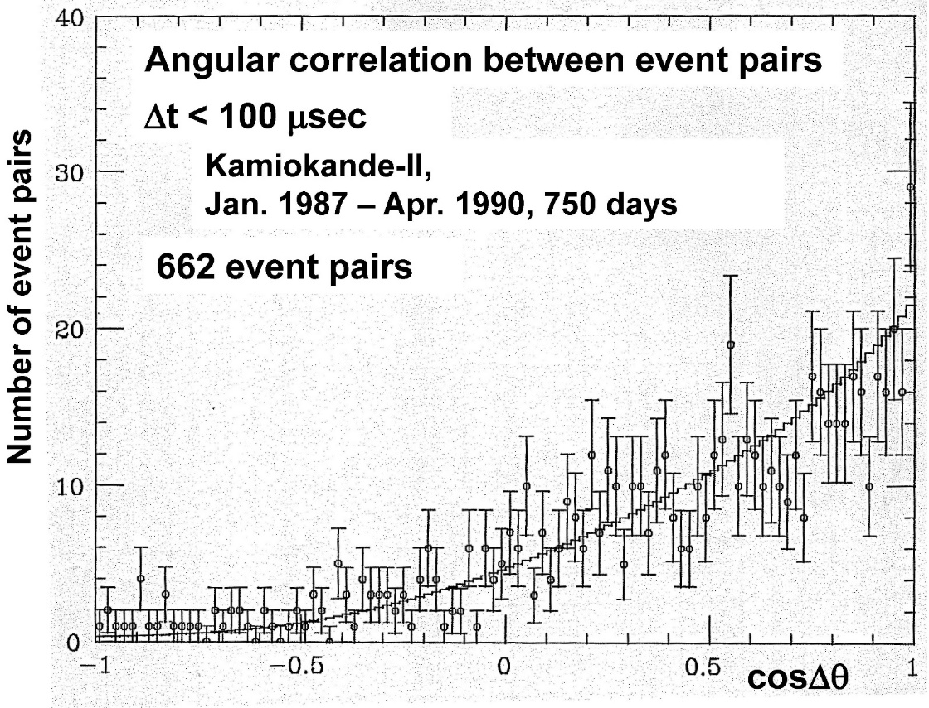
Kamiokande-II analysis
(Analysis-1)No upward through-going muon candidates have their preceding events within 10msec.
(Analysis-2)Event pairs are selected from a following criteria;
-Both events have total photoelectrons larger than 3000p.e, which is
~1GeV equivalent and corresponding to 5 meter track of muon.
-The time difference is less than 100μsec.
Events are reconstructed, and the angular correlation was examined.
In cosΔθ < -0.9, 6 event pairs were found. However, the all first events have large energy deposit in the detector by interactions, and the second events are fake events generated by ringing of the
electronics within 10μsec.
-> the clock was working correctly
Expected : (750x24x60x60x0.37Hz)
x(100x10⁻⁶x0.37Hz)=888 events
Oops! I should have made a plot for 10μsec < Δt < 100μsec, and we should have kept an event view of the interactions!
No candidates were found!
31

Slide 32
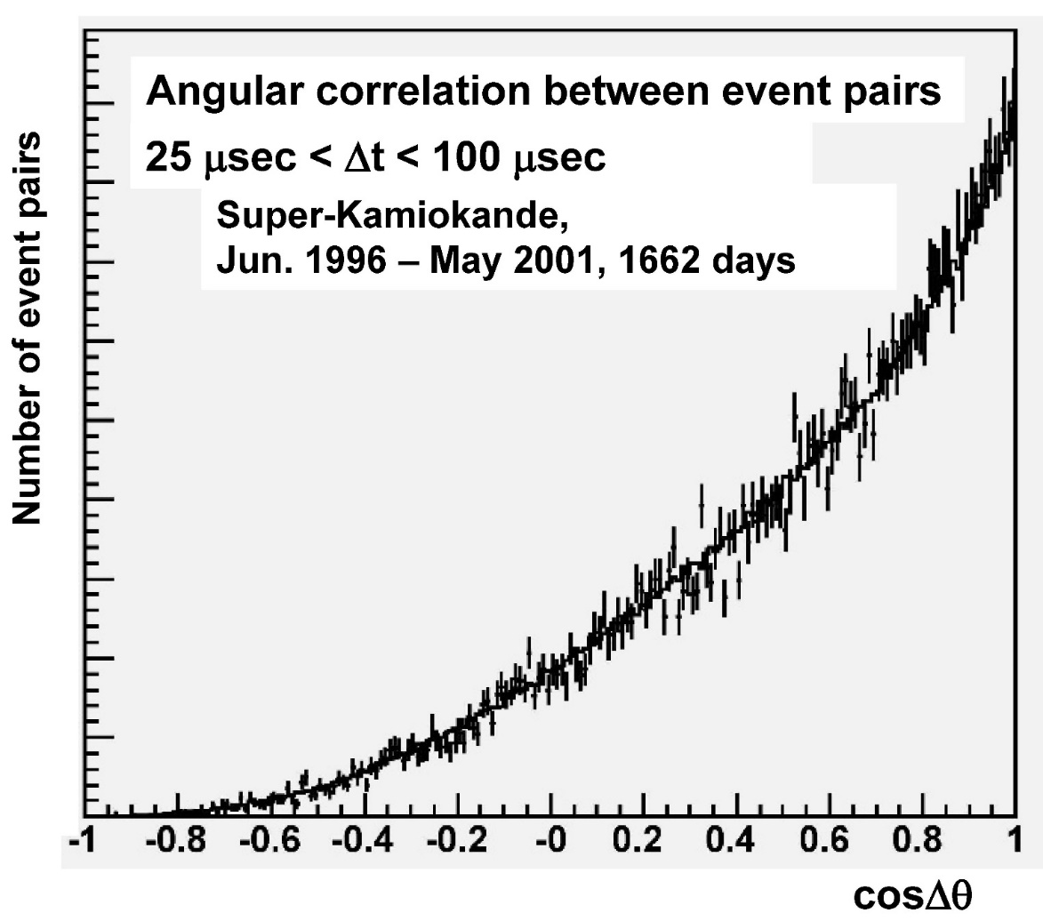
Super-Kamiokande analysis
A total of 2.54 x 10⁸ cosmic-ray muon track data were accumulated in Super-Kamiokande-I, when the anisotropy of primary cosmic rays in the celestial coordinate was analyzed.
I asked G.Guillian to make
similar plot using the SK
data. (Thank you, Gene and
Prof. John G. Learned!)
We could not find any
events near cosΔθ=-1.
Observation of the anisotropy of 10 TeV primary cosmic ray nuclei flux with
the Super-Kamiokande-I detector, G.Guillian et al., Phys.Rev.D 75,062003(2007)
Any Super-Kamiokande data must not
be shown without collaboration agreement.
However, please accept my quite poor
excuse that this plot is not “data” because
the labels for vertical axis are deleted.
32

Slide 33
END

Slide 34
Extra slide about further details
Short abstract
Three new topics from old Kamiokande-II experiment are presented. They are seven second gap during SN1987A neutrino burst, high energy neutrino from SN1987A, and abnormal time gap between upward stopping muon and preceding cosmic ray muon.
Primary Author
Yuichi Oyama
Orcid
https://orcid.org/0000-0002-1689-0285
Affiliation
KEK/J-PARC
Key-words
"Kamiokande" "SN1987A" "seven second gap" "high energy neutrino from supernova remnant“ "IMB" "cosmic ray muon" "exotic"
Publishing information
Y.Oyama, Astrophys. J. 922, 223(2021) https://doi.org/10.3847/1538-4357/ac374b
Y.Oyama, Astrophys. J. 925, 166(2022) https://doi.org/10.3847/1538-4357/ac4269

