Slide 1
What we have learned from our experience with Kamioka-related neutrino experiments
Yuichi Oyama
(KEK/J-PARC)
November 26-28, 2025
3rd International Workshop
“Particles, Gravitation and the Universe:
from Quantum Mechanics to Quantum Gravity”
@Hanoi, Vietnam
1

Slide 2
Introduction
Prof. Nguyen Anh Ky, who is one of the organizers of this workshop, requested a presentation about Japan's successful experiences and some recommendation for Vietnam.
From 1984, I have participated in many Kamioka-related experiments; Kamiokande, E261A, Super-Kamiokande, K2K, T2K.
I will talk about our experience in those experiments.
I focus on three topics.
Most of my slides are from my lectures at Vietnam School on Neutrino (VSoN), which is held in every July at ICISE, Quy Nhon.
If you think my presentation is interesting, please recommend the school to your students.
Birth of Kamiokande
Extension to low energy physics in Kamiokande-II
Toward the confirmation of atmospheric neutrino oscillation
2

Slide 3
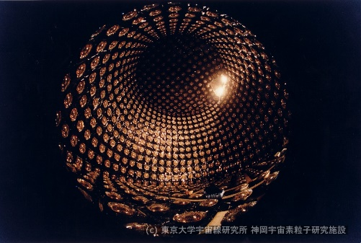
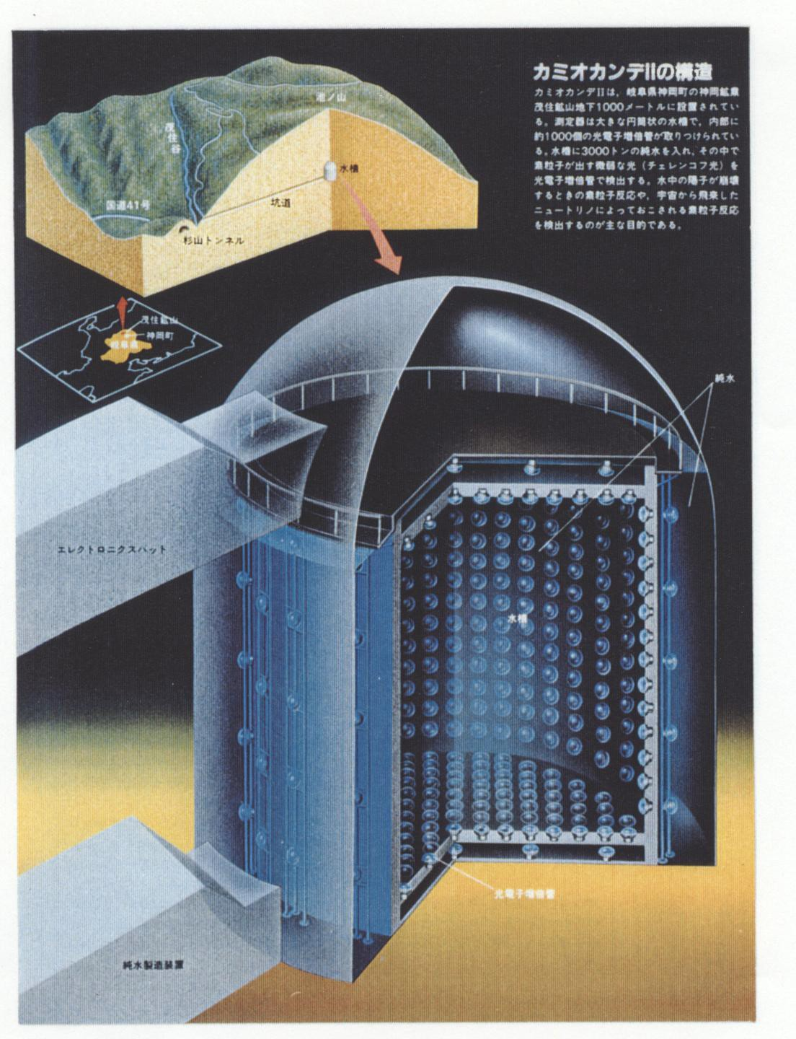
Kamiokande(1983-1996)
A large water Cherenkov detector constructed at 1000 m
(2400 meter water equivalent) underground in Kamioka mine, Japan.
3000 tons of pure water are viewed by 1000 20-inchΦ PMTs.
The first target is observation of nucleon decay.
3

Slide 4
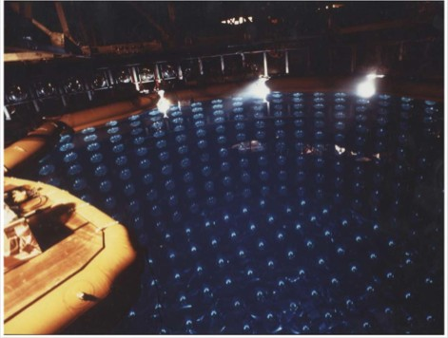
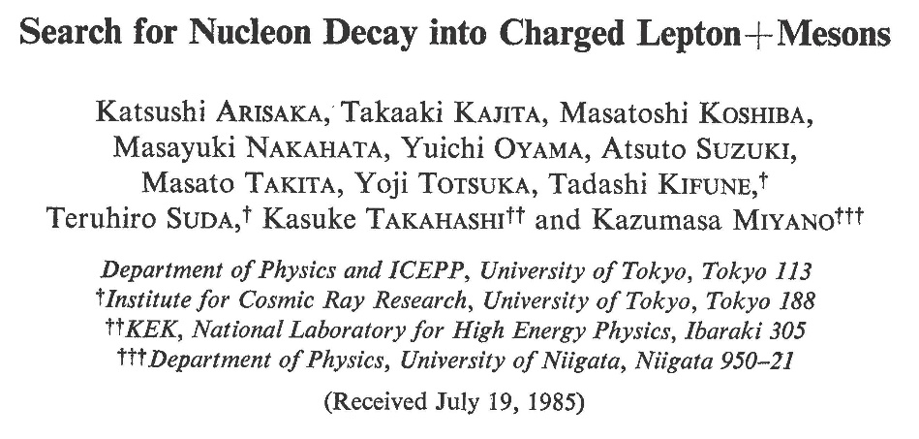
Birth of Kamiokande
Kamiokande was the first Nobel Prize experiment outside of Europe and America in the field of high energy physics.
Kamiokande was small manpower / small budget experiment.
In the first Kamiokande paper in 1985, only 12 authors. They are
7 staffs (about 5 Full Time Equivalent) and 5 graduate students.
The initial budget for the experiment was 5 Oku-yen and additional running cost was about 1 Oku-yen/year. It was quite small budget.
(1 Oku-yen ~ 0.5 Million US dollars in early 1980s.)
Reporting why Kamiokande experiment succeeded with small manpower / small budget will be very instructive.
4

Slide 5
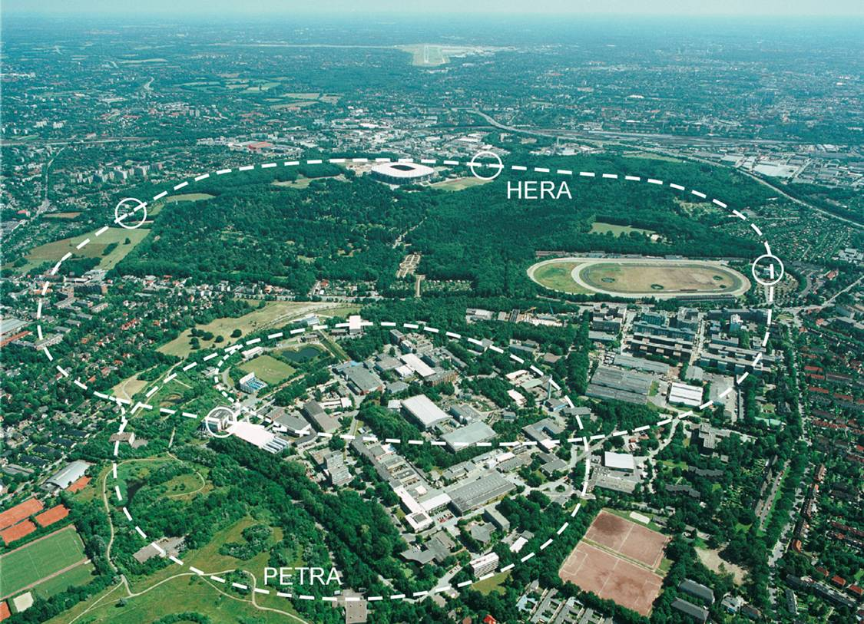

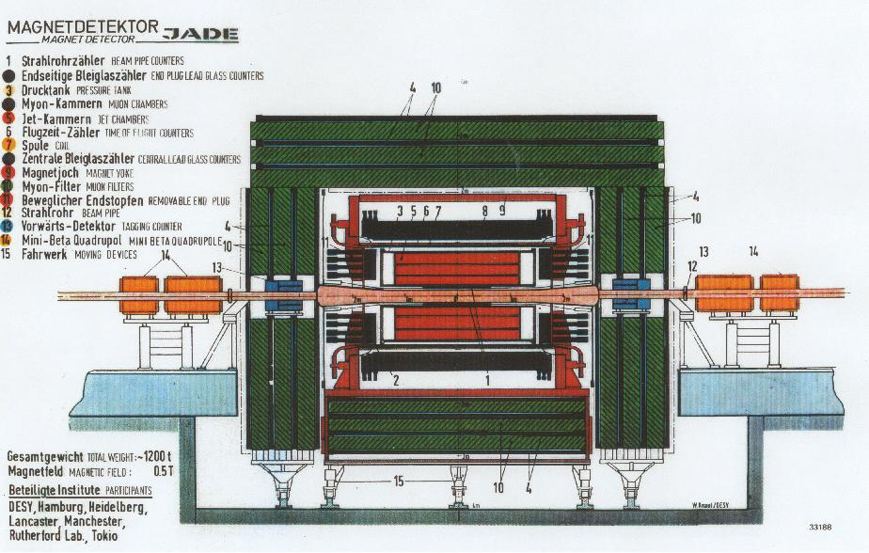
Before Kamiokande experiment…..
Before Kamiokande experiment, Koshiba's group in department of physics, University of Tokyo participated in JADE Experiment (1977-1986) in PETRA Ring in DESY, Hamburg.
Kamiokande was the second and local experiment of the group.
It was planned just after the JADE experiment started successfully.
JADE detector
PETRA Ring in DESY
5

Slide 6
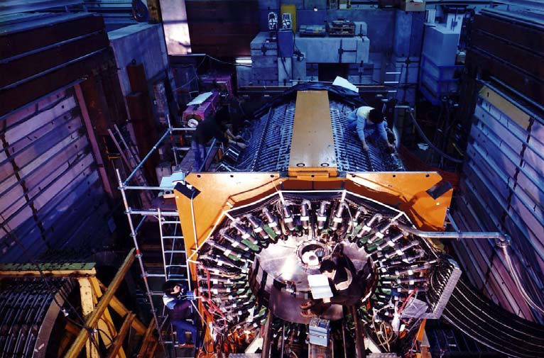
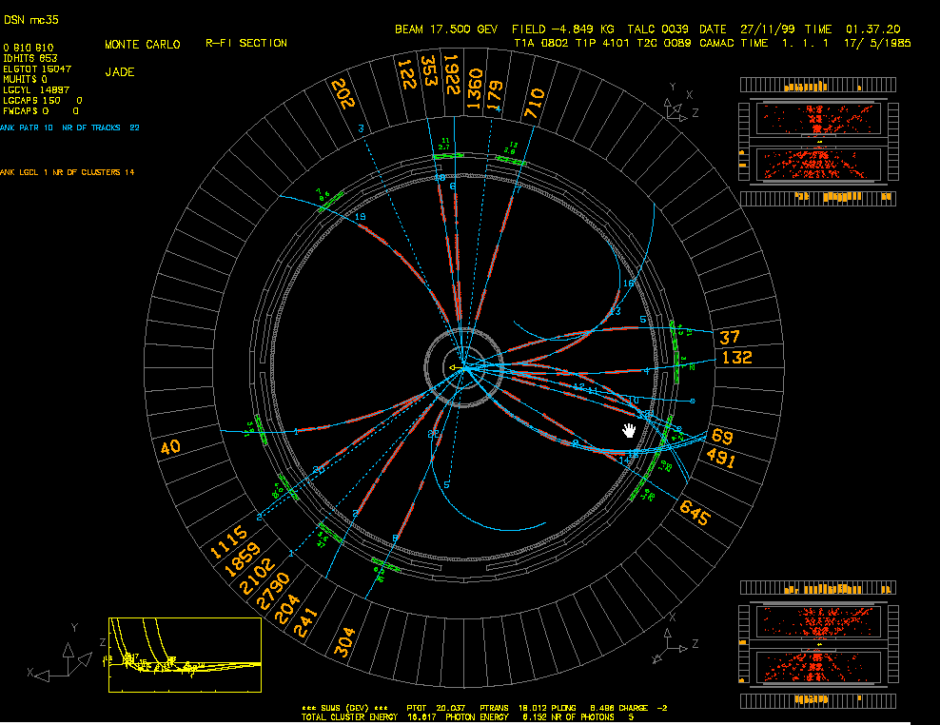
JADE experiment
JApan Deutschland England collaboration.
The main purpose of the experiment was observation of heavier new quarks. Unfortunately, it was not succeeded.
Instead, 3 jet events which directly show existence of gluons were discovered together with other 3 experiments in PETRA.
JADE detector
gluon event
6

Slide 7
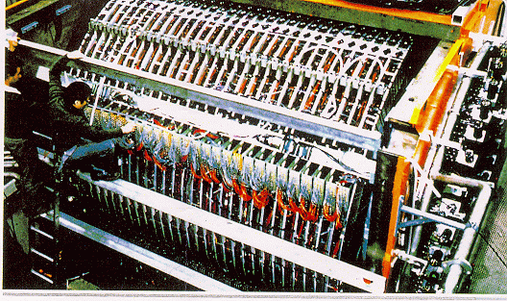
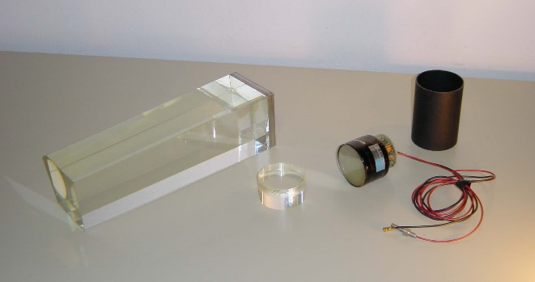
Lead glass counter and photomultiplier tubes (PMT)
In JADE experiment, Koshiba's group took charge of lead glass counters. It is a calorimeter to measure energy of electro-magnetic showers. Basically, it consists of a total of 2712 photomultiplier tubes (PMTs) and lead glasses.
At that time, the leading company of the PMTs was Philips in Nederland. PMTs made by Philips and made by Hamamatsu were compared and obviously Philips PMTs were much much better than Hamamatsu PMTs.
Assembling JADE Lead glass counter
Lead glass and PMT for OPAL experiment
(sorry! I could not find that of JADE)
7

Slide 8
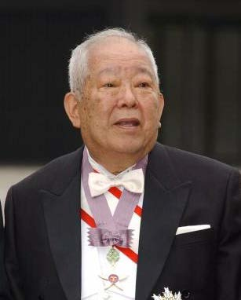
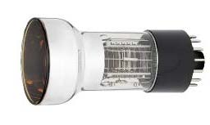
Hamamatsu PMTs !
Koshiba decided to use Hamamatsu PMTs although all other collaborators strongly opposed it. Koshiba said
"Our research budget is funded by the Japanese government.
For the critical and high-technology component of the detector,
we must purchase Japanese products as much as possible.“
Hamamatsu developed new PMTs for JADE
lead glass counters with cooperation of
Japanese JADE members. Hamamatsu
accumulated experience in the design of
PMTs thanks to Koshiba's decision.
It was real “first step” for the Kamiokande
experiment.
M. Koshiba
Hamamatsu R594 PMT for JADE experiment
8

Slide 9
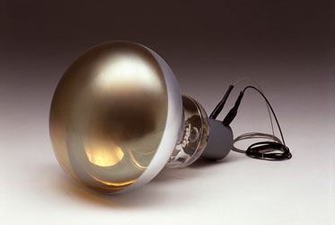
Development of 20-inchΦ PMT
When the planning of Kamiokande experiment started around 1979,
IMB group have already started similar project independently in USA.
The IMB detector is larger and the start of the experiment is earlier.
It seems there is no advantage in Kamiokande.
“Ask Hamamatsu to make new PMTs which
have large diameter. They cannot reject
my request. They succeeded as a PMT
company after we selected Hamamatsu
PMTs for JADE experiment!”
20-inchΦ PMT are developed, and precise
measurement became possible with large
photo collection.
It led to the success of the experiment.
 | IMB | Kamiokande
Total (Fiducial) Volume | 8000 ton (3300 ton) | 3000 ton (1000 ton)
Start | 1982 | 1983
PMTs (size x number) | 8 inchΦ x 2048 | 20 inchΦ x 1000
special price
9

Slide 10
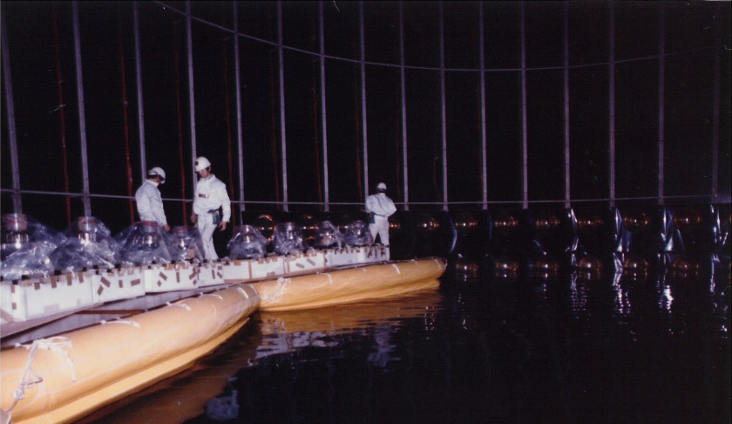
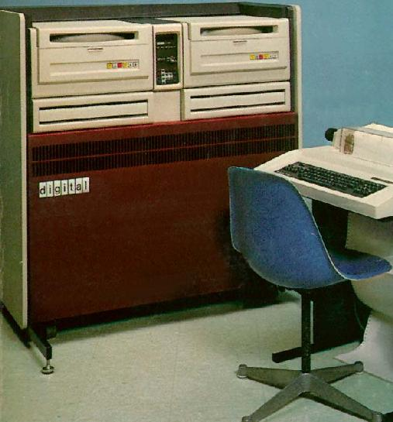
Use property of JADE experiment !
The tank including PMT support structure was designed and constructed by Mitsui Engineering
and Shipbuilding Co.,Ltd.
The company also designed
structure of the JADE lead glass counter. The group had enough experience of communication
with the company.
DEC PDP 11/60 was used as on-line data-taking computer. The group asked how to use it to a JADE member since PDP 11 series was used in JADE.
For readout electronics, high voltage power supplies and distributors, ready-made electronics were purchased. For some of the component, second-hand modules were used.
DEC PDP 11/60
10

Slide 11
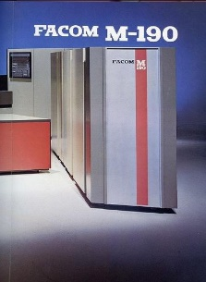
Use property of JADE experiment !
For off-line analysis computer, an IBM-type
mainframe computer, FACOM M-190 for
JADE experiment was used without any
charge. Kamiokande members were just
USERS of the computer, and did not care
any maintenance and management.
In the analysis computer, all utility software
for JADE experiment were used. They
include data structure or event display.
For Monte Carlo simulation program, lead
glasses were replaced with water, and only
geometry was changed.
To summarize, Kamiokande borrow (or steal) almost everything
from JADE experiment. In that sense, Kamiokande is (JADE)' at
the first stage. That is one reason why Kamiokande started with small manpower and small budget.
11

Slide 12
What we have learned – summary①
Your high energy experimental group will join (or already joined) a large international collaboration. Keep in mind following…….
For critical and high-technology components of the detector,
purchase your own national products.
It would contribute to technology upgrade of your national companies, and would be the "first step" of your future experiments.
You should consider to imitate a detector component of your international collaboration, and start your own experiment in your own country. You can borrow (or steal) every property/ experience/technology/software/ hardware/manpower from your international collaboration.
12

Slide 13
Extension to low energy physics
In Kamiokande, no signal for nucleon
decay was found in the first couple
of years The nucleon life time was
found to be much longer than the
expectation before the experiment.
And it has not been found yet.
The Kamiokande experiment shifted
its primary research subjects.
From “Kamioka Nucleon Decay Experiment”
to “Kamioka Neutrino Detection Experiment”.
The detector must be upgraded to detect low energy (< 10MeV) neutrinos.
Extension of the research field from high energy physics to nuclear
physics and astrophysics.
τ = 10²⁸ ~ 10³² years
τ = 1.6 x 10³⁰ years
(most hopeful model)
For τ = 10³⁰ ~ 10³² years,
600~6 nucleon decays in 1kt・year
τ/B > 2.4x10³⁴ years (90% C.L.) for p->e⁺+π⁰ decay mode.
First prediction in 1981
Present constraint in SK
Atmospheric neutrinos
(100MeV ~ 1000 MeV)
Solar neutrinos (< 10MeV)
13

Slide 14
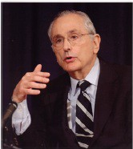
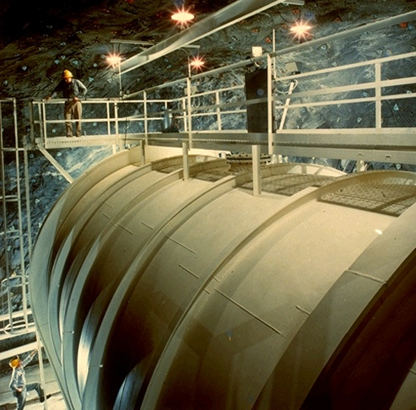
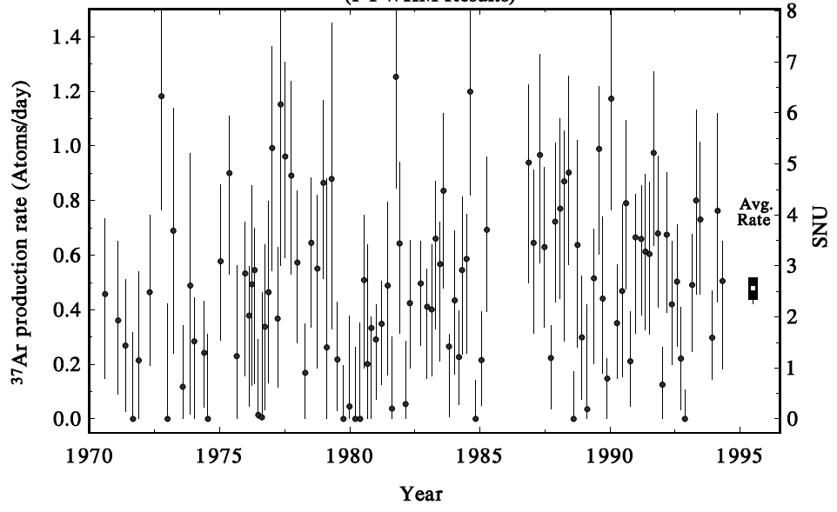
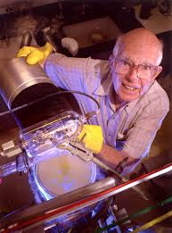
Solar Neutrino Problem (1969 ~ )
Solar neutrino flux detected by Homestake ³⁷Cl experiment is about 1/3
of the theoretical calculation by John N. Bahcall.
If the discrepancy is correct, it is an evidence of neutrino oscillation.
However, the experiment and/or the calculation are thought to be suspicious. No experiments followed.
Standard Solar Model expectation
John N. Bahcall
Homestake experiment
³⁷Ar production rate (atoms/day)
SNU (1 SNU is 10⁻³⁶ captures
per target atm per second)
R. Davis Jr.
14

Slide 15
Kamiokande-II
When Kamiokande experiment started, the trigger threshold of the detector was ~29 MeV. This threshold was low enough to detect nucleon decay mode p->νK⁺(μ⁺ν), which records the smallest energy deposit in the detector.
To detect ⁸B solar neutrinos, the trigger threshold of the detector should be reduced to around ~8 MeV.
In addition to the trigger threshold, background events in the low energy range should be reduced. They are from radioisotope in water.
From fall 1984 to end of 1986, many detector upgrade to observe
⁸B solar neutrinos were done. They are:
After these upgrade, namely, Kamiokande-II started in early 1987.
Removal of radioactive sources in water
Construction of anticounter
Installation of New electronics
15

Slide 16
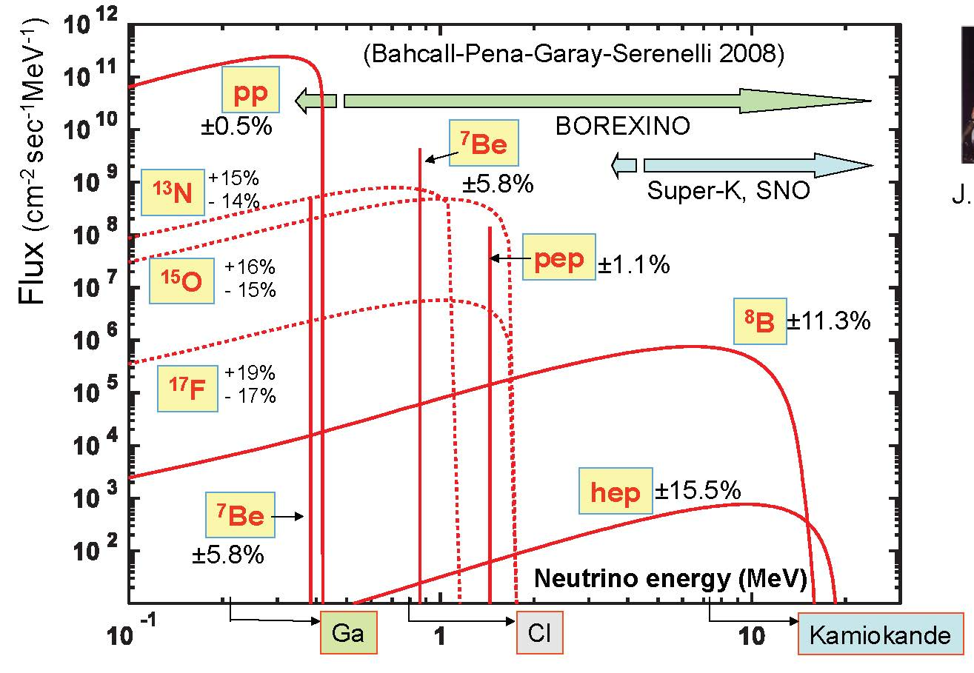
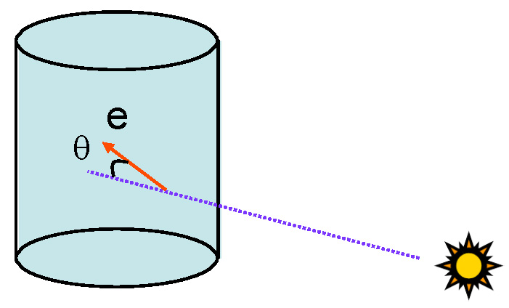

Solar neutrinos in water Cherenkov detector
In water Cherenkov detector, only ⁸B neutrinos whose nominal energy is ~8 MeV can be detected.
Elastic scattering between neutrinos and orbital electrons are employed.
Recoil electrons keep energy and directional information of initial neutrinos.
ν_{e} + e -> ν_{e} + e
16

Slide 17
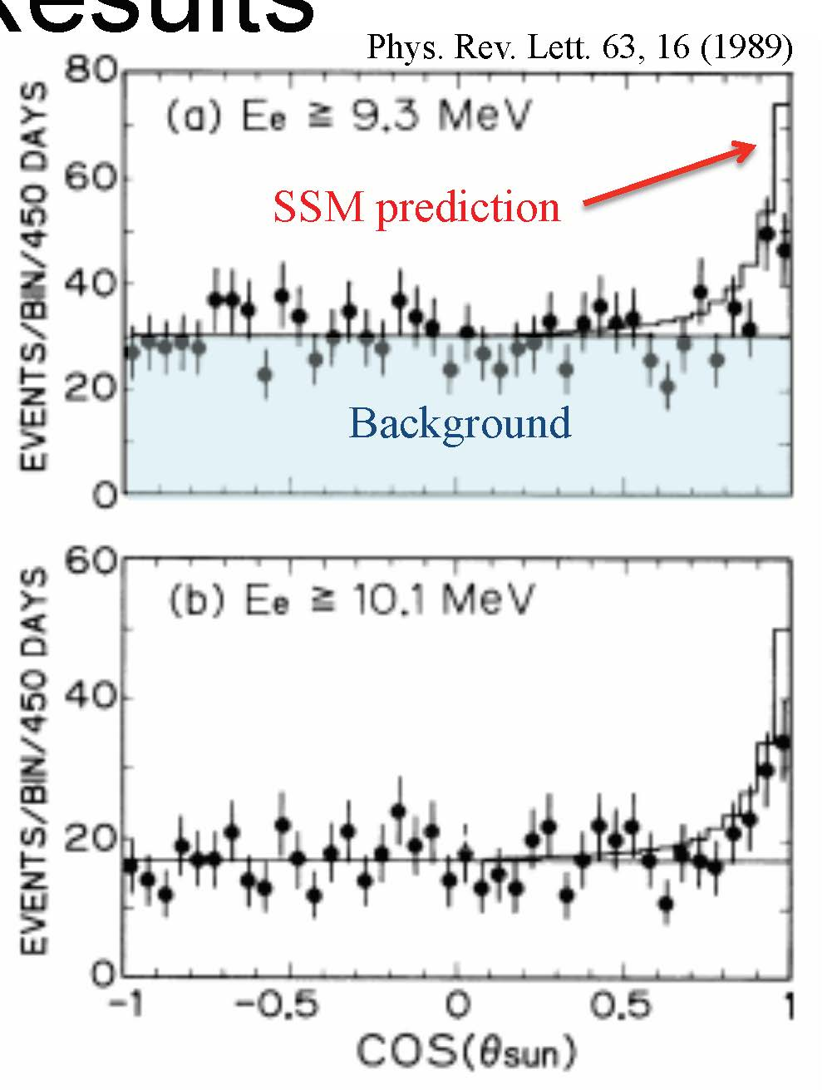
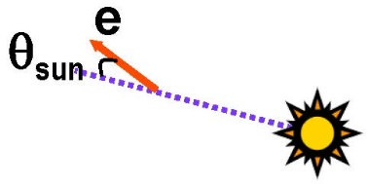
Observation of solar neutrinos in Kamiokande-II
Based on 450 days of data, the first real-time, directional neutrino signal from the direction of the Sun was found.
The observed neutrino flux is
0.46 ± 0.13(stat.) ± 0.08(sys.)
of SSM prediction.
The observation is certainly smaller than the SSM prediction. However, the discrepancy is
not consistent with Homestake.
Homestake : ~ 1/3 of SSM
Kamiokande-II : ~ 1/2 of SSM
After Kamiokande-II observation, measurements with different energy threshold became key issue for other new experiments.
K.S.Hirata et al., Phys. Rev. Lett. 63, 16(1989)
Background
17

Slide 18
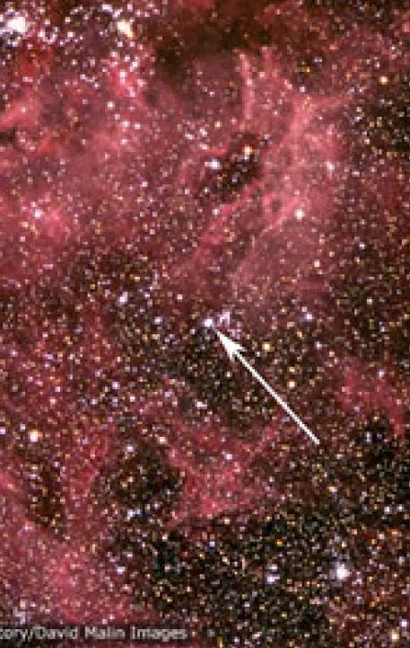
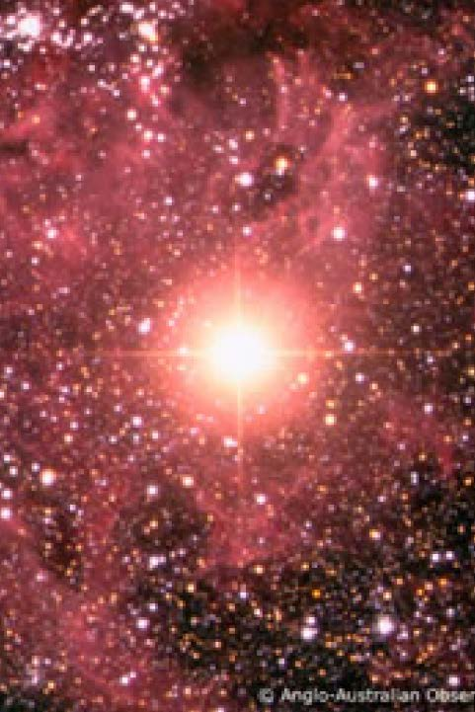
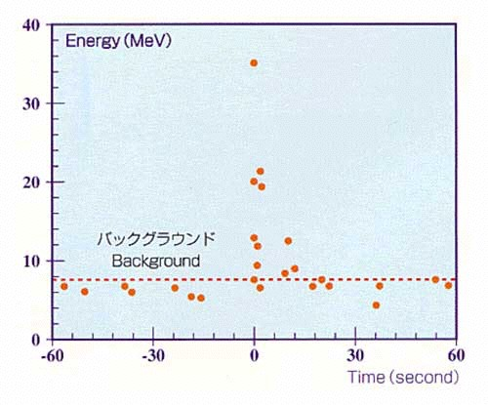
SN1987A
In addition to the solar neutrino
observation, we succeeded to detect
supernova neutrinos from SN1987A
just after the detector became ready
for the low energy detection.
Hearing the news of a supernova
explosion in Large Magellanic
Cloud, Kamiokande-II immediately
analyzed the data, and found
a clear 11 neutrino events in 13
seconds from February 23 1987,
07:35:35UT (±1min).
If the energy threshold had been
29 MeV as in the Kamiokande-I
period, only one neutrino event
would have been detected.
18

Slide 19
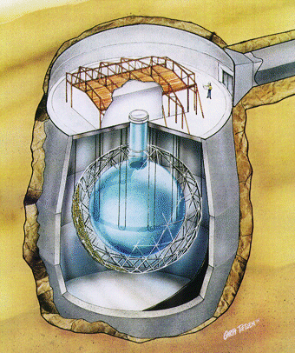
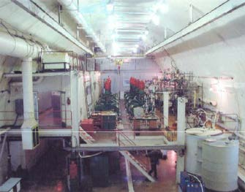
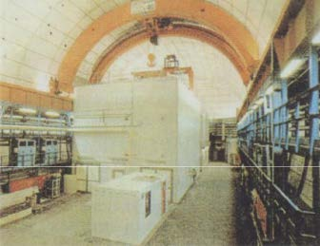
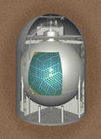
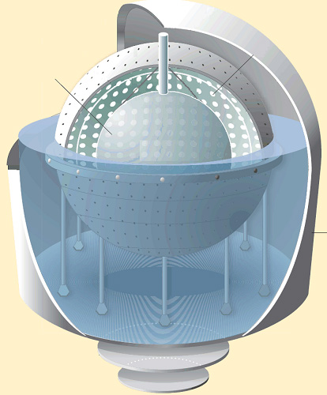
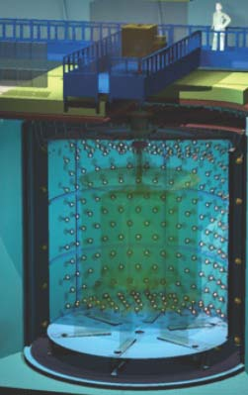
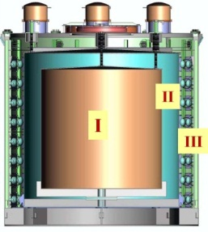
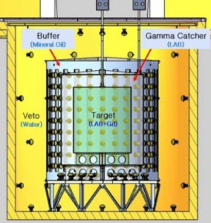
Solar neutrino/Reactor neutrino experiments
Solar neutrino observation became an active research subject, and many solar/reactor experiments followed.
Super-Kamiokande
SNO
SAGE
Gallex/GNO
KamLAND
Borexino
Double Chooz
Daya Bay
RENO
19

Slide 20
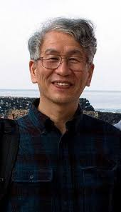
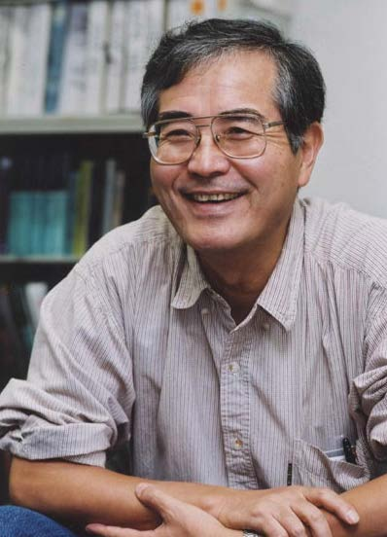
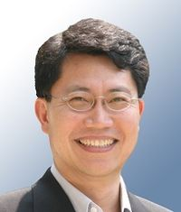
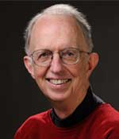
Solar neutrino/Reactor neutrino experiments
Kamiokande-II became a historical prototype for some of other solar/reactor neutrino detectors. Radioactivity-free-liquid (water, heavy water or liquid scintillator) are target materials. They are stored in a large tank and viewed by large diameter PMTs. The inner detector is surrounded by 4π anticounter.
Members of Kamiokande-II became leaders in other experiments:
- Spokespersons of Super-Kamiokande, KamLAND and Reno were
members of Kamiokande-II.
- University of Pennsylvania group joined SNO experiment and designed the
SNO electronics. The co-spokesperson of the SNO experiment was a
member of Kamiokande-II.
Y.Totsuka/
Super-Kamiokande
A.Suzuki/
KamLAND
S.B.Kim/
Reno
E.W.Beier/
SNO
20

Slide 21
What we have learned – summary②
Once the detector was constructed, we must consider what physics can be done with our own detector. We must not stick to our own research field.
For that purpose, we must keep watching nearby research field.
In fact, solar neutrinos and supernova neutrinos are in the field of nuclear physics and astronomy. Not high energy physics.
We must keep close communication with physicists in other fields.
When we analyzed neutrinos from SN1987A, our knowledge about
supernova neutrinos learned from theoretical astrophysics group in the University of Tokyo was very helpful.
The energy range for high energy physicists is E > 100 MeV
(or mainly > 1 GeV). Energy range of nuclear physics (< 10 MeV)
is definitely “unknown world”. We struggled with radioisotopes.
We knew nothing about astronomy.
We have started from “definition of celestial coordinate”.
21

Slide 22
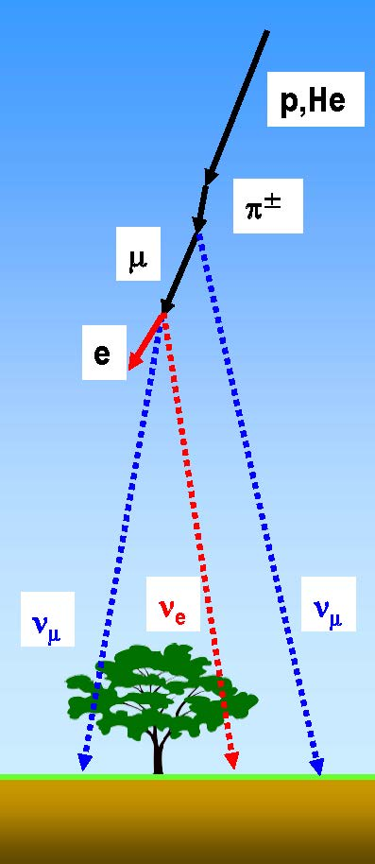
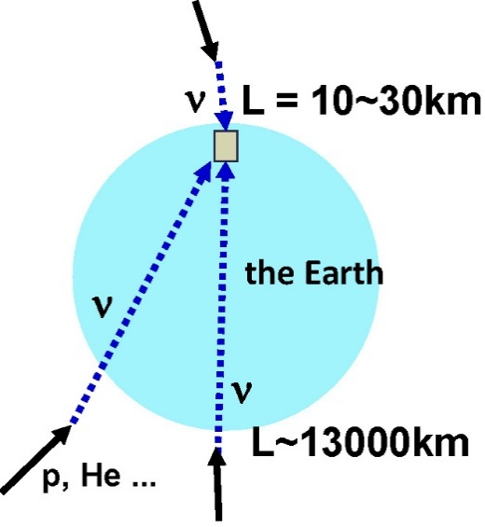
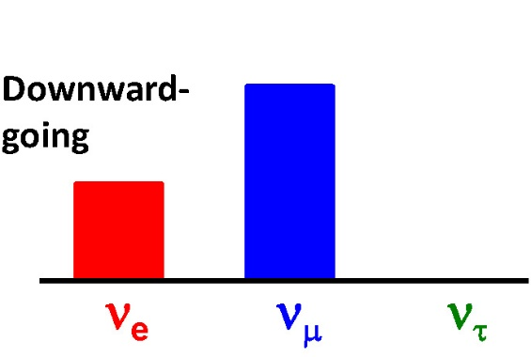
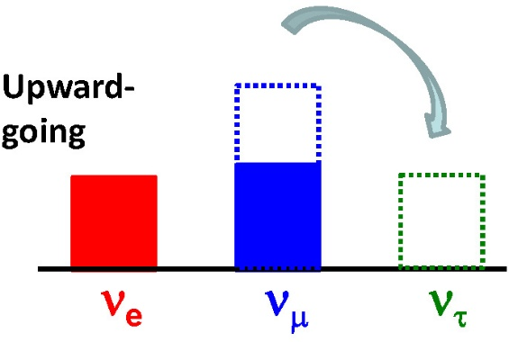
Atmospheric neutrino oscillation
Atmospheric neutrinos are produced by collisions between primary cosmic ray protons and upper atmosphere.
Downward-going ν_{e} agree with expectation. Downward-going ν_{μ} agree with expectation.
Upward-going ν_{e} agree with expectation.
Only upward-going ν_{μ} are significantly smaller
than expectation.
Upward-going neutrinos may oscillate during their long travel distance. Neutrino oscillation from ν_{μ} to ν_{τ} can explain the ν_{μ} deficit.
π μ + ν_{μ}
ν_{e} : ν_{μ} ~ 1 : 2
e + ν_{e} + ν_{μ}
22

Slide 23
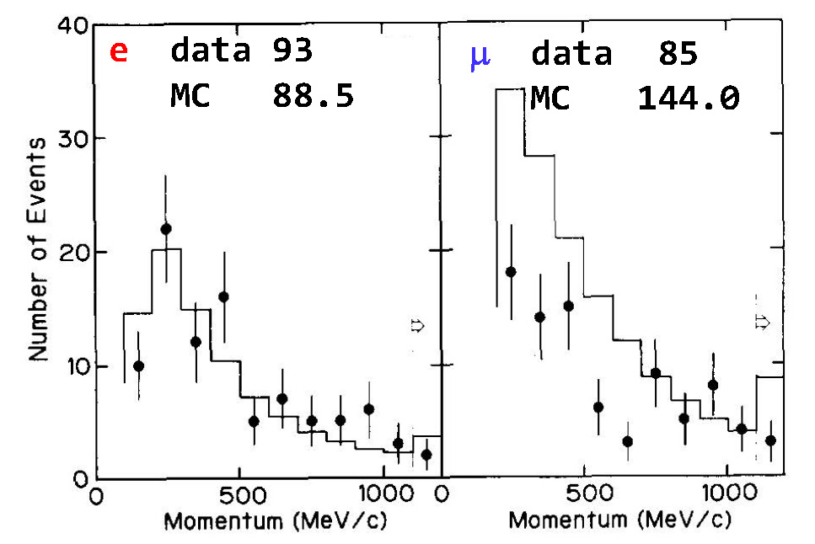

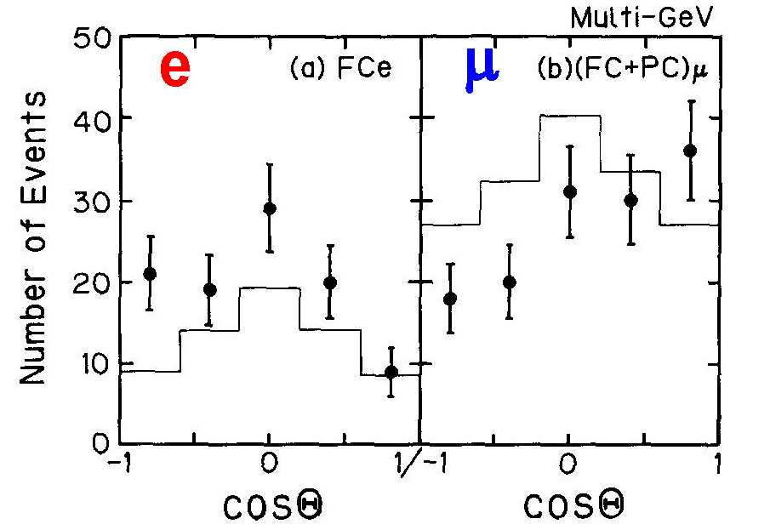
Three Kamiokande papers
on the atmospheric muon neutrino deficit
K.S.Hirata et al., Phys. Lett B205, 416(1988)
Deficit of atmospheric muon
neutrino was found.
K.S.Hirata et al., Phys. Lett B280, 146(1992)
Although absolute atmospheric
neutrino flux has large ambiguity,
ν_{μ}/ν_{e} ratio is robust.
is significantly smaller than 1.
K.S.Hirata et al., Phys. Lett. B335, 237(1994)
The muon neutrino deficit was also
found in higher energy region.
Zenith angle dependence was
also found.
23

Slide 24
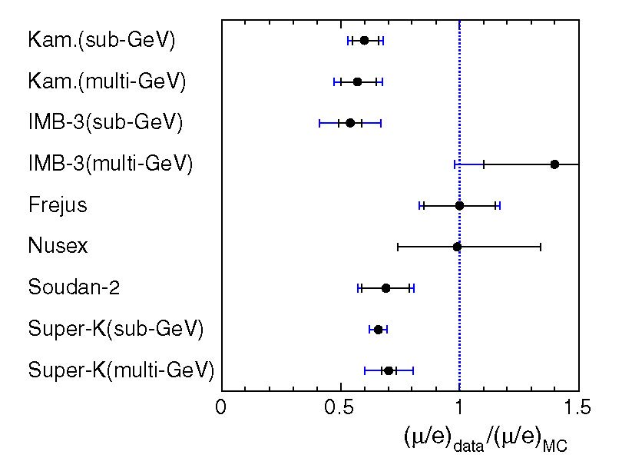
Atmospheric neutrino oscillation in early 1990s
In the first result, the statistics was poor, and the up/down asymmetry was not clear. The straightforward impression was "Number of muon neutrino events is slightly small..."
Some of other experiments reported negative results.
Kamiokande results are not widely believed.
To claim "Neutrino Oscillation”
was big and risky challenge.
If it is not true, all Kamiokande
members will loose their
confidence as high energy
physicists.
We hesitated to use word
"neutrino oscillations".
We frequently used
"muon neutrino deficit” or
"atmospheric neutrino anomaly",
instead.
From a review article "Atmospheric Neutrinos" by T. Kajita
New Journal of Physics 6, 194(2004)
(data after 1995 were deleted)
Water Cherenkov
Tracker
1989,92
1994
1992
1997
1989
1989
1999
1998
1998
24

Slide 25


Atmospheric neutrinos really oscillate??
An episode around 1992 in Kamioka.
Conversation between Prof. Y. Totsuka
and myself when drinking.
Stressful working days
in Kamioka mine.
Conversations occasionally become radical when drinking.
Next morning
Around 1992, even the spokesperson could not believe our own result.
Why we could not?
25

Slide 26
Toward confirmation of ν_{μ}-ν_{τ} oscillation
To claim neutrino oscillations, there are some problem to be solved.
First 3 suspicious points should be experimentally examined one by one. Such examinations were started after the observation of muon neutrino deficit in Kamiokande.
For the 4th point, negative results were given by all tracking type detectors. However, it was beyond what we can do.
The capability of e/μ particle identification is suspicious.
Statistics is definitely poor. Much more data is needed.
Large uncertainty of atmospheric neutrino flux.
Negative results by other experiments.
26

Slide 27
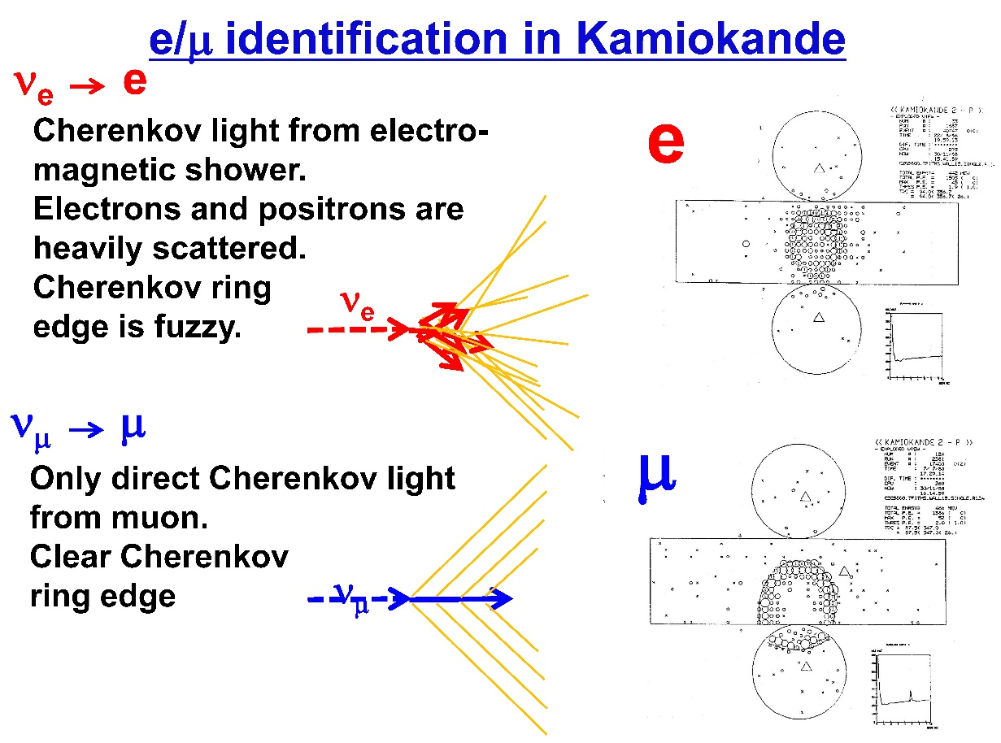
Beam Test for the e/μ identification
Only two water Cherenkov detectors, Kamiokande and IMB, claimed atmospheric muon neutrino deficit. Tracking type detectors, NUSEX and Frejus, could not find the anomaly.
Is it a problem of water Cherenkov detectors ?
The e/μ identification of water Cherenkov detector has been examined only by Monte Carlo events.
The e/μ identification
capability are certainly
critical issue to be
examined.
To verify the particle
identification capability,
a “beam test” was
planned.
E261A experiment
27

Slide 28
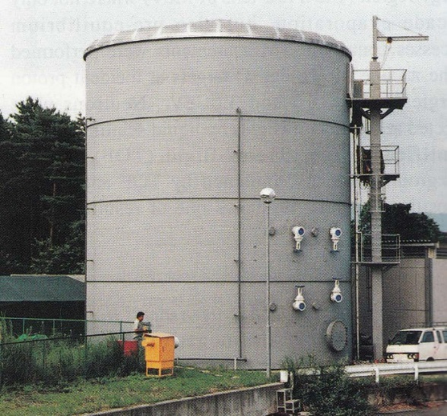
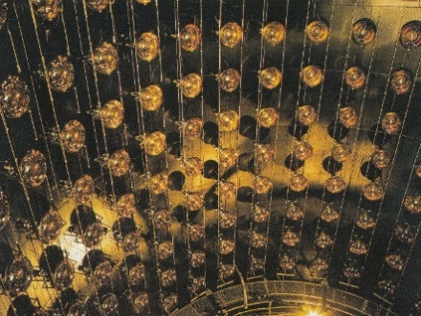
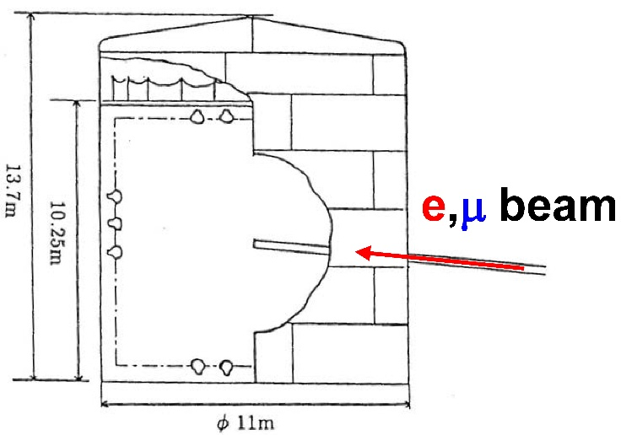


KEK Proton Synchrotron E261A (1992-1994)
1kt water Cherenkov detector was built in KEK North counter hall.
Electrons and muons from 12 GeV proton Synchrotron were injected.
Fuzzy edge for e event and clear edge for μ event are confirmed.
It was experimentally
verified that the e/μ
identification capability
is better than 99%.
e
μ
28

Slide 29


Super-Kamiokande (1996 - )
50 kt water Cherenkov detector with 11146 20-inch Φ PMTs.
The fiducial volume is 22.5 kt.
Located at 1000 m underground in Kamioka mine, Japan
Operation since April 1996.
29

Slide 30


Discovery of atmospheric neutrino oscillation
in Super-Kamiokande
At NEUTRINO 1998 Conference
in Takayama, discovery of ν_{μ}-ν_{τ}
oscillation was reported by
Prof. T. Kajita, on behalf of
Super-Kamiokande collaboration.
30

Slide 31

From “atmospheric neutrino” to “neutrino beam”
Atmospheric neutrino flux has inevitable large uncertainties.
High energy physicists strongly hope to examine neutrino oscillations using neutrino beam. Artificial neutrino beam can be controlled and the neutrino flux can be measured by physicists directly.
K2K (KEK to Kamioka) is the first long-baseline neutrino-oscillation experiment (1999-2004). Muon neutrino beam generated at KEK is shot toward the Super-Kamiokande, which is 250km away from KEK
31

Slide 32


Confirmation of neutrino oscillation by K2K
From the 6 years of beam operation, 112 neutrino events were found where the expectation is 158.1 .
The observation is considerably smaller than expectation.
A distortion of the neutrino energy spectrum which reflects energy dependence of neutrino oscillation probability was also found.
This is the first confirmation of the muon neutrino oscillation using artificial neutrino beam.
1
Neutrino Survival probability
P(ν_{μ} ν_{μ})
Δm²=3.0x10⁻³eV², sin²2θ=1.0, L=250km
+9.2
-8.6
0
0
1
2
3
4
5
E_{ν}
K2K 0.922x10²⁰ POT
data
No oscillation
Number of neutrino events
Best fit
No oscillation
(normalized to data)
M.H.Ahn et al., Phys. Rev. D74, 072003 (2006)
32
Neutrino energy (GeV)

Slide 33




MINOS experiment (2005 – 2016) followed
Long-baseline neutrino-oscillation experiment using FNAL 120 GeV Main Injector (NuMI) and far detector in Soudan Mine, 735 km away.
The far detector is a "sandwich" of iron plate of 2.54 cm thickness and scintillator of 1.00 cm thickness.
The total volume is 5.4 kton. They
are in 1.3 Tesla of magnetic field.
A 0.98 kton near detector of similar
design is also constructed in FNAL.
Soudan
735km
Fermilab
33

Slide 34

MINOS confirmed atmospheric neutrino oscillation
Both reduction of the total neutrino events and a distortion of the neutrino energy spectrum were confirmed.
This is the first completely independent confirmation of the atmospheric neutrino oscillation.
accelerator neutrino beam, not atmospheric neutrino
Scintillator + iron detector, not water Cherenkov detector
completely independent experimental group
34

Slide 35
Confirmation of ν_{μ}-ν_{τ} oscillation
To verify the evidence of ν_{μ}-ν_{τ} oscillation found in Kamiokande,
there were many problems to be solved.
ν_{μ}-ν_{τ} oscillation was perfectly verified!
They lead to the Nobel prize in physics in 2015 for Prof. T.Kajita
(Super-Kamiokande collaboration), "for the discovery of neutrino oscillations, which shows that neutrinos have mass".
The capability of e/μ particle identification is suspicious.
Statistics is definitely poor. Much more data is needed.
Large uncertainty of atmospheric neutrino flux.
Negative results by other experiments.
E261A experiment
Super-Kamiokande
K2K experiment, MINOS experiment
MINOS experiment
35

Slide 36





History of “muon neutrino deficit”
Progress in a quarter of a century is very impressive.

Slide 37
What we have learned – summary③
We found a very weak "atmospheric neutrino anomaly", which could
be an evidence of neutrino oscillations.
We recognized that it must be experimentally verified or disproved. To that end, we proposed and conducted various experiments.
From many experiments, atmospheric neutrino oscillation was successfully proved.
As the experiments progressed, the experiment groups have been extended drastically. The number of authors of the first Kamiokande paper is only 12, but 40 year later, number of authors in the T2K experiment now exceed 500.
The relentless pursuit of weak evidence of neutrino oscillations led to major success of their discovery, and the drastic expansion of the scale of the experimental group.
When you find any evidence for new physics, propose and conduct new experiments!
37

Slide 38
Thank you !
38

