Slide 1
Solar neutrino experiments
Yuichi Oyama
(KEK/J-PARC)
December 7-18 2020
Vietnam School on Neutrino (online)
1

Slide 2
History of solar neutrino physics
1938 Energy production in the Sun was proposed by H.A.Bethe (N)
1968 Solar neutrino deficit claimed by Homestake experiment (N)
1968 First calculation of solar neutrino flux by J.N.Bahcall
1985 Resonantly enhancement of solar neutrino (MSW effect) was proposed
1989 First real-time directional observation of solar neutrino by Kamiokande-II
1998 Super-Kamiokande confirmed solar neutrino deficit
1999 Gallex and SAGE confirmed solar neutrino deficit
2001 SNO confirmed solar neutrino oscillation by neutral current measurement (N)
2002 (KamLAND claimed LMA solution from reactor neutrino measurement)
2013 First indication of terrestrial matter effect by Super-Kamiokande
2014 Borexino claimed that pp, pep, ⁷Be, ⁸B solar neutrino fluxes are separately
measured by a single experiment
2020 Borexino observed solar neutrinos from CNO cycle
2

Slide 3
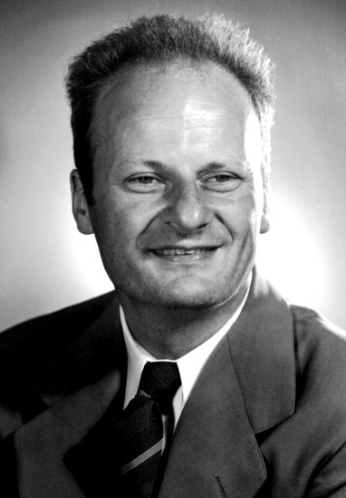
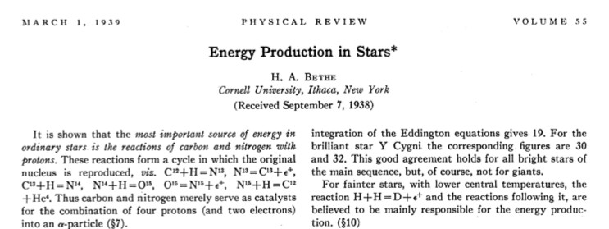
Energy production in the Sun
In 1938, Hans A. Bethe proposed that the energy production in the Sun can be explained by the fusion process. It was before the discovery of neutrinos.
“the reaction H + H = D + e⁺ and the reactions following it, are believed to be mainly responsible for the energy production.”
Helium productions by CNO cycle in heavier stars
are also discussed.
H. A. Bethe, Phys. Rev. 55, 434 (1939) , Nobel prize paper in 1967
3

Slide 4
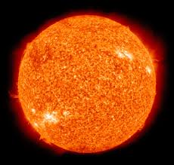
Total solar neutrino flux
The solar energy is produced by nuclear fusion.
From fusion of 4 protons, a helium nucleus
is produced.
where ΔE is ~27 MeV and is, finally, emitted
from the Sun.
The solar luminosity, L_{Sun}, is accurately
estimated from solar energy received at the Earth's surface.
Accordingly, total ν_{e} flux at the Earth can be estimated as follows.
4p -> He + 2e⁺ + 2ν_{e} + ΔE,
L_{Sun} = 3.84 x 10³³ erg/sec
(L_{sun} /ΔE)x2
Φ = = 6 x 10¹⁰cm⁻² sec⁻¹
4πd_{S-E}²
4

Slide 5
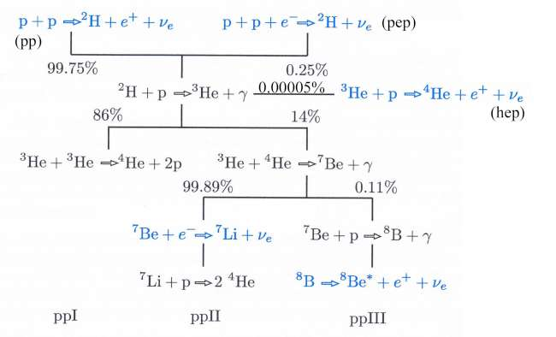
Chain reactions in the Sun
pp chain
In addition to pp chain, there are contributions from CNO cycle in which ¹²C work as catalyst for the cycle in heavier stars.
5

Slide 6
Calculation of solar neutrino flux
AGSS09 M. Asplund, N. Grevesse, A. J. Sauval and P. Scott
“The Chemical Composition of the Sun”
Annual Review of Astronomy and Astrophysics, 47, 481 (2009)
component | ν_{e} flux (x 10¹⁰ cm⁻²s ⁻¹ ) | Error (%) | Fraction (%)
pp | 6.03 | 0.6 | 92.2
pep | 0.0147 | 1.2 | 0.22
hep | 0.000000831 | 30 | 0.000013
⁷Be | 0.456 | 7 | 6.97
⁸B | 0.000459 | 14 | 0.0070
¹³N | 0.0217 | 14 | 0.33
¹⁵O | 0.0156 | 15 | 0.24
¹⁷F | 0.000340 | 17 | 0.0052
Total | 6.54 |  | 100
6

Slide 7
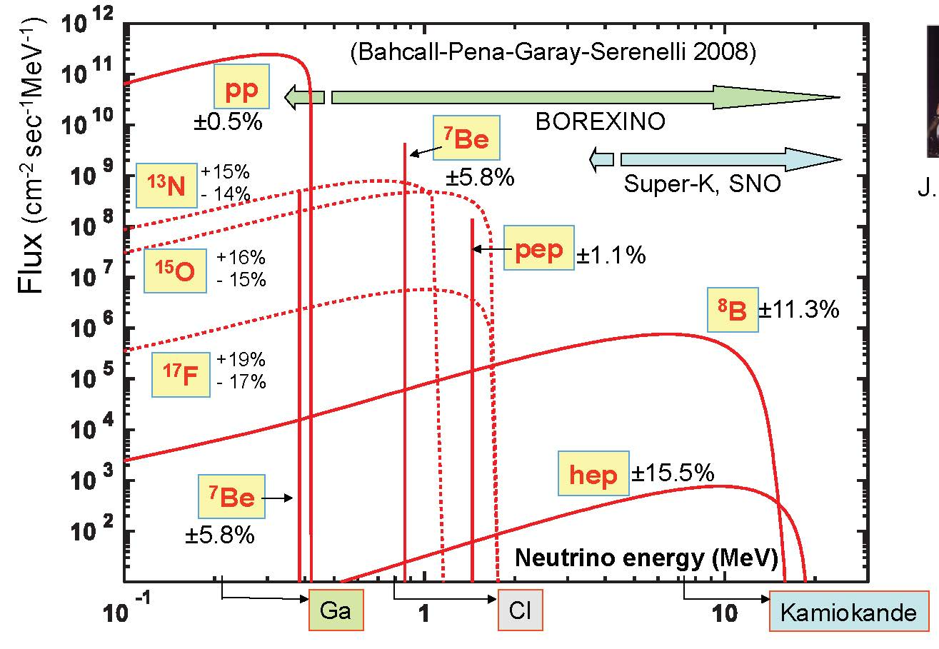
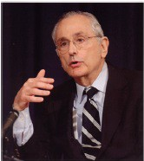

Energy spectrum of solar neutrinos
Standard Solar Model (SSM)
J. N. Bahcall
7

Slide 8
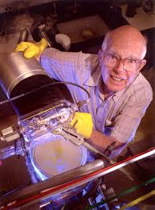
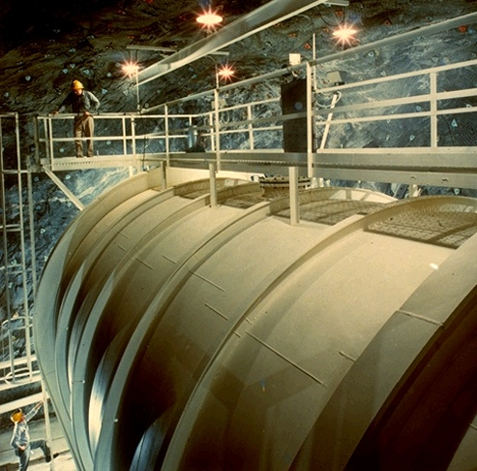
Homestake Chlorine Experiment
The pioneer solar neutrino experiment conducted by Raymond Davis Jr. The experiment started in 1967.
615 tons of fluid C₂Cl₄ are stored in a tank chamber at 1480m underground in Homestake lead mine, South Dakota.
From ³⁷Cl + ν_{e} -> ³⁷Ar + e⁻ reaction,
³⁷Ar are accumulated. The energy
threshold of the reaction is
0.814 MeV, and the production
rate is ~0.5 ³⁷Ar/day. Sensitive to
⁷Be (~14%) and ⁸B (~78%) solar
neutrinos.
³⁷Ar atoms are extracted by
bubbling helium gas through tank
every few weeks. Number of ³⁷Ar
decays (τ_{1/2} = 35 days) are counted
in a low-background environment.
R. Davis Jr.
8
9

Slide 9
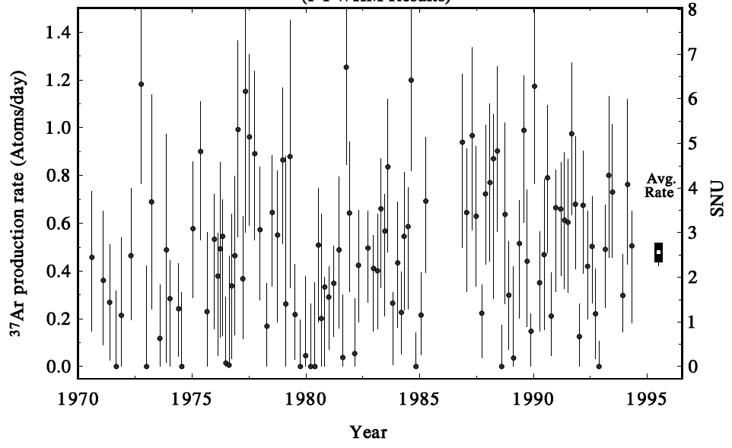
Results from Homestake experiment
The number of solar neutrino events measured by Homestake experiment is about 1/3 of the Standard Solar Model prediction.
The first result was published in 1968. R. Davis et al., Phys. Rev. Lett. 20, 1205(1968)
It was an evidence of neutrino oscillation, but it
was not widely believed.
~25 years of data
2200 solar neutrinos
Standard Solar Model expectation
(1 SNU is 10⁻³⁶ captures per
target atom per second)
Kamiokande started solar neutrino observation
9

Slide 10
Solar neutrino oscillation?
Homestake experiment claimed solar neutrino deficit for over 15 years. However, we did not consider the result seriously until middle of 1980s.
SSM calculation
Total neutrino flux seems to be certainly robust.
It can be directly evaluated from the solar luminosity.
However, Homestake experiment does not measure pp neutrino.
Other neutrino components are small fractions and not robust.
It strongly depend on core temperature, chemical composition,
cross sections, opacity of the Sun, etc.
Homestake experiment
Experiments in ~1MeV energy range are not territory of high energy physicists. Neutrino oscillation is territory of high energy physics.
Radiochemical method is not common technology for high energy physicists. R. Davis Jr. was not a physicist, but a chemist.
We cannot believe the calculation !
We cannot imagine the experiment !
No experiment followed Homestake.
10

Slide 11
In 1980s
In the middle of 1980s, there were two big progress in the solar neutrino physics.
In 1985, resonant enhancement of neutrino oscillation from the core of the Sun was predicted. It is known as MSW effect.
Kamiokande experiment started an upgrade of the detector to observe solar neutrinos in 1984. The detection of solar neutrinos was succeeded in 1989.
11

Slide 12
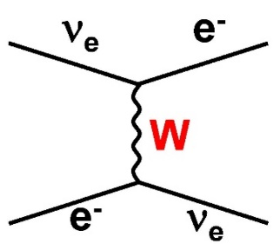
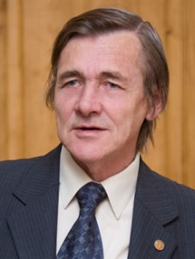
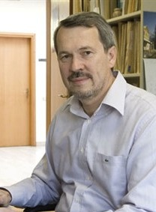
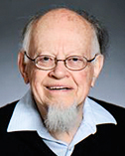
MSW effect
L. Wolfenstein in 1978
When electron neutrinos travels in matter, they seem
to have additional mass. It is due to charged-current
forward-scattering with electrons in matter.
It is analogy of light in medium. Speed of light in
medium is slower than speed of light in vacuum.
It is due to forward scattering of light by medium.
It seems that light have mass.
charged current
forward scattering
S. Mikheyev
A. Smirnov
L. Wolfenstein
12

Slide 13
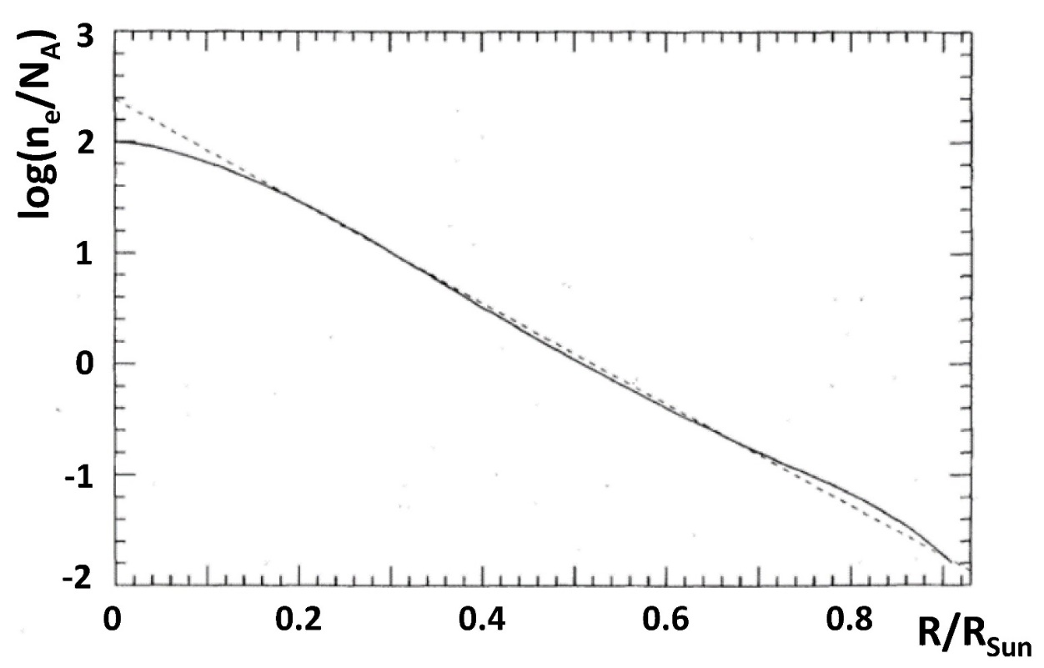
In the Sun……
A.Smirnov and S.Mikheyev in 1985
In the core of the Sun, matter density is high and electron neutrinos have large additional masses. Electron neutrinos may have larger mass than muon neutrinos.
When solar neutrinos travel away from the Sun, matter density is small. Electron neutrinos have smaller masses than muon neutrinos.
Because of the change of the masses, neutrino mixing can be resonantly enhanced when the mass levels are inverted.
electron density in the Sun
Neutrino mixing can be resonantly enhanced around here
Core
Outside
13

Slide 14
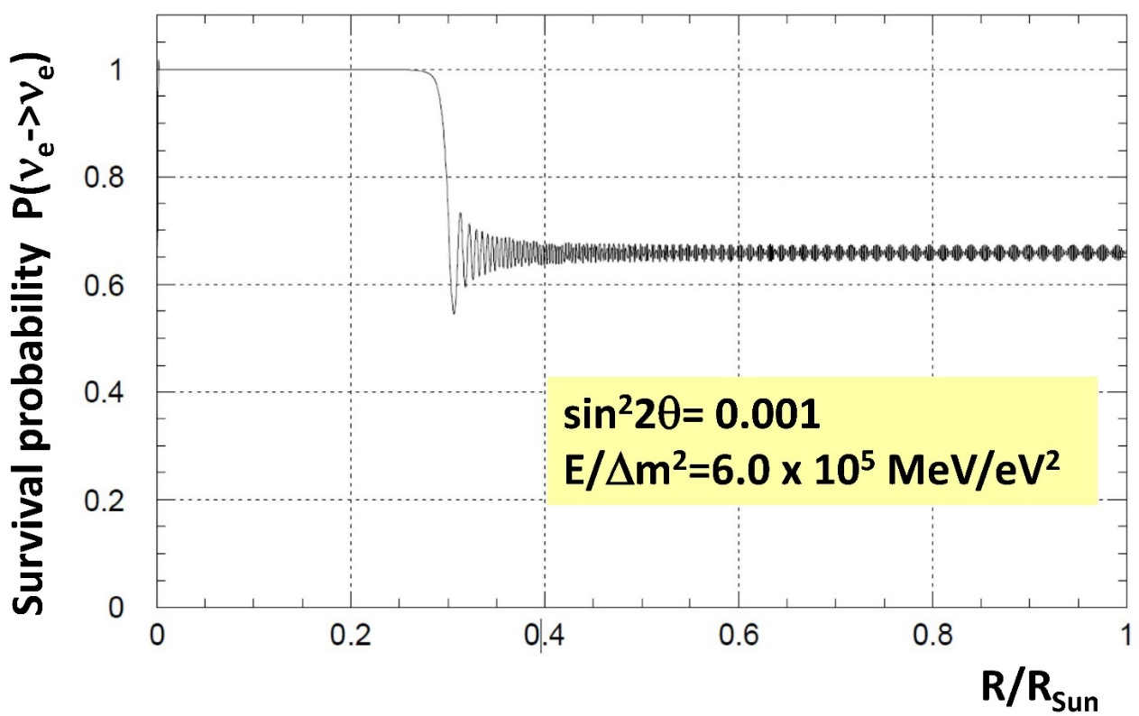
An example of matter oscillation in the Sun
Very small mixing angle is assumed, and the survival probability of electron neutrinos is simulated.
Although the mixing angle is sin²2θ=0.001, about 35% of electron neutrinos convert to other flavors.
MSW effect shed light on “neutrino oscillations as a solution
for solar neutrino problem”
14

Slide 15
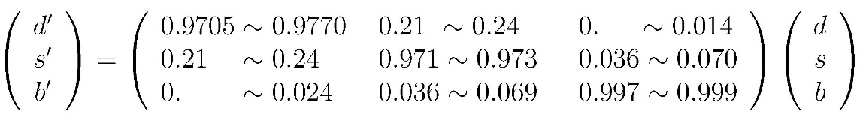
Why the MSW effect is so attractive…..
In the quark sector, the relation between the mass eigenstate and the flavor eigenstate was written with Kobayashi-Maskawa matrix.
The mixing angles are very small, and d’~d, s’~s and b’~b.
In the lepton sector, there were strong prejudice that the mixing angles must be also small from an analogy of the quark sector.
About ~2/3 reduction of solar neutrino flux by neutrino oscillation cannot be believed.
The MSW effect suggested that even if the true mixing angle is small, large flavor mixing can occur when resonant condition is satisfied.
Numbers from
Particle data
book 1984
Mass eigenstate
Flavor eigenstate
15

Slide 16
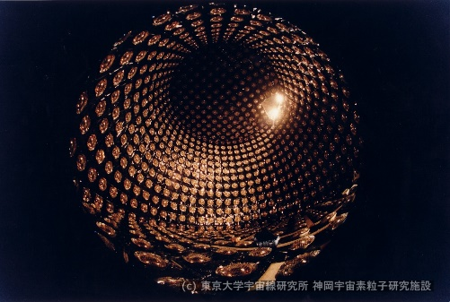
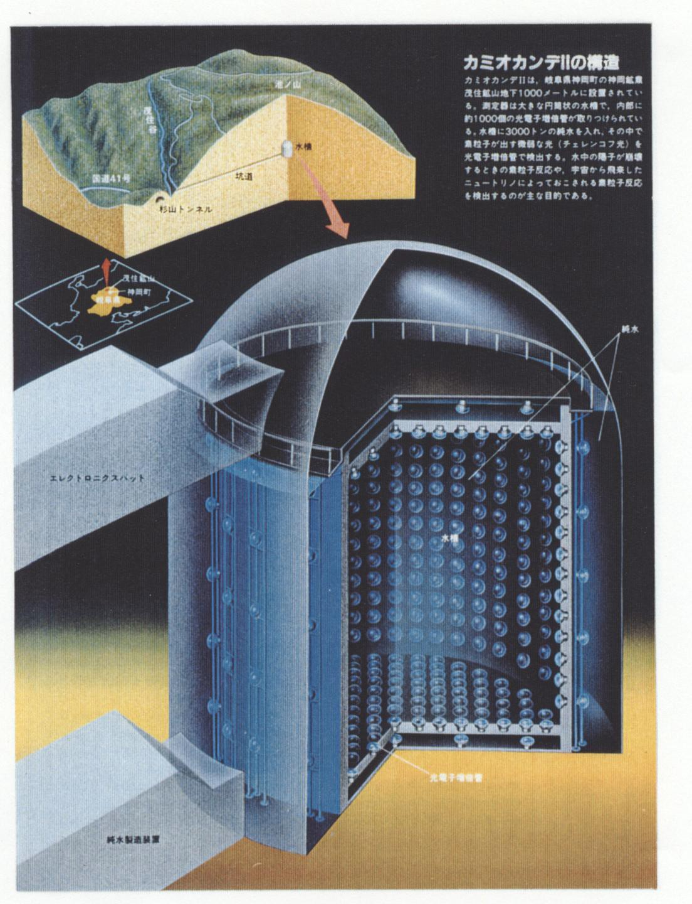
Kamiokande(1983-1996)
A large water Cherenkov detector constructed at 1000 m
(2400 meter water equivalent) underground in Kamioka mine, Japan.
3000 tons of pure water are viewed by 1000 20-inchΦ PMTs.
16

Slide 17
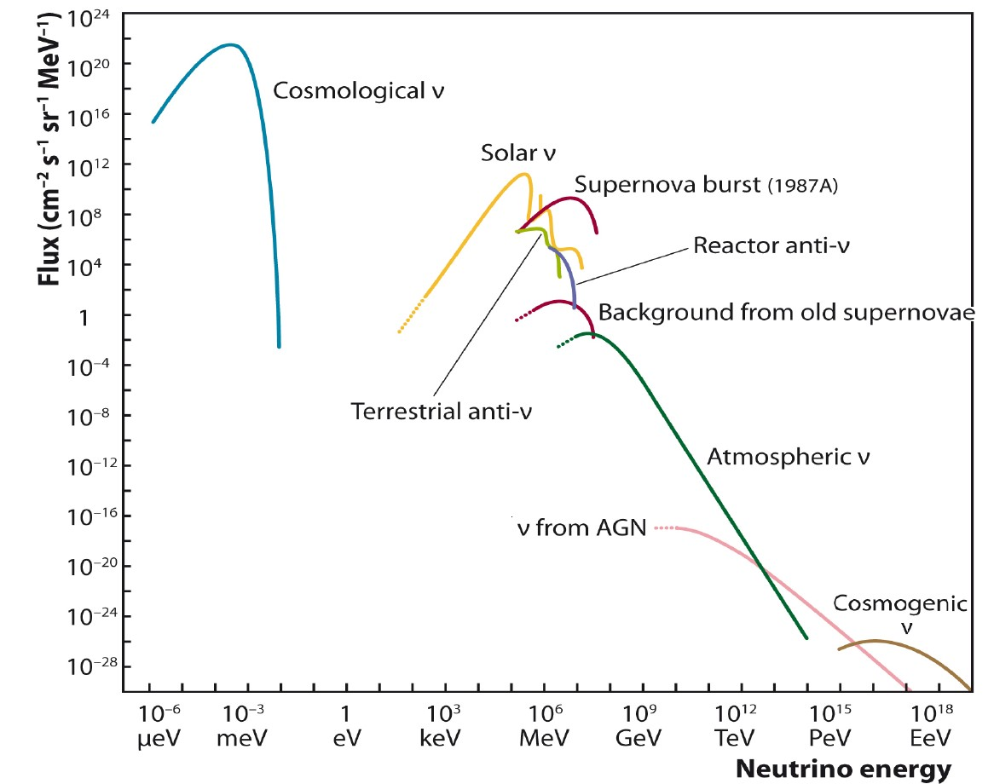
“Kamioka Nucleon Decay Experiment” to
“Kamioka Neutrino Detection Experiment”
After successful exclusions of most of Grand Unified Theories…..,
main subjects became Solar Neutrinos and Atmospheric Neutrinos.
Sources of Neutrinos
http://arxiv.org/abs/1207.4952
17

Slide 18
Solar neutrino and Atmospheric neutrino
Solar Neutrino
E~10 MeV energy range. (“Low energy” in Kamioka terminology)
Energies of supernova neutrinos are also in this range.
Reactor neutrinos have slightly smaller energy.
ν_{e}-ν_{μ} oscillation was studied with these neutrinos.
Atmospheric neutrino
E~1 GeV energy range. (“ATMPD” in Kamioka terminology)
Accelerator neutrino beam have similar energies.
Nucleon decays are also in this energy range (if exist).
ν_{μ}-ν_{τ} oscillation was studied using neutrinos in this energy range
18

Slide 19
Kamiokande-II
When Kamiokande experiment started, the trigger threshold of the detector was ~29 MeV. This threshold was low enough to detect nucleon decay mode p->νK⁺(μ⁺ν), which records the smallest energy deposit in the detector.
To detector ⁸B solar neutrinos, the trigger threshold of the detector should be reduced to be around ~8 MeV.
In addition to the trigger threshold, background events in the low energy range should be reduced.
From fall 1984 to end of 1986, many detector upgrade to observe
⁸B solar neutrinos were done. They are:
After these upgrade, namely, Kamiokande-II started in early 1987.
Removal of radioactive sources in water
Construction of anticounter
Installation of New electronics
19

Slide 20


Solar neutrinos in water Cherenkov detector
In water Cherenkov detector, only
⁸B neutrinos whose nominal energy is
~8 MeV can be detected.
Elastic scattering between neutrinos
and orbital electrons are employed.
Recoil electrons keep energy and
directional information of initial neutrinos
Interactions with hydrogen and oxygen
nuclei do not occur because the energy
of solar neutrinos are too low.
ν_{e} + e -> ν_{e} + e
e
θ
20

Slide 21
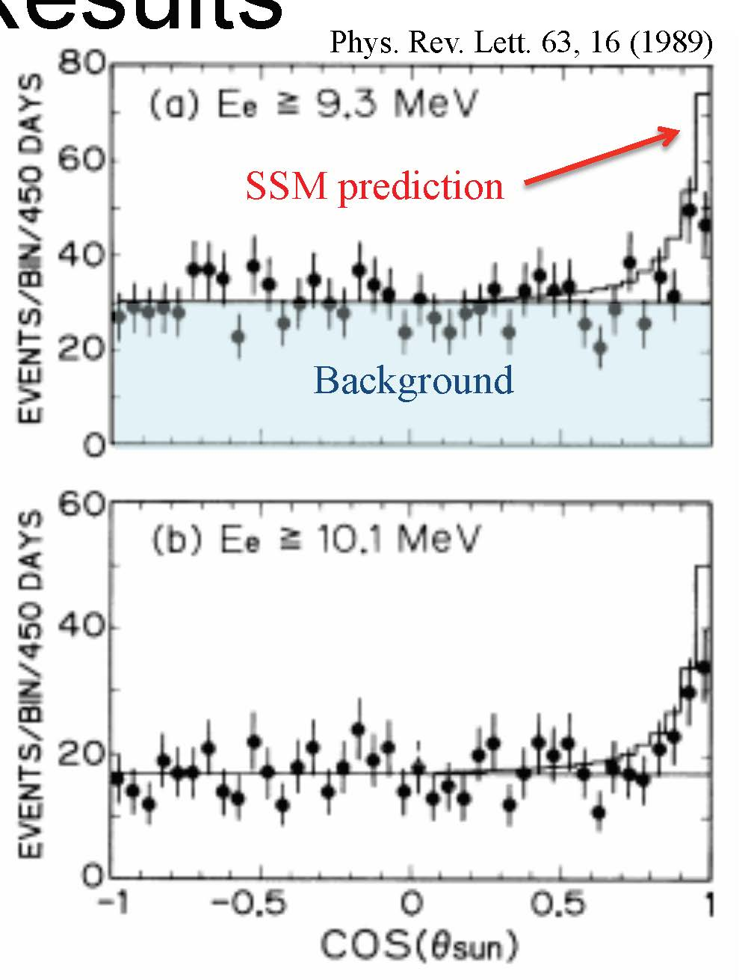
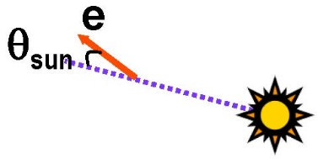
Observation of solar neutrinos in Kamiokande-II
Based on 450 days of data, the first real-time, directional neutrino signal from the direction of the Sun was found.
The observed neutrino flux is
0.46 ± 0.13(stat.) ± 0.08(sys.)
of SSM prediction.
The observation is certainly smaller than the SSM prediction. However, the discrepancy is
not consistent with Homestake.
Homestake : ~ 1/3 of SSM
Kamiokande-II : ~ 1/2 of SSM
After Kamiokande-II observation, measurements with different energy threshold became key issue for other new experiments.
K.S.Hirata et al., Phys. Rev. Lett. 63, 16(1989)
Background
21

Slide 22
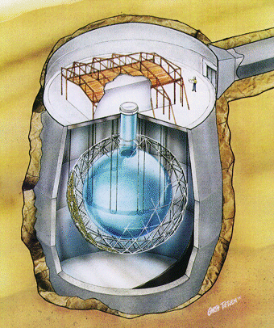
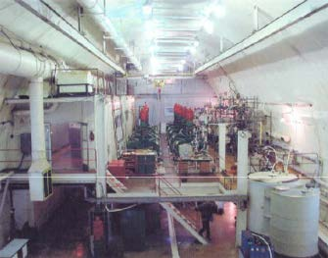
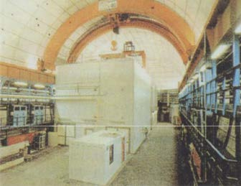
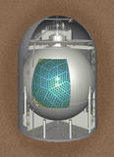
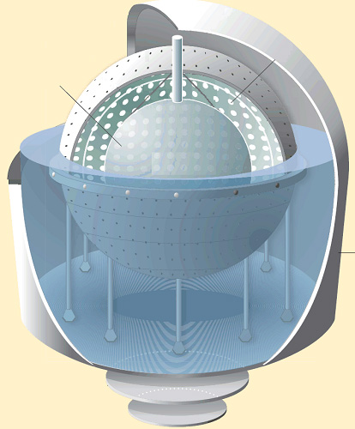
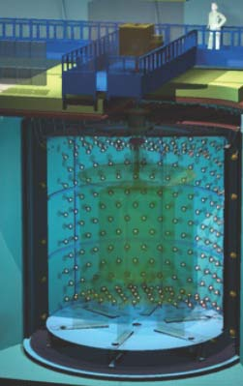
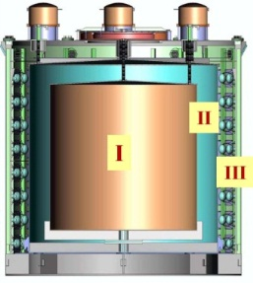
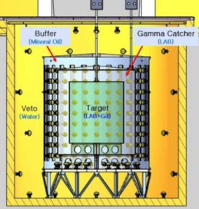
Solar neutrino/Reactor neutrino experiments
Solar neutrino observation became an active research subject, and many solar/reactor experiments followed.
Super-Kamiokande
SNO
SAGE
Gallex/GNO
KamLAND
Borexino
Double Chooz
Daya Bay
RENO
22

Slide 23
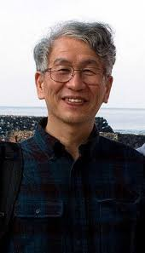
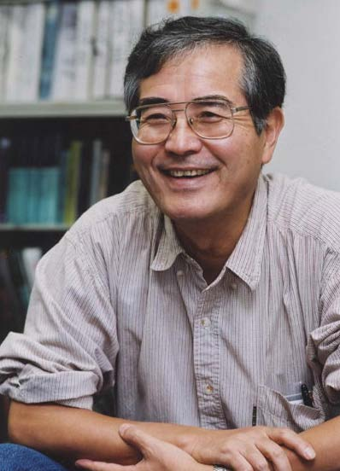
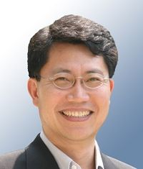
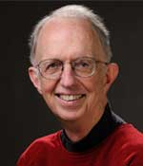
Solar neutrino/Reactor neutrino experiments
Kamiokande-II became a historical prototype for some of other solar/reactor neutrino detectors. Radioactivity-free-liquid (water, heavy water or liquid scintillator) are target materials. They are stored in a large tank and viewed by large diameter PMTs. The inner detector is surrounded by 4π anticounter.
Members of Kamiokande-II became leaders in other experiments:
- Spokespersons of Super-Kamiokande, KamLAND and Reno were
members of Kamiokande-II.
- University of Pennsylvania group joined SNO experiment and designed the
SNO electronics. The co-spokesperson of the SNO experiment was a
member of Kamiokande-II.
Y.Totsuka/
Super-Kamiokande
A.Suzuki/
KamLAND
S.B.Kim/
Reno
E.W.Beier/
SNO
23

Slide 24

In 1990s
Around the end of 1990s, three experiments reported the solar neutrino deficit.
In 1998, Super-Kamiokande
confirmed the ⁸B solar neutrino
deficit with high statistics.
In 1999, two gallium experiments
Gallex and SAGE reported solar
neutrino deficit at lower energy
threshold.
24

Slide 25
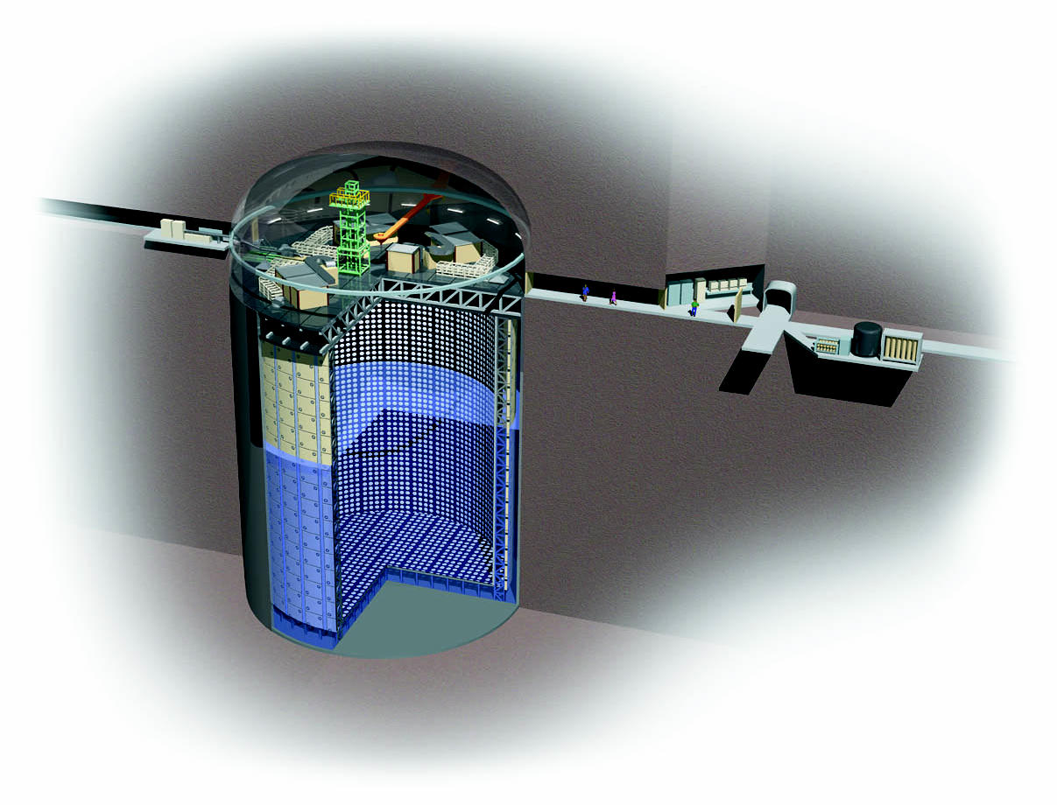
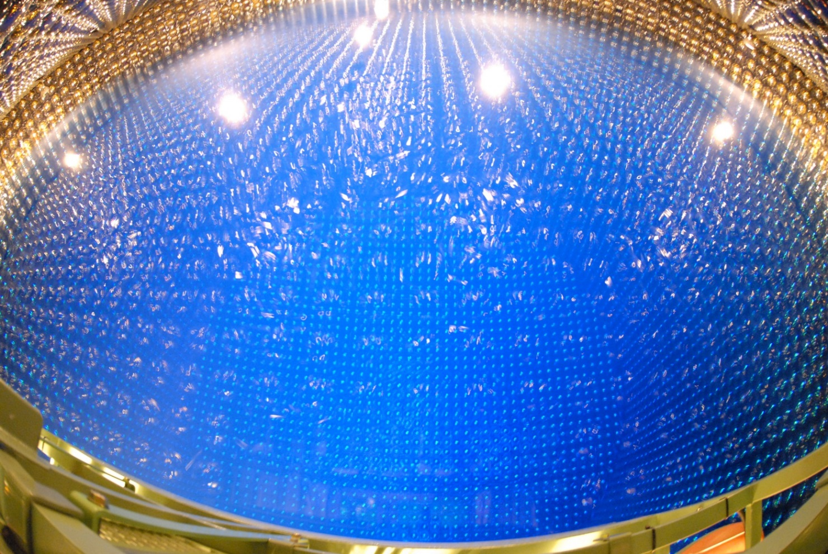
Super-Kamiokande (1996 - )
50 kt water Cherenkov detector with 11146 20-inch Φ PMTs.
The fiducial volume is 22.5 kt.
Located at 1000 m underground in Kamioka mine, Japan
Operation since April 1996.
25

Slide 26
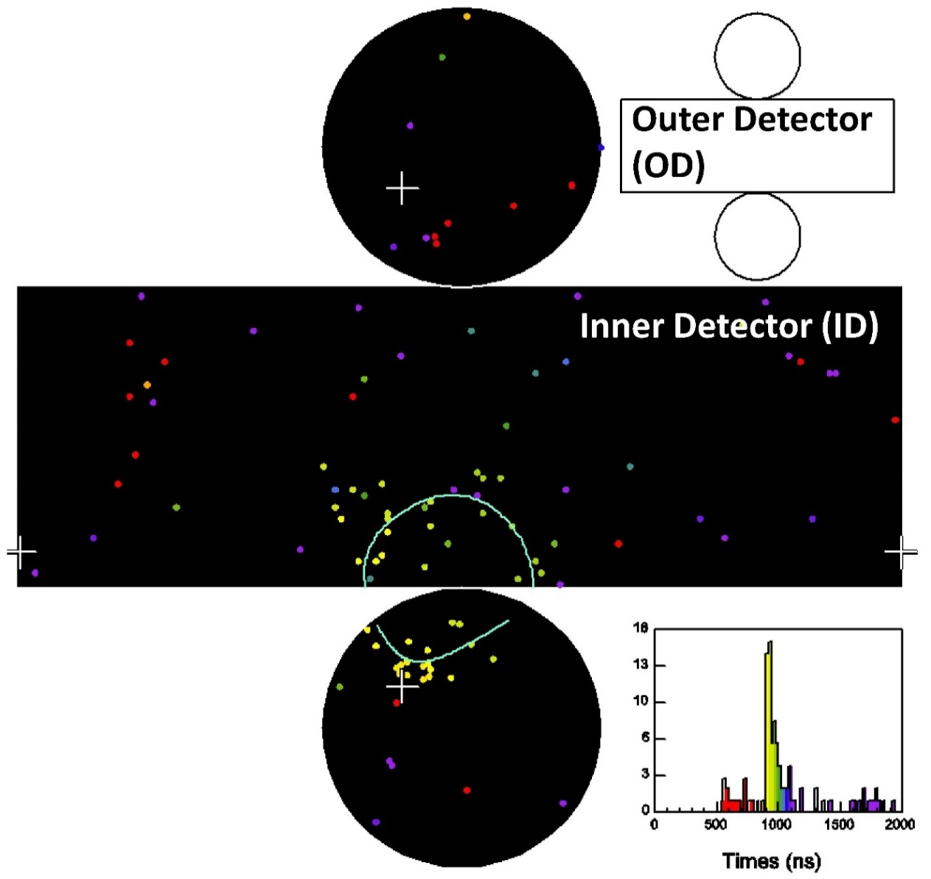
Typical Low energy event in Super-Kamiokande
The vertex position is obtained
from the timing information
of PMTs, which is shown by
the color in the display.
The vertex resolution is
87cm for 10 MeV electron.
The electron travel
direction can be calculated
from the ring pattern.
The angular resolution is
26º for 10 MeV electron
The electron energy is calculated
from number of hit PMTs.
The number of hit PMT is
~6 hits/MeV. The energy resolution
for 10 MeV electron is 14%.
26

Slide 27
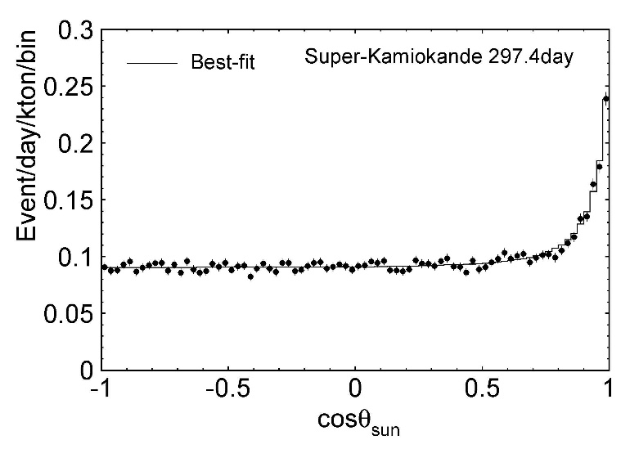
The first result from Super-Kamiokande
The first result on solar
neutrino was published
in 1998.
The analysis was based
on 297.4 days data from
May 1996 to June 1997.
Angular correlation between
low energy events and the
solar direction was plotted.
Clear excess from the Sun
was found.
Number of excess events was 4017±105 (stat) (syst) in
energy range between 6.5 MeV and 20 MeV.
It corresponds to ~13.5 events/day.
The solar neutrino signal was certainly smaller than the Standard Solar Model (SSM) prediction, and consistent with Kamiokande.
Y.Fukuda et al., Phys. Rev. Lett. 81, 1158(1998)
+161
-116
+0.009
+0.014
Data/SSM = 0.358 (stat) (syst)
-0.008
-0.010
27

Slide 28
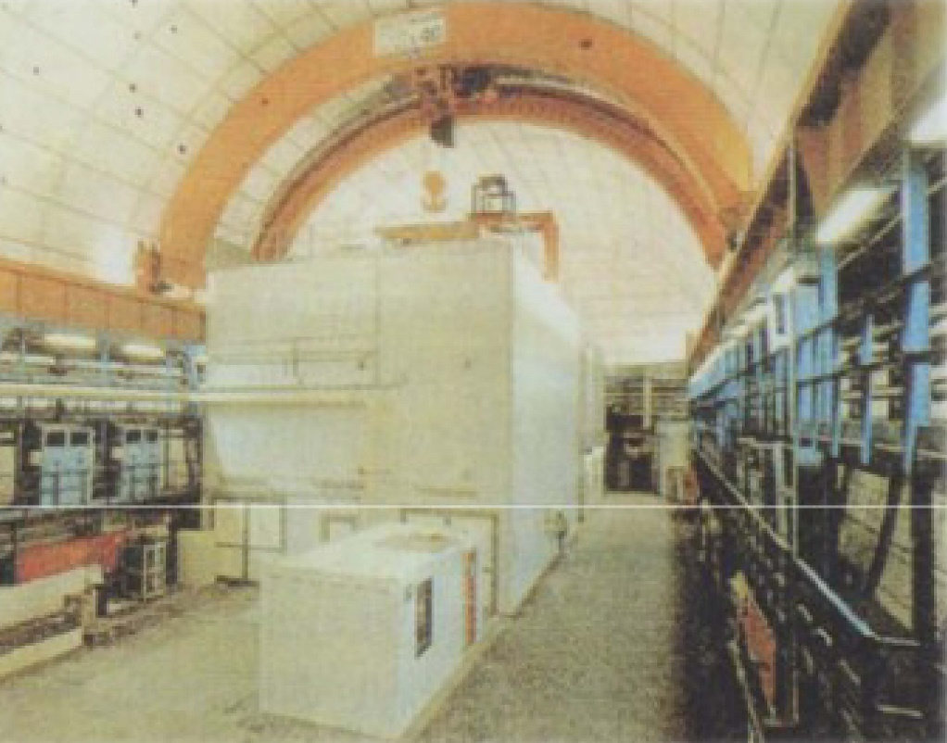
Gallex (1991-1997) and GNO (1998-2003)
Gallex is a radio-chemical experiment using 30.3 tons of ⁷¹Ga in GaCl₃. It is located at 3400 m.w.e. underground Laboratori Nazionali del Gran Sasso, Italy. In 1998, the total ⁷¹Ga was increased to 100 tons, and the experiment was renamed to GNO.
From an inverse β-decay
⁷¹Ga + ν_{e} -> ⁷¹Ge + e⁻ reaction,
⁷¹Ge is generated and is
extracted every ~20 days.
⁷¹Ge decay through electron
capture with τ_{1/2} =11.43 days.
This decay is measured by
proportional counters.
The energy threshold for the
inverse β-decay reaction is
0.233 MeV. The measurement
is sensitive to all solar neutrinos
including pp neutrinos.
28

Slide 29
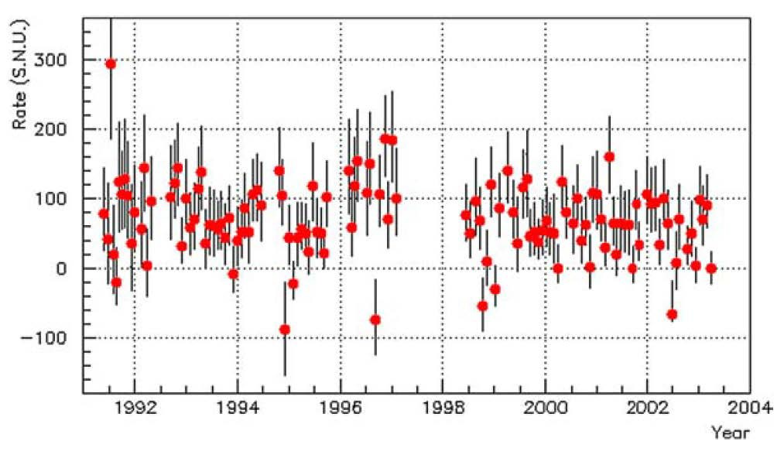
Gallex/GNO results
The averaged neutrino capture rate in the Gallex period is
The capture rate in the GNO period is
The average of Gallex and GNO is significantly smaller than SSM.
+4.3
(77.5±6.2(stat) (syst)) SNU (May 1991-Jan.1997)
-4.7
W.Hampel et al.,
Phys.Lett. B447, 127 (1999)
+5.5
(62.9 (stat)±2.5(syst)) SNU (May 1998-Apr.2003)
-5.3
M. Altmann et al.,
Phys.Lett. B616, 174(2005)
GALLEX
GNO
The SSM expectation
is 129 SNU.
BP98: J. N. Bahcall et al.,
Phys. Lett. B433, 1 (1998)
(69.3±5.5(stat+syst)) SNU (May 1991-Apr.2003)
29

Slide 30
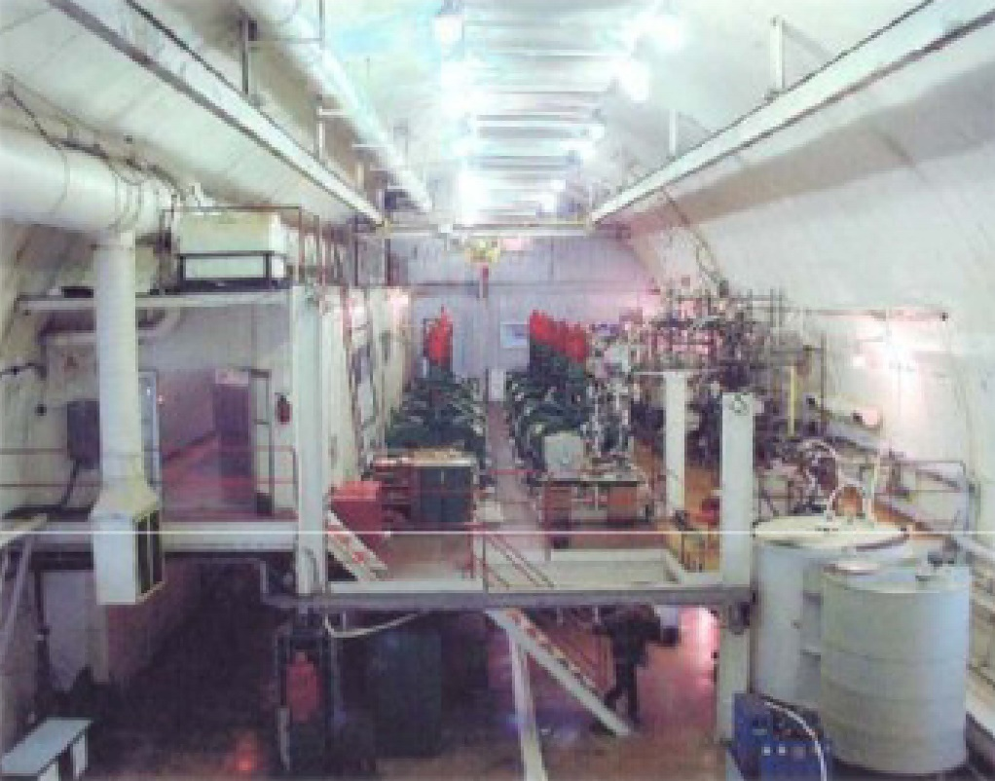
SAGE (1990- )
SAGE (Soviet-American Gallium Experiment) is a Radio-chemical experiment using 57 tons of liquid metallic gallium. It is located in Baksan Neutrino Observatory at 4700 m.w.e in Caucasus, Russia.
From an inverse β-decay ⁷¹Ga + ν_{e} -> ⁷¹Ge + e⁻ reaction, ⁷¹Ge is generated and is extracted from ⁷¹Ga every ~27 days.
⁷¹Ge decay through electron
capture with τ_{1/2} =11.43 days.
This decay is measured by
proportional counters.
The energy threshold for the
inverse β-decay reaction is
0.233 MeV. The measurement
is sensitive to all solar
neutrinos including
pp neutrinos.
Those detection method is almost same as Gallex/GNO.
30

Slide 31
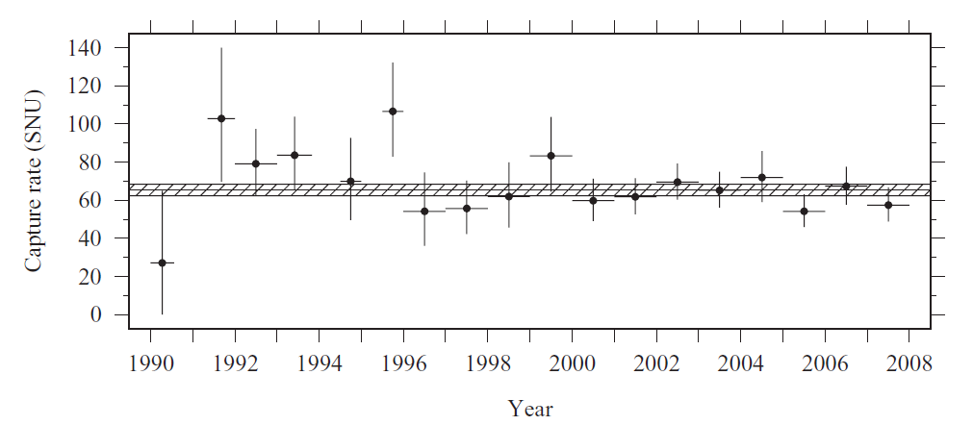
SAGE results
The first result was published in 1999.
The neutrino capture rate was measured to be
An updated result was published in 2009. The solar neutrino rate was constant during the entire period. The averaged rate was
The standard solar model (SSM) expectation
is 129 SNU (BP98). The data is 52~53% of the
standard solar model prediction.
J. N. Abdurashitov et al.,
Phys. Rev. C 60, 055801 (1999)
+7.2
+3.5
(67.2 (stat) (syst)) SNU (Jan.1990-Dec.1997)
-7.0
-3.0
+3.1
+2.6
(65.4 (stat) (syst)) SNU (Jan.1990-Dec.2007)
-3.0
-2.8
J. N. Abdurashitov et al.,
Phys. Rev. C 90, 015807 (2009)
BP98: J. N. Bahcall et al.,
Phys. Lett. B433, 1 (1998)
31

Slide 32
Summary of solar neutrino experiments before 2000
By the end of 20th century, 5 experiments with 3 different energy thresholds had successfully measured solar neutrino flux.
All experiments found that their measurements are smaller than the SSM expectations. However, the ratio to the SSM depend on experiments.
Experiment | Reactions and threshold | Neutrino sources | Results (Ratio to the SSM)
Homestake (1967-1995) | ν_{e} + ³⁷Cl -> e⁺ + ³⁷Ar 0.814MeV | ⁷Be(~14%), ⁸B(~78%) | 0.275±0.017±0.017 (BP95) Ap.J. 496, 505(1998)
Kamiokande (1983-1996) | ν_{e} + e⁻ -> ν_{e} + e⁻ ~7 MeV | ⁸B(> 99%) | 0.492 ±0.058 (BP92) Phys.Rev.Lett. 77, 1683(1996)
Super-K (1996-) | ν_{e} + e⁻ -> ν_{e} + e⁻ ~6.5 MeV | ⁸B(> 99%) | 0.358 (BP95) Phys.Rev.Lett. 81, 1158(1998)
GALLEX (1991-1997) | ν_{e} + ⁷¹Ga -> e⁻ + ⁷¹Ge 0.233MeV | pp(~53%), ⁷Be(~27%), ⁸B(~11%) | 0.601±0.048 (BP98) Phys.Lett. B447, 127(1999)
SAGE (1990-) | ν_{e} + ⁷¹Ga -> e⁻ + ⁷¹Ge 0.233MeV | pp(~53%), ⁷Be(~27%), ⁸B(~11%) | 0.521 (BP98) Phys.Rev.C60, 055801(1999)
+0.034
-0.033
+0.009
+0.014
-0.008
-0.010
+0.033
-0.036
+0.056
+0.027
-0.054
-0.023
32

Slide 33
Around end of 1990s…….
Around the end of 1990s, there was another big change.
It was our mind about neutrino oscillation.
In 1998, atmospheric neutrino oscillation was established by
Super-Kamiokande. After that all experiments are aggressive to affirm atmospheric neutrino oscillations.
This optimism extended to solar neutrinos. No experiment hesitate to claim their solar neutrino deficits. As soon as any deficit was found, neutrino oscillation was claimed and constraints on the oscillation parameters were discussed.
Experiments which claimed neutrino oscillations around end of 1990s
Experiment | Laboratory | Neutrino Source | Start | Confirm Neutrino Oscillation
MACRO | Gran Sasso, Italy | atmospheric | 1989 | Jun. 1998
Soudan-2 | Soudan, U.S.A | atmospheric | 1989 | Jan. 1999
Gallex | Gran Sasso, Italy | solar | 1991 | Oct. 1998
SAGE | Baksan, Russia | Solar | 1990 | Apr. 1999
33

Slide 34
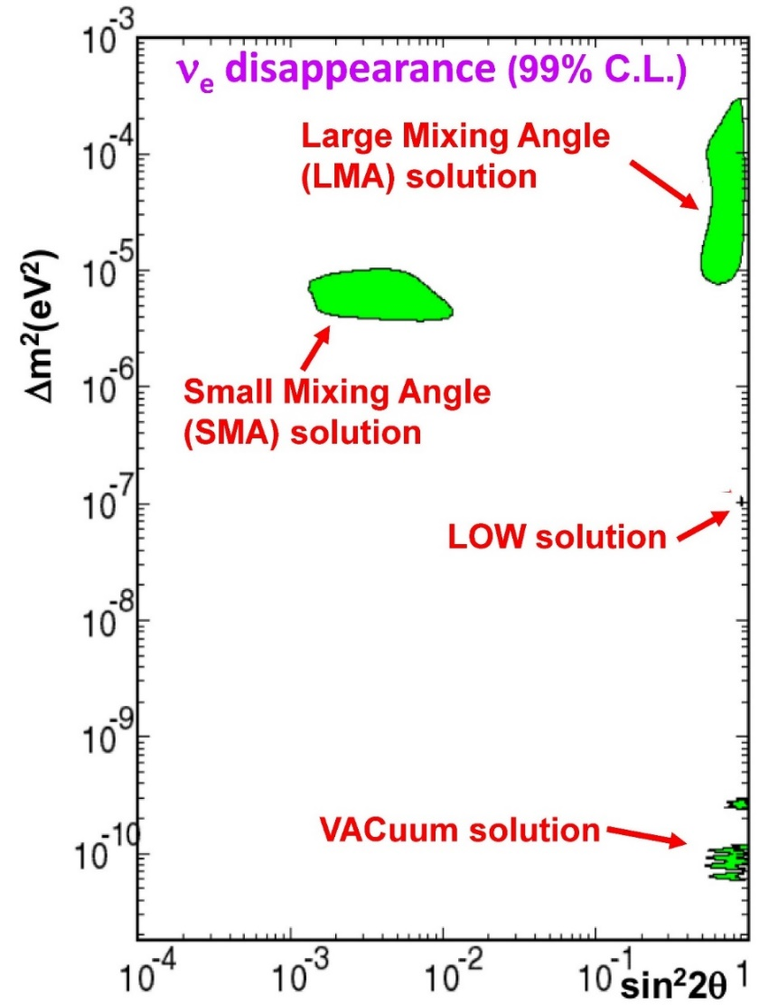
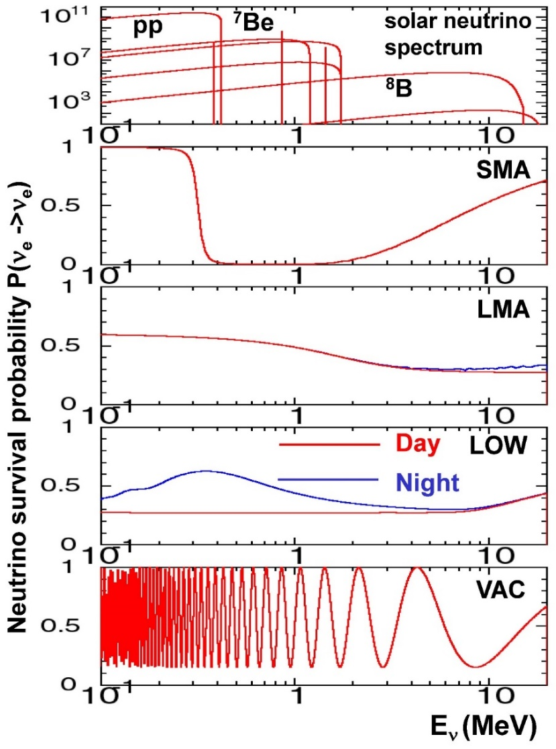
Constraints on Δm² – sin²2θ plane
Constraints on oscillation parameter regions was calculated based on solar neutrino deficits. Four regions remain as possible solutions.
"Energy spectrum" and “Day-Night asymmetry" became key issue.
34

Slide 35

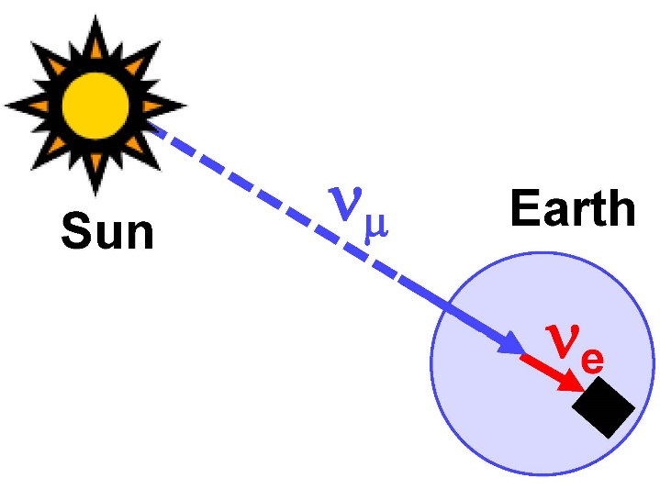
Day-Night asymmetry
Muon neutrinos may generate from electron neutrinos by neutrino oscillation in the core of the Sun. They also travel from the Sun to the Earth.
They may oscillate back to electron neutrinos again by matter effect in the Earth, since the matter density in the Earth (ρ=5~13 g/cm³) is not negligibly small.
Such regeneration might be detected
as Day-Night asymmetry or
zenith angle distribution of solar
neutrino flux.
35

Slide 36
In 2000s
Around end of 20th century, 2 large experiments were under construction. First results were reported in early 21st century.
In 2001, SNO confirmed solar neutrino oscillation by observation of neutral current measurement.
In 2002, KamLAND found that LMA solution is the answer for the solar neutrino deficit.
KamLAND is not a solar neutrino experiment but a reactor neutrino experiment. However, it is closely related to the electron neutrino oscillation, and is mentioned briefly.
Details was already presented by Matsubara-san yesterday.
36

Slide 37

SNO (1999-2006)
SNO (Sudbury Neutrino Observatory) is a heavy water (D₂O)
Cherenkov detector located in 6010 m.w.e. underground in Sudbury, Ontario, Canada.
In the 12.01 m diameter transparent
acrylic vessel, 1000 tons of D₂O are
stored.
The acrylic vessel is surrounded by
1700 tons of H₂O layer in the inner
vessel.
The inner D₂O volume are viewed by
9456 8-inch PMTs, supported by a
17.8 m diameter stainless steel
structure. The photo coverage is 60%.
The inner vessel is surrounded by
5300 tons of H₂O layer as an outer
shielding.
37

Slide 38
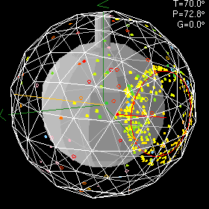
An example of the SNO event
The vertex position and the travel direction of the particle are
calculated from the timing/charge information of the hit PMTs .
The reconstruction accuracy and resolution are measured using Compton electrons from the ¹⁶N calibration source
(predominantly 6.13 MeV γ’s).
At these energies, the vertex resolution is 16 cm and the
angular resolution is 26.7º.
Number of hit PMT is
~9 hits/MeV, and the energy
resolution for 5 MeV electron is 16%.
38

Slide 39
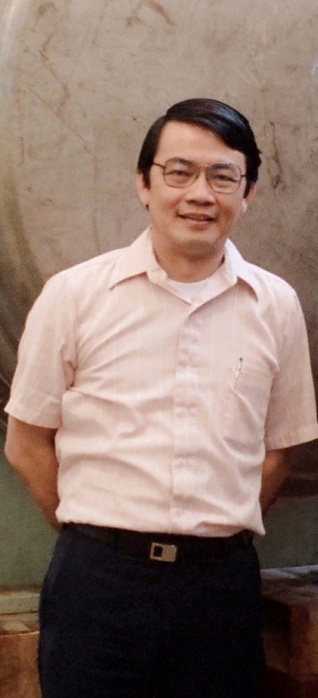
D₂O water Cherenkov detector
Heavy water Cherenkov detector was proposed by
Herbert H. Chen in 1985.
"Direct Approach to Resolve the Solar-Neutrino Problem”
Herbert H. Chen, Phys. Rev. Lett.55,1534 (1985)
SNO group could start the experiment by borrowing 1000 ton D₂O
from Atomic Energy of Canada Limited, a Canadian government-owned company. The market price of the 1000 ton D₂O was 330M C$
or 230M US$, but they did not pay any charge.
Unfortunately, Chen passed away by leukemia at age 45 in 1987. However, his name can be found in the author list of the Nobel prize papers of the SNO experiment published in 21st century.
A direct approach to resolve the solar-neutrino problem would be to observe neutrinos by use of both neutral-current and charged-current reactions. Then, the total neutrino flux and the electron-neutrino flux would be separately determined to provide independent tests of the neutrino-oscillation hypothesis and the standard solar model. A large heavy-water Cherenkov detector, sensitive to neutrinos from ⁸B decay via the neutral-current reaction ν + d -> ν + p + n and the charged-current reaction
ν + d -> e + p + p, is suggested for this purpose.
Herbert H. Chen
(1942-1987)
39

Slide 40
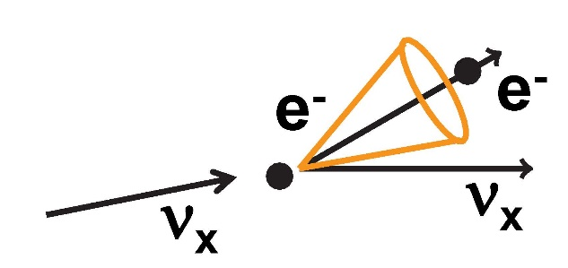


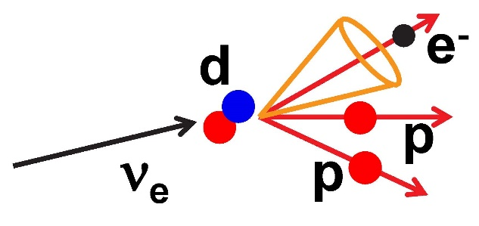
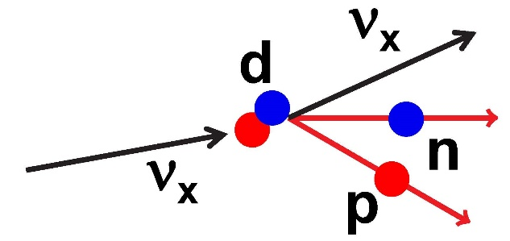

Neutrino interactions with D₂O
ES (Elastic Scattering)
-Same as H₂O
-Mainly sensitive to CC interaction of ν_{e}
-~1/6 cross section for NC of all neutrinos
-Low statistics but strong forward peak
CC (Charged Current)
-Sensitive only to ν_{e}
-Energy threshold is 1.442 MeV
-Angular distribution of e ∝ (1–1/3cosθ)
-No neutron produced.
NC (Neutral Current)
-Equal cross section for all neutrino types
-Total ⁸B neutrino flux can be measured
-Energy threshold is 2.22 MeV
-Neutron capture is a key issue
40

Slide 41

Neutron capture in SNO
To identify ν + d -> ν + p + n reaction, detection of the neutron is important. Three different neutron detections were employed in 3 SNO phases
Phase-I (pure D2O phase), Nov.1999- May 2001 (306 days)
-Neutron captured on deuteron and single 6.25MeV γ is produced
Phase-II (salt phase), Jul.2001- Sep 2003 (391 days)
-2 tons of NaCl was added in D₂O, and neutrons are captured by ³⁵Cl.
-Neutron capture rate was increased by factor more than 3.
Phase-III (³He counter phase), Nov.2004- Nov. 2006 (385 days)
-36 ³He neutron counters were installed in pure D₂O.
-Different neutron detection method provides excellent cross check.
Q.R.Ahmad et al.,
Phys.Rev.Lett. 89, 011301(2002)
S. N. Ahmed et al.,
Phys.Rev.Lett. 92,181301(2004)
B. Aharmim et al.,
Phys.Rev.Lett,101, 111301(2008)
41

Slide 42
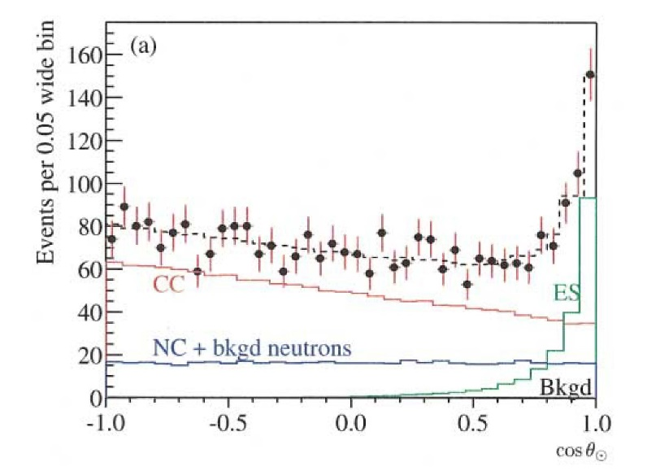
SNO results (pure D₂O phase)
SNO pure D₂O phase, 306.4 days data (Nov. 1999 – May 2001).
The ⁸B neutrino fluxes measured with each reactions are
Difference between Φ_{NC} and Φ_{CC} is thought to be contribution from ν_{μ} or ν_{τ}.
Correlation with the solar direction
From the forward peak,
263.6 ES events were identified.
+26.4
Q.R.Ahmad et al., Phys.Rev.Lett. 89, 011301(2002)
-25.6
From the slope of
∝ (1-1/3cosθ) distribution,
1967.7 CC events were selected.
+61.9
-60.9
Using 6.25MeV γ signal from
the neutron capture
576.5 NC events
were selected.
+49.5
-48.9
+0.24
Φ_{ES} = (2.39 (stat)±0.12(syst)) x 10⁶ cm⁻²s⁻¹
Φ_{CC} = (1.76 (stat)±0.09(syst)) x 10⁶ cm⁻²s⁻¹
Φ_{NC} = (5.09 (stat) (syst)) x 10⁶ cm⁻²s⁻¹
NC flux agree with
the SSM prediction,
~4.6x10⁶ cm⁻²s⁻¹ (14% error)
-0.23
+0.06
-0.05
+0.44
+0.46
-0.43
-0.43
42

Slide 43

Determination of ν_{e} and ν_{μ}(ν_{τ}) fluxes
The ν_{e} and ν_{μ} (or ν_{τ})
fluxes can be calculated
from comparison of
three fluxes.
In the Φ_{e}-Φ_{μτ} plane,
allowed regions from
ES/CC/NC measurements
intersect at one region.
The ν_{e} and ν_{μ} (or ν_{τ}) fluxes
are obtained as
This is the first direct evidence of neutrinos oscillated from ν_{e}.
Q.R.Ahmad et al.,
Phys.Rev.Lett. 89, 011301(2002)
Φ_{e} = (1.76±0.05(stat)±0.09(syst)) x 10⁶ cm⁻²s⁻¹
Φ_{μτ} = (3.41±0.45(stat) (syst)) x 10⁶ cm⁻²s⁻¹
+0.48
-0.45
43

Slide 44


KamLAND(2002-)
KamLAND (Kamioka Liquid scintillator Anti-Neutrino
Detector) is located at 2700 m.w.e. underground in
Kamioka mine, Japan. 1000 ton liquid scintillator is
viewed by 1325 17-inchΦ fast PMTs and 554 20-inchΦ
large area PMTs.
Reduction of anti-neutrino flux from reactors
(175±35) km away from Kamioka was examined.
If LOW or VAC solution, the neutrino
travel distance is too short for
oscillation. If SMA solution, MSW
condition is not satisfied. Deficit
could be found only if LMA solution
is the case.
From the exposure of 162 ton・yr,
54 events ( > 3.4MeV) were observed,
where the expectation for null oscillation
is 86.8±5.6. The ratio is 0.611±0.085(stat)±0.041(syst).
It is a strong evidence that the LMA solution is the answer for the solar neutrino problem.
Number of events
K.Eguchi et al.,
P.R.L. 90,
021802(2003)
44

Slide 45
After 2010
After 2010, two experiments reported critical new results after long data accumulation.
In 2013, first indication of terrestrial matter effect was reported by Super-Kamiokande after more than 15 years of data-taking.
In 2014, Borexino claimed that pp, pep, ⁷Be, ⁸B solar neutrino fluxes are separately measured by a single experiment.
In 2020, they also observed solar neutrino flux from CNO cycle.
45

Slide 46
Super-Kamiokande in 21st century
“Energy spectrum” and “Day-Night asymmetry” are studied with high statistics data.
To cover wider energy range, many efforts were made.
Especially, new electronics were installed in Super-Kamiokande-IV, and the minimum kinetic energy was reduced to be E_{kin} = 3.5MeV.
Summary of the solar neutrino detection in ~18 years.
 | period | Live days | E_{kin}(MeV) | Extracted Signal
SK-I | 1996.04-2001.07 | 1496 | 4.5-19.5 | 22404±226(stat)
SK-II | 2002.10-2005.10 | 791 | 6.5-19.5 | 7213 (stat)
SK-III | 2006.07-2008.08 | 548 | 4.0-19.5 | 8148 (stat)
SK-IV | 2008.09-2014.02 | 1664 | 3.5-19.5 | 31891 (stat)
+153
-151
+133
-131
+283
-281
The SK results in this lecture are based on the official publications.
A.Renshaw et al., Phys.Rev.Lett. 112,091805(2014) (for day-night)
K.Abe et al., Phys.Rev.D94, 052010(2016) (for energy spectrum)
The latest (but preliminary) results using 2970 live days data (SK-IV) can be found in Y.Nakajima for Super-Kamiokande collaboration, talk at Neutrino 2020
46

Slide 47

Angular correlation with the Sun
Angular correlation with the solar direction is obtained.
Large statistics is certainly the advantage of Super-Kamiokande.
+0.039
Φ_{e}=(2.308±0.020(stat) (syst)) x 10⁶ cm⁻²s⁻¹
-0.040
47

Slide 48

Energy spectrum from Super-Kamiokande
Data/SSM as a function of the recoil electron kinetic energy.
The distribution well agree with the LMA solution.
48

Slide 49


Day-Night asymmetry of solar neutrino flux
The first indication of day-night asymmetry of solar neutrino flux
was reported by Super-Kamiokande in 2013.
The asymmetry is A_{DN}=2(D-N)/(D+N)=(-3.3±1.1(stat)±0.5(syst))%.
It is deviated from zero by 2.7σ.
(In Neutrino 2020, the reduction of the asymmetry to be A_{DN} = (-2.1±1.1)%,
(~2σ discrepancy from zero) was reported.)
49

Slide 50

Day-Night asymmetry of solar neutrino flux
Day-Night asymmetry as a function of the recoil electron kinetic energy.
Regeneration of solar neutrinos by matter effect in the Earth well explain the asymmetry. The result agree with the LMA solution.
A_{DN}=2(D-N)/(D+N) (%)
50

Slide 51

Borexino (2007- )
Borexino is a liquid scintillator solar neutrino detector located at
3400 m.w.e. underground in Gran Sasso (Italy).
278 ton liquid organic scintillator
(PC + PPO) is stored in a 8.5mΦ
Nylon container.
The fiducial mass is 100 ton.
An 13.8mΦ stainless-steel sphere
surrounds the Nylon container.
About 1000 tons of PC is filled
between the Nylon container and
the stainless-steel sphere.
2200 8-inchΦ PMTs on the inner wall
of the stain-less steel sphere view
lights from the organic scintillator.
The spherical tank is surrounded by
H₂O water Cherenkov anti-counter
PC: C₆H₃(CH₃)₃
PPO : C₁₅H₁₁NO
51

Slide 52

Borexino data
Electrons scattered by neutrinos ionize the liquid scintillator, and fluorescence lights are emitted from the liquid scintillator.
The light yield is ~500p.e./MeV.
Because of this large light yield,
the energy of the incident particle can
be determined with energy resolution:
ΔE ~ 5% (E/1MeV)^{1/2}.
The energy threshold is ~200keV.
Since the fluorescence lights are emitted
isotropically, directional information of
the incident particles cannot be
obtained.
The energy spectrum of the incident
particle is essential.
52

Slide 53


Borexino analysis
Events correlated to cosmic ray
muons are rejected. External background events are also
rejected by the fiducial volume cut.
The energy spectrum is composed
of solar neutrinos and
radioisotopes in the detector.
Possible radioisotopes are
¹¹C, ¹⁴C, ²¹⁰Bi, ²¹⁰Po, and ⁸⁵Kr.
The energy spectrum of their
decay products are well known.
The energy spectrum from solar neutrinos are also well understood.
The energy spectrum is carefully fitted using all contributions from radioisotopes and solar neutrinos.
raw spectrum
cosmic ray muon cut
fiducial volume cut
53

Slide 54



Borexino result
A total of 1291.51 days x 71.3 tons data recorded between Dec.14 2011 and May 21 2016 are analyzed. The energy spectrum between 0.19MeV and 2.93MeV is fitted, and solar neutrino fluxes are extracted.
Low energy part
O. Smirnov for Borexino collaboration
Talk at Neutrino 2018
The first full spectroscopy was reported in
Nature 512, 383(2014)
⁸B flux was reported in earlier paper.
HZ : High metallicity SSM
LZ : Low metallicity SSM
54

Slide 55


Survival probabilities of solar neutrinos
from Borexino
Neutrino fluxes are divided by the SSM predictions, and the survival probabilities are plotted as a function of neutrino energy.
This is the full spectroscopy of the solar
neutrinos obtained from a single experiment.
Agreement with the LMA (Large Mixing Angle) solution is excellent.
O. Smirnov
for Borexino collaboration
Talk at Neutrino 2018
MSW errors (1σ) are shown by rose band Total error on P_{ee}:
for pp and pep neutrinos, contribution of experimental errors dominates (easy to predict, difficult to measure)
for ⁷Be and ⁸B theoretical predictions of the Solar model are worse than measurements
High metallicity SSM
Low metallicity SSM
This is the full spectroscopy of the solar neutrinos obtained from single experiment
LMA prediction
55

Slide 56

CNO neutrinos were observed!
New!
At Neutrino 2020 Conference, Borexino collaboration reported that solar neutrinos from CNO cycle were observed.
The CNO neutrino flux is
When combined with other solar neutrino fluxes measured by the Borexino experiment, the LZ hypothesis is disfavoured at a level of 2.1σ. (Examination of Standard Solar Model is out of scope of this lecture....)
The Borexino collaboration, Nature 587, 577(2020)
In the 2014 paper,
Φ_{CNO} < 7.9x10⁸ (95% C.L.)
+3.0
Φ_{CNO} = (7.0 ) x 10⁸ cm⁻²s⁻¹
-2.0
56

Slide 57

Let’s combine all solar neutrino data
Constraints on oscillation parameters in Δm²₂₁-sin²2θ₁₂ plane was calculated.
Δm²₂₁ from solar neutrino data shows ~1.4σ discrepancy with KamLAND. The discrepancy was ~2σ in 2016. At that time, it was referred as tension.....
57

Slide 58

Let’s combine all solar neutrino data
The survival probability of solar neutrino agree with the LMA-MSW solution in E<1MeV (vacuum oscillation) region and E>6MeV (matter effect) region.
For final confirmation of LMA-MSW solution, data in 1MeV < E < 6MeV region
is necessary. However, solar neutrino flux in this energy region is small,
and experimental data is poor.
When the detection threshold of ⁸B solar neutrino become lower, the neutrino survival probability should turn up. This upturn cannot be observed so far.
58

Slide 59
Remaining problems
There are still some unsolved problems on solar neutrino physics.
The oscillation parameter Δm² from solar neutrino experiments shows ~1.4σ discrepancy with that from KamLAND.
The oscillation probability in 1MeV < E < 6 MeV region must be measured for the final confirmation of LMA-MSW solution.
More precise measurements for day/night asymmetry.
High metallicity SSM or Low metallicity SSM
59

Slide 60
Large volume/low radioactivity technology
For the detection of solar neutrinos, detectors of large volume and low radioactivity are essential. Many advanced detector technologies were accumulated after their hard works.
For example, radioactivity in the Borexiono experiment was significantly reduced.
These low contamination led to the successful observation of CNO neutrinos. These low ²³²Th/²³⁸U contaminations are always shown in their presentations or articles as a great achievement.
The reduction of radioisotopes in a large detector is definitely hard work. A young member of a solar neutrino experiment complained.
Please do not ask who in which experiment.
2008
²³²Th : < (6.8±1.5)x10⁻¹⁸ g/g
²³⁸U : < (1.6±0.1)x10⁻¹⁷ g/g
2020
²³²Th : < 5.7x10⁻¹⁹ g/g
²³⁸U : < 9.4x10⁻²⁰ g/g
“More than 80% of our detector effort is cleaning of the large detector
components and purification of the large volume liquid……”
60

Slide 61
From solar neutrino to other physics
Their large volume/low radioactivity technologies can be also applied for other physics.
Large volume/low radioactivity technologies will open new fields of particle physics.
Kamland succeeded to observe geoneutrinos. It was also upgraded to KamLAND-Zen to examine 0νββ (neutrinoless double beta decay).
SNO was upgraded to SNO+. Their purpose is also discovery of 0νββ.
61

Slide 62



Nobel Prize in solar neutrino experiments
Raymond Davis Jr. of Homestake experiment shared the Nobel Prize in Physics for 2002 with Masatoshi Koshiba.
The reason of the award is “for pioneering contributions to astrophysics, in particular for the detection of cosmic neutrinos”
Arthur B. McDonald of SNO experiment shared the Nobel Prize in Physics for 2015 with Takaaki Kajita.
The reason of the award is “for the discovery of neutrino oscillations, which shows that neutrinos have mass”
62

Slide 63
History of solar neutrino physics
1938 Energy production in the Sun was proposed by H.A.Bethe (N)
1968 Solar neutrino deficit claimed by Homestake experiment (N)
1968 First calculation of solar neutrino flux by J.N.Bahcall
1985 Resonantly enhancement of solar neutrino (MSW effect) was proposed
1989 First real-time directional observation of solar neutrino by Kamiokande-II
1998 Super-Kamiokande confirmed solar neutrino deficit
1999 Gallex and SAGE confirmed solar neutrino deficit
2001 SNO confirmed solar neutrino oscillation by neutral current measurement (N)
2002 (KamLAND claimed LMA solution from reactor neutrino measurement)
2013 First indication of terrestrial matter effect by Super-Kamiokande
2014 Borexino claimed that pp, pep, ⁷Be, ⁸B solar neutrino fluxes are separately
measured by a single experiment
2020 Borexino observed solar neutrinos from CNO cycle
63

Slide 64
Thank you !
64

Slide 65


CNO cycle

Slide 66

Removal of radioactive sources in water
The most serious background were the β-decay products in Uranium-Radium series. Their nominal energies are < several MeV.
Fresh water from the mine contains
large concentration of Radon.
Supplying the fresh water was stopped
and closed circulation mode was
employed. A Radon-free water
generation system was also installed.
In the water circulation system, Uranium
resin and Ion-exchanger were added.
To prevent contact of water and
Radon-rich mine air, an air-tight ceiling
on the top of the tank were made.
Other components in the water circulation
system were also made air-tighten.
Finally, the radioactivity was reduced by
3 orders of magnitudes.

Slide 67

Anticounter
The anticounter layer surrounding the inner detector were newly constructed until
fall 1985.
It was also water Cherenkov detector with >1.4 m water thickness and 123 20-inchΦ
PMTs.
The main purpose of the anticounter layer is to identify entering/exiting charged
particles such as cosmic ray muons.
The anticounter water layer effectively absorb radio activities from surrounding rocks and air.
Rocks
β, γ, n
anticounter

Slide 68

Nov. 1984

Slide 69

New electronics
University of Pennsylvania group joined the experiment and installed new readout electronics in summer 1986.
The new electronics
was operated with the
condition N_{hit} ≧ 20,
which corresponds to
7.6MeV energy threshold.
Design of the new electronics
Charge and timing information of PMTs are digitized in PMT by PMT basis.
Discriminator is also in PMT by PMT basis.
“Number of hit PMT” signal is made from sum of the discriminator outputs, and used for the trigger logic.
Trigger efficiency
Kamiokande-II
(50% eff. @8.7MeV)
Kamiokande-I
(50% eff. @29MeV)
E(MeV)

Slide 70


Lower the trigger rate !
Old electronics (1985)
(with improved trigger logic)
50%@~14MeV
Finally, trigger rate of low energy events reduced by more than
3 orders of magnitudes.
The detector became ready for solar neutrino observation in early 1987.
Fresh water
New electronics (Jul 1986 - )
20 hit PMT
50%@7.6MeV

Slide 71
KamLAND(2002-)
KamLAND (Kamioka Liquid scintillator Anti-Neutrino Detector) is located at 2700 m.w.e. underground in Kamioka mine, Japan.
1000 ton liquid scintillator is contained
in a 13mΦ spherical balloon.
It is viewed by 1325 17-inchΦ fast PMTs
and 554 20-inchΦ large area PMTs.
The photocathode coverage is 34%.
An 18mΦ spherical stainless-steel
tank, and buffer oil between the
balloon and the tank shields the liquid
scintillator from external radiation.
The spherical tank is surrounded by
H₂O water Cherenkov anti-counter

Slide 72


KamLAND events
The photon yield from charged particles in the liquid scintillator is ~500 p.e./MeV. Because of this excellent photon yield and low radio activities in the detector material, charged particles in the liquid scintillator with energy larger than ~1.8 MeV can be detected.
An electron anti-neutrino interacts with a proton by an inverse
β-decay reaction.
The nominal energy of the positron
from a reactor anti-neutrino is ~3MeV.
The neutron is captured by a proton,
and a 2.2MeV γ-ray is emitted with
an average delay time τ~200μsec.
The electron anti-neutrino signal can
be identified by the coincidence
between the prompt positron and
the delayed γ-ray .
d
γ
ν_{e}
p
n
~200μs delayed
γ
e⁺
γ
prompt

Slide 73





KamLAND and reactor anti-neutrinos
Near the KamLAND site, a total power of ~70GW reactors are located from distances (175±35) km. It is about 7% of reactors in the world.
The survival probability of anti-neutrino can be written as follows.
Neutrino oscillation can be recognized when
The first equation can be written as
Accordingly, disappearance of reactor ν_{e}
can be found in the case of LMA solution.
If the LOW solution or Vacuum solution are
the case, the baseline is too short. If the
SMA solution is the case, the mixing angle
is too small, and the resonance enhancement
of oscillations in matter does not occur.

Slide 74
KamLAND first result : LMA solution !
Data recorded between Mar. 4 and Oct. 6, 2002 was analyzed.
The live time was 145.1 days, and the exposure was 162 ton・yr.
For the energy larger than 3.4 MeV, 54 events are observed, where the expectation for null oscillation is 86.8±5.6.
The ratio is 0.611±0.085(stat)±0.041(syst).
The observation is
smaller than the
expectation with
99.95%C.L.
It is a strong
evidence that
the LMA solution
is the answer for
the solar neutrino
problem.
Number of events
K.Eguchi et al.,
Phys. Rev. Lett.90,
021802(2003)

Slide 75


Why D₂O instead of H₂O ?
Interaction with H₂O
Interaction with electron
The ratio of the cross section is
NC/CC~1/6
Interaction with H
Charged current interaction does not occur.
Interaction with O
Neutrino energy is too low to break oxygen nuclei.
Charged current interaction with neutron in oxygen cannot occur.
charged current of
electron neutrinos
neutral current of
all neutrinos
×
charge must be 2+
If D₂O is used instead of H₂O, neutral current interactions can be measured by ν + D -> ν + p + n, and charged current interactions can be measured by ν + D -> e⁻ + p + p.

Slide 76



SNO photo during construction
Acrylic vessel viewed by PMTs
Structures during installation
PMT array from outside

Slide 77

Correlation with the sun activity cycle
A correlation between 11-years of the sun activity cycle and solar neutrino flux is frequently addressed.
Solar neutrino fluxes over 20 years are plotted together with the sunspot numbers, which strongly correlated with the sun activity cycle.
Clearly, no correlation was found.
M.Ikeda for Super-Kamiokande
collaboration, Talk at Neutrino 2018
Sun spot numbers

