Slide 1
Welcome to “Vietnam School on Neutrino”!
Dec-7-2020
Yuichi Oyama (KEK/J-PARC)
Makoto Miura (Kamioka Observatory, ICRR, Univ. of Tokyo)
Atsumu Suzuki (Kobe Univ.)
Tsuyoshi Nakaya (Kyoto Univ.)
Son Cao (KEK/J-PARC)
Nguyen Thi Hong Van (IFIRSE & IOP, Hanoi)
Le Duc Ninh (IFIRSE)
Jean Tran Thanh Van (Rencontres du Vietnam)
Presented by Yuichi Oyama
Let me present the background, the feature and the program of this neutrino school.

Slide 2
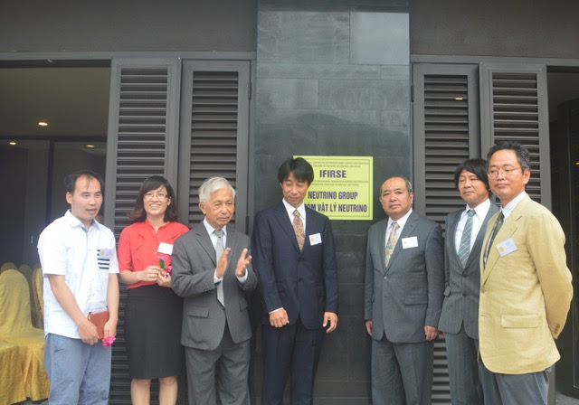
Background of this Neutrino School
An experimental neutrino group was created in Quy Nhon on July 17, 2017.
The project was proceeded with an strong leadership of Prof. Jean Tran Thanh Van, who is the president of Rencontres du Vietnam.
Since no high energy experimental group existed in Vietnam at that time, Japanese physicists working in Super-Kamiokande and T2K helped the formation of the group.
The Vietnam neutrino group successfully joined in the T2K collaboration in October 2017.
July 17, 2018 Opening Ceremony of the Vietnam neutrino group

Slide 3
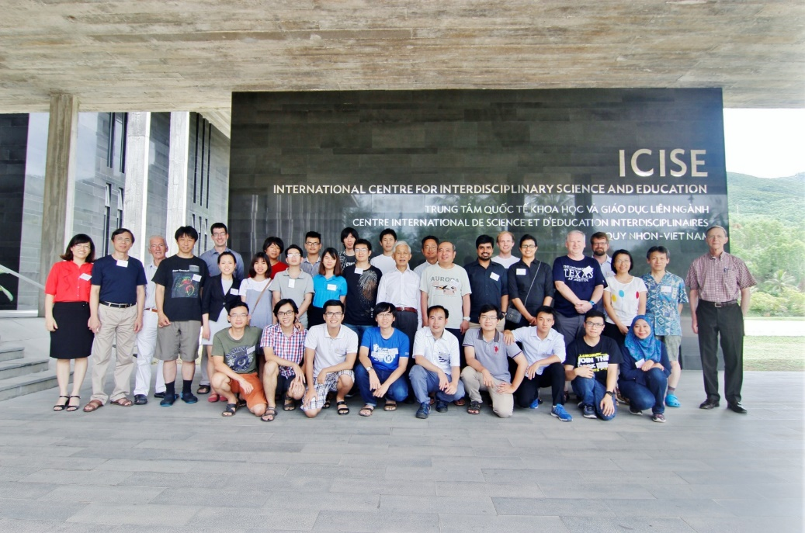
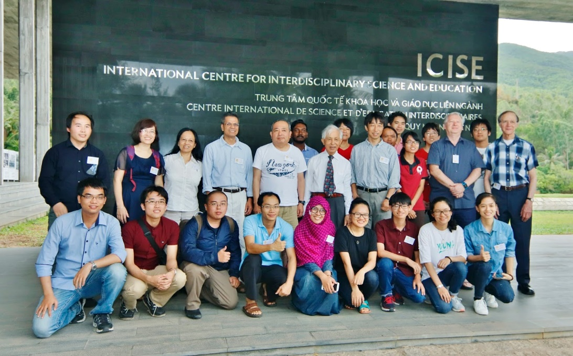
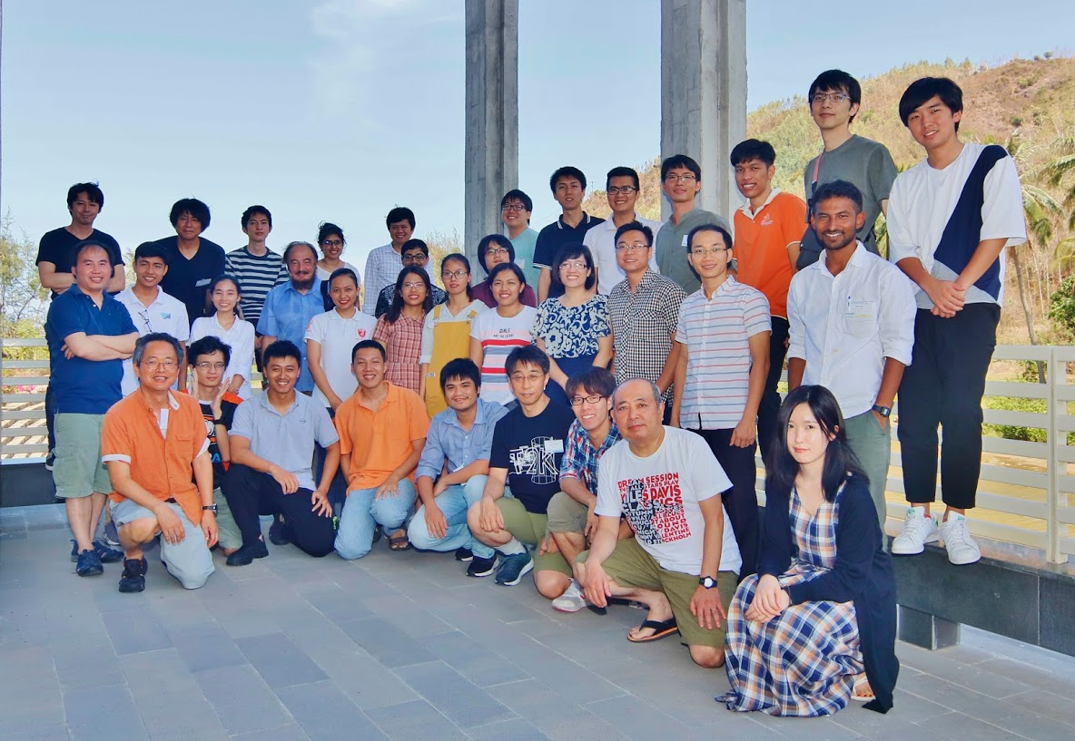
The Vietnam School on Neutrino (VSoN)
VSoN started with the formation of the neutrino group in 2017. It has been held every year.
Japanese physicists who contributed the Vietnam neutrino group also organize the school.
Unfortunately, VSoN2020 is held by online because of coronavirus.
VSoN2017
VSoN2018
VSoN2019

Slide 4
About the school program
The program mainly focus on experimental neutrino physics. About 2/3 lectures are given by experimental physicists
One of the school purpose is Invitation to experimental neutrino physics. Students have a chance to join the Vietnam neutrino group and to participate in Japanese neutrino experiments.
We read Curriculum Vitae of students, and we found that most of them are studying theoretical particle physics. We hope that some of them will change their research field from theory to experiment, and become a pioneer of the Vietnamese high energy experiment.

Slide 5
Students
We have 36 students in total.
Only 5 students join the school from ICISE. Hardware training will be held for them.
About half of the students attend not only lectures but also software training and group work.
Other students hoped to join only lectures. They can attend any lectures they like. There is no restriction about their attendance.

Slide 6
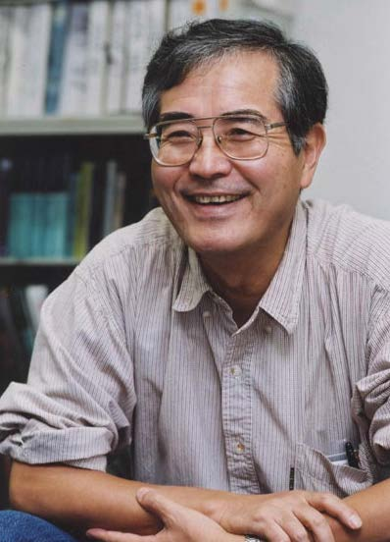
Experiments are important!
To invite students to experiments, let me introduce some words from Prof. Totsuka who was the first spokesperson of the Super-Kamiokande experiment.
Prof. Yoji Totsuka
(1942-2008)
Even though a great theorist propose a fantastic and beautiful theoretical model, we can easily reject it, saying “No! it does not agree with our experiment!”. In physics, the experimental result is everything.
Straightforwardly speaking, I am a detector physicist. I can make the best detector in the world, and I can explore the most advanced physics in the world.

Slide 7
Welcome to the world of neutrino experiments !
at least, for 2 weeks,
hopefully,
for the rest of your research life.
Enjoy !

