Slide 1
Neutrino physics
- Introduction and first 50 years -
Yuichi Oyama (KEK/J-PARC)
August 29-September 9 2021 Vietnam School on Neutrino 2021(online)
1

Slide 2
Motivation of this lecture
After the entire school program was made, we found some topics were missing.
In this lecture, I would like to cover introduction and first 50 years.
Students in undergraduate course also participate in this school. Since all participants should follow advanced lectures in two weeks, a very introductory and primitive program on neutrinos is certainly needed at the beginning of the school.
A lecture on the history of old neutrino experiments is missing.
Some part of this lecture would be already very familiar to some of participants and it may be waste of time. Please be patient.
To explain the basic concept as easy as possible, some theoretical explanations are not accurate, or even incorrect if strictness is considered.
I apologize in advance.
2

Slide 3
Contents
Prediction of neutrinos by Wolfgang Pauli in 1930
Neutrinos in elementary particle table and “weak” interaction
Four Experiments
Very short introduction to the Standard Model (GWS model)
One more Experiment
1980 (instead of summary)
1956 Discovery of electron anti-neutrinos by Savannah River reactor experiment
1962 Discovery of muon neutrinos by AGS neutrino experiment in BNL
1965 Observation of atmospheric neutrinos by KGF experiment
1968 Solar neutrino deficit claimed by Homestake experiment
1973 Discovery of neutral current interactions by Gargamelle experiment
3

Slide 4
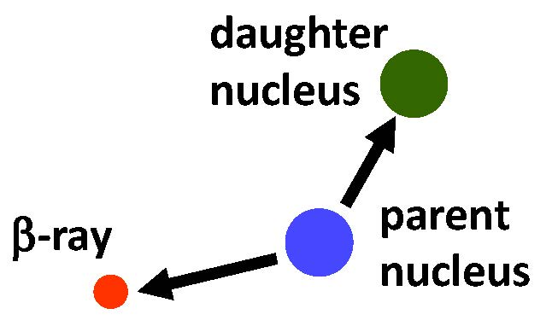
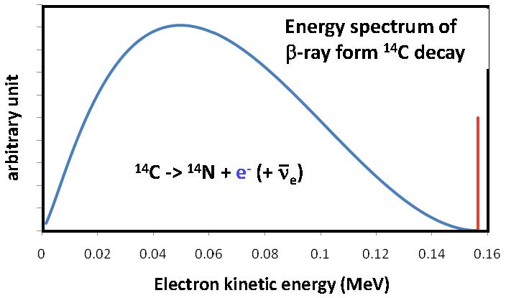
Anomalies in β-decay process
Around 1930, two anomalies were found in the β-decay process.
The daughter nucleus do not recoil backwards in a straight line. There is a momentum imbalance. It seems that the principle of momentum conservation is violated.
The energy spectrum of the β-ray shows broad distribution. If total energy is conserved in a two body decay, the energy spectrum of the β-ray must be monochromatic. The principle of energy conservation seems to be broken.
If total energy is conserved….
4

Slide 5
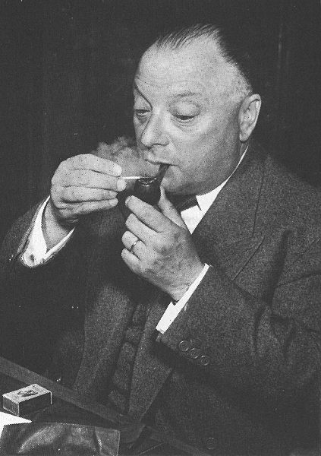
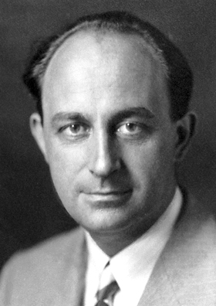
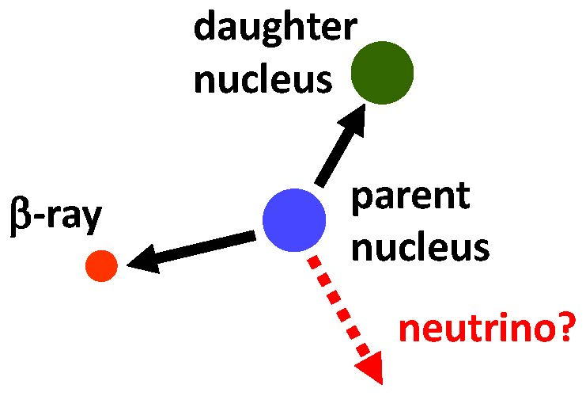

Prediction of neutrinos in 1930
In 1930, Wolfgang Pauli predicted that another particle may be produced in the β-decay. The energy released in β-decay was shared in a random way between the β-ray and the unknown particle. This would account for both the momentum imbalance and the broad energy spectrum of β-ray. The particles have not discovered because it is very difficult to detect.
Enrico Fermi named the particle “neutrino”. The word was made from neutral, and Italian suffix -ino which means small. Therefore, it means neutral and small particle.
Later, it was found that β-decay can be written as
Wolfgang Pauli
Enrico Fermi
5

Slide 6
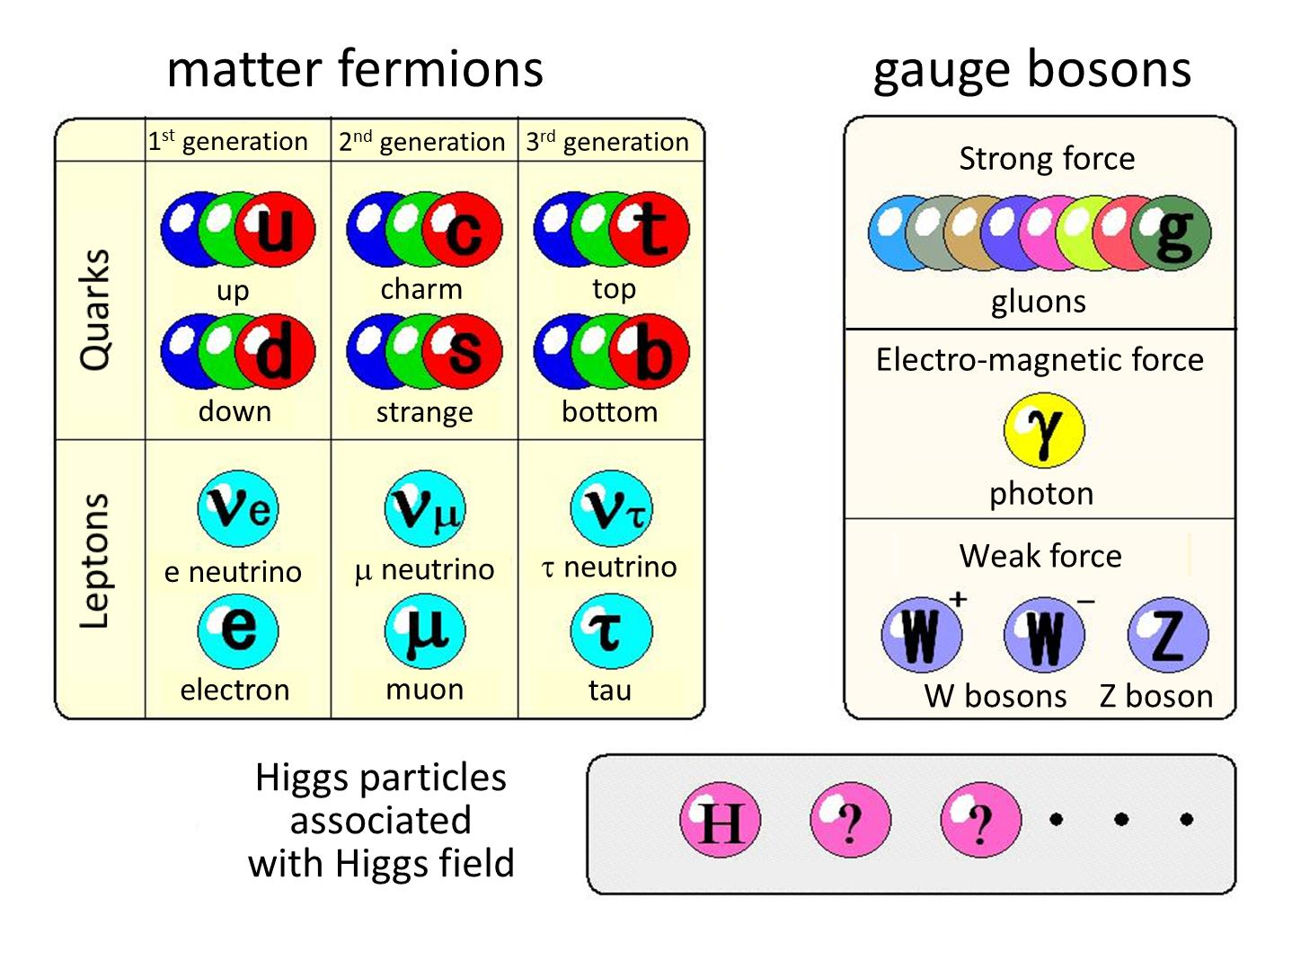
Table of elementary particles
In the table of elementary particles, neutrinos belong to matter fermions. They are members of leptons together with electron, muon and tau.
6

Slide 7
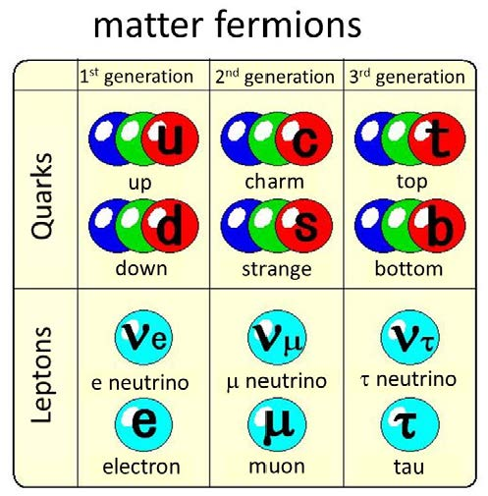
Matter fermions??
In the table of elementary particles, neutrinos belong to matter fermions. They are members of leptons together with electron, muon and tau.
Matters are made of matter fermions?
Where are neutrinos?
Although neutrinos are member of matter fermions, they cannot join the constitution of matter. They can interact only weakly and cannot be captured with other particles. Neutrinos are traveling elsewhere!
orbital electron
proton
u
atom
n
p
H
p
p
n
d
u
quarks
O
nucleus
n
n
H
atom
nucleus
neutron
nucleon (proton)
Molecule of water
7

Slide 8
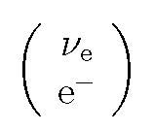
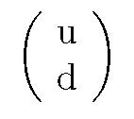
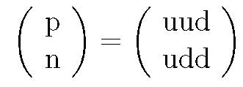
Interpretation of the elementary particle table
How can we understand this table?
It seems that similar particles are collected in the same group. However, we can change the interpretation. “One particle has different two states, upper state and lower state”
It is a basic concept of “unified theory in elementary particle physics”.
lepton pair
quark pair
nucleon pair
8

Slide 9

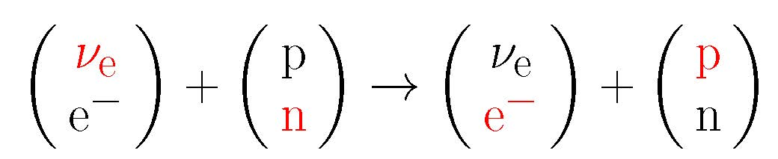
Neutrino Interaction
Neutrino interaction is understood as an exchange of the upper and lower states.
(Example) : Neutron decay which led Pauli to the prediction of neutrinos
An anti-neutrino is equivalent to a neutrino which travel from future to past. The equation can be changed as follows:
The interaction can be understood as follows:
Before the interaction, the lepton was in the upper state and nucleon was in lower state. The “state” was exchanged between lepton and nucleon. The lepton became lower state and the nucleon became upper state.
9

Slide 10
Neutrino interaction is “weak”
It is frequently said that “neutrinos are small particles” or “neutrino interaction is weak”. However, these expressions are slightly confusing. More appropriate expression is that probability of interaction is small or neutrino interaction is rare.
The concept of cross section is useful to understand the rareness. Cross section (σ (cm²)) is the size of the target particle from a view point of interaction.
If 1 GeV proton see that target nuclei, the interaction is hadron interaction, and the cross section is σ~3 x 10⁻²⁶cm².
On the other hand, if 1 GeV neutrino see the target muclei, the interaction is weak interaction and the cross section is about σ~1 x 10⁻³⁸cm². It is smaller than that of hadron interaction by factor of 3 x 10¹².
target material
proton’s view
target material
neutrino’s view
proton
neutrino
nucleon ~3x10⁻²⁶cm²
nucleon ~1x10⁻³⁸cm²
10

Slide 11
Home works : cross section and flux
The concept of "cross section" and "flux" is important and it takes time for a complete understanding.
Two exercise are added at the end of this presentation file as home works. Please try them when you have time.
11

Slide 12
History of old neutrino experiments
Keep in mind two important features of neutrinos. And survey four historically important experiments which contributed progress of neutrino physics drastically.
Neutrino interaction is exchange of upper/lower state
Small cross section and small interaction probability of neutrinos
1956 Discovery of electron anti-neutrinos by Savannah River reactor experiment
1962 Discovery of muon neutrinos by AGS neutrino experiment in BNL
1965 Observation of atmospheric neutrinos by KGF experiment
1968 Solar neutrino deficit claimed by Homestake experiment
12

Slide 13
Common configuration of neutrino experiments
All neutrino experiments have similar configuration.
Other particles are absorbed.
Neutrino Source
(Reactor, beam, the Sun, atmospheric neutrino....)
Experimental hall
detector (large target mass)
Neutrino
Lepton
shielding
(soil, concrete, iron....)
13

Slide 14
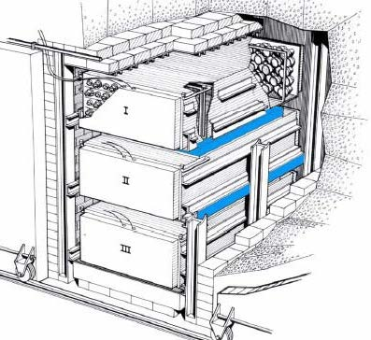
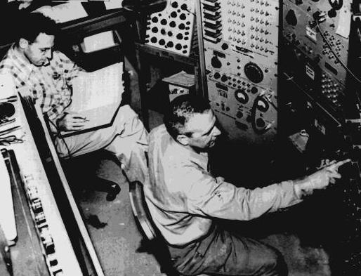
Savannah River reactor experiment by Reines and Cowan
Anti-neutrinos from a reactor in Savannah River Plant in South Carolina were used. The experimental area was shielded location, 11 m from the reactor and 12 m underground.
Two tanks with a total of about 200 liters of water were used as target material. About 40 kg of CdCl₂ were dissolved in the water.
The water tanks were sandwiched between three liquid scintillator layers which are viewed by 110 5-inch photomultiplier tubes.
14

Slide 15
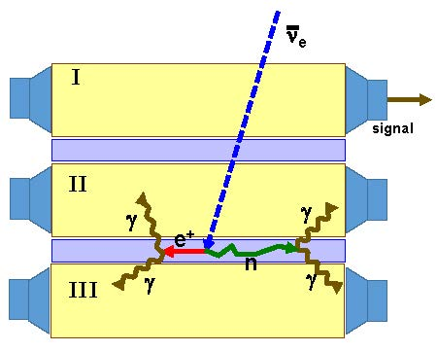
Detector of the Savannah River experiment
The anti-neutrino interact with a proton of water. A positron and a neutron are created. The positron annihilate with an electron and create a pair of 0.511 MeV γ-rays.
Cd is a highly effective neutron absorber. It absorbs a neutron and gives off a ~9 MeV γ-ray. If a neutron was truly produced by the interaction, a γ-ray from the Cd would be emitted 5 μs after the γ-ray from the positron.
The γ-rays were detected by liquid scintillator. The scintillator material gives off flashes of light in response to the γ-rays.
These light flashes are detected by photomultiplier tubes and the signal are sent to oscilloscopes.
ν_{e} + p -> e⁺ + n
e⁺ + e⁻ -> 2γ
n+ ¹⁰⁸Cd -> ¹⁰⁹Cd* -> ¹⁰⁹Cd+γ
15

Slide 16
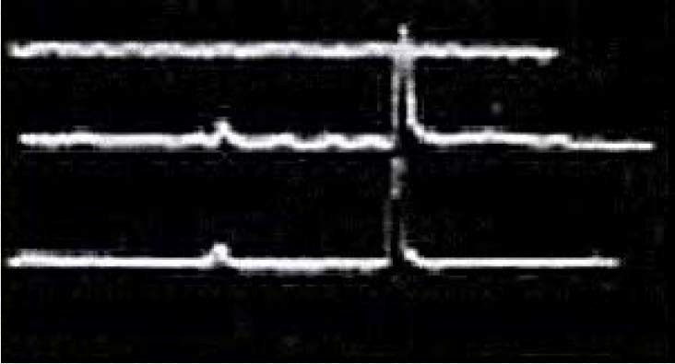
Results of the Savannah River experiment
Oscilloscope traces were recorded photographically.
Oscilloscope traces which show prompt signals accompanied with delayed coincidences were selected as events.
The rate of the possible neutrino events were found to be 3.0±0.2 events per hour.
From a comparison with reactor-off data, about ~75% of the events in reactor-on data are found to be true signals from reactor antineutrinos.
This is the discovery of (anti-)neutrinos.
Prompt signal from a pair of 0.511 MeV γ-rays
Delayed coincidence signal from ~9 MeV γ-ray
I
II
III
16

Slide 17
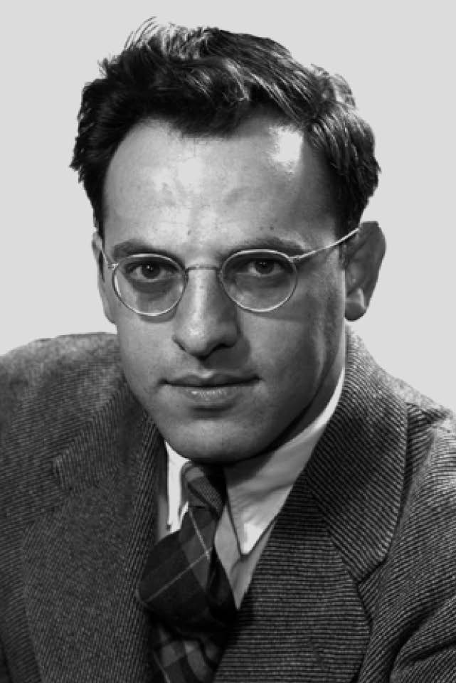
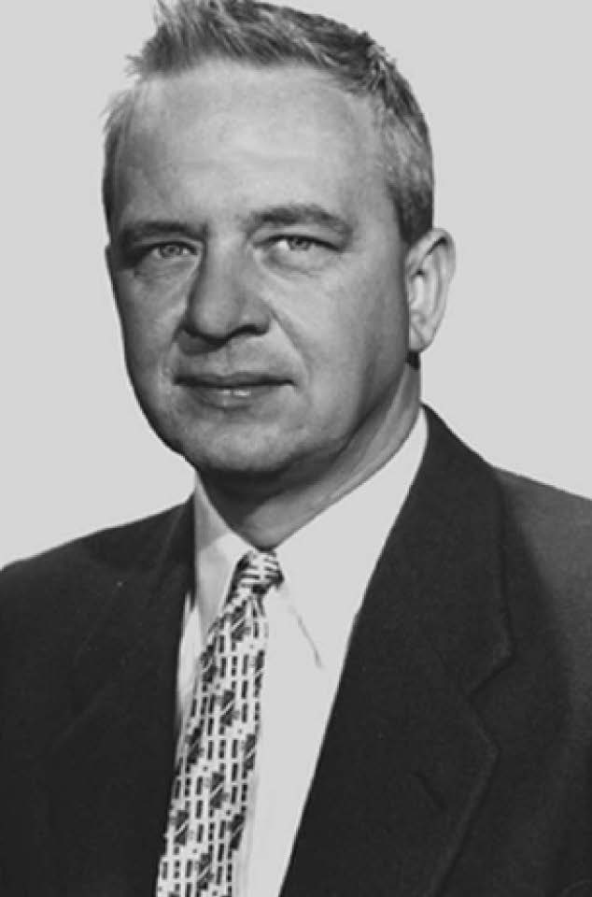
The discovery of ν_{e} won the Nobel Prize
F.Reines won the Nobel prize in physics for 1995. “for pioneering experimental contributions to lepton physics, the detection of the neutrino” Unfortunately C.L.Cowan passed away in 1974.
F. Reines
C.L.Cowan
Impact to other experiments
Liquid scintillator is good material for detection of electrons in the energy range of reactor neutrinos, because of their large light yield. Liquid scintillator is used by many reactor neutrino experiments; Kamland, Daya bay, Reno and Double Chooz.
Neutron absorber and delayed coincidence also became common experimental technique. Recently, Gadolinium which emit ~8MeV γ-ray with ~30μsec delay is popular neutron absorber. Daya bay, Reno and Double Chooz use Gd. SK-Gd project also just started.
17

Slide 18


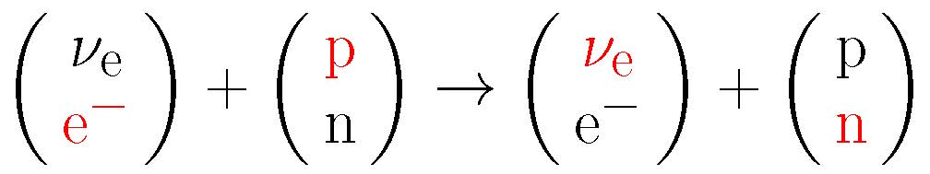
Neutrino interaction in Savannah River experiment
Neutrino production
The nuclear fission in the reactor is essentially decay of neutron in radioisotopes.
Neutrino detection
The interaction is sometimes referred as inverse beta decay, or IBD.
Anti-particles can be moved to the other side, and the equation is equivalent to:
The interaction can be understood as
18

Slide 19
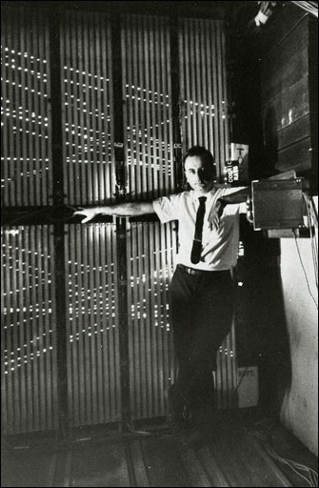
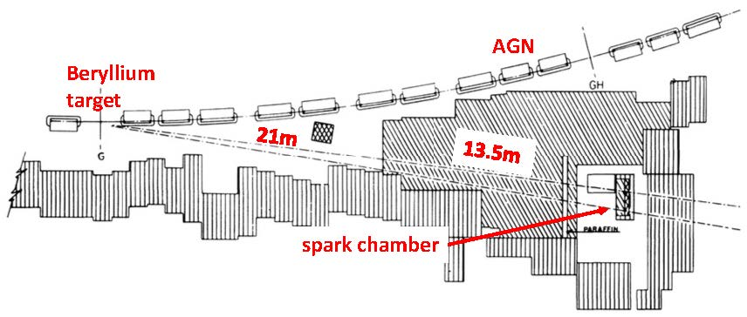
The AGS Neutrino Experiment at BNL
Muon neutrinos were discovered by Alternating Gradient Synchrotron (AGS) in Brookheaven National Laboratory (BNL).
15 GeV proton beam hit the Beryllium target and pions are produced. Some of the pions decay into muons in 21 m distance between the target and the shielding. Charged particles are completely absorbed in the iron shield of 13.5 m thickness.
Spark chambers were placed downstream of the shielding. To reject cosmic ray muons, they were surrounded by thick steel/lead plates and plastic scintillators as veto counters.
G. Danby et al., PRL 9, 36(1962)
Spark Chambers

Slide 20
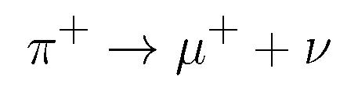
The AGS Neutrino Experiment at BNL
The pion produced at the target seems to decay into a muon and an unknown particle.
The unknown particle might be a neutrino.
The purpose of the experiment is
?
μ
p (15GeV)
π
Be target (sorry! I don’t know the shape.)
ν?
detect neutrinos from pion decays
examine whether they are the same neutrinos as the Savannah River experiment. (i.e. Neutrinos which convert to electrons by the weak interaction)
20

Slide 21
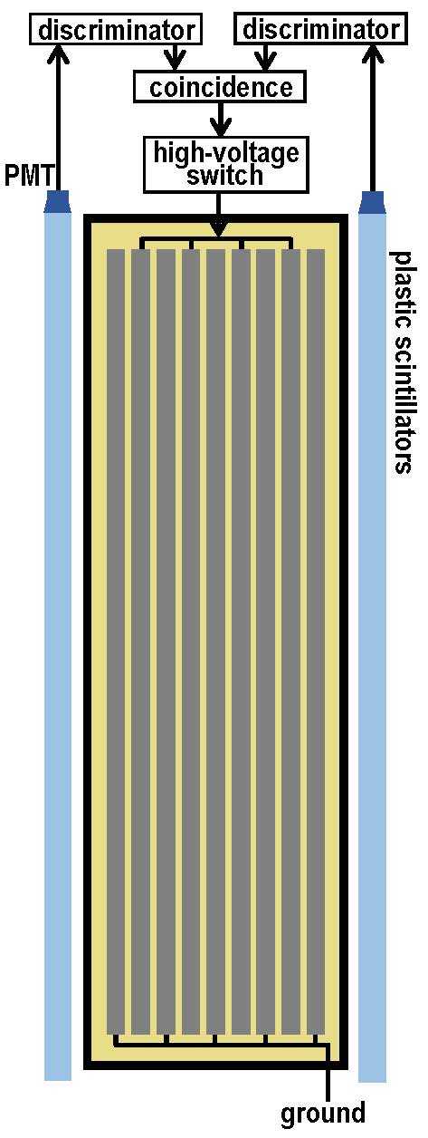
Spark Chamber
The spark chamber detector consists of an array of 10 one-ton modules. Each unit has 9 aluminum plates 44-inch (111.76 cm) x 44-inch and 1 inch (2.54cm) thick. The plates are separated by 3/8 inch (0.9525cm). The chamber is filled by gas mixture of Neon and Helium.
When a charged particle travels in the chamber,
it ionize the gas.
A coincidence signal from upstream and downstream plastic scintillators makes trigger. It switch on the high-voltage supply for a short time interval.
The large electric fields create current flows along the paths of ionized gas. The current flows are seen as spark.
The coincidence signal is also used as the trigger for the photograph after appropriate time delay.

Slide 22
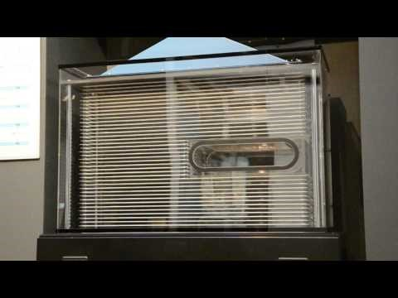
Movie of a spark chamber
KEK has a small spark chamber. The real operation is demonstrated in KEK open house.
A movie is uploaded in Youtube.
Visitors can insert their palms in the center space, and confirm that cosmic ray muons penetrate their palms
https://www.youtube.com/watch?v=gdk2kBKcuNY
22

Slide 23
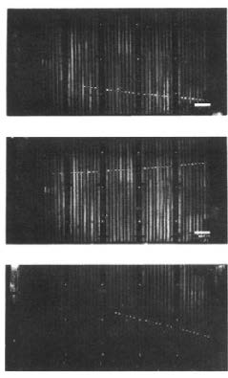
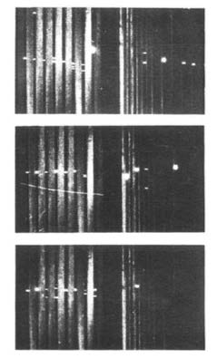
Particle identification in spark chamber
Spark chambers can distinguish muons and electrons. Long single track without interaction is certainly muons.
Difference from electron is verified by a beam test employing electron beam from Cosmotron.
Muon event have a clear single track
Electron event have multi track produced by electro-magnetic shower
23

Slide 24
Results from the AGS Neutrino Experiment
A total of 3.48 x 10¹⁷ protons were delivered to the target. Typical operation yields about 10 triggers per hour. After geometrical selection criteria, 113 events are selected at the first stage.
If neutrinos from muon decays are assumed to be electron neutrinos, 29 electron-magnetic shower events are expected. However, only 6 such events are found among them.
29 events have single long tracks which are thought to be muons. No clear explanation for the 29 muon events were found.
The result shows that neutrinos from pion decays certainly exist, but they are different from neutrinos from β-decays.
 | No neutrinos | If ν is ν_{e} | Result
Shower events | -------- | 29 | 6
Single track events | -------- | -------- | 29
-------- small (clear numbers cannot be found in the paper)
24

Slide 25
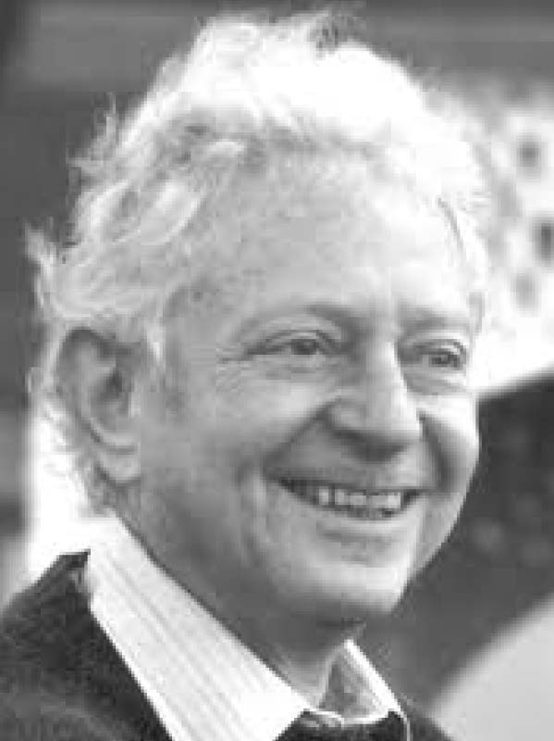
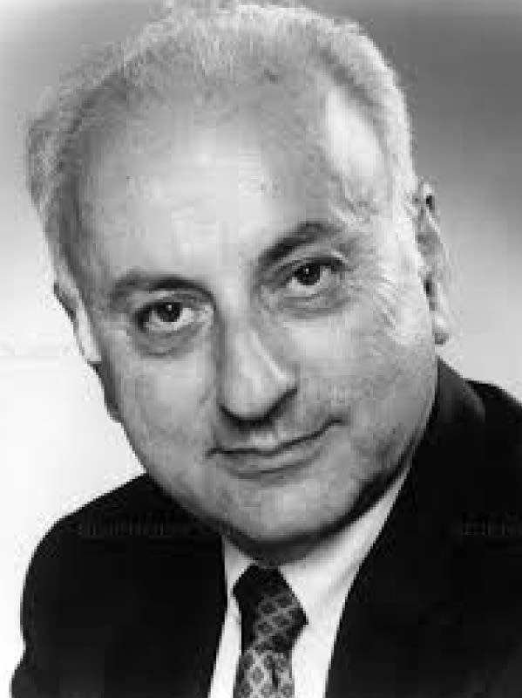
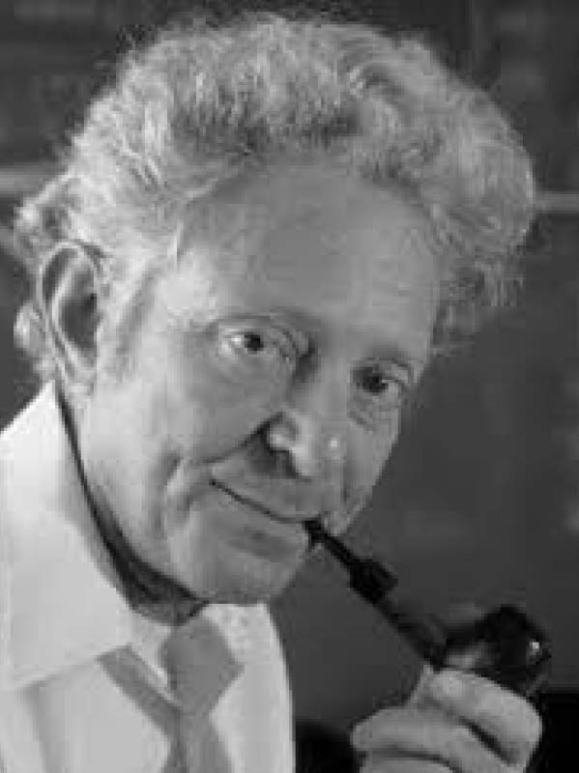
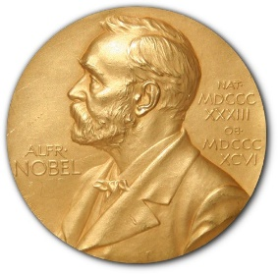
AGS Neutrino Experiment won the Nobel prize
This is the first direct observation of muon neutrinos. Nobel Prize in Physics was given to Leon Lederman, Melvin Schwartz, and Jack Steinberger in 1988.
The Nobel prize for the “second neutrino” was earlier than the “first neutrino” (1995). It is because progress of experimental neutrino physics were mainly achieved with muon neutrino beam. Production of accelerator electron neutrino beam is difficult and was not used in any experiments. Another reason is that Reines/Cowan made a mistake to calculate neutrino cross section from their experiment, and their results were suspected???
Leon Lederman
Melvin Schwartz
Jack Steinberger
25

Slide 26
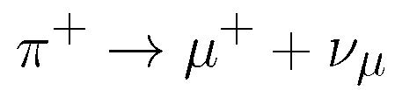

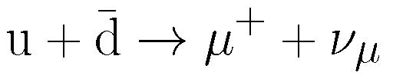
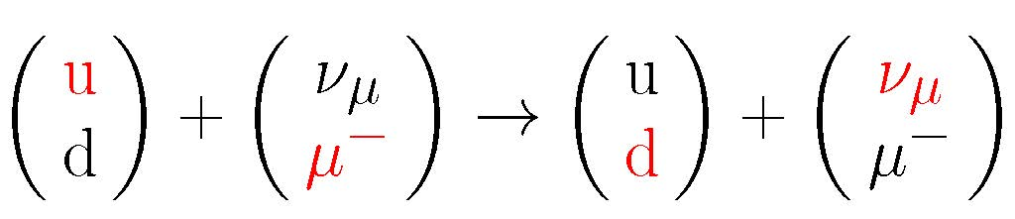

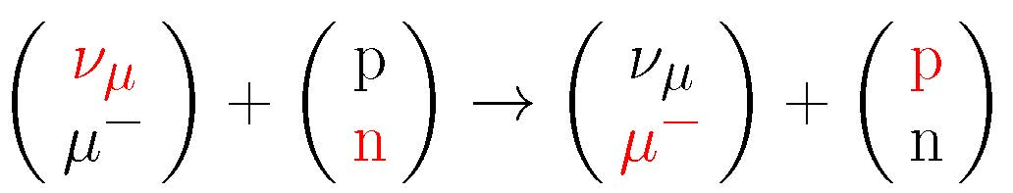

Neutrino interactions in the AGS
Neutrino Experiment
Neutrino production
A muon neutrino is produced by decay of the pion.
Contributions from π⁻ and kaons also exist.
Since the pion consists of quarks, it can be written as
Anti-particles are moved to the other side of the equation, and the equation can be understood as exchange of upper/lower status.
Neutrino detection
A muon neutrino interact with neutron, and a muon is produced.
Other interactions also exist.
26

Slide 27
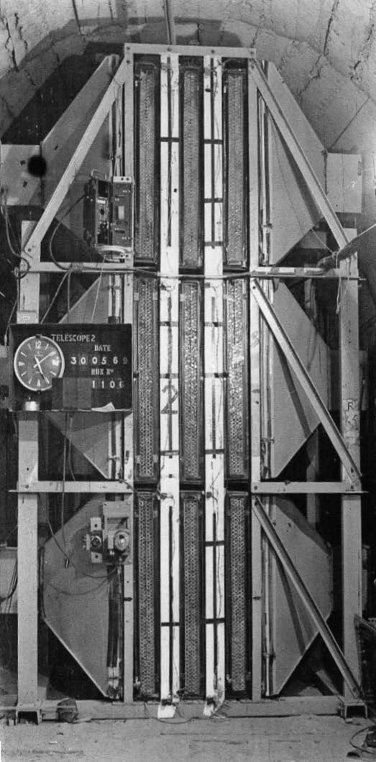
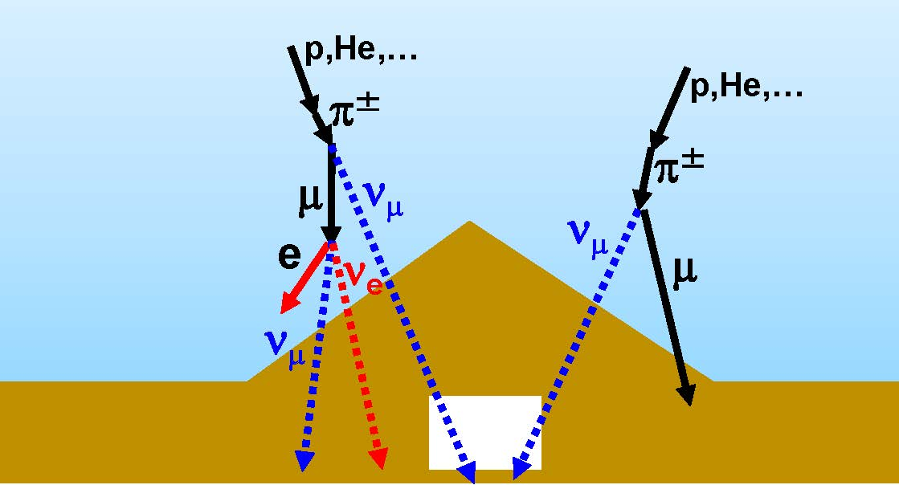
KGF (Kolar Gold Field) experiment
Atmospheric neutrinos were discovered by KGF (Kolar Gold Field) experiment in 1965.
Primary cosmic rays (p, He,…) collide with upper atmosphere and pions are made. From decays of pions, atmospheric neutrinos and cosmic ray muons are produced.
C.V.Achar et al., Phys. Lett. 18, 196(1965)
KGF detector
27

Slide 28
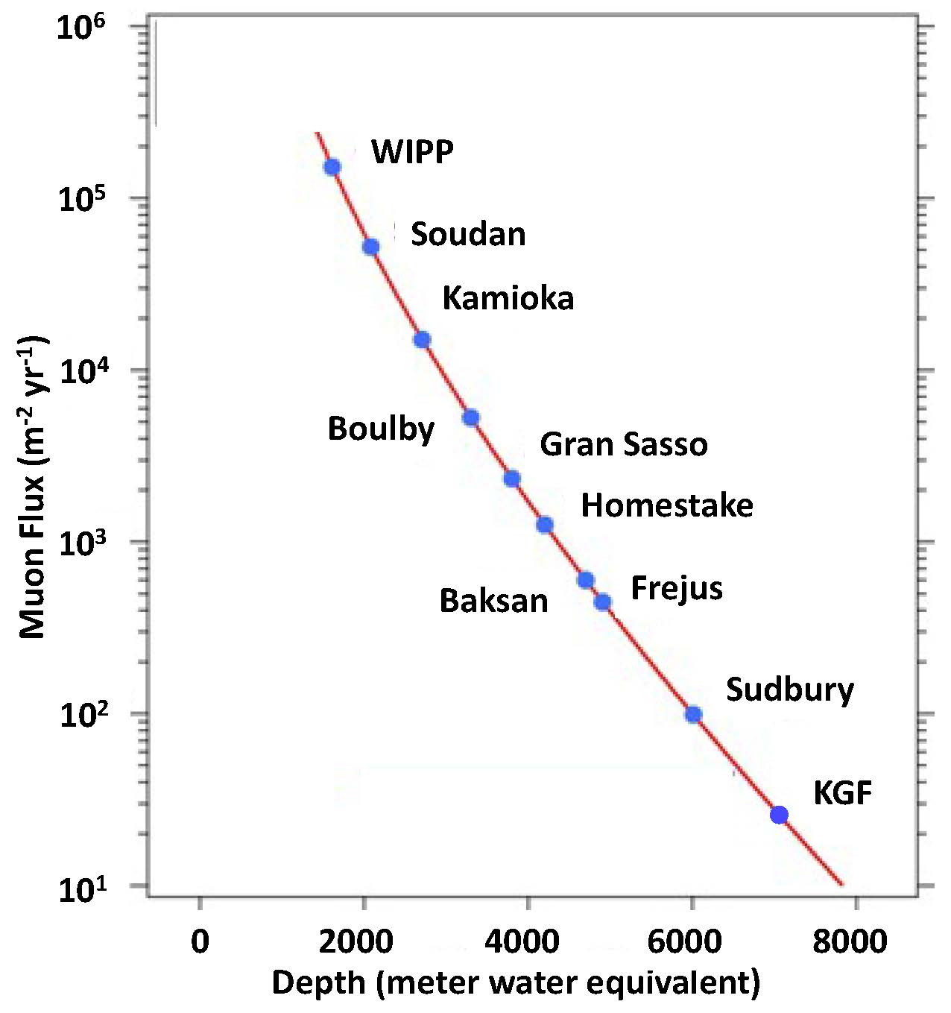
Underground laboratory in Kolar Gold Mine
The experimental site is Kolar Gold Mine in South India. It is located ~2300m (6930 meter water equivalent) underground.
It is the deepest underground laboratory. Deep underground is very dangerous. Depth of the mine is strongly correlated to price of the metal. Gold is great !
Cosmic ray muon flux is much smaller than other underground laboratories. For example, it is about 3 orders of magnitude smaller than that of Kamioka zinc mine.
This provides excellent opportunity to observe atmospheric neutrinos because of small cosmic ray muon background.
28

Slide 29
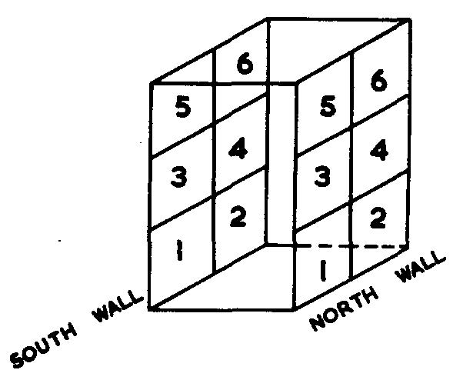
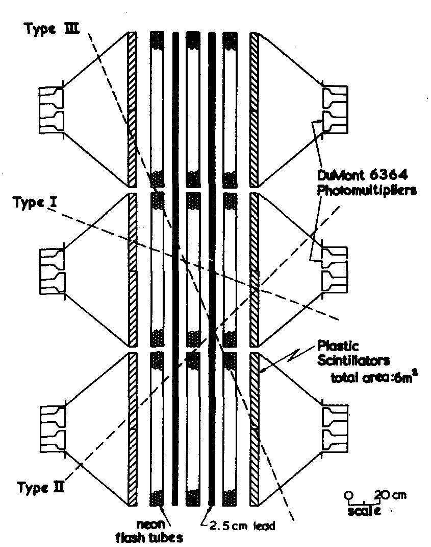
KGF detector
2 detectors of the same design were constructed.
Each detector consists of 12 1m x 1m plastic scintillator plates. They are aligned in 2 walls separated by 80 cm; in each wall, 2 plates in horizontal and 3 plates in vertical.
Each plastic scintillator plate is viewed by 2 photomultipliers. Coincidence of two PMTs is required to reduce accidental noise.
Coincidence of two plastic scintillators in different walls were required.
3 layers of neon flash tubes and 2 layers of 2.5 cm lead plates between the scintillator walls are helpful for identification of the track of the particle and for reduction of the background.
According to the vertical position of the plastic scintillators, the events are categorized to type I, type II and type III.
29

Slide 30
Results from KGF
About 2140 (m² days Sr) data are recorded in ~50 days, and 3 events have been observed.
All 3 events are categorized to type I, and expected background from atmospheric muon is only 0.065. The 3 events are thought to be muons from atmospheric neutrinos.
It is the discovery of atmospheric neutrinos !
The results were confirmed by another underground experiment conducted by F. Reines in South Africa. The receipt of the South Africa paper was later than the KGF only by 14 days.
Event type | I | II | III
Observed event | 3 | 0 | 0
Expected atm. μ event | 0.065 | 0.80 | 0.47
30

Slide 31
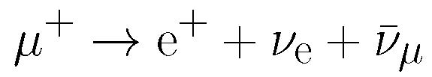
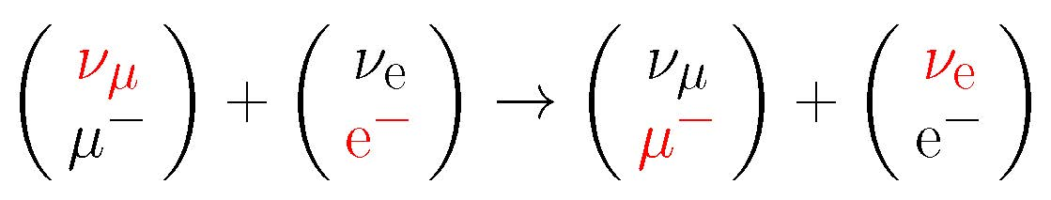
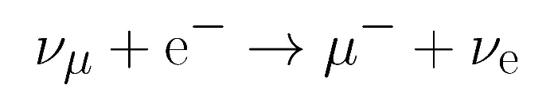
Neutrino interactions in the KGF experiment
Neutrino production
Contributions from π⁻ and kaons also exist.
A neutrino is produced by decay of the pion.
This interaction is the same as that in the AGS neutrino beam. Some of muons also decay before they reach the surface of the Earth.
Anti-particles are moved to the other side. It can be understood as exchange of upper/lower states.
Neutrino detection
A muon neutrino interact with neutron, and a muon is produced.
It is also the same as that in the AGS neutrino experiment.
31
Other interactions also exist.

Slide 32
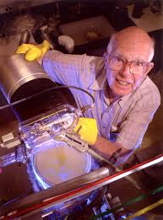
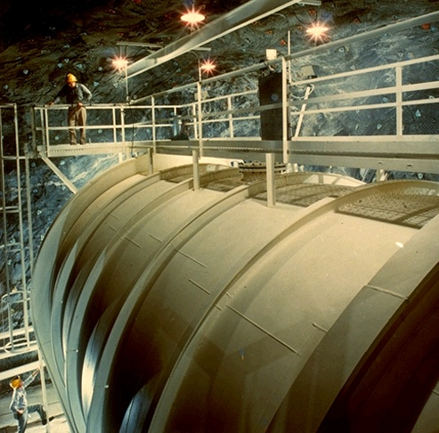
Homestake Chlorine Experiment
The pioneer solar neutrino experiment conducted by Raymond Davis Jr. The experiment started in 1967.
615 tons of fluid C₂Cl₄ are stored in a tank chamber at 1480m underground in Homestake lead mine, South Dakota.
From ³⁷Cl + ν_{e} -> ³⁷Ar + e⁻ reaction, ³⁷Ar are accumulated. The energy threshold of the reaction is 0.814 MeV, and the production rate is ~0.5 ³⁷Ar/day. Sensitive to ⁷Be (~14%) and ⁸B (~78%) solar neutrinos.
³⁷Ar atoms are extracted by bubbling helium gas through tank every few weeks. Number of ³⁷Ar decays (τ_{1/2} = 35 days) are counted in a low-background environment.
R. Davis Jr.
32
9

Slide 33
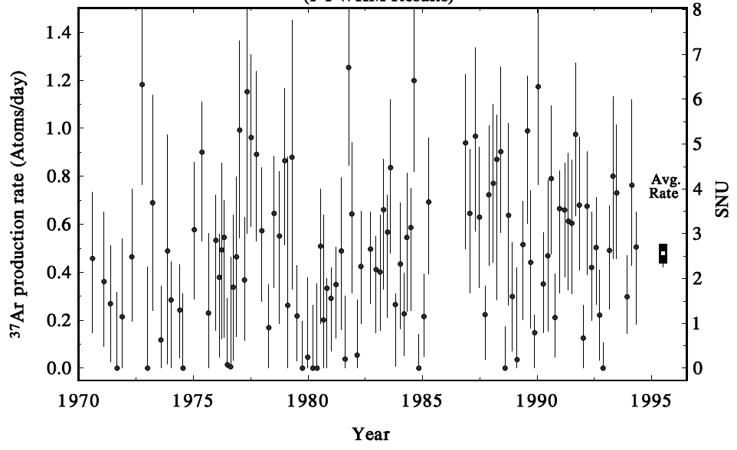
Results from Homestake experiment
The number of solar neutrino events measured by Homestake experiment is about 1/3 of the Standard Solar Model prediction. The first result was published in 1968. R. Davis et al., Phys. Rev. Lett. 20, 1205(1968)
It was an evidence of neutrino oscillation, but it was not widely believed.
~25 years of data 2200 solar neutrinos
Standard Solar Model expectation
(1 SNU is 10⁻³⁶ captures per target atom per second)
Kamiokande started solar neutrino observation
33

Slide 34

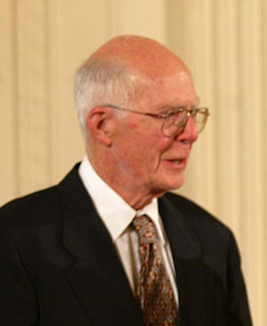
Nobel Prize
Solar neutrino deficit claimed by Homestake experiments was confirmed by Kamiokande and some other experiments after late 1980s. The deficit was considered as an evidence of neutrino oscillation.
Raymond Davis Jr. shared the Nobel Prize in Physics 2002 with Masatoshi Koshiba.
The reason of the award was "for pioneering contributions to astrophysics, in particular for the detection of cosmic neutrinos"
Raymond Davis Jr.
34

Slide 35
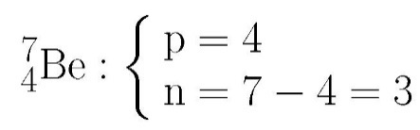
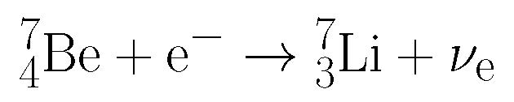
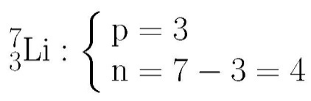
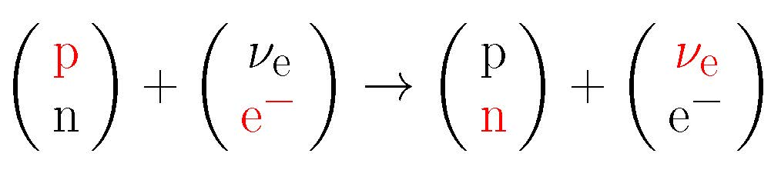

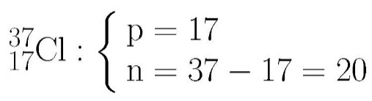




Neutrino interactions in the Homestake ³⁷Cl experiment
Neutrino production
Neutrinos from ⁷Be are used.
A proton in ⁷Be capture an electron. A neutron and a neutrino are produced.
Neutrino detection
Neutrinos interact with ³⁷Cl.
A neutron in ³⁷Cl interacts with neutrino.
35

Slide 36




Weak interaction and W boson
Neutrino interaction is thought to be exchange of state (upper and lower) between matter fermions.
We can consider that exchange of the state is exchange of intermediate particle, W boson.
Particles which mediate “state” and force are categorized as gauge bosons.
or
36

Slide 37

Mass of W boson
Mass of W boson is very heavy. It is correlated with the small cross section of the weak interaction.
To understand this correlation, we must recall “Heisenberg’s uncertainty principle”.
For very short time period, very high energy can be generated virtually. A heavy particle can exist virtually for a short time because E=mc². The heavy virtual particle can travel only R~cΔt. If other particles happen to pass the area S~(cΔt)², weak interaction may occur.
The size of the area in which the virtual particle can travel is proportional to the cross section.
From the cross section of weak interactions, it is guessed that the mass of W is ~100GeV.
(natural unit)
matter fermion
R~cΔt
cross section ∝ R²
37

Slide 38





Weak interaction and W boson
Look the exchange of the W boson carefully.
You can find a similarity with following matrix calculation.
Intermediate bosons W⁺ and W⁻ corresponds to
38

Slide 39
Weak interaction model
Matter fermions which constitute matters can be expressed by column vectors of 2 elements.
Weak bosons which intermediate force can be expressed by 2x2 matrices.
Weak interactions are exchange of 2x2 matrices between column vectors.
When 2x2 matrices are considered, there will be 4 independent matrices. W⁺ and W⁻ are off-diagonal matrices. Are there any diagonal matrices?
39

Slide 40





Z⁰ boson and neutral current interaction
One of the diagonal matrices, Z⁰ boson, is predicted.
The exchange of a Z⁰ boson is called neutral current interaction. In neutral current interactions, matter fermions exchange momentum or energy, but they do not exchange their states (upper or lower).
Neutral current interaction between a neutrino and an electron
The electron is “kicked” by a neutrino.
40

Slide 41




Other examples of neutral current interaction
Neutral current interaction between a muon neutrino and a proton.
Neutral current interaction : Single pion production.
In all those neutral current interactions, neutrino interactions from muon neutrinos seem to occur, but no muon track is found.
The proton is “kicked” by a neutrino.
By the energy transfer, the n (udd) is broken, and p (uud) and π⁻(ud) are produced. u and u are generated from a pair creation.
41

Slide 42
GWS Model (the Standard Model)
The other diagonal 2x2 matrix corresponds to photon (γ). It is the gauge boson which intermediate electromagnetic interaction.
It is surprising that familiar γ and unfamiliar W, Z belong to the same category!
This model unifies electromagnetic interaction and weak interaction. It is called electroweak theory or the Standard Model or Glashow-Weinberg-Salam (GWS) Model.
S.L.Glashow. Nucl.Phys.22, 579(1961)
S.Weinberg, Phys. Rev. Lett. 19, 1264(1967)
A.Salam and J.C.Ward, Nuovo Cimento 11, 568(1959)
42

Slide 43

More about the GWS Model…….
More about the GWS model is beyond the scope of my lecture. However, brief story with key words are shown below.
You can learn more in other classes!
W±,Z⁰ and photon seem to be completely different particles, although they are categorized as gauge bosons.
Just after the big bang, those gauge bosons were symmetrical and there was no difference.
After the universe expanded and became cool, intermediate bosons which coupled with Higgs particles became massive and were redefined as weak bosons. Intermediate boson which did not couple with Higgs particles were left massless. They were redefined as photons.
This transition is called spontaneous symmetry breaking.
You can find this illustration frequently when you study spontaneous symmetry breaking.
43

Slide 44
Predictions from the GWS model
The GWS model predicted three new interactions or particles. They are:
Examinations of the GWS model started.
Neutral current interaction
Weak bosons (W± and Z⁰)
Higgs particles.
An excellent theoretical model clearly explain all existing experimental data. It also predicts some discoveries which can be examined by real experiments.
1973 Discovery of neutral current interactions by Gargamelle experiment
44

Slide 45


Gargamelle experiment
Gargamelle was a bubble chamber at CERN designed to detect neutrinos. It operated with a muon-neutrino beam produced by the 26 GeV CERN Proton Synchrotron (PS).
Proton beam was delivered to Beryllium target and pions and Kaons were produced. They were focused by using a magnetic horn, which was invented by Simon van der Meer. He won the Nobel prize for the contribution for UA1 experiment later.
Magnetic horn
26GeV PS
Magnetic horn
Beryllium target
45

Slide 46

Gargamelle experiment
After being focused, some pions and kaons decayed in 70 m long of decay tunnel and muon neutrinos were produced. All particles except neutrinos were absorbed by a shielding.
Neutrinos are delivered to the Gargamelle detector located at 96 m from the target and behind the shielding. The neutrino beam had an energy between 1 and 10 GeV.
Gargamelle detector
Gargamelle detector
shielding
decay tunnel
46

Slide 47


Gargamelle detector
The size of Gargamelle was 4.8 m long and 2 m in diameter. It was filled with 12 m³ of heavy liquid Freon (CF₃Br). The entire weight is more than 1000 tons.
The chamber was surrounded by magnet providing a 2 Tesla field.
Freon in the chamber is superheated. After a charged particle travel through the chamber, an ionization track is left. The Freon vaporizes around the track and microscopic bubbles are formed.
The track visualized by the bubbles are photographed using timing information from the beam line.
The track is bent by the magnetic field. Momentum of charged particle can be measured from curvature of the track.
Gargamelle is currently on exhibition at CERN
47
Inside view of Gargamelle

Slide 48


Discovery of neutral current interactions
Neutral current interaction between a muon anti-neutrino and an electron.
No muon track
ν_{μ}
F.J.Hasert et al., Phys. Lett. B46, 121(1973)
48

Slide 49


Discovery of neutral current interactions
Neutral current interaction between a muon neutrino and a nucleon.
No muon track
ν_{μ}
F.J.Hasert et al., Phys. Lett. B46, 138(1973)
Neutral current interactions were certainly discovered !
49

Slide 50



The GWS model won the Nobel Prize
The Gargamelle experiment discovered neutral current interactions, and the GWS model was confirmed.
Sheldon Lee Glashow, Abdus Salam and Steven Weinberg won the Nobel Prize in physics 1979.
The reason of the award was “for their contributions to the theory of the unified weak and electromagnetic interaction between elementary particles, including, inter alia, the prediction of the weak neutral current”
The Gargamelle collaboration was also worth for the Nobel Prize, but it was not clear that which collaborator should be awarded.
(Latin)especially
(copy and paste from the Nobel Prize HP)
S. L. Glashow
A. Salam
S. Weinberg
50

Slide 51
In 1980
The subtitle of my lecture is “Introduction and first 50 years”. 1980 is 50 years from the prediction of neutrinos by W. Pauli in 1930.
Neutrinos and weak interactions were well explained in the framework of the Standard Model (GWS model). The success of the Standard Model was widely approved. It won the Nobel prize in 1979.
After the Gargamelle experiment, there were no critical progress in neutrino experiments for long time.
Neutrino physics seemed to be completed. Only verifications by discoveries of W and Z bosons and Higgs particles remained. It seemed that their nature were perfectly understood, and no question were left !
51

Slide 52
After 1980
After 1980, additional direct confirmations of the Standard Model were obtained from hadron collider experiments.
After more than 10 years of long fruitless period, neutrino experiments became an active research field again in late 1980s. Neutrino oscillations, which imply physics beyond the Standard Model, opened new epoch of neutrino experiments.
In 1983, W and Z bosons were discovered by UA1/UA2 experiment in SppS, CERN
In 2012, Higgs particles were discovered by ATLAS/CMS experiment in LHC, CERN
52

Slide 53
Thank you !
53

Slide 54
Home works
54

Slide 55
Cross section and interaction probability
(Exercise1) Calculate the interaction probability that 1GeV neutrino interacts with iron of d=1 cm thickness.
d(cm)
S(cm² )
Total volume of the iron is V=Sd(cm³).
Total number of nucleon in the volume is
N_{nucleon} =ρ_{iron}N_{A} Sd.
V(cm³) = S(cm²) x d(cm) d=1cm
ρ_{ιron} =7.9g/cm³
N_{A} = 6.02 x 10²³ (g⁻¹)
σ = ~1 x 10⁻³⁸ cm²
neutrino
neutrino’s view
Total area of the target nucleon is
S_{interaction} = N_{nucleon}σ = ρ_{iron}N_{A} Sdσ (ρd is referred as column density)
The probability of interaction is P = S_{interaction}/S=ρ_{iron}N_{A} dσ
S(cm² )
nucleon ~1x10⁻³⁸cm²
The probability of the interaction is calculated to be ~5x10⁻¹⁴.
Note : The purpose of this exercise is to present the relation between cross section and interaction probability, and show up the smallness of the interaction probability numerically. Details such as difference between proton and neutron, or effect of nucleus are ignored.
55

Slide 56
Cross section and flux
The concept of flux is also important as well as cross section, and should be learned together. Flux is defined as number of particles which pass through unit area in unit time, Φ cm⁻²s⁻¹
(Exercise2) Assume that the neutrino flux is Φ=3x10⁻²cm⁻²s⁻¹ and neutrino energy is 1GeV. Calculate number of neutrino interactions in 22.5kton water in 443 days.
Number of neutrinos which pass through area S (cm²) in T (s) is N_{neutrino}= Φ S T
The probability of interaction is P =ρ_{water}N_{A} dσ
Number of neutrino interaction is
N_{interaction} = P N_{neutrino}
= ρ_{water}N_{A} dσ Φ S T
=(ρ_{water} S d)N_{A} σ Φ T
Number of interaction is calculated to be ~156.
ρ_{water}V(cm³) = ρ_{water}S(cm²) x d(cm)
= 22.5 x 10⁹ g
N_{A} = 6.02 x 10²³ (g⁻¹)
= ~1 x 10⁻³⁸ cm²
= 3 x 10⁻² cm⁻²s⁻¹
T = 443 days = 3.83 x 10⁷ s
These numbers are taken from real numbers in K2K experiment.
56

