Slide 1
Concluding Remarks
Jul-28-2023
Yuichi Oyama (KEK/J-PARC)
Makoto Miura (Kamioka Observatory, ICRR, Univ. of Tokyo)
Atsumu Suzuki (Kobe Univ.)
Tsuyoshi Nakaya (Kyoto Univ.)
Son Cao (IFIRSE)
Nguyen Thi Hong Van (IOP-VAST, Hanoi)
Jean Tran Thanh Van (Rencontres du Vietnam)
Presented by Yuichi Oyama

Slide 2
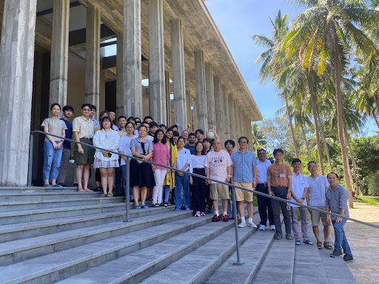
The school ended without any serious problems.
We are very happy.
Let’s thank Son-san for the excellent organization !

Slide 3
In the welcome address, I presented……
Welcome to the world of neutrino experiments !
at least, for 2 weeks,
hopefully,
for the rest of your research life.
Enjoy !

Slide 4
Let me ask some questions………..
Did you enjoy the world of neutrino experiment
for 2 weeks?
Do you hope to continue experimental neutrino physics for rest of your research life?
Thank you very much
and see you again !

