Slide 1
Welcome to “Vietnam School on Neutrino”!
Jul-19-2023
Yuichi Oyama (KEK/J-PARC)
Makoto Miura (Kamioka Observatory, ICRR, Univ. of Tokyo)
Atsumu Suzuki (Kobe Univ.)
Tsuyoshi Nakaya (Kyoto Univ.)
Son Cao (IFIRSE)
Nguyen Thi Hong Van (IOP-VAST, Hanoi)
Jean Tran Thanh Van (Rencontres du Vietnam)
Presented by Yuichi Oyama
Let me present the background and the program of this neutrino school.
1

Slide 2
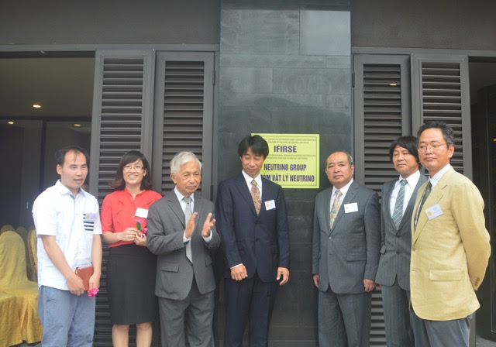
Background of this Neutrino School
An experimental neutrino group was created in ICISE, Quy Nhon on July 17, 2017.
The project was proceeded with a strong leadership of Prof. Jean Tran Thanh Van, who is the president of Rencontres du Vietnam.
Since no high energy experimental group existed in Vietnam at that time, Japanese
physicists working in
Super- Kamiokande and
T2K helped the formation
of the group.
The Vietnam neutrino
group successfully joined
in the T2K collaboration
in October 2017 and the
Super-Kamiokande
collaboration in June
2021.
July 17, 2017
Opening Ceremony of the Vietnam neutrino group
2

Slide 3
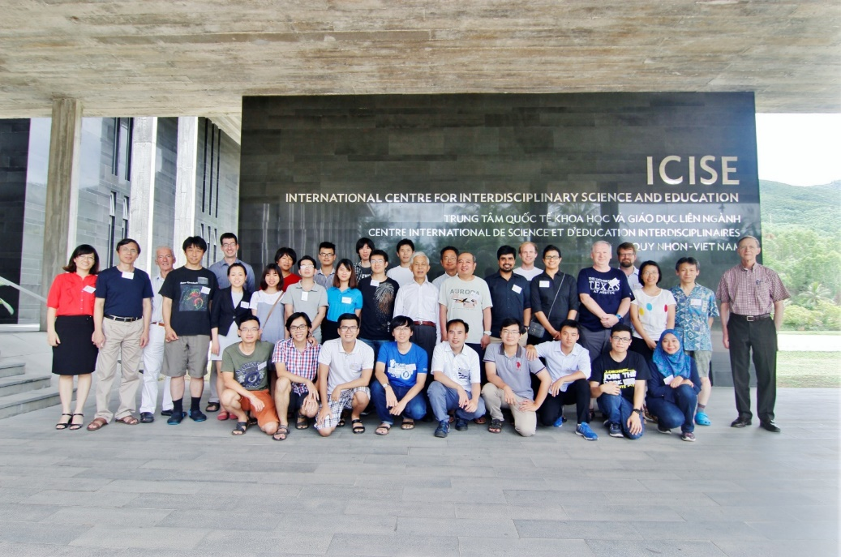
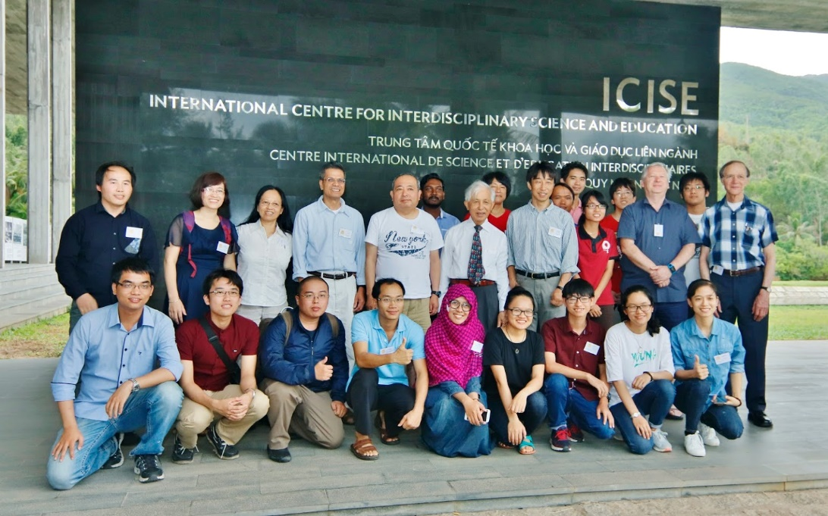
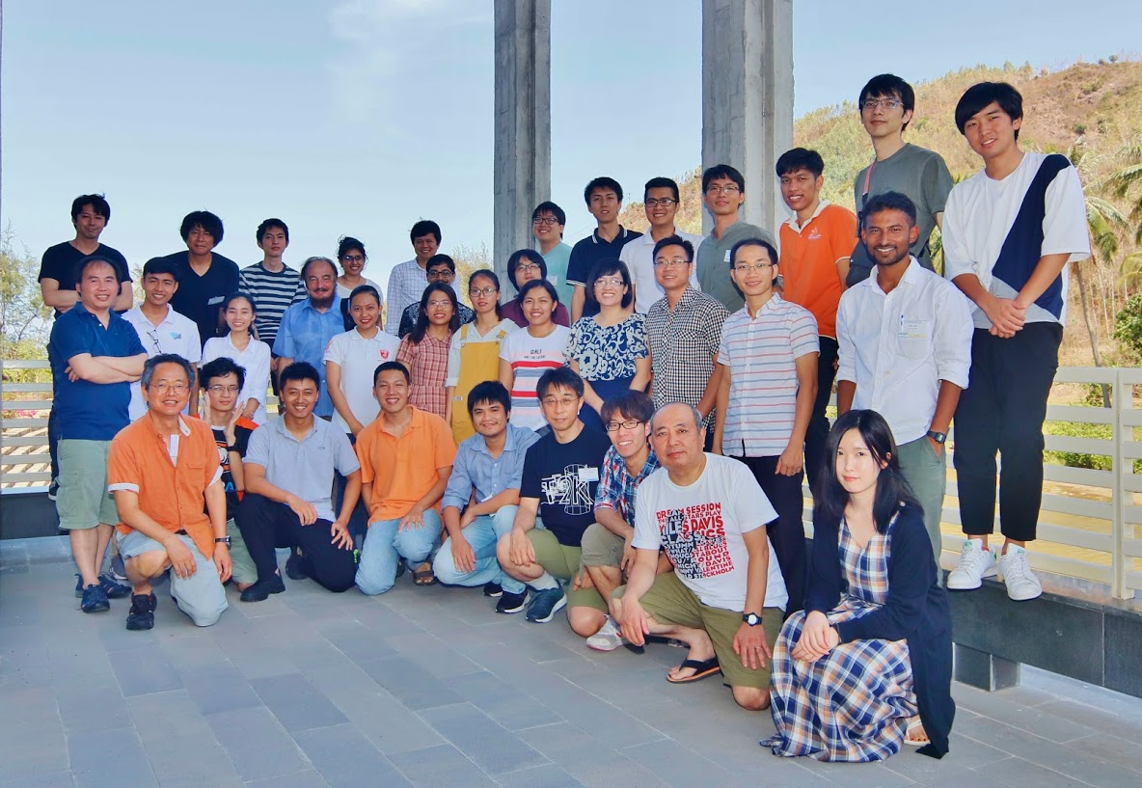
The Vietnam School on Neutrino (VSoN)
VSoN started with the formation
of the neutrino group in 2017.
It has been held every year.
Japanese physicists who
contributed the Vietnam neutrino
group also organize the school.
Unfortunately, VSoN2020 and
VSoN2021 were held by online
because of coronavirus.
VSoN2017
VSoN2018
VSoN2019
3

Slide 4
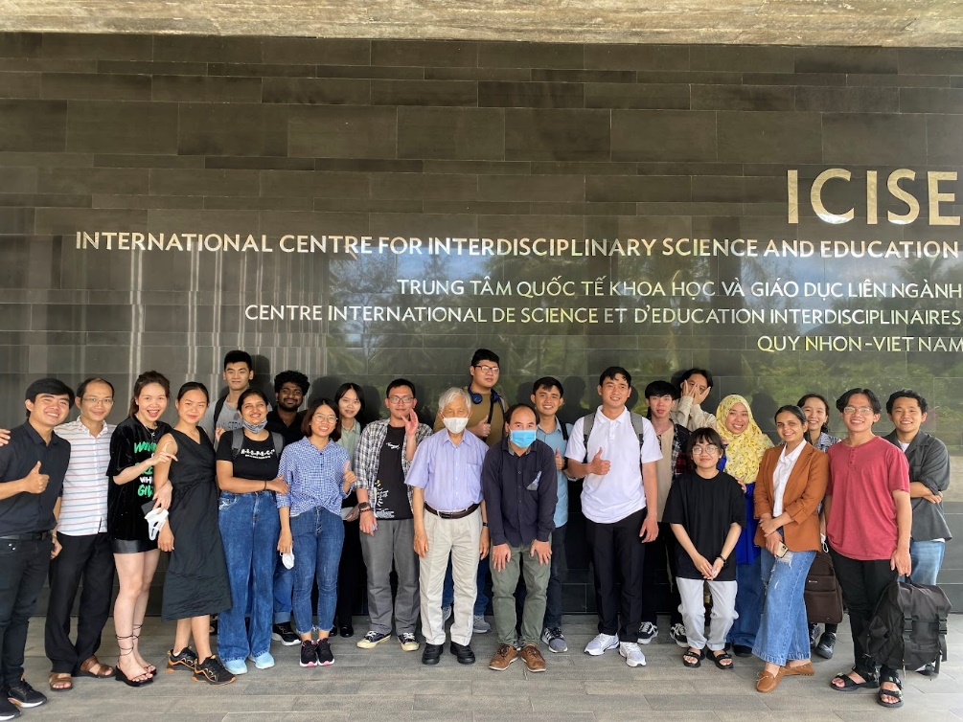
Onsite school restarted from 2022!
The face-to-face school restart
from last year!
The school program mainly focus
on experimental neutrino physics.
About 2/3 lectures are given by
experimental physicists.
We have 21 x 90 minutes lectures.
Among them, only one lecture will
be given remotely.
In addition to lectures, we have
2 software trainings, hardware training and group works.
And we have also an excursion and a school dinner!
VSoN2022
4

Slide 5
Students
We have 26 students. They are 11 from Vietnam, 6 from Japan,
4 from India, 3 from Taiwan, 1 from China and 1 from Nepal.
In every year, most of the students are studying theoretical particle physics. Therefore, one of the school purpose is Invitation to experimental neutrino physics.
We hope that some of them will change their research field from theory to experiment, and will join the Vietnam neutrino group and participate in Japanese neutrino experiments.
We hope that they will become a pioneer of the Vietnamese high energy experiment in future.
5

Slide 6
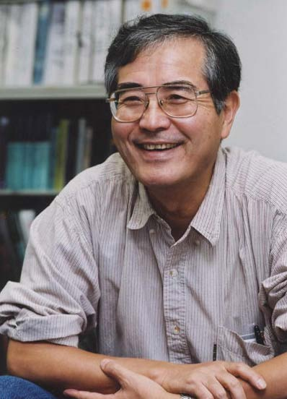
Experiments are important!
To invite students to experiments, let me introduce some words from Prof. Totsuka who was the first spokesperson of the Super-Kamiokande experiment.
Prof. Yoji Totsuka
(1942-2008)
Even though a great theorist propose a fantastic and beautiful theoretical model, we can easily reject it, saying “No! it does not agree with our experiment!”.
In physics, the experimental result is everything.
Straightforwardly speaking, I am a detector physicist.
I can make the best detector in the world,
and I can explore the most advanced physics in the world.
6

Slide 7
Welcome to the world of neutrino experiments !
at least, for 2 weeks,
hopefully,
for the rest of your research life.
Enjoy !
7

