Slide 1
From Kamiokande to K2K
Yuichi Oyama
(KEK/J-PARC)
July 15-26, 2024
Vietnam School on Neutrino 2024
@ICISE, Quy Nhon
1

Slide 2
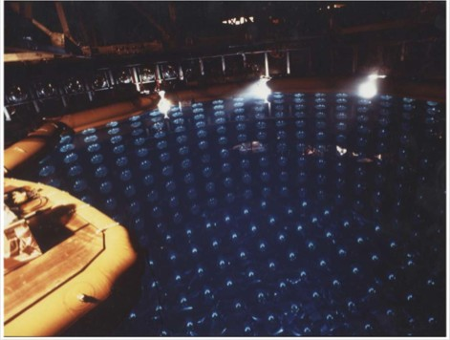
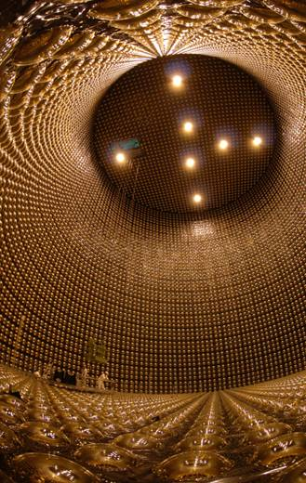
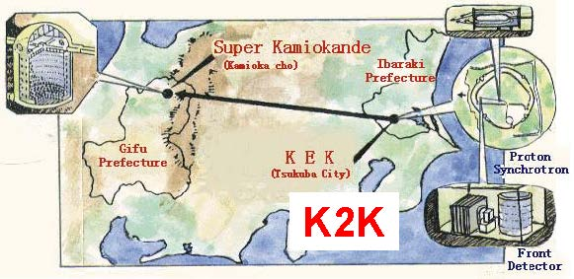
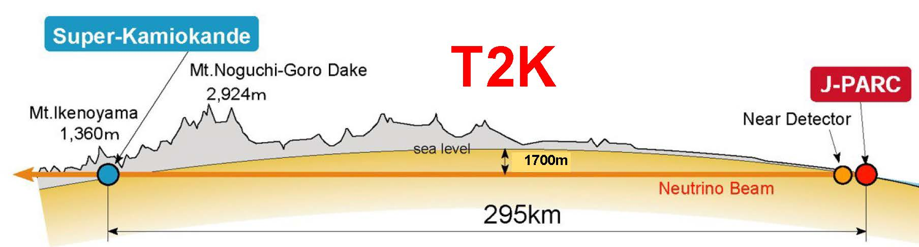
About myself / About my lecture
From 1984, I have participated in following experiments.
Kamiokande experiment
Super-Kamiokande experiment
2
I would like to present a review of these Kamioka-related experiments.

Slide 3
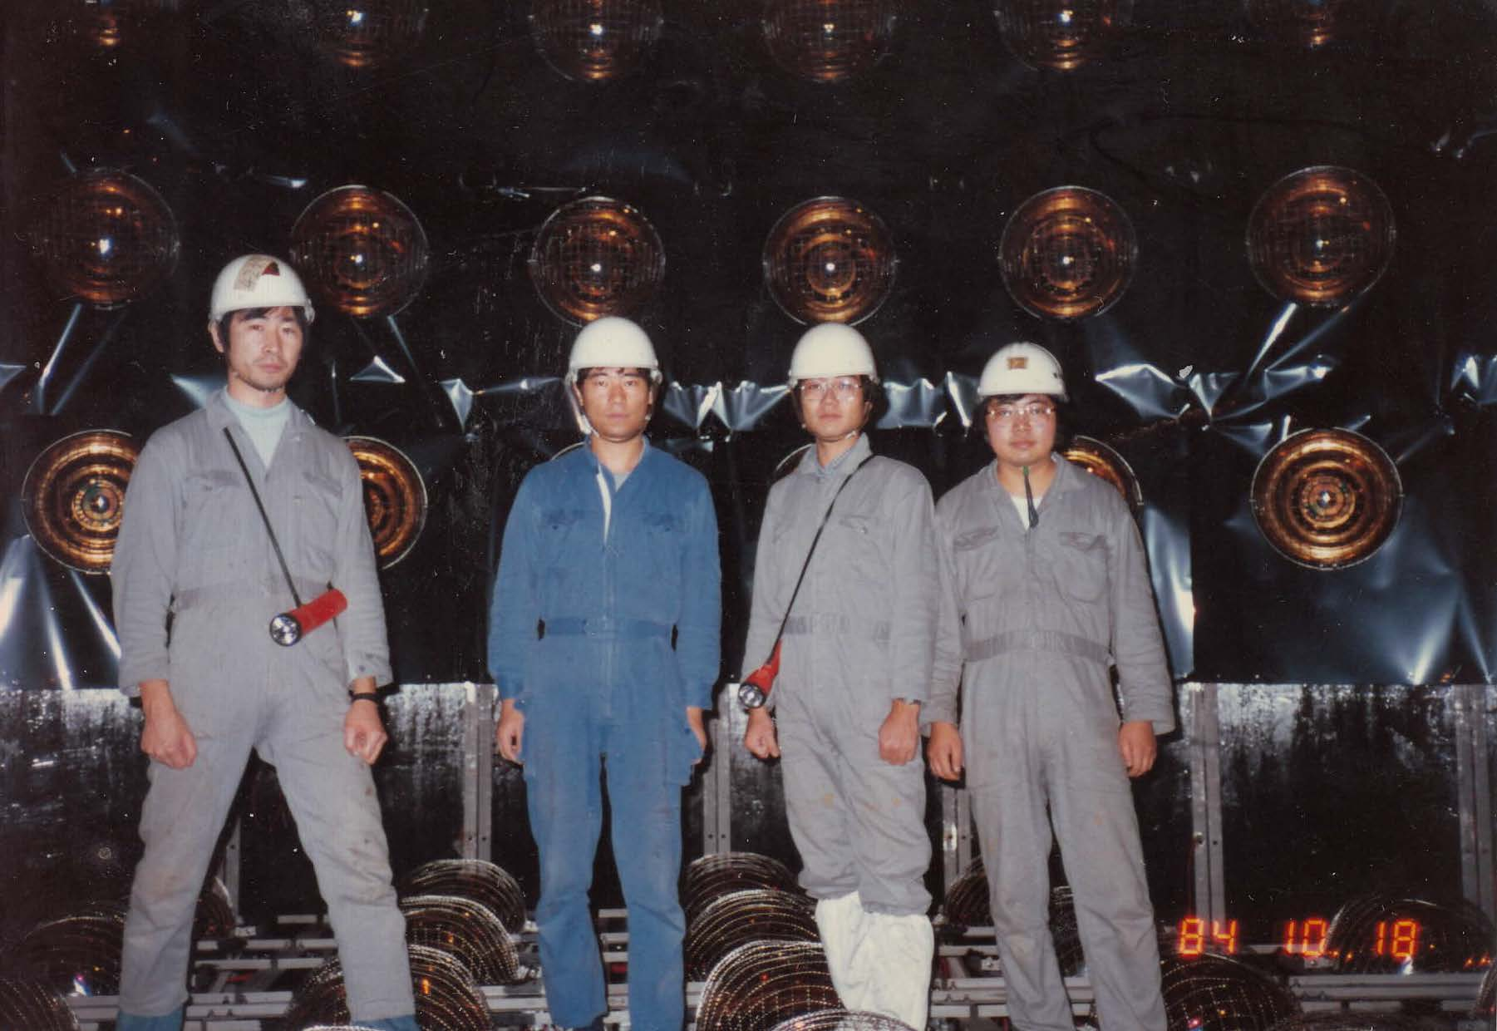
Oct. 1984
3

Slide 4
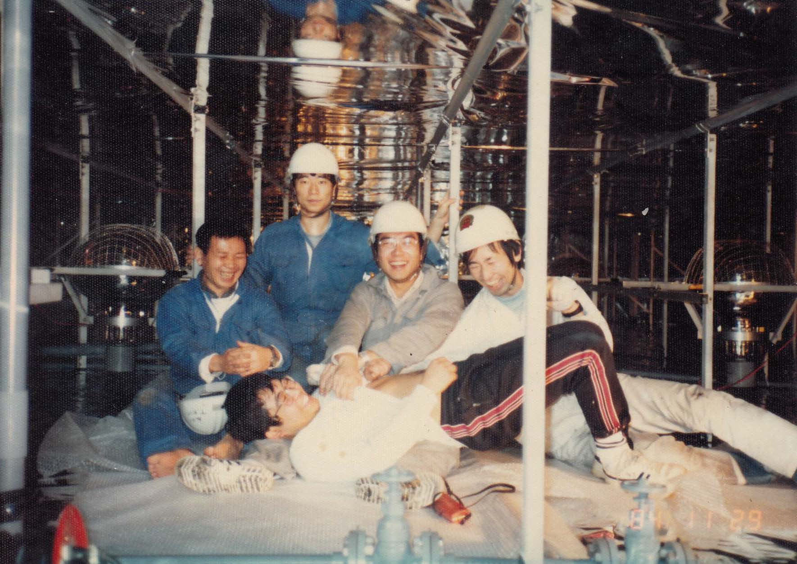
Nov. 1984
4

Slide 5
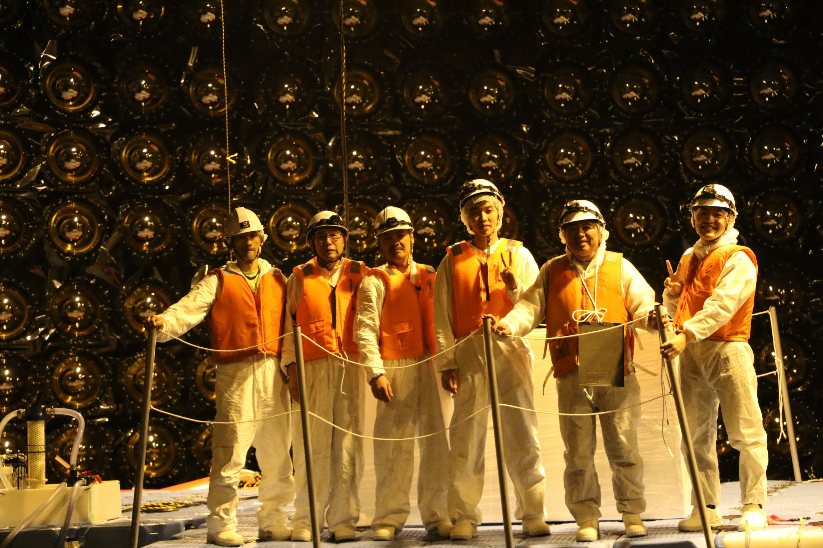
5
Jun. 2018

Slide 6
In this lecture…….
In Vietnam School on Neutrino in 2017 and 2018, I gave 3 days lectures with the title “From Kamiokande to T2K”.
From 2019, the lecture is reduced to 2 days. T2K experiment is not covered. The title was changed to “From Kamiokande to K2K”, accordingly.
Prof. Atsumu Suzuki will give a lecture on T2K experiment after this
lecture, instead.
In the first day, I will present about Kamiokande experiment with
an appendix.
In the second day, I will present experiments after Kamiokande.
6

Slide 7
History of Discoveries by neutrino experiments
1956 Discovery of ν_{e} by Savannah River reactor experiment (N)
1962 Discovery of muon neutrinos by AGS neutrino experiment in BNL (N)
1965 Observation of atmospheric neutrinos by KGF experiment
1968 Solar neutrino deficit claimed by Homestake experiment (N)
1973 Discovery of neutral current interactions by Gargamelle experiment
1987 Kamiokande and IMB detected neutrinos from supernova SN1987A (N)
1988 Kamiokande claimed atmospheric muon neutrino deficit
1989 Kamiokande confirmed the solar neutrino deficit
1998 Super-Kamiokande observed atmospheric neutrino oscillation (N)
1998 Super-Kamiokande confirmed solar neutrino deficit
2000 DONUT observed tau neutrino
2001 SNO confirmed solar neutrino oscillation by neutral current measurement (N)
2002 Kamland observed deficit of reactor neutrinos
2004 K2K confirmed atmospheric neutrino oscillation by artificial neutrino beam
2006 Completely independent confirmation of ν_{μ}-ν_{τ} oscillation by MINOS
2011 First indication of non-zero θ₁₃ by T2K
2012 Non-zero θ₁₃ was confirmed by 3 reactor experiments
2013 Discovery of extraterrestrial high energy neutrinos by IceCube
2015 Discovery of ν_{τ} signal from ν_{μ}-ν_{τ} oscillation by OPERA
2018 Discovery of high energy neutrinos from an astronomical object by IceCube
2020 First indication of CP violation in lepton sector by T2K
Main topics of my lecture, and will be presented precisely.
Related to main topics, and will be mentioned briefly.
7

Slide 8
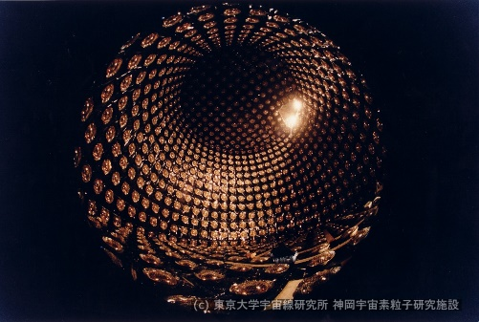
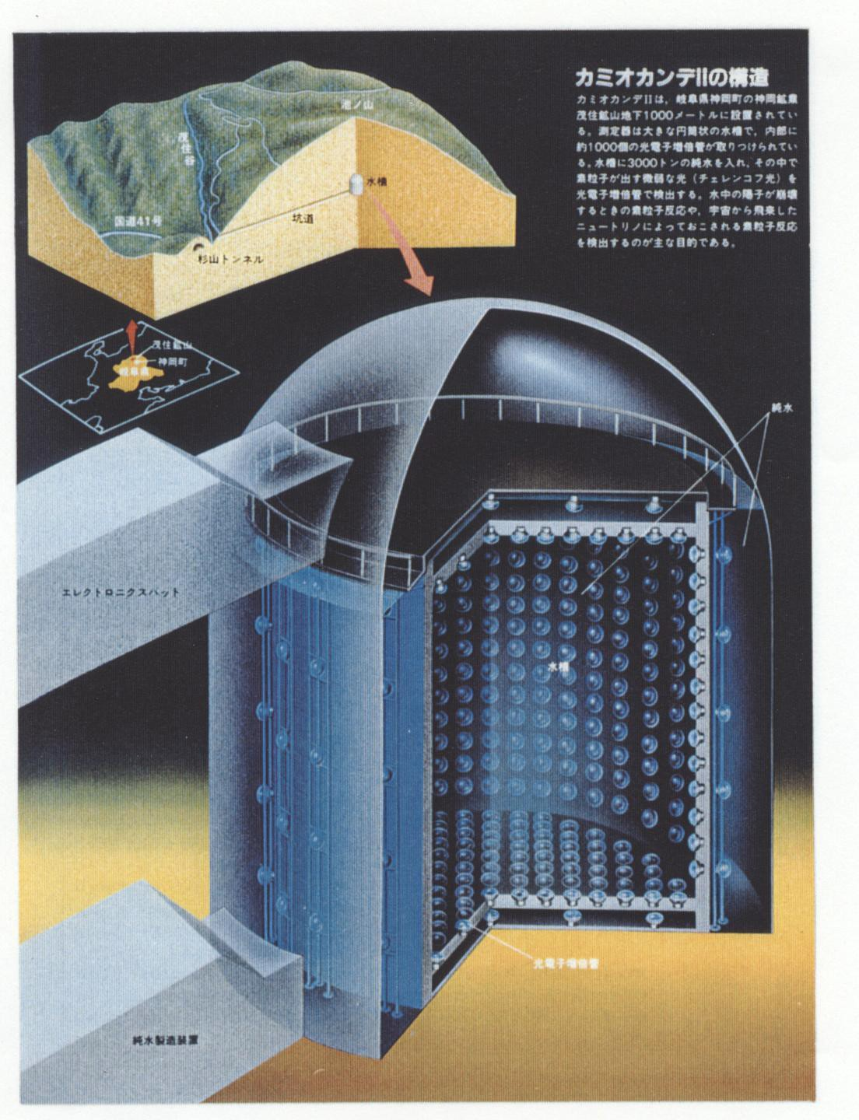
Kamiokande(1983-1996)
A large water Cherenkov detector constructed at 1000 m
(2400 meter water equivalent) underground in Kamioka mine, Japan.
3000 tons of pure water are viewed by 1000 20-inchΦ PMTs.
8

Slide 9
Grand Unified Theories
At the beginning of Kamiokande experiment, the main purpose was examination of Grand Unified Theories (GUTs).
Around the end of 1970s, GUTs were proposed by many theorists.
What is GUTs……..
Accordingly, “nucleon decay” is predicted by the GUTs.
GUTs within 100 words. (Do not ask any question about this.)
There might exist extremely rare interaction by which a quark convert to a lepton. Corresponding gauge boson is very heavy, M~10¹⁵GeV.
Accordingly, the interaction might be suppressed.
In the hot universe just after the big bang, such interaction was frequent. After the universe became cold, the gauge boson became massive due to coupling with Higgs particle. The interaction became suppressed and leptons and quarks were isolated.
It is an analogy or an extension of the GWS model in which neutrino interactions are weak (rare) because W and Z bosons are heavy (M~10²GeV).
If such extremely rare interactions occur between quarks in a nucleon, the nucleon decay into a lepton and a meson.
9

Slide 10
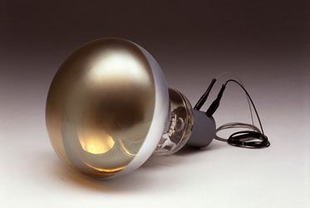
Kamioka Nucleon Decay Experiment
To search for nucleon decay, huge number
of nucleons must be 'viewed'.
Water Cherenkov detectors are one of
best solutions for nucleon decay search.
In February 1979, the first unofficial
proposal of Kamiokande was presented.
In December 1980, the design of 20-inchΦ
photomultiplier tube (PMT) was fixed.
After ~1 year of construction, the experiment started in July 1983.
Water is very cheap and transparent.
Assume that nominal size of the
detector is R. The volume is in proportional to R³, but number of photo sensor on the wall is in proportional to R². It is effectively cheaper for larger detector.
10

Slide 11
Outlook of the Kamiokande
before the start of the experiment
Atmospheric neutrinos (~100 events per year) are serious background for the nucleon decay search !
Outlook of the Kamiokande experiment (From a document in Feb. 1981)
The nucleon life time is expected to be 10²⁸ years to 10³² years, depending on theories. The most hopeful theoretical model predicts that the nucleon lifetime is 1.6 x 10³⁰ years.
With 1000 tons of fiducial volume of the Kamiokande detector,
expected numbers of nucleon decays are as follows,
for τ = 10³⁰ years, 600 nucleon decays per year
for τ = 10³¹ years, 60 nucleon decays per year
for τ = 10³² years, 6 nucleon decays per year
11

Slide 12


Nucleon decay and
atmospheric neutrino background
nucleon decay
Invariant mass (M_{tot}) from all generated particle agrees with mass of nucleon
(M_{p} = 938.3 MeV/c² or M_{n}=939.6 MeV/c²).
Since a nucleon at rest decays, momentum imbalance ΔP = Σp ~ 0 MeV/c.
atmospheric neutrino
Invariant mass and momentum imbalance are correlated with initial neutrino energy
and travel direction.
ν
Possible nucleon decay can be examined
in M_{tot} vs ΔP plane. “Back to back” is a key feature of a nucleon decay event.
12

Slide 13
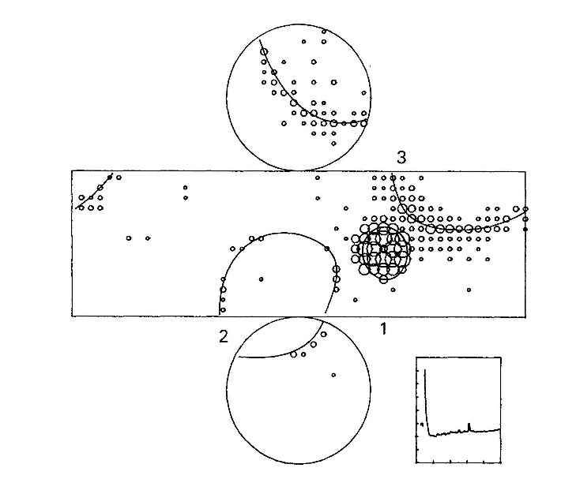
Nucleon decay search was started!
At the early stage of the experiment, most of automatic analysis tools had not been developed.
Event reconstruction
including ring
identification were
carried out manually
by a visual scan.
Koshiba spent a
couple of hours and
scanned hundreds
of events per day.
Possible p->μ⁺+η⁰
candidate
at early stage
Exploded
view
M_{tot} = 972±78 MeV/c²
ΔP = 396±71 MeV/c
13

Slide 14

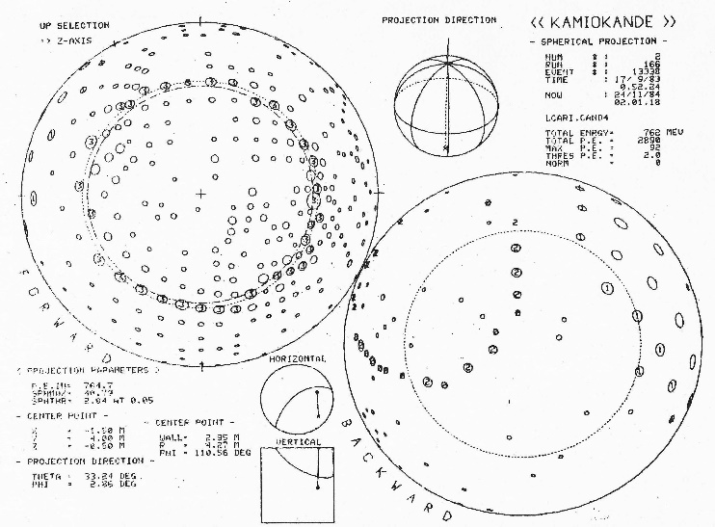
Spherical View
Koshiba's favorite
scanning tool is
"spherical view" .
Finding the first ring.
The view position is set to
the vertex obtained from
the first ring.
The first ring is displayed
in the forward direction.
Simultaneously, backward
view is also displayed.
Another ring is searched
for in the backward view.
Koshiba “I think this would be another ring. How do you think ?”
Kajita “................................”
14

Slide 15
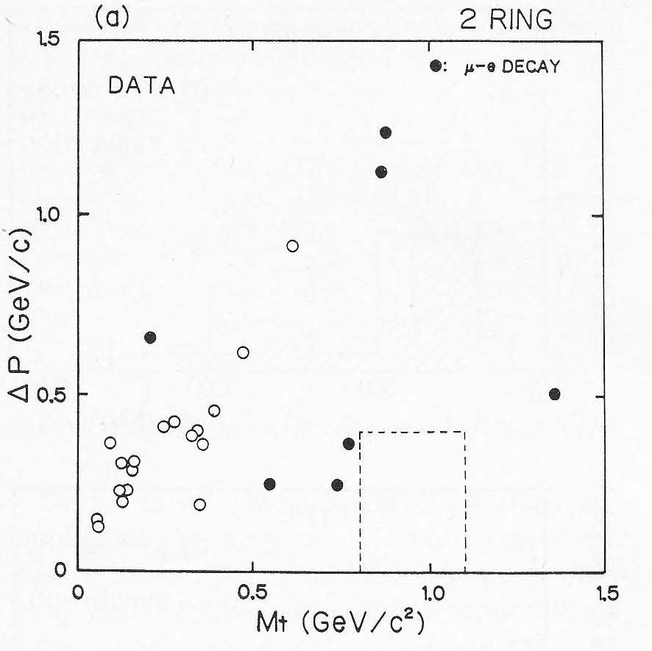
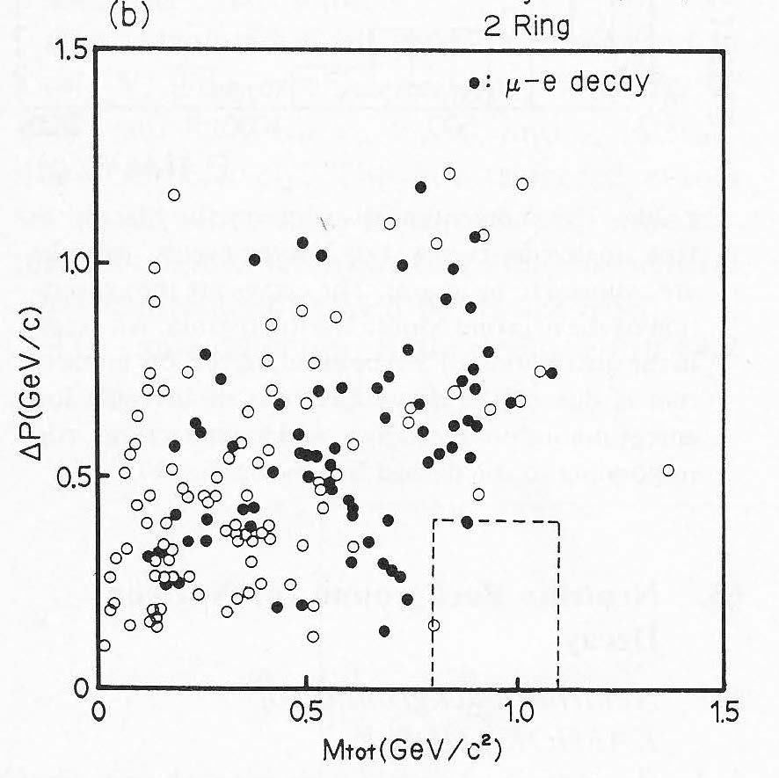
After ~2 years observation
M_{tot} – ΔP plot for 2 ring events after ~2 years observation
M.Nakahata, et al., J.Phys.Soc.Jpn. 55,3786(1986)
1.11kt year data
8.8kt year MC(atmospheric)
signal box
M_{tot}(GeV/c²)
M_{tot}(GeV/c²)
No nucleon decay signal was found.
15

Slide 16
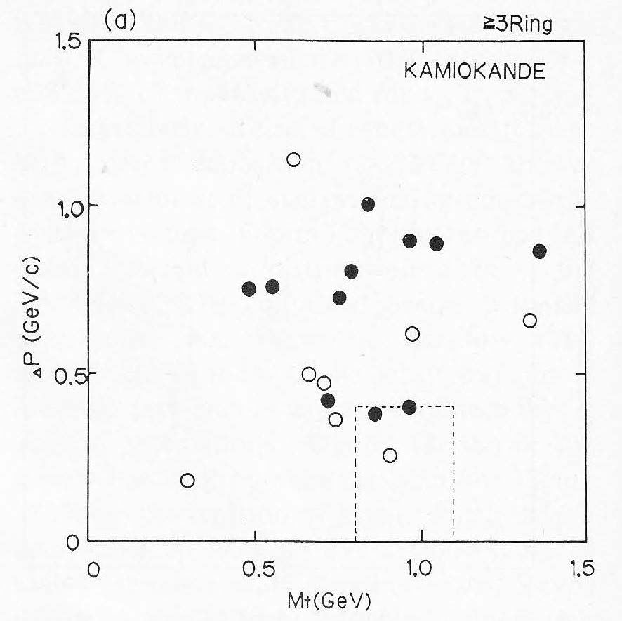
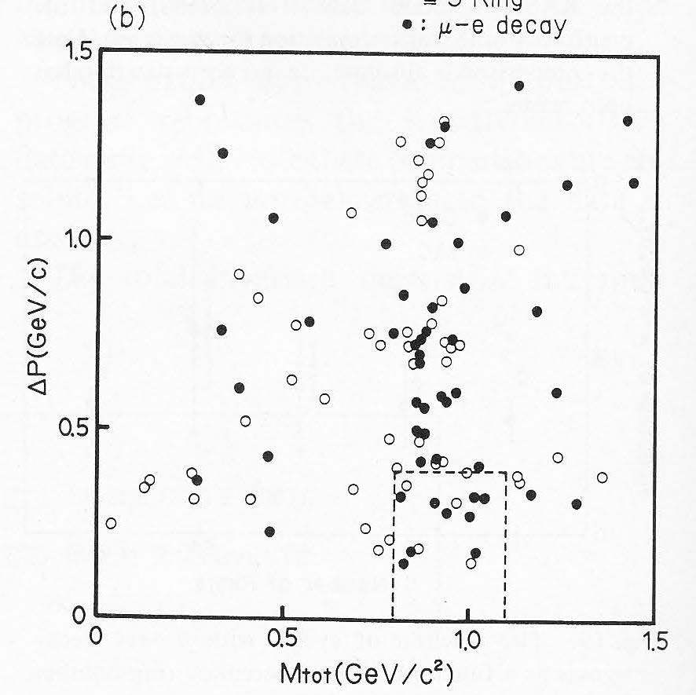
After ~2 years observation
M_{tot} – ΔP plot for 3 ring events after ~2 years observation
M.Nakahata, et al., J.Phys.Soc.Jpn. 55,3786(1986)
1.11kt year data
8.8kt year MC(atmospheric)
signal box
M_{tot}(GeV/c²)
M_{tot}(GeV/c²)
No nucleon decay signal was found.
16

Slide 17
Nucleon decay searches……
In middle of 1980s
Nucleon life time is found to be
much longer than the first prediction.
Start long and patient waiting.
τ = 10²⁸ ~ 10³² years
τ = 1.6 x 10³⁰ years
(most hopeful model)
For τ = 10³⁰ ~ 10³² years,
600~6 nucleon decays in 1kt・year
First prediction in 1981
In 2022
Any positive signals for nucleon
decay have not been found yet
even in Super-Kamiokande.
After more than 20 years of Super-Kamiokande operation, 450 kt・year data has been accumulated. The present constraints on nucleon
lifetime is τ/B > 2.4x10³⁴ years (90% C.L.) for p->e⁺+π⁰ decay mode.
We will continue the nucleon decay search. The impact of nucleon decay on physics is much larger than other topics.
A.Takenaka et al. (Super-Kamiokande collaboration), Phys. Rev. D102, 112011(2020).
Miura-san is an expert on this topics, waiting patiently.
17

Slide 18
A Joke : Conversation between
a Kamioka member and a theorist
Kam: The discrepancy between the experiments and the theoretical prediction is 4 orders of magnitude!
Theorists are liars!
Theo: Experimental results are slightly different from our expectation.
But……., thanks to wrong GUT predictions, Kamiokande experiment was born.
Kam: Yes! Thank you very much (^^).
Now, theoretical models which predict nucleon lifetime around
10³⁵ years are welcome.
It will contribute for financial approval of the next
Hyper-Kamiokande project !
The Hyper-Kamiokande was successfully funded in December 2019!
18

Slide 19
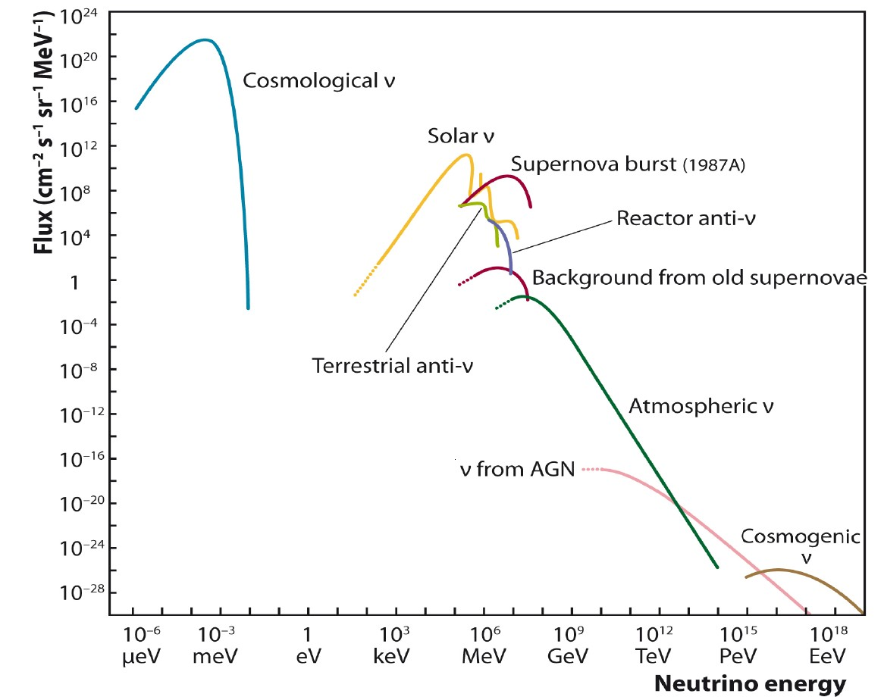
“Kamioka Nucleon Decay Experiment” to
“Kamioka Neutrino Detection Experiment”
After successful exclusions of most of Grand Unified Theories…..,
main subjects became Solar Neutrinos and Atmospheric Neutrinos.
Sources of Neutrinos
http://arxiv.org/abs/1207.4952
19

Slide 20
Solar neutrino and Atmospheric neutrino
Solar Neutrino
E~10 MeV energy range. (“Low energy” in Kamioka terminology)
Energies of supernova neutrinos are also in this range.
Reactor neutrinos have slightly smaller energy.
ν_{e}-ν_{μ} oscillation was studied with these neutrinos.
Atmospheric neutrino
E~1 GeV energy range. (“ATMPD” in Kamioka terminology)
Accelerator neutrino beam have similar energies.
Nucleon decays are also in this energy range (if exist).
ν_{μ}-ν_{τ} oscillation was studied using neutrinos in this energy range
Solar neutrinos in Kamiokande will be covered in
“Solar neutrino experiments” on another day.
20

Slide 21
Kamiokande-II
When Kamiokande experiment started, the trigger threshold of the detector was ~29 MeV. This threshold was low enough to detect nucleon decay mode p->νK⁺(μ⁺ν), which records the smallest energy deposit in the detector.
To detect ⁸B solar neutrinos, the trigger threshold of the detector should be reduced to be around ~8 MeV.
In addition to the trigger threshold, background events in the low energy range should be reduced.
From fall 1984 to end of 1986, many detector upgrade to observe
⁸B solar neutrinos were done. They are:
After these upgrade, namely, Kamiokande-II started in early 1987.
Removal of radioactive sources in water
Construction of anticounter
Installation of New electronics
21

Slide 22
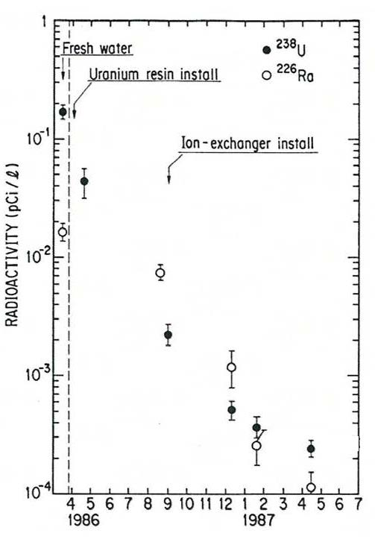
Removal of radioactive sources in water
The most serious background were the β-decay products in Uranium-Radium series. Their nominal energies are < several MeV.
Fresh water from the mine contains
large concentration of Radon.
Supplying the fresh water was stopped
and closed circulation mode was
employed. A Radon-free water
generation system was also installed.
In the water circulation system, Uranium
resin and Ion-exchanger were added.
To prevent contact of water and
Radon-rich mine air, an air-tight ceiling
on the top of the tank were made.
Other components in the water circulation
system were also made air-tighten.
Finally, the radioactivity was reduced by
3 orders of magnitudes.
22

Slide 23
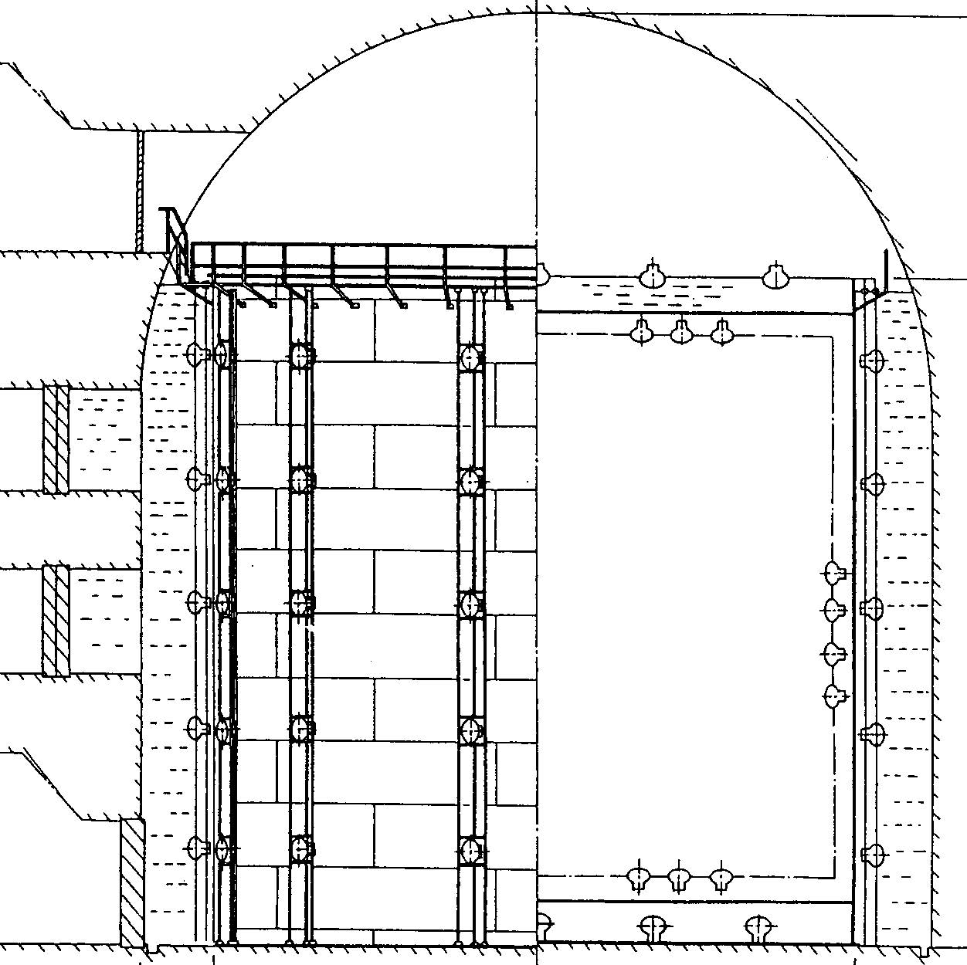
Anticounter
The anticounter layer surrounding the inner detector were newly constructed until
fall 1985.
It was also water Cherenkov detector with >1.4 m water thickness and 123 20-inchΦ
PMTs.
The main purpose of the anticounter layer is to identify entering/exiting charged
particles such as cosmic ray muons.
The anticounter water layer effectively absorb radio activities from surrounding rocks and air.
Rocks
β, γ, n
anticounter
23

Slide 24
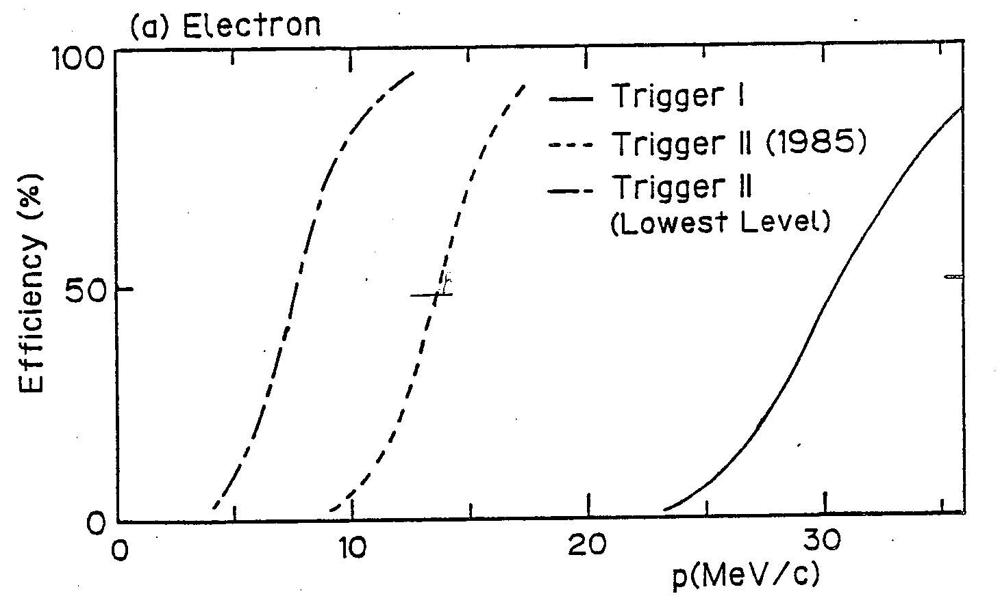
New electronics
University of Pennsylvania group joined the experiment and installed new readout electronics in summer 1986.
The new electronics
was operated with the
condition N_{hit} ≧ 20,
which corresponds to
7.6MeV energy threshold.
Design of the new electronics
Charge and timing information of PMTs are digitized in PMT by PMT basis.
Discriminator is also in PMT by PMT basis.
“Number of hit PMT” signal is made from sum of the discriminator outputs, and used for the trigger logic.
Trigger efficiency
Kamiokande-II
(50% eff. @8.7MeV)
Kamiokande-I
(50% eff. @29MeV)
24
E(MeV)

Slide 25
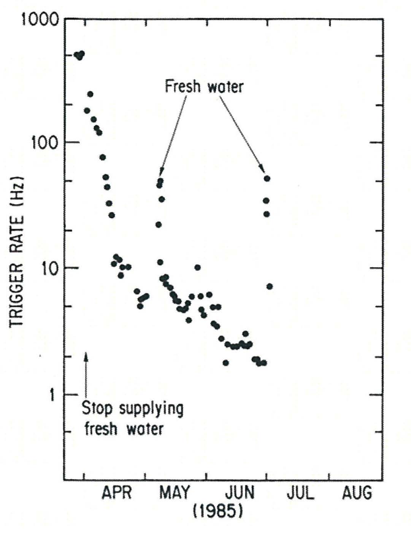
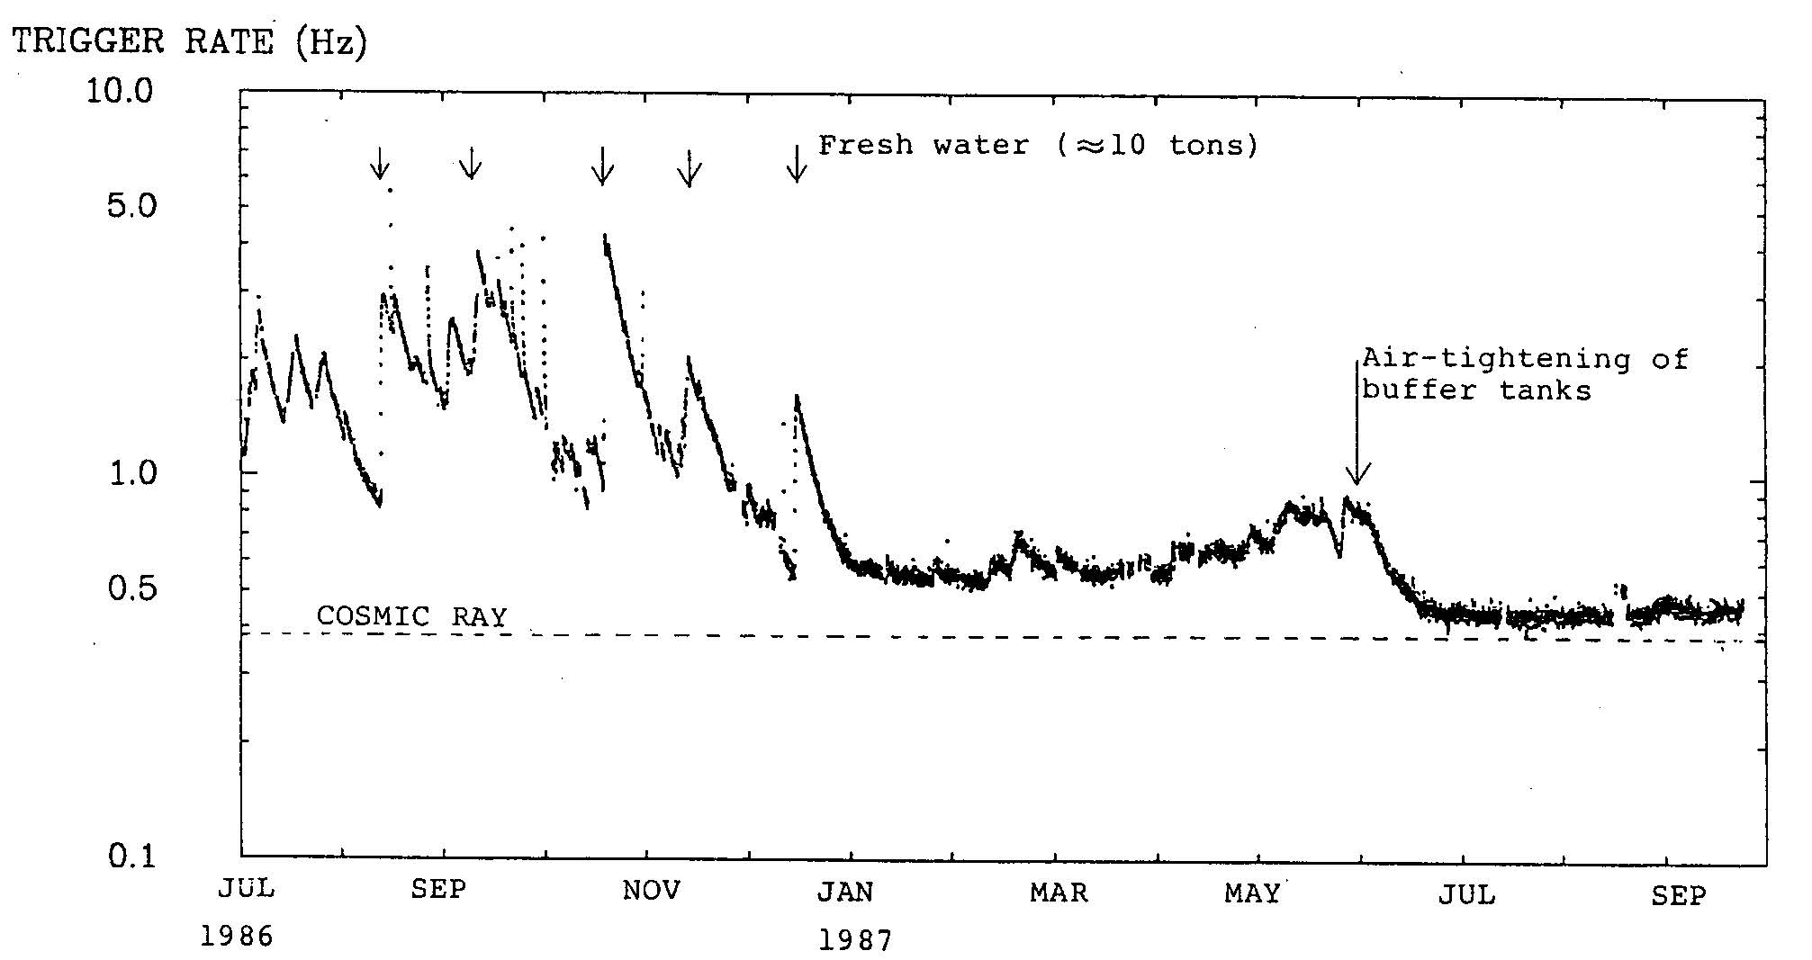
Lower the trigger rate !
Old electronics (1985)
(with improved trigger logic)
50%@~14MeV
Finally, trigger rate of low energy events reduced by more than
3 orders of magnitudes.
The detector became ready for solar neutrino observation in early 1987.
Fresh water
New electronics (Jul 1986 - )
20 hit PMT
50%@7.6MeV
25

Slide 26
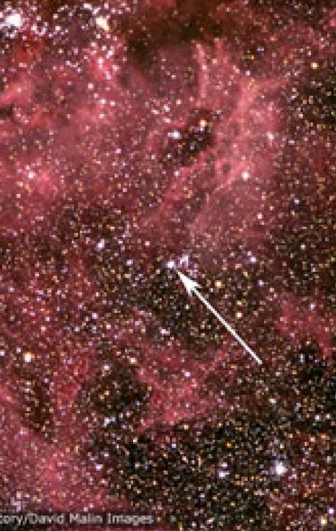
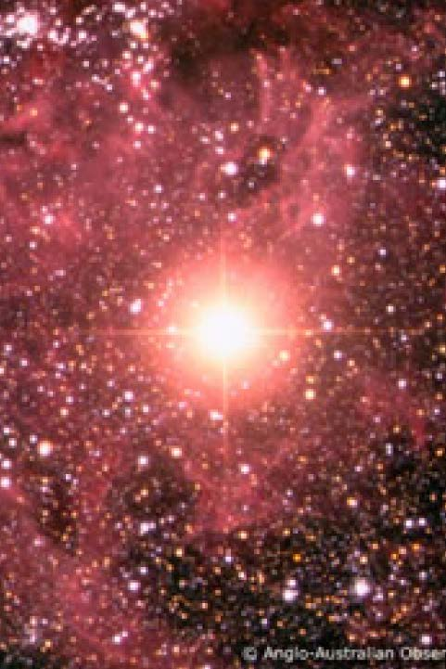
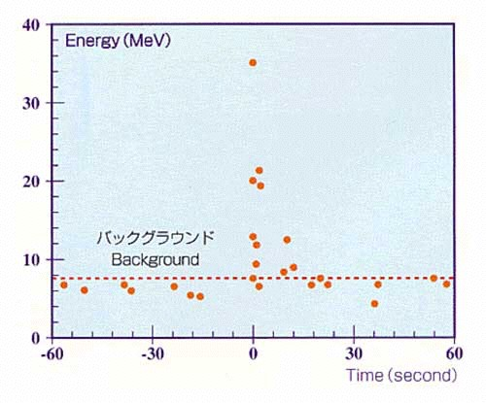
SN1987A
Just after Kamiokande-II became
ready for low energy neutrino
detection....
In February 25, 1987, we received
a news of a supernova
explosion in Large Magellanic
Cloud, which is only 160k
light-year away from our solar
system.
Kamiokande-II immediately
analyzed the data, and found
a clear 11 neutrino events in 13
seconds from February 23 1987,
07:35:35UT (±1min).
26

Slide 27
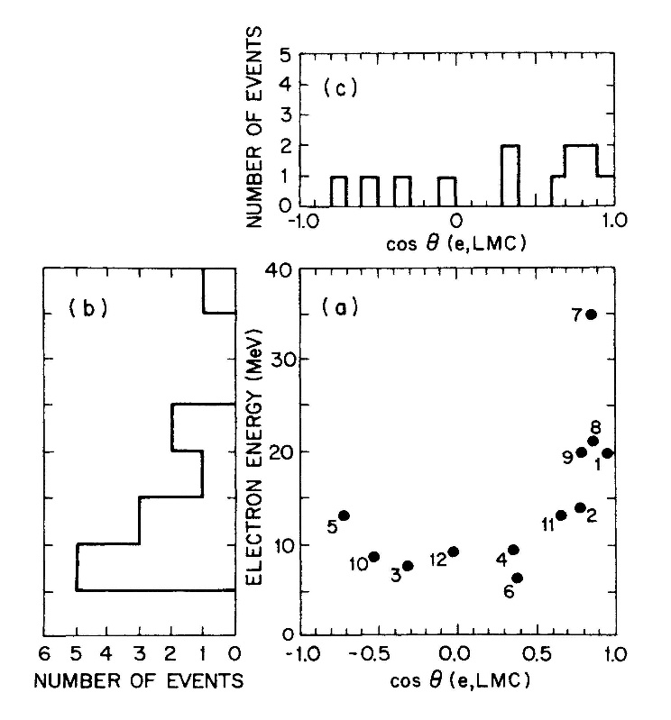
SN1987A
The time structure, energy, and angular correlation with the SN1987A direction, were obtained.
Basically, the distributions as
well as total event number agree with simulations based on theories of supernova explosion.
This extremely lucky observation was the birth of neutrino astronomy.
K.Hirata et al., Phys.Rev.Lett. 58,1490(1987)
K.S.Hirata et al., Phys.Rev.D 38,448(1988)
27

Slide 28
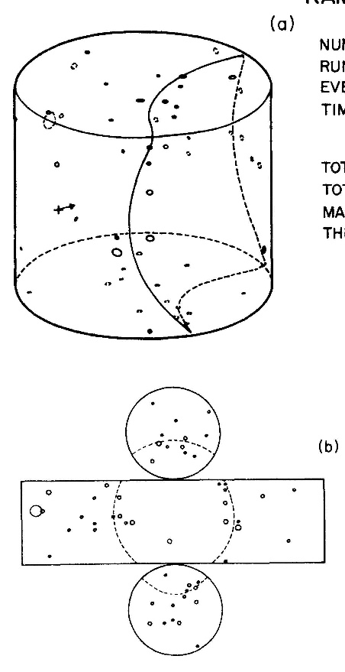
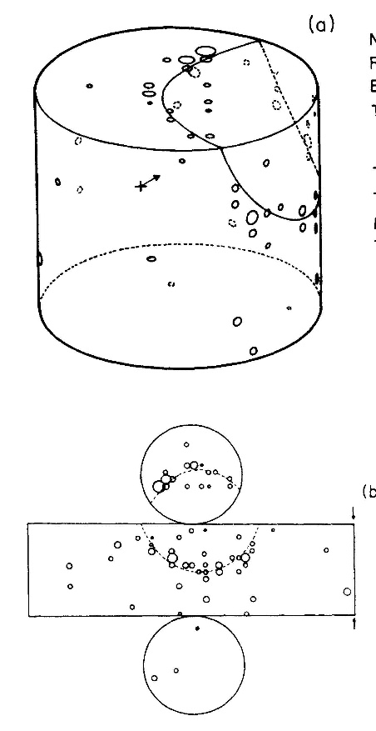
SN1987A neutrino events
Event 1 E_{e}=(20.0±2.9) MeV
Δθ=18º±18º
Event 9 E_{e}=(19.8±3.2) MeV
Δθ=38º±22º
ΔT=1.915 sec
28

Slide 29
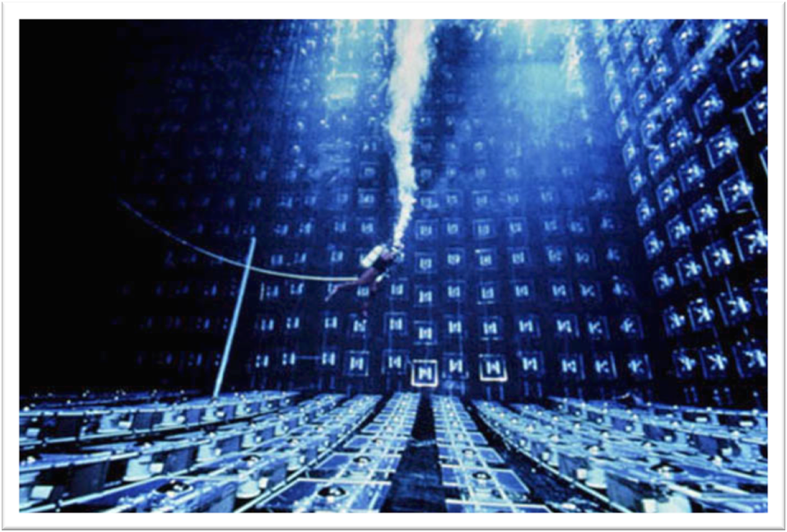
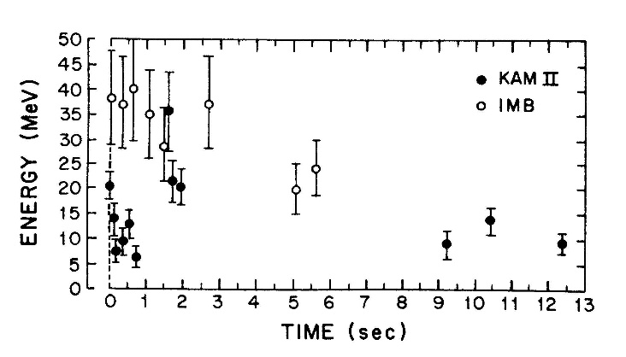
Confirmation by IMB
IMB experiment (1982-1991)
After hearing observation of Kamiokande, the IMB group found neutrino events in Kamiokande event time.
They found 8 neutrino events with energies between 20 MeV to 40 MeV during 6 seconds. The Kamiokande result was certainly confirmed.
IMB physicists searched for neutrino events in > 100MeV energy range?
Kamiokande members in Univ. of Tokyo well knew the neutrino energy range because they kept close communication with theoretical astrophysics group in the University.
Communication with theorists is important.
A water Cherenkov detector at 1570 m.w.e. in the Morton Salt Mine, Ohio.
8 kt of water is viewed by 2048 8-inchΦ PMTs. Fiducial volume is 3.3 kt.
R.M.Bionta et al., Phys.Rev.Lett. 58,1494(1987)
29

Slide 30
Some words by Koshiba
“Measurements of arrival time and arrival direction of signals are essentially important in astronomy. If such information is missing,
it is difficult to claim astronomy. Observation of neutrinos from SN1987A by Kamiokande was the birth of neutrino astronomy.”
The title of second Kamiokande paper on solar neutrino became
“Results from One Thousand Days of Real-Time, Directional Solar- Neutrino Data”.
“Just after the start of Kamiokande-II, neutrinos from SN1987A passed through our detector. It is said that Koshiba is an extremely lucky person. However, I would like to emphasize that 6 billions of people had equal opportunity to detect the Supernova neutrinos.
Only our group prepared for it.”
He strongly appealed that he is the founder of neutrino astronomy, and his achievement was not unexpected good luck.
30

Slide 31
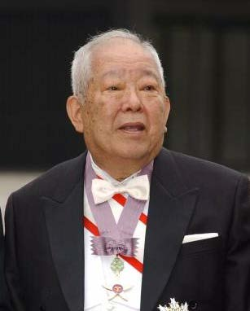
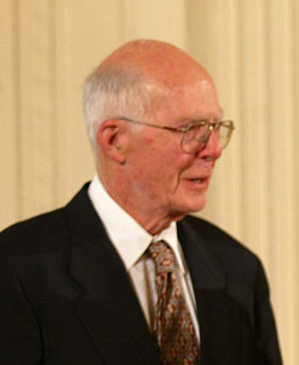
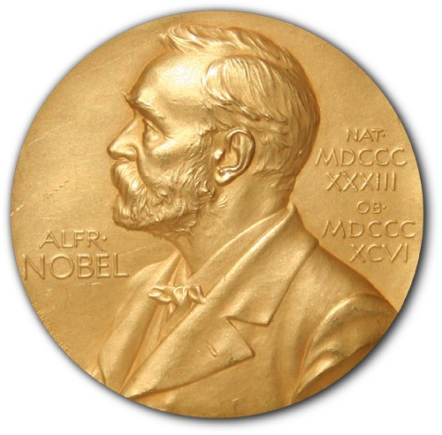
Nobel Prize
Masatoshi Koshiba shared the Nobel Prize in Physics for 2002 with Raymond Davis Jr. The reason of the award is "for pioneering contributions to astrophysics, in particular for the detection of cosmic neutrinos"
31

Slide 32
What we have learned from
the low energy experience?
Once the detector was constructed, we must consider what physics can be done with our own detector.
For that purpose, we must keep studying nearby research field and must keep close communication with physicists in that field.
Actually, solar neutrinos and supernova neutrinos are in the field of nuclear physics and astronomy. We were not familiar to these fields, and we have
learned basics from the experts.
-We have started from “nuclear decay” instead of nucleon decay.
-We have started from “definition of celestial coordinate”.
32

Slide 33



Atmospheric neutrinos
p,He,…
Primary cosmic rays (p, He,…)
collide with upper atmosphere
and neutrinos are produced.
π±
μ
π μ + ν_{μ}
e + ν_{e} + ν_{μ}
e
ν_{e} : ν_{μ} ~ 1 : 2
Particles and anti-particles are not distinguished unless needed.
For example, π -> μ + ν_{μ} means
π⁺ -> μ⁺ + ν_{μ} and π⁻ -> μ⁻ + ν_{μ}.
ν_{μ}
ν_{e}
ν_{μ}
33

Slide 34
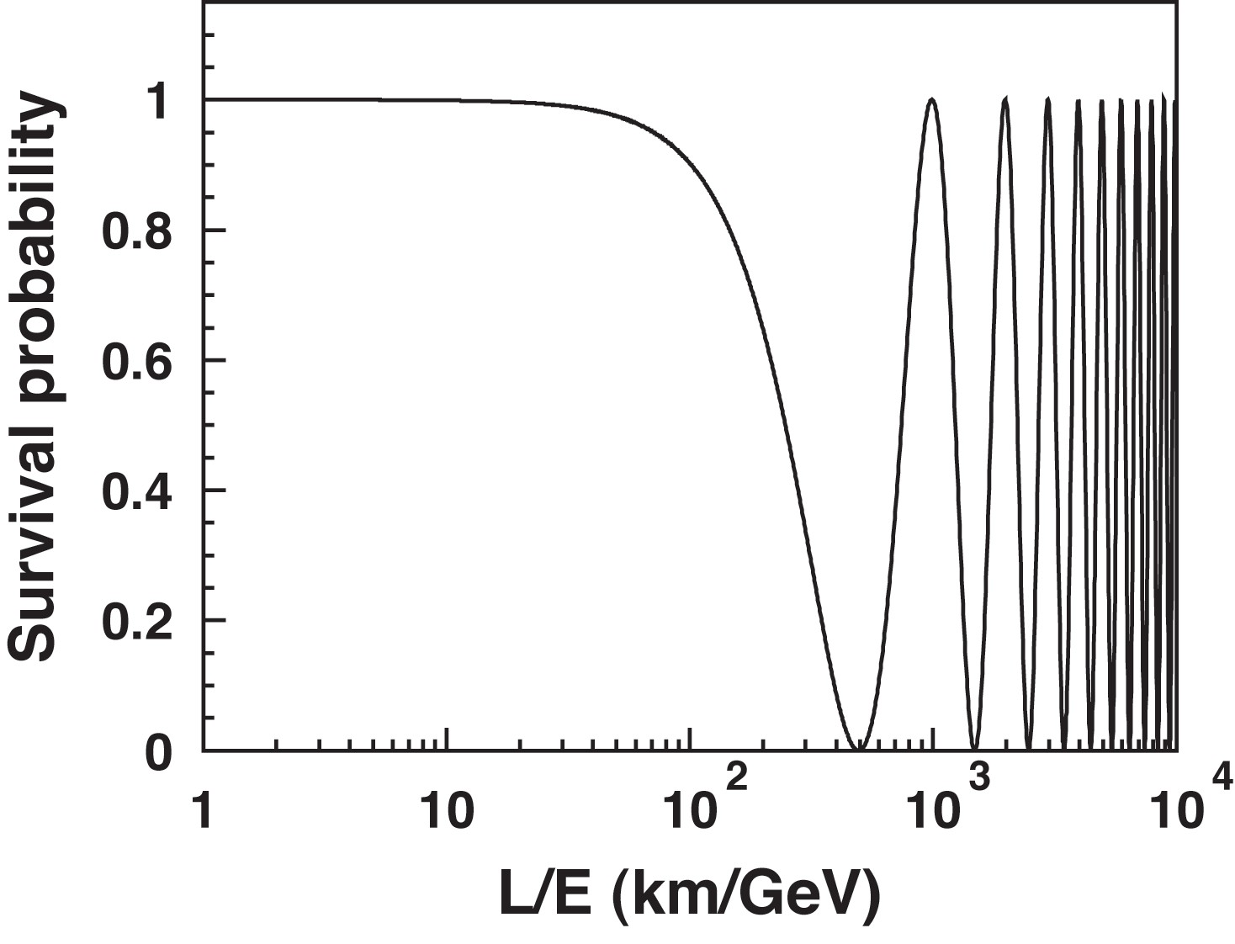
Atmospheric neutrino oscillation
Downward-going ν_{e} agree with expectation. Downward-going ν_{μ} agree with expectation. Upward-going ν_{e} agree with expectation.
Only upward-going ν_{μ} are significantly smaller than expectation.
Neutrino oscillation from ν_{μ} to ν_{τ} can explain the ν_{μ} deficit.
ν
L = 10~30km
the Earth
ν
ν
L~13000km
Downward-going
p, He ...
P(ν_{μ}->ν_{μ}) = 1-sin²2θ sin²(Δm²L/4E)
ν_{e}
ν_{μ}
ν_{τ}
Downward-going
Upward-going
Upward-going
ν_{e}
ν_{μ}
ν_{τ}
34

Slide 35
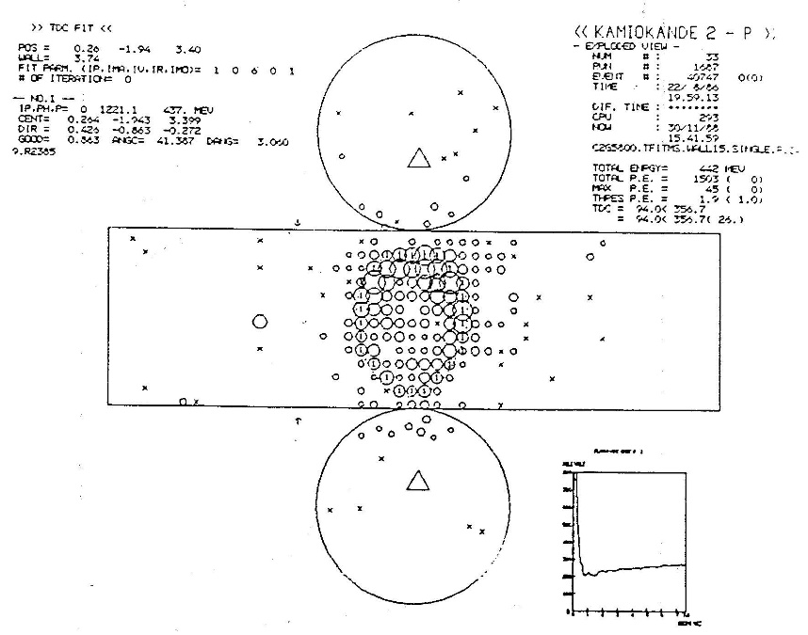
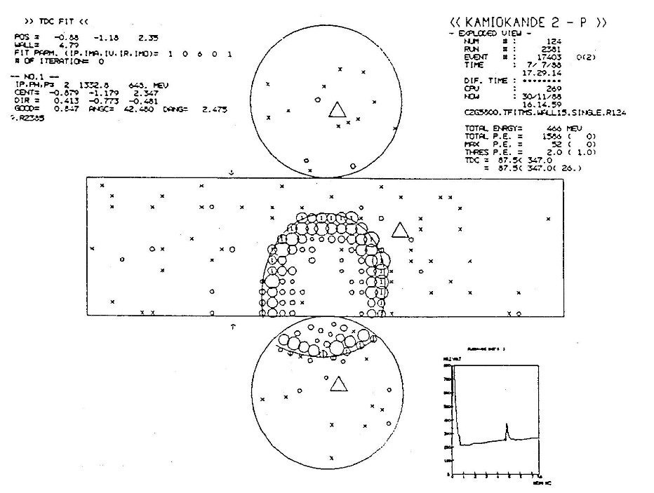
e/μ identification in Kamiokande
ν_{e} e
Cherenkov light from electromagnetic shower. Electrons and positrons are heavily scattered.
Cherenkov ring edge is fuzzy.
ν_{e}
e
ν_{μ} μ
Only direct Cherenkov light from μ
Clear Cherenkov ring edge
ν_{μ}
μ
e/μ misidentification probability is less than 1 %.
35

Slide 36
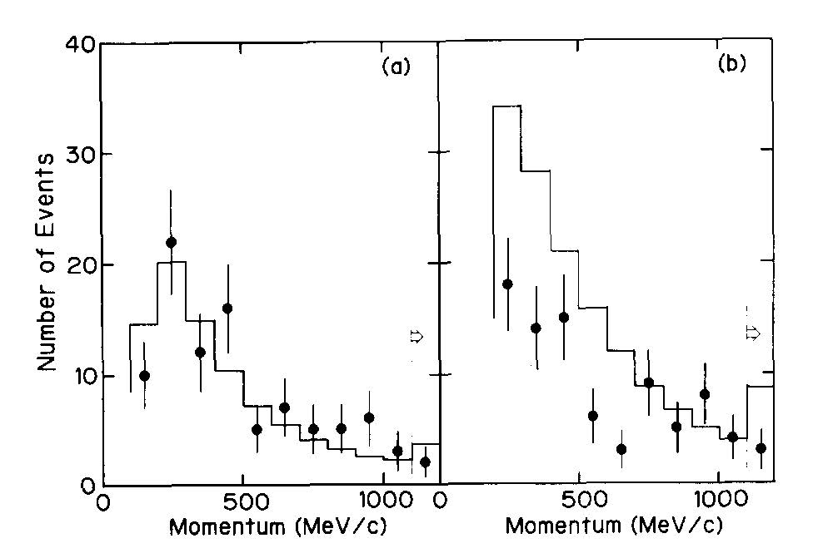
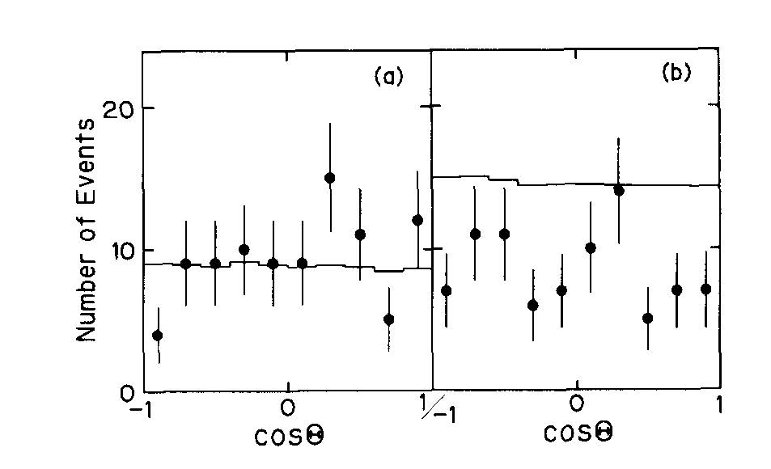
“Experimental study of the atmospheric neutrino flux”
The first Kamiokande paper : K.S.Hirata et al., Phys. Lett B205, 416(1988)
2.87 kt・yr data
e data 93
MC 88.5
μ data 85
MC 144.0
 | data | MC
Single ring e-like | 93 | 88.5
Single ring μ-like | 85 | 144.0
Multi ring | 87 | 86.2
total | 265 | 318.7
e-like : good agreement
μ-like : data/MC = 59±7% (stat)
“We are unable to explain the data as the result of systematic detector effects or uncertainties in the atmospheric neutrino fluxes.
Some as-yet-unaccounted-for physics such as neutrino oscillations might explain the
data.”
e data 93
MC 88.5
μ data 85
MC 144.0
36

Slide 37
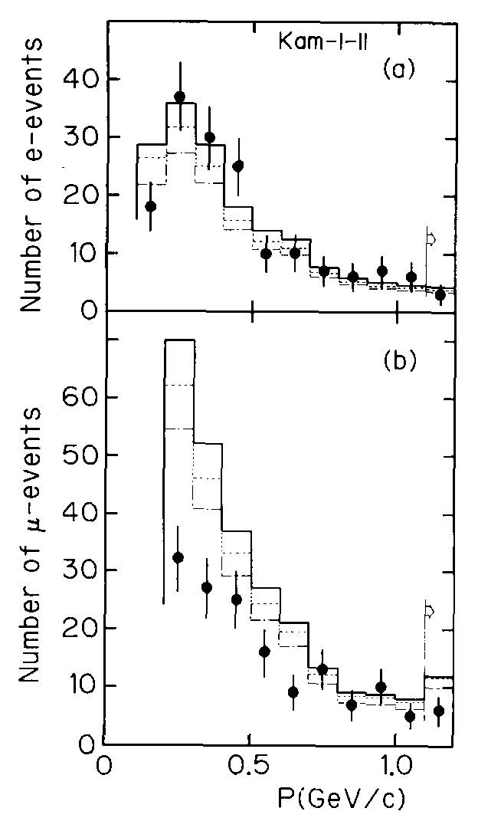
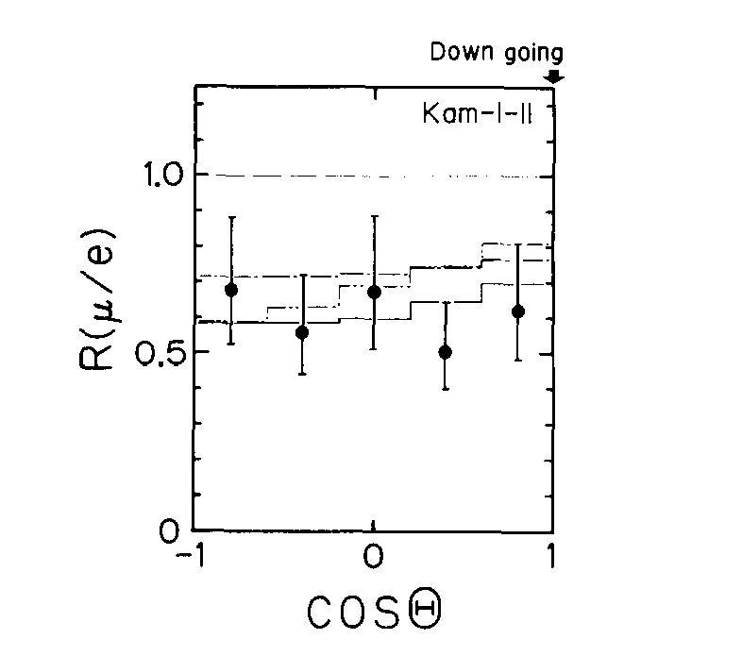
“Observation of a Small ν_{μ}/ν_{e} Ratio in Kamiokande”
The second Kamiokande paper : K.S.Hirata et al., Phys. Lett B280, 146(1992)
4.92 kt・yr data, 310 single ring events
 | data | MC1 | MC2 | MC3
Single ring e-like | 159 | 164.9 | 146.0 | 127.7
Single ring μ-like | 151 | 260.6 | 234.2 | 205.2
e data 159
MC1 164.9
MC2 146.0
MC3 127.7
1992論文
“an earlier observation in the atmospheric neutrino flux of a smaller ratio (ν_{μ}+ν_{μ})/(ν_{e}+ν_{e}) than expected has been strengthened by additional data of comparable statistical weight.”
μ data 151
MC1 260.6
MC2 234.2
MC3 205.2
151
260.6
234.2
205.2
μ data/e data
μ expected/e expected
+0.07
R(μ/e) = 0.60 (stat.)±0.05(syst.)
-0.06
37

Slide 38
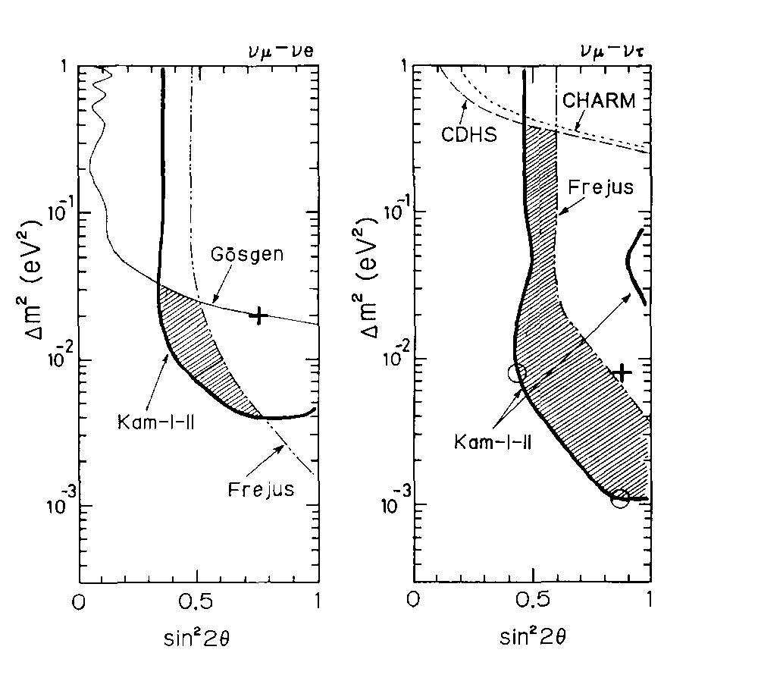
“Observation of a Small ν_{μ}/ν_{e} ……” (continued)
Absolute atmospheric neutrino flux is ambiguous but ν_{μ}/ν_{e} ratio is robust. ν_{μ}-ν_{τ} oscillation is favored, but ν_{μ}-ν_{e} cannot be denied.
"Neutrino Oscillation" was discussed positively.
sin²2θ-Δm² plot was officially reported first time.
ν_{μ}-ν_{e}
ν_{μ}-ν_{τ}
ν_{μ}-ν_{τ}
Best fit
(sin²2θ,Δm²)=
(0.87,0.8x10⁻²eV²)
ν_{e}
ν_{μ}
ν_{τ}
ν_{μ}-ν_{e}
Best fit in 2016
(sin²2θ,Δm²)=
(1.00,2.51x10⁻²eV²)
ν_{e}
ν_{μ}
ν_{τ}
38

Slide 39
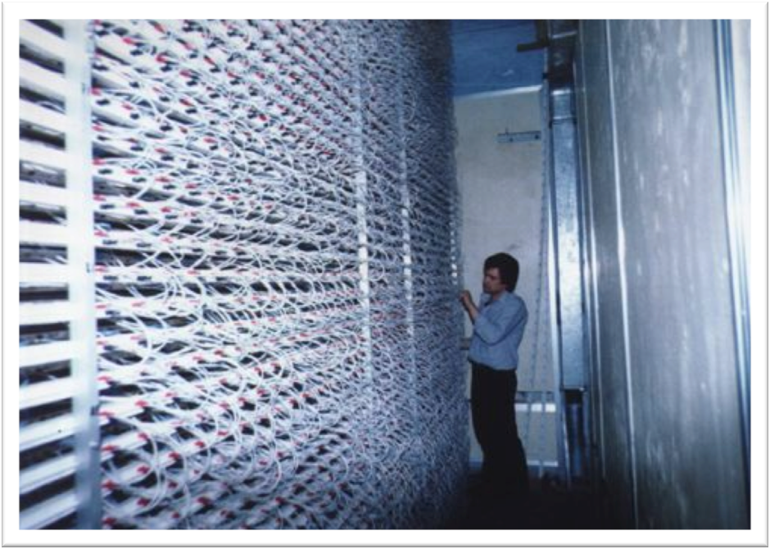
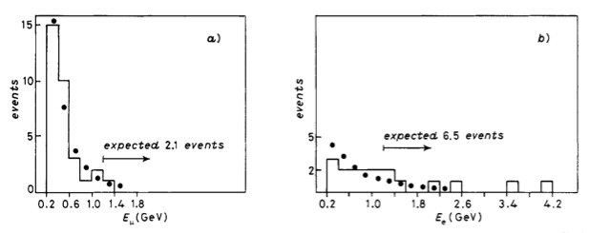
NUSEX experiment (1982-1988)
The NUSEX detector is a digital tracking
calorimeter of 3.5m x 3.5m x 3.5m,
located in Mont Blanc tunnel at
4800 m.w.e. underground.
It is a sandwich of 134 horizontal iron
plates of 1.0 cm thickness, and layers of
plastic streamer tubes 3.5 m long and of
(9 x 9) mm² cross-section.
The total active mass is 150 ton.
From 740 ton・yr of exposure, data agree with Monte Carlo expectation.
μ data 32
expected 36.8
e data 18
expected 20.5
R=(μ_{data}/μ_{MC})/(e_{data}/e_{MC})
+0.32
=0.96
-0.28
M. Aglietta et al., Europhys. Lett. 8 (7),
611 (1989)
39

Slide 40
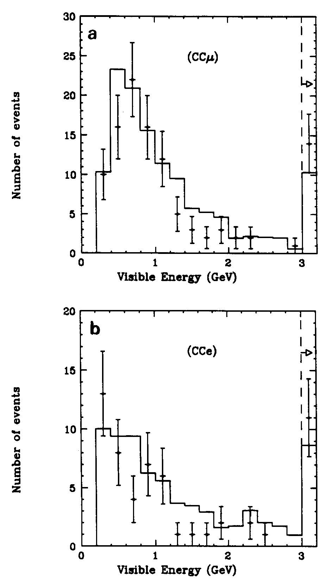
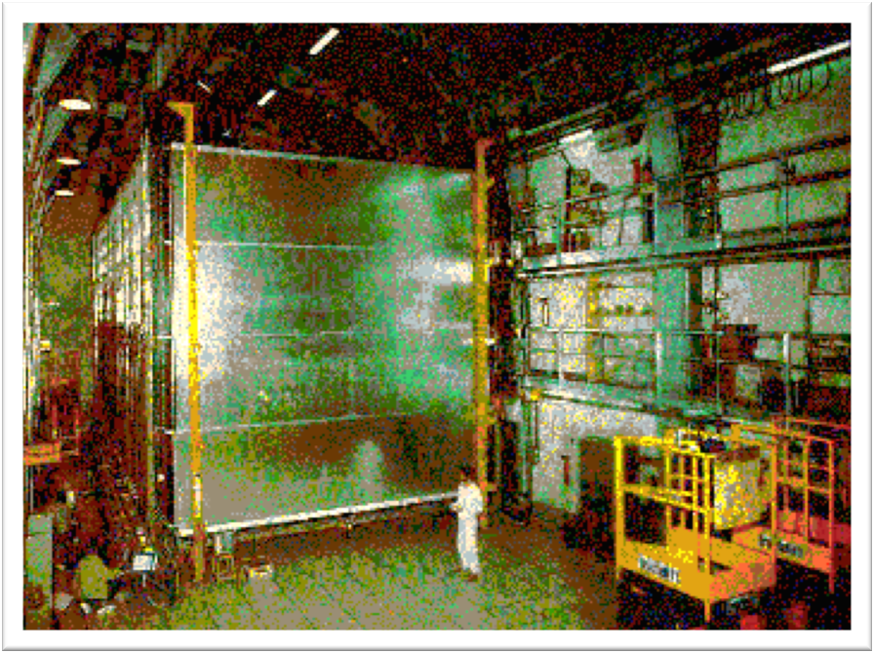
Frejus experiment (1984-1988)
The Frejus detector is located in the Frejus highway tunnel connecting France and Italy. The rock coverage is 1780m.
It consists of 912 flash chamber planes and 113 Geiger tube planes. A flash chamber plane is made of a sandwich of 3 mm thick iron plates and 5 mm thick plane of plastic flash tubes. The fiducial mass is 554 tons.
“Good agreement is obtained between the data and the simulation within statistics.”
μ
ｄata 108
expected 125.8
1.56kton・yr data
e
Data 57
expected 70.6
Ch. Berger et al.,
Phys. Lett B227, 489(1989)
40

Slide 41
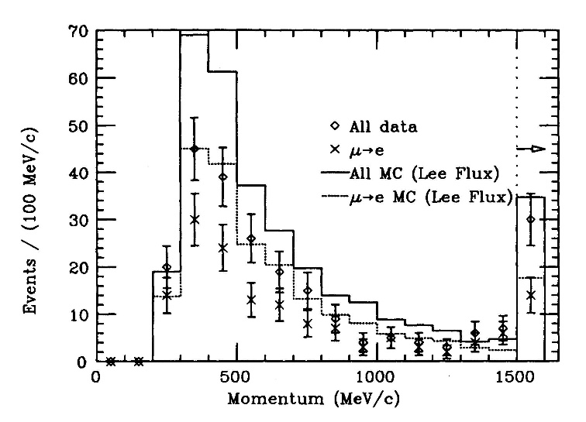
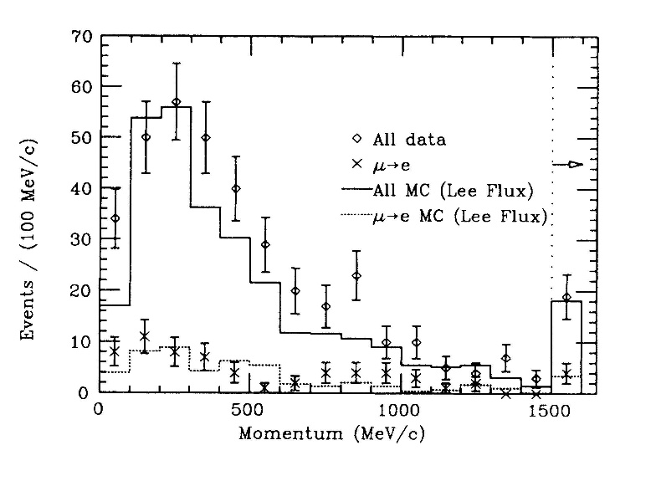
IMB-3 experiment
Data from 851 days of IMB-3 experiment are analyzed.
A total of 935 contained atmospheric neutrino events are
accumulated from 7.7 kton・yr of exposure.
The fraction of nonshowering events is
The discrepancy is 2.6σ.
Alternative analysis employing μ->e
decay signal also shows a similar
discrepancy.
R.Becker-Szendy, et al PhysRevD.46.3720(1992)
 | data | Monte Carlo
Nonshowering (ν_{μ}-like single ring) | 182 | 268.0
Showering (ν_{e}-like single ring) | 352 | 257.3
Nonshower
300 < p < 1500 MeV
data 182
MC 268.0
〇: all data
×: μ->e signal
Data: 0.36±0.02(stat)±0. 02(syst)
MC: 0.51±0.01(stat)±0. 05(syst)
Shower
１00 < p < 1500 MeV data 325
MC 257.3
〇: all data
×: μ->e signal
41

Slide 42

“Atmospheric ν_{μ}/ν_{e} ratio in the multi-GeV energy range”
The third Kamiokande paper : K.S.Hirata et al., Phys. Lett. B335, 237(1994)
Atmospheric neutrino analysis was extended to higher (multi-GeV) energy range. In addition to fully contained events with E_{vis} > 1.33 GeV, partially contained events are included.
Analysis for the sub-GeV neutrinos was also updated.
In the multi-GeV energy range,
The result shows a small ν_{μ}/ν_{e} ratio,
and is consistent with sub-GeV energy range.
 |  |  | data | M.C.
Sub-GeV (7.7 kt・yr, 690 events) |  | e-like | 248 | 227.6
 |  | μ-like | 234 | 356.8
Multi-GeV | Fully-contained (8.2 kt・yr,195 events) | e-like | 98 | 66.5
 |  | μ-like | 31 | 37.8
 | Partially-contained (6.0 kt・yr,118 events) | e-like | --- | -----
 |  | μ-like | 104 | 124.4
ν
+0.08
R(μ/e) = 0.57 (stat.)±0.07(syst.)
-0.07
ν
42

Slide 43
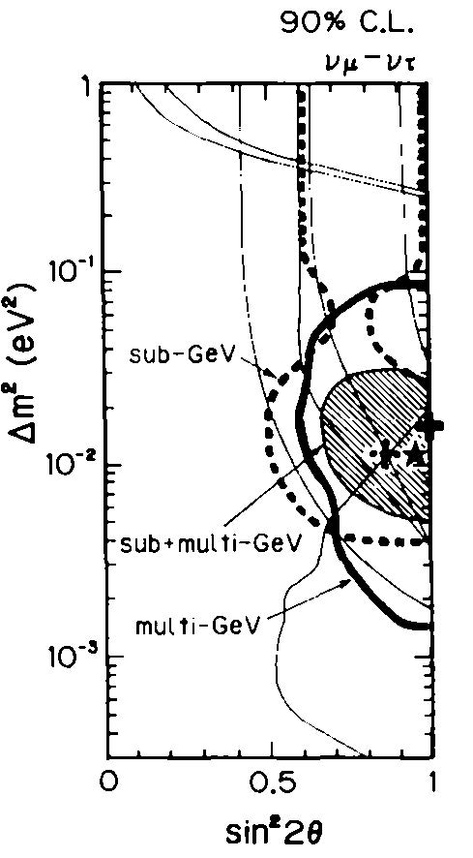
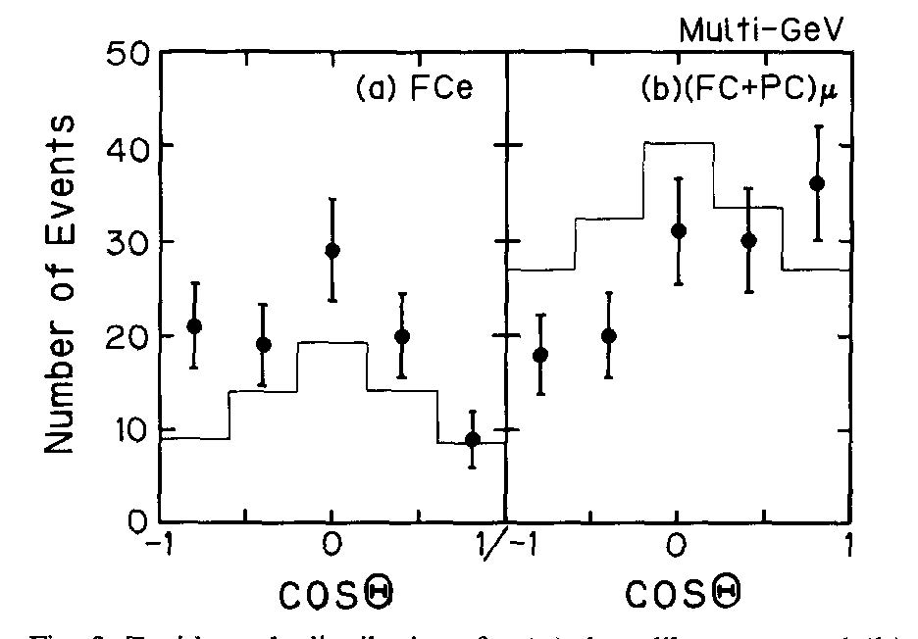
“Atmospheric …… multi-GeV
energy range”(continued)
Best fit in 2016
(sin²2θ,Δm²)=
(1.00,2.51x10⁻²eV²)
Zenith angle distribution of multi-GeV
muon neutrino events shows clear
up/down asymmetry.
Sub-GeV and Multi-GeV results are
consistent with each other.
Strict constraints for oscillation
parameters are obtained.
Multi-GeV
Sub-GeV
e
μ
Combined
43

Slide 44
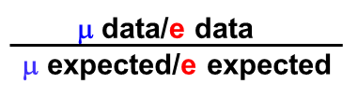
Summary of Kamiokande paper
on the atmospheric muon neutrino deficit
1988 paper
Deficit of atmospheric muon neutrino was found.
1992 paper
Although absolute atmospheric neutrino flux has large ambiguity,
ν_{μ}/ν_{e} ratio is robust.
R(μ/e)= is significantly smaller than 1.
1994 paper
The muon neutrino deficit was also found in higher energy region.
Zenith angle dependence was also found.
44

Slide 45

Atmospheric neutrino oscillation in early 1990s
In the first result, the statistics was poor, and the up/down asymmetry was not clear. The straightforward impression was "Number of muon neutrino events is slightly small..."
Some of the experiment reported negative results.
Kamiokande results are not widely believed.
To claim "Neutrino Oscillation”
was big and risky challenge.
If it is not true, all Kamiokande
members will loose their
confidence as high energy
physicists.
We hesitated to use word
"neutrino oscillations".
We frequently used
"muon neutrino deficit” or
"atmospheric neutrino anomaly",
instead.
From a review article "Atmospheric Neutrinos" by T. Kajita
New Journal of Physics 6, 194(2004)
(data after 1995 were deleted)
Water Cherenkov
Tracker
1989,92
1994
1992
1997
1989
1989
1999
1998
1998
45

Slide 46

Atmospheric neutrinos really oscillate??
An episode around 1992 in Kamioka.
Conversation between Prof. Y. Totsuka
and myself when drinking.
Stressful working days
in Kamioka mine.
Conversations occasionally become radical when drinking.
drunken font
Y.O Totsuka-sensei, please tell me honestly !
Do you really believe atmospheric neutrino oscillation ?
Y.T Um………….., probably, it is not true. It might be our mistake.
Next morning
Around 1992, even the spokesperson could not believe our own result.
Why we could not?
46

Slide 47
Toward confirmation of ν_{μ}-ν_{τ} oscillation
To claim neutrino oscillations, there are some problem to be solved.
First 3 suspicious points should be experimentally examined one by one. Such examinations were started after the observation of muon neutrino deficit in Kamiokande.
For the 4th point, negative results were given by all tracking type detectors. However, it was beyond what we can do.
The capability of e/μ particle identification is suspicious.
Statistics is definitely poor. Much more data is needed.
Large uncertainty of atmospheric neutrino flux.
Negative results by other experiments.
47

Slide 48
Beam Test for the e/μ identification
Only two water Cherenkov detectors, Kamiokande and IMB, claimed atmospheric muon neutrino deficit.
Tracking type detectors, NUSEX and Frejus, could not find the anomaly.
Is it a problem of water Cherenkov detectors ?
The e/μ identification of water Cherenkov detector has been examined only by Monte Carlo events.
The e/μ identification capability are certainly critical issue to be examined.
To verify the particle identification capability, a “beam test” was planned.
E261A experiment
48

Slide 49



KEK Proton Synchrotron E261A (1992-1994)
1kt water Cherenkov detector was built in KEK North counter hall.
Electrons and muons from 12 GeV proton Synchrotron were injected.
e,μ beam
49

Slide 50



Beam test for the particle identification
Fuzzy edge for e event and clear edge for μ event are confirmed.
e-likelihood (L_{e}) and μ-likelihood (L_{μ})
are calculated. From a comparison
between L_{e} and L_{μ}, particle id are
judged.
The algorithm clearly separate
e beam events and μ beam events.
It was experimentally verified that
the e/μ identification capability is
better than 99%.
e
μ
e
μ
Number of events
Number of events
e
μ
S.Kasuga et al., Phys. Lett. B374,238(1996)
50

Slide 51


Super-Kamiokande (1996 - )
50 kt water Cherenkov detector with 11146 20-inch Φ PMTs.
The fiducial volume is 22.5 kt.
Located at 1000 m underground in Kamioka mine, Japan
Operation since April 1996.
51

Slide 52


e/μ identification in Super-Kamiokande
ν_{e} e
Cherenkov light from e-m shower. Electrons and positrons are heavily
scattered.
Cherenkov ring edge is fuzzy.
ν_{e}
ν_{μ} μ
Only direct Cherenkov light from μ
Clear Cherenkov ring edge
ν_{μ}
e/μ misidentification probability is less than 1 %.
52

Slide 53

Improvements of atmospheric neutrino analysis
In Kamiokande
Event reconstructions were based on visual scan. The visual scan might be a cause of biases in the analysis.
I was a poor scanner and the results of the reconstruction were different from other scanners.
Kajita-san told me
“You're fired!”
In Super-Kamiokande
Number of events is much larger than
Kamiokande. Visual scan was
impossible any more.
Automatic analysis tools were
developed. They are;
1)Automatic vertex reconstruction
2)Automatic ring counting
3)Ring separation
4)Determination of particle direction
Particle identification program were
applied to the result of automatic
reconstruction.
Y.Fukuda et al.,
Phys. Lett. B433, 9 (1998)
53

Slide 54


Discovery of atmospheric neutrino oscillation
in Super-Kamiokande
At NEUTRINO 1998 Conference
in Takayama, discovery of ν_{μ}-ν_{τ}
oscillation was reported by
Prof. T. Kajita, on behalf of
Super-Kamiokande collaboration.
54

Slide 55

“Evidence for Oscillation of Atmospheric Neutrinos”
Y. Fukuda et al., Phys. Rev. Lett. 81, 1562 (1998)
Immediately after NEUTRINO 1998, the results are published.
A total of 4654 atmospheric neutrino events are employed
which are accumulated in 535 days, corresponding to 33.0 kt・yr.
Number of electron neutrinos well agrees with expectation, but number of muon neutrinos is clearly smaller than the expectation. Significant zenith angle distributions are also found.
55

Slide 56

“Evidence for Oscillation of Atmospheric Neutrinos”
The data are consistent
with two-flavor ν_{μ}- ν_{τ}
oscillations with
at 90% confidence level.
The best fit parameters are
Δm² = 2.2 x 10⁻³eV²
sin²2θ = 1.0.
It agrees with the numbers in
PDG2019,
|Δm²| = (2.444~2.53) x 10⁻³eV²
sin²θ = 0.512~0.542
(depending on mass hierarchy)
sin²2θ > 0.82
and
5 x 10⁻⁴ < Δm² < 6 x 10⁻³ eV²
The results are inconsistent with the Kamiokande data. Do not ask me why. Ask Kajita-san !
17 years later, this paper became a “Nobel Prize paper”.
56

Slide 57


MACRO experiment (1989-2000)
UpThrough
InUp
The MACRO detector is a large rectangular
box of 76.6 m x 12 m x 9.3 m. It was located
at 3150 m.w.e. underground in Gran Sasso
Laboratory, Italy.
The experiment is optimized for muon track
measurement.
Streamer tubes provides track information
of the muons with angular resolution
between 0.2º and 1º, depending
on the track length.
Liquid scintillator planes records
arrival time of particles. The nominal
time resolution is 500 ps.
The time difference between two
separate planes provides the travel
direction of muons.
UpStop
InDown
57

Slide 58


MACRO results
The muon neutrino deficit was reported in 1998. From 1989 to 1997,
451 UpThough events were found where MC expectation was 612.
R = (μ)_{data}/(μ)_{MC} was calculated to be
“The observed zenith distribution for -1.0≦cosθ ≦-0.1 does not fit well with the no oscillation expectation,"
In 2000, observation of muon neutrino deficit
in UpStop+InDown and InUP events followed.
R = 0.74±0.036(stat.)±0.046(syst.)±0.13(theor.)
M. Ambrosio et al.,
Phys. Lett. B478, 5(2000)
UpStop+InDown
UpThrough
InUp
M. Ambrosio et al.,
Phys. Lett. B434, 451(1998)
58

Slide 59



Soudan-2 experiment (1989-2001)
Fine-grained iron tracking
calorimeter with a honeycomb
geometry. The fiducial mass was
770 ton.
The detector was located at a depth
of 2070 m.w.e underground in
Soudan mine, Minnesota.
R=(μ/e)_{data}/(μ/e)_{MC} were;
The muon neutrino deficit was
confirmed in the 1999 paper.
+0.05
e-flavor,
157 events
μ-flavor,
167 events
R = 0.72±0.19(stat.) (syst.)
-0.07
1.52 kt・yr (1997)
R = 0.64±0.11(stat.)±0.06(syst.)
3.9 kt・yr (1999)
R = 0.69±0.10(stat.)±0.06(syst.)
5.90 kt・yr (2003)
5.90 kt・yr (2003)
W.W.M.Allison et al., Phys. Lett. B391,491(1997)
W.W.M.Allison et al., Phys. Lett. B449,137(1999)
M.Sanchez et al., Phys. Rev. D 68, 113004 (2003)

Slide 60
Toward confirmation of ν_{μ}-ν_{τ} oscillation (~1999)
In early 1990s
The capability of e/μ particle identification is suspicious.
Statistics is definitely poor. Much more data is needed.
Large uncertainty of atmospheric neutrino flux.
Negative results by other experiments.
Particle identification problem was settled by E261A experiment.
Enough statistics of data were accumulated by Super-Kamiokande.
Two tracking type detectors claimed the atmospheric muon neutrino deficit. However, it was just after the observation by Super-Kamiokande. Their statistics were quite poor to claim “neutrino oscillation” by a single experiment.
They completely forgot that claiming neutrino oscillation is quite risky! Their announcement was “Do not miss the bus”.
or, in Japanese famous phrase,
「赤信号みんなで渡れば恐くない!」
“If everyone crosses against the red light, there's nothing to be afraid of.”

Slide 61



Calculation of atmospheric neutrino flux
Calculation of atmospheric neutrino flux is based on:
Primary proton (and heavier nuclei) flux
Geomagnetic field including effects from solar activity.
Travel direction of charged particles are dispersed.
Hadronic interaction models
Atmospheric temperature. Atmosphere is target material
and also affects decay/absorption ratio of pions/kaons.
There are large uncertainties of the input data.
Primary proton
(and heavier nuclei) flux
Geomagnetic field
South pole
61

Slide 62


Energy distribution and ratio of
atmospheric neutrino flux
M.Honda et al., Phys. Rev. D83, 123001(2011)
HKKM11
HKKM11
Discrepancies between calculations are thought to be intrinsic systematic uncertainty.
62

Slide 63

Zenith angle distribution of atmospheric neutrino flux
M.Honda et al., Phys. Rev. D83, 123001(2011)
0.32 GeV
1.0 GeV
downward-
going
3.2 GeV
upward-
going
It is claimed that even though absolute atmospheric neutrino fluxes have large uncertainty, ν_{e}/ν_{μ} ratio is robust. However.....
It is difficult to say that atmospheric neutrinos are perfectly understood for studies of neutrino oscillations.
63

Slide 64

From “atmospheric neutrino” to “neutrino beam”
Atmospheric neutrino flux has inevitable large uncertainties.
High energy physicists strongly hope to examine neutrino oscillations using neutrino beam. Artificial neutrino beam can be controlled and the neutrino flux can be measured by physicists directly.
The first experiment was K2K (KEK to
Kamioka) experiment started in 1999.
Late 20th century was an epoch of natural neutrino experiments.
atmospheric neutrino, solar neutrino, supernova neutrino
Early 21st century is an epoch of artificial neutrino experiments.
neutrino beam, reactor neutrino
Long-baseline Neutrino-oscillation experiments
K2K (KEK) 1999 - 2004
MINOS(Fermilab) 2005 - 2014
T2K(KEK) 2009 -
NOvA(Fermilab) 2014 -
1999 - 2004
2005 - 2016
2009 -
2014 -
K2K experiment
64

Slide 65


Atmospheric neutrino(AN) vs Neutrino beam(NB)(1)
Calculation of neutrino flux
(AN) Flux of primary proton beam has large uncertainty. Geomagnetic field and atmospheric temperature should be also taken into account.
(NB) Primary proton beam is well controlled, and has fixed energy and direction. Geometry of the beam line including target, magnetic horn, decay volume, beam dump are completely known.
Near detector
(AN) We cannot make near detectors.
(NB) We can construct near detector at hundreds meters downstream of the target. We can accurately measure energy spectrum and components of the neutrino beam just after the neutrino production.
65

Slide 66
Atmospheric neutrino(AN) vs Neutrino beam(NB)(2)
Calculation of neutrino oscillation probability in event by event basis
Neutrino oscillation probability is written as
P(ν_{μ}->ν_{x}) = sin²2θ sin²(Δm²L/4E)
（L is neutrino travel distance, E is neutrino energy）
Measurement of neutrino travel distance and neutrino energy is essential
(AN) The true neutrino travel direction in unknown. The travel direction of charged lepton must be used instead. Accordingly, approximate neutrino travel distance must be used. Also neutrino energy must be estimated from muon/electron energy.
(NB) Neutrino travel distance is the distance of the baseline. Unlike atmospheric neutrinos, we have one additional information; scattering angle between the neutrino and the muon. The neutrino energy can be calculated from the muon energy and the opening angle from the neutrino direction.
ν
m_{N}E_{μ} - m_{μ}²/2
1700m
E_{ν} =
m_{N} - E_{μ} + P_{μ}cosθ_{μ-ν}
66

Slide 67

Atmospheric neutrino(AN) vs Neutrino beam(NB)(3)
Neutrino energy spectrum
(AN) Cannot be changed
(NB) Can be changed. In T2K experiment, peak energy of the neutrino beam is adjusted to the oscillation maximum by off-axis beam.
ν_{e}/ν_{μ} ratio
(AN) ~1/2
(NB) order of ~1/100
Neutrino beam and antineutrino beam
(AN) Cannot be changed
(NB) Can be changed by switching current direction of magnetic horns
Budget and manpower
(AN) Free of charge, no manpower
(NB) Huge budget and enormous manpower are required for construction and operation. Stressful daily life of physicists.
④,⑤,⑥ are important features of the T2K experiment and will be discussed later.
From scientific point of view, neutrino beam has many advantages.
However, neutrino oscillation was discovered with atmospheric neutrinos.
The winner in the history is atmospheric neutrinos.
67

Slide 68

K2K experiment
First long-baseline neutrino oscillation experiment (1999-2004)
Confirmation of ν_{μ}-ν_{τ} oscillation reported by Super-Kamiokande using artificial neutrino beam.
Muon neutrino beam generated at KEK is shot toward the
Super-Kamiokande detector, which is 250km away from KEK
Search for neutrino oscillations in the parameter region
Δm²₃₂ > 2×10⁻³ eV² is possible. It covers the parameter regions suggested by the atmospheric neutrino anomaly.
68

Slide 69

K2K neutrino beamline in KEK
TRISTAN RING
(B-factory)
Primary Beam-line
12GeV PS
P
12GeV/c proton beam
Al Target
1.1μsec beam duration
Intensity 5~6x10¹² ppp
2.2sec accelerator cycle
Decay Volume
(200m)
Total ~10²⁰ p.o.t.
π⁺ -> μ⁺ + ν_{μ}
Muon Pit
Near Detectors
ν_{μ}
To Kamioka
69

Slide 70
K2K Near Detectors
Beam
Direction
70

Slide 71

K2K Near Detectors at 300m from the target
(a)1kt water Cherenkov detector (1kt)
An 1/50 miniature of SK detector. Direct comparison with SK data
(b)Fine-Grained Detector (FGD)
Consists of 4 detector elements.
Precise measurement of neutrino beam property.
71

Slide 72


Study of the Neutrino beam in the Near Detectors
Data recorded in the Near Detectors are used to study properties of the neutrino beam.
The beam direction, stability of the beam intensity, energy spectrum, ν_{e}/ν_{μ} ratio well agree with expectations.
The excellent agreements between data and expectations in KEK site ensure the reliability of the expected beam at SK site.
Fine-Grained detector
1kt detector
72

Slide 73


Property of the neutrino beam
The mean energy is ~1.3 GeV and the peak energy is about ~1.0 GeV.
Almost pure muon neutrino beam. ν_{e}/ν_{μ} ratio is ~1%.
The direction of the beam is adjusted within 1mrad.
Nearly the same energy spectrum and flux within 3 mrad.
It covers the size of SK; ~50m/250km = 0.2mrad.
Neutrino flux at SK (250km downstream) is 1.3x10⁶ν/cm² for 10²⁰p.o.t.,
and ~170 events are expected in the 22.5kton of fiducial volume
in the case of null oscillation.
spectrum at SK
profile at SK
ν/cm² (x10⁶)
ν/cm² /0.1GeV(x10⁶)
5
1
SK(0.2mrad)
3mrad
0
0
0
1
2
3
4
5
0
1
2
3
Neutrino energy (GeV)
73
distance (km)

Slide 74

Summary of data-taking in K2K
First neutrino beam: January 27, 1999
●
●
Physics run: Jun 4, 1999 – Jul 12, 2001 (K2K-I)
Super-Kamiokande accident
Jan 17, 2003 – Nov 6, 2004 (K2K-II)
Total physics run: 442.8 days (233.7+209.1)
●
Total spill numbers: 17.4x10⁶ spill
●
Total POT for analysis: 92.2x10¹⁸ p.o.t. (47.9x10¹⁸ + 44.3x10¹⁸)
●
Delivered Protons on Target (POT)
100
(x10¹⁸)
Total POT
0
5
(x10¹²)
protons/pulse
0
1999 2000 2001 2002 2003 2004
Year
74

Slide 75

The first K2K neutrino event in Super-Kamiokande
June 19, 1999
It was a great achievement in the history of physics…,
but the event was poor looking.
75

Slide 76

Neutrino events in Super-Kamiokande
Selection
E_{vis} > 30 MeV and no signal in the outer detector
Events within 1.5μsec time window are
selected because neutrino beam width
is 1.1μsec and accuracy of the absolute
time determination by GPS is 0.2μsec.
History of event accumulation
# of events
time correlation with the neutrino beam
GPS
Number of events
1.5μs
KEK
Kamioka
Results
P.O.T. (x10¹⁸)
Number of events in the fiducial volume is 112.
Expected atmospheric neutrino background is 2.5x10⁻³ events.
The rate of the neutrino events is uniform.
76

Slide 77

A typical K2K neutrino event in Super-Kamiokande
The event seems to be quasi-elastic scattering interaction;
ν_{μ} + n μ⁻ + p
Neutrino energy can be calculated from muon energy and opening angle from the neutrino direction.
m_{N}E_{μ} - m_{μ}²/2
E_{ν} =
m_{N} - E_{μ} + P_{μ}cosθ_{μ-ν}
77

Slide 78


ν_{μ}-ν_{τ} oscillation analysis for K2K data
We observed 112 neutrino events where the expectation is 158.1 .
Number of neutrino events is considerably smaller than expectation.
Neutrino energy distribution is calculated from 58 single ring μ-like events. The result shows a clear distortion in 0.5-1.0 GeV range. It reflects energy dependence of neutrino survival probability.
If null oscillation is assumed, such poor agreements happen with a probability of 0.0015%(4.3σ).
1
Neutrino Survival probability
P(ν_{μ} ν_{μ})
+9.2
Δm²=3.0x10⁻³eV², sin²2θ=1.0, L=250km
-8.6
0
0
1
2
3
4
5
E_{ν}
K2K 0.922x10²⁰ POT
data
No oscillation
Number of neutrino events
Best fit
No oscillation
(normalized to data)
M.H.Ahn et al., Phys. Rev. D74, 072003 (2006)
78
Neutrino energy (GeV)

Slide 79

Constraints on ν_{μ}-ν_{τ} oscillation
The best fit parameters
Δm² = 2.8x10⁻³eV²
sin²2θ = 1.0
For sin²2θ=1.0,
Δm² = (1.9~3.5)x10⁻³eV²
at 90% C.L.
The constraints agree with atmospheric neutrino results from Super-Kamiokande.
This is the first confirmation of ν_{μ}-ν_{τ} oscillation by an
artificial neutrino beam.
M.H.Ahn et al., Phys. Rev. D74, 072003 (2006)
79

Slide 80




MINOS experiment (2005 - )
Long-baseline neutrino-oscillation experiment using FNAL 120 GeV Main Injector (NuMI) and far detector in Soudan Mine, 735 km away.
The far detector is a "sandwich" of iron plate of 2.54 cm thickness and scintillator of 1.00 cm thickness.
The total volume is 5.4 kton. They
are in 1.3 Tesla of magnetic field.
A 0.98 kton near detector of similar
design is also constructed in FNAL.
Soudan
735km
Fermilab
80

Slide 81

Muon neutrino disappearance by MINOS
MINOS experiment published the first result of muon neutrino disappearance in 2006.
From 1.27 x 10²⁰ POT data, 215 muon neutrino events are found, where 336±14 events are expected if no-oscillation is assumed.
A distortion of the energy spectrum which is a strong indication of neutrino oscillation is also found.
D. G. Michael et al., Phys. Rev. Lett. 97, 191801(2006)
MINOS
81

Slide 82

Constraints on ν_{μ}-ν_{τ} oscillation from MINOS
The data are consistent with ν_{μ} disappearance via oscillations with
The result is consistent with SK
and K2K.
This is the first perfectly-
independent and convincing
confirmation of the ν_{μ}- ν_{τ}
neutrino oscillation discovered
by Super-Kamiokande.
+0.44
|Δm²₃₂| = (2.74 )x10⁻³ eV²
-0.27
and
sin²2θ₂₃ > 0.87 (68%C.L.).
MINOS
D. G. Michael et al.,
Phys. Rev. Lett. 97, 191801(2006)
82

Slide 83
Confirmation of ν_{μ}-ν_{τ} oscillation
To verify the evidence of ν_{μ}-ν_{τ} oscillation found in Kamiokande,
there were many problems to be solved.
ν_{μ}-ν_{τ} oscillation was perfectly verified!
The capability of e/μ particle identification is suspicious.
Statistics is definitely poor. Much more data is needed.
Large uncertainty of atmospheric neutrino flux.
Negative results by other experiments.
E261A experiment
Super-Kamiokande
K2K experiment, MINOS experiment
MINOS experiment
83

Slide 84


Nobel Prize
Takaaki Kajita (Super-Kamiokande collaboration) shared the Nobel Prize in Physics for 2015 with Arthur B. McDonald (SNO collaboration). The reason of the award is "for the discovery of neutrino oscillations, which shows that neutrinos have mass"
84

Slide 85

Why Prof. Y. Totsuka could not win Nobel Prize ?
In 2008, Prof. Y.Totsuka (spokesperson at 1998) passed away
In 1998, neutrino oscillation was discovered by Super-Kamiokande
Only one experiment claimed the discovery.
Confirmation by other experiments were needed.
In 2004, confirmation by K2K experiment
Far detector of K2K is Super-Kamiokande.
Member of the experiments are overlapped.
Two experiments are not independent.
In 2006, MINOS confirmed neutrino oscillation
Detector, beam, member are independent from
Super-Kamiokande/K2K. Ready for Nobel Prize?
Only 2 years after the confirmation were too
short?
The discoverer must be alive and wait for
the confirmation by an independent group to win the prize.
Prof. Yoji Totsuka
(1942-2008)
This page is based on personal
opinion of Y.O.
85

Slide 86
SK atmospheric neutrino analysis after 1998
Although atmospheric neutrino “beam” have disadvantage,
huge statistics is definitely advantage of Super-Kamiokande.
Progress after the discovery of neutrino oscillation after 1998
are as follows.
Improvement of the statistics by about 10 times.
PDG2016 http://pdg.lbl.gov/
E/L analysis
“Evidence for an oscillatory signature in atmospheric neutrino oscillation”
Y.Ashie et al., Phys.Rev.Lett. 93,101801(2004)
Measurement of ν_{τ} appearance
“Measurement of Atmospheric Neutrino Flux consistent with Tau Neutrino Appearance”
K.Abe et al., Phys.Rev.Lett. 97,171801(2006)
86

Slide 87

SK zenith angle distribution with 20 years data
4654 events (33 kt・yr, 1998) → 35326 events (306 kt・yr, 2016)
“UpStop” and “UpThrough” are included in the analysis.
ν
ν
PDG2016 http://pdg.lbl.gov/
87

Slide 88

L/E analysis
The deficit of upward-going atmospheric muon neutrinos can be
explained not only by neutrino oscillations but also by other exotic models such as neutrino decoherence or neutrino decay.
Which is the right answer can be examined from neutrino survival probability as a function of L/E.
To keep high L/E
resolution (Δ(L/E) < 70%),
low energy events are
removed because the
correlation between
neutrino direction and
outgoing particle direction
are poor. Horizontal events
are also removed because
of large dL/d(cos θ_{z})
Neutrino survival probability
oscillation
decoherence
decay

Slide 89



L/E analysis
A clear dip corresponding to the first oscillation maximum can be found.
Neutrino oscillation can well explain
the data.
Neutrino decoherence and
neutrino decay are disfavored
with more than 3.4σ.
Number of events in the dip region
 |  | 1 bin | 4 bins
Expected | No oscillation | ~20 | ~131
 | decoherence/ decay | ~10 | ~68
 | oscillation | ~7 | ~48
data |  | 4 | 44
Y.Ashie et al.,
Phys.Rev.Lett. 93,101801(2004) 1489 live-day data
89

Slide 90


Measurement of ν_{τ} appearance
atmospheric neutrino flux
ν_{τ} CC
When neutrino energy is larger than
E_{th}~3.5GeV, ν_{τ} can produce τ
by charged current interaction.
Such events are direct evidence
of ν_{μ}-ν_{τ} oscillation.
τ decay immediately, and high
multiplicity events are generated.
E_{th}=3.5GeV
HKKM11
typical ν_{τ}
CC event (MC)
90

Slide 91

Measurement of ν_{τ} appearance
A ν_{τ} selection algorithm was developed. Note that most of the selected events are not ν_{τ} events but ν_{e} or ν_{μ} interactions.
Zenith angle distribution of “ν_{τ}-like” events are examined.
The data well agree with
the expected ν_{τ} signal for
oscillation parameters
obtained from other results.
“No ν_{τ} appearance hypothesis” is disfavored by 2.4σ.
zenith angle distribution of “ν_{τ}-like” events
Best fit excess
138±48(stat.) (syst.)
Expected ν_{τ} signal
78±26(syst.)
(Δm²=2.4x10⁻³ eV² and sin²2θ=1.0.)
Super-Kamiokande
1489.2 days data
+15
-32
data
ν_{e}+ν_{μ} only
excess (best fit)
K.Abe et al., Phys.Rev.Lett. 97,171801(2006)
91

Slide 92
Status of neutrino oscillations
in the middle of 2000s
The neutrino mixing between ν_{μ} and ν_{τ} (between 2nd and 3rd generation) was discovered with atmospheric neutrinos by Super-Kamiokande in 1998.
The ν_{μ}-ν_{τ} oscillation was confirmed with artificial neutrino beam
by K2K experiment in 2004.
The ν_{μ}-ν_{τ} oscillation was also confirmed with MINOS experiment in 2006. It was first perfectly-independent confirmation of the Super-Kamiokande results.
Around 2000, the neutrino mixing between ν_{e} and ν_{μ} (between 1st and 2nd generation) was also established with solar/reactor neutrinos.
There were contributions from Homestake, Kamiokande, Super-Kamiokande, Gallex, SAGE, SNO and Kamland.
(This is out of scope of today’s lecture)
Experimental study of neutrino oscillations moved to new phase:
Three flavor oscillation.
92

Slide 93
History of Discoveries by neutrino experiments
1956 Discovery of ν_{e} by Savannah River reactor experiment (N)
1962 Discovery of muon neutrinos by AGS neutrino experiment in BNL (N)
1965 Observation of atmospheric neutrinos by KGF experiment
1968 Solar neutrino deficit claimed by Homestake experiment (N)
1973 Discovery of neutral current interactions by Gargamelle experiment
1987 Kamiokande and IMB detected neutrinos from supernova SN1987A (N)
1988 Kamiokande claimed atmospheric muon neutrino deficit
1989 Kamiokande confirmed the solar neutrino deficit
1998 Super-Kamiokande observed atmospheric neutrino oscillation (N)
1998 Super-Kamiokande confirmed solar neutrino deficit
2000 DONUT observed tau neutrino
2001 SNO confirmed solar neutrino oscillation by neutral current measurement (N)
2002 Kamland observed deficit of reactor neutrinos
2004 K2K confirmed atmospheric neutrino oscillation by artificial neutrino beam
2006 Completely independent confirmation of ν_{μ}-ν_{τ} oscillation by MINOS
2011 First indication of non-zero θ₁₃ by T2K
2012 Non-zero θ₁₃ was confirmed by 3 reactor experiments
2013 Discovery of extraterrestrial high energy neutrinos by IceCube
2015 Discovery of ν_{τ} signal from ν_{μ}-ν_{τ} oscillation by OPERA
2018 Discovery of high energy neutrinos from an astronomical object by IceCube
2020 First indication of CP violation in lepton sector by T2K
Main topics of my lecture, and will be presented precisely.
Related to main topics, and will be mentioned briefly.
93

Slide 94
Summary
Neutrino physics made great progress in recent several decades guided by many experiments.
Experiments in Kamioka contributed to the progress significantly.
94

Slide 95
Thank you !
95

Slide 96
Appendix:
The birth of Kamiokande
This is not a physics session, but a kind of business session…..
96

Slide 97

Introduction
Kamiokande (1983 - 1996) was the first Nobel Prize experiment outside of Europe and America in the field of high energy physics.
Kamiokande was small manpower / small budget experiment.
In the first Kamiokande paper in 1985, only 12 authors. They are
7 staffs (about 5 Full Time Equivalent) and 5 graduate students.
The initial budget for the experiment was 5 Oku-yen and additional running cost was about 1 Oku-yen/year. It was quite small budget.
(1 Oku-yen ~ 0.5 Million US dollars in early 1980s.)
Reporting why Kamiokande experiment succeeded with small manpower / small budget will be very instructive.
97

Slide 98



Before Kamiokande experiment…..
Before Kamiokande experiment, Koshiba's group in department of physics, University of Tokyo participated in JADE Experiment (1977-1986) in PETRA Ring in DESY, Hamburg.
Kamiokande was the second and local experiment of the group.
It was planned just after the JADE experiment started successfully.
JADE detector
PETRA Ring in DESY
98

Slide 99


JADE experiment
JApan Deutschland England collaboration.
The main purpose of the experiment was observation of heavier new quarks. Unfortunately, it was not succeeded.
Instead, 3 jet events which directly show existence of gluons were discovered together with other 3 experiments in PETRA.
JADE detector
gluon event
99

Slide 100


Lead glass counter and photomultiplier tubes (PMT)
In JADE experiment, Koshiba's group took charge of lead glass counters. It is a calorimeter to measure energy of electro-magnetic showers. Basically, it consists of a total of 2712 photomultiplier tubes (PMTs) and lead glasses.
At that time, the leading company of the PMTs was Philips in Nederland. PMTs made by Philips and made by Hamamatsu were compared and obviously Philips PMTs were much much better than Hamamatsu PMTs.
Assembling JADE Lead glass counter
Lead glass and PMT for OPAL experiment
(sorry! I could not find that of JADE)
100

Slide 101

Hamamatsu PMTs !
Koshiba decided to use Hamamatsu PMTs although all other collaborators strongly opposed it. Koshiba said
"Our research budget is funded by the Japanese government.
For the critical and high-technology component of the detector,
we must purchase Japanese products as much as possible.“
Hamamatsu developed new PMTs for JADE
lead glass counters with cooperation of
Japanese JADE members. Hamamatsu
accumulated experience in the design of
PMTs thanks to Koshiba's decision.
It was real “first step” for the Kamiokande
experiment.
Hamamatsu R594 PMT
for JADE experiment
101

Slide 102
Development of 20-inchΦ PMT
When the planning of Kamiokande experiment started around 1979,
IMB group have already started similar project independently in USA.
The IMB detector is larger and the start of the experiment is earlier.
It seems there is no advantage in Kamiokande.
“Ask Hamamatsu to make new PMTs which
have large diameter. They cannot reject
my request. They succeeded as a PMT
company after we selected Hamamatsu
PMTs for JADE experiment!”
20-inchΦ PMT are developed, and precise
measurement became possible with large
photo collection.
It led to the success of the experiment.
 | IMB | Kamiokande
Total (Fiducial) Volume | 8000 ton (3300 ton) | 3000 ton (1000 ton)
Start | 1982 | 1983
PMTs (size x number) | 8 inchΦ x 2048 | 20 inchΦ x 1000
102

Slide 103


Use property of JADE experiment !
The tank including PMT support structure was designed and constructed by Mitsui Engineering
and Shipbuilding Co.,Ltd.
The company also designed
structure of the JADE lead glass counter. The group had enough experience of communication
with the company.
DEC PDP 11/60 was used as on-line data-taking computer. The group asked how to use it to a JADE member since PDP 11 series was used in JADE.
For readout electronics, high voltage power supplies and distributors, ready-made electronics were purchased. For some of the component, second-hand modules were used.
DEC PDP 11/60
103

Slide 104

Use property of JADE experiment !
For off-line analysis computer, an IBM-type
mainframe computer, FACOM M-190 for
JADE experiment was used without any
charge. Kamiokande members were just
USERS of the computer, and did not care
any maintenance and management.
In the analysis computer, all utility software
for JADE experiment were used. They
include data structure or event display.
For Monte Carlo simulation program, lead
glasses were replaced with water, and only
geometry was changed.
To summarize, Kamiokande borrow (or steal) almost everything
from JADE experiment. In that sense, Kamiokande is (JADE)' at
the first stage. That is one reason why Kamiokande started with small manpower and small budget.
104

Slide 105
What we can learn from the Kamiokande experience?
Vietnamese high energy experimental groups/physicists will join
(or already joined) a large international collaboration.
Keep in mind following…….
For critical and high-technology components of the detector,
purchase your own national products.
It would contribute to technology upgrade of your national companies, and would be the "first step" of your future experiments.
You should consider to imitate a detector component and start
your own experiment in your own country. You can borrow (or steal) every property/experience/technology/software/hardware/ manpower from your international collaboration.
105

