Slide 1

Status of the experiment
Yuichi Oyama (KEK/J-PARC) for T2K collaboration
Feb-27-2020 CNNP2020@Cape Town, South Africa

Slide 2
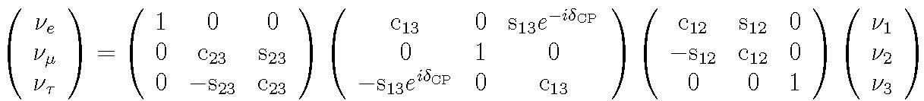
Neutrino mixing matrix
Study of neutrino mixing is one of the most active areas in recent particle physics.
The flavor eigenstates are mixtures of the mass eigenstates. Assuming 3 generations of neutrinos, the mixing matrix has 6 parameters.
2 mass square differences (Δm²₂₁, Δm²₃₂),
Δm²_{ij}=m²_{i}-m²_{j}
3 mixing angles (θ₁₂,θ₂₃,θ₁₃)
1 CP violation phase, δ_{CP}.
The mixing between 2nd and 3rd generation was established with atmospheric/long-baseline neutrinos around 2000. Prof. Kajita (Super-Kamiokande collaboration) won the Nobel prize in 2015.
The mixing between 1st and 2nd generation was established with solar/reactor neutrinos around 2000. Prof. McDonald (SNO collaboration) won the Nobel prize in 2015.
Observation of mixing between 1st and 3rd generations began in 2010s.

Slide 3
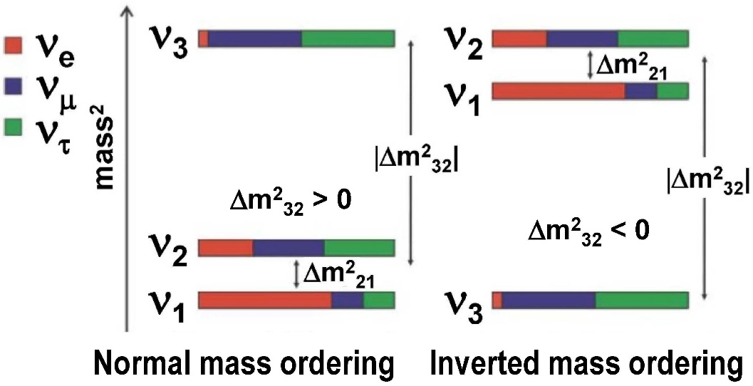
Neutrino oscillation parameters from PDG2019
Δm²₂₁ and θ₁₂ are
Δm²₂₁ = (7.53±0.18)x10⁻⁵eV², sin²θ₁₂ = 0.307±0.013
θ₁₂~34º
|Δm²₃₂| and θ₂₃ are
+0.019
|Δm²₃₂| = (2.444±0.034)x10⁻³ eV², sin²θ₂₃ = 0.512 (for normal mass ordering, octant I)
-0.022
θ₂₃~45º
First non-zero indication of θ₁₃ was reported by T2K in 2011. Present constraint given by reactor experiments is
sin²θ₁₃ = 0.0218±0.0007
θ₁₃~8º
At present, weak constraints on δ_{CP} have been obtained. δ_{CP} = (1.37 )π radian
Further constraints on δ_{CP} as well as mass ordering, sign of Δm²₃₂, can be studied by long-baseline neutrino oscillation experiments.
+0.18
-0.16

Slide 4
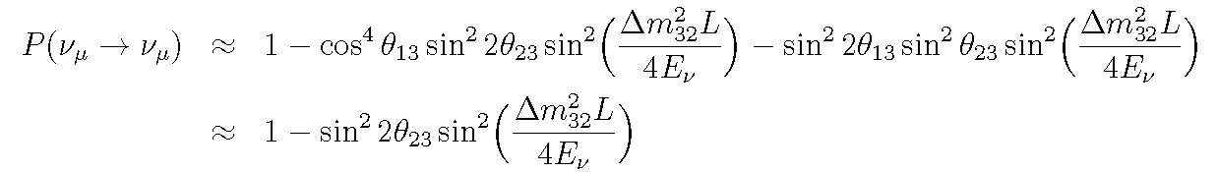
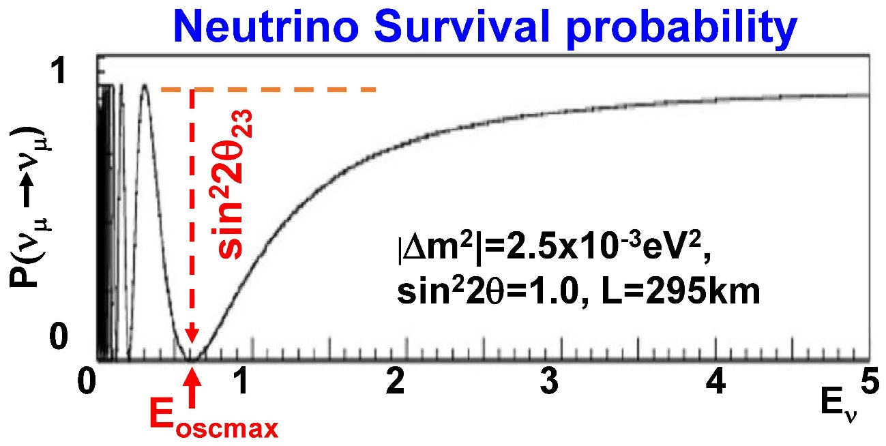
ν_{μ} disappearance in long-baseline experiments
The survival probability that ν_{μ} remain as ν_{μ} can be written as
|Δm²₃₂| can be determined from position of the oscillation maximum E_{oscmax};
sin²2θ₂₃ can be determined from depth of the dip in the energy distribution.
|Δm²₃₂|L
π
=
4E_{oscmax}
2

Slide 5
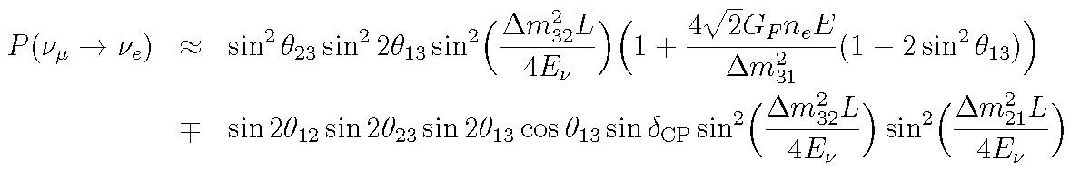
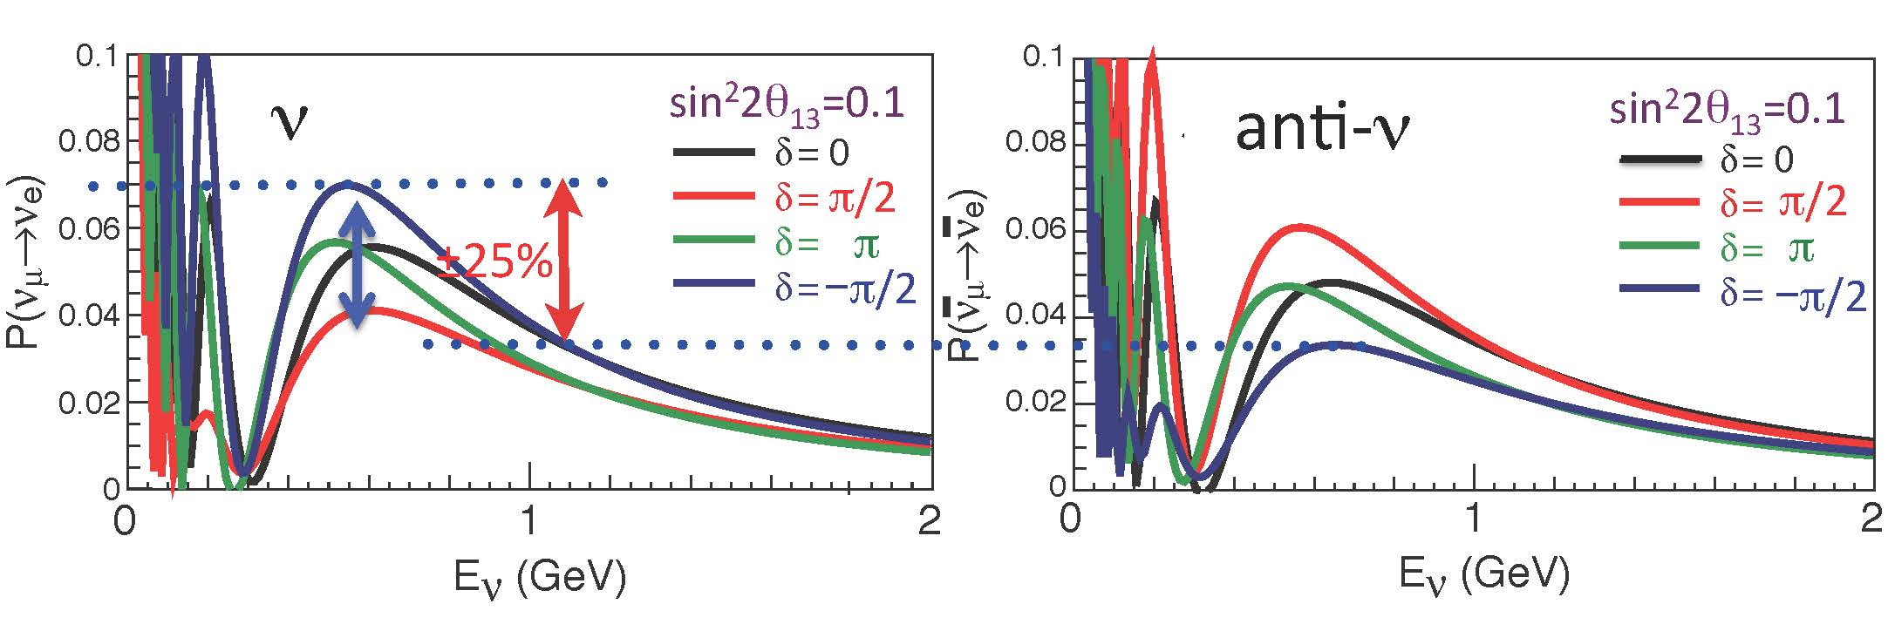
ν_{e} appearance in long-baseline experiments
The probability of ν_{e} appearance can be written as These probabilities are used to study δ_{CP} and mass hierarchy.
Oscillation probabilities P(ν_{μ} -> ν_{e}) and P(ν_{μ} -> ν_{e}) If P(ν_{μ}->ν_{e}) < P(ν_{μ}->ν_{e}), δ_{CP} > 0 If P(ν_{μ}->ν_{e}) > P(ν_{μ}->ν_{e}), δ_{CP} < 0
- for neutrino, + for anti-neutrino

Slide 6
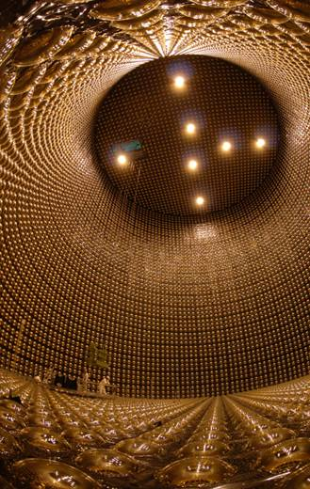
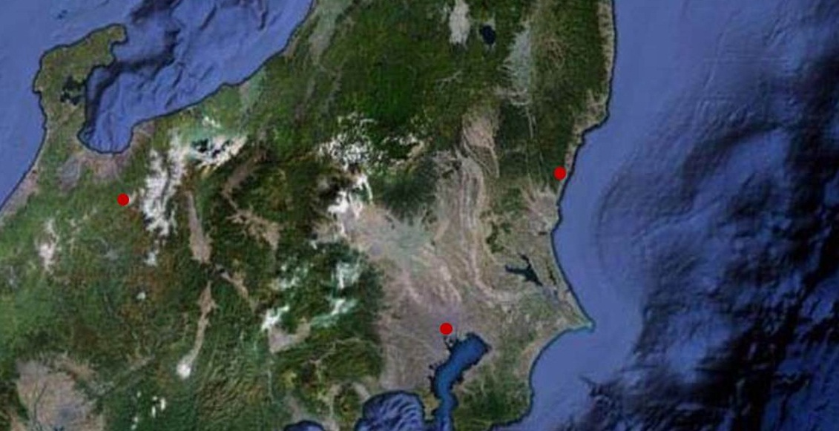
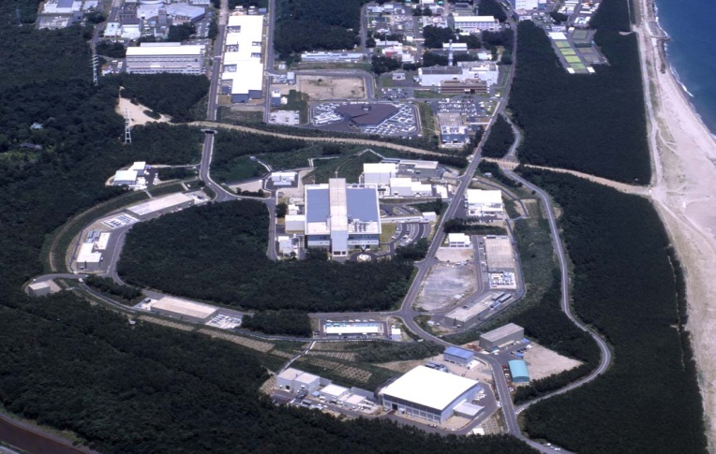
T2K experiment
Tokai
Kamioka
KEK
J-PARC in JAEA
J-PARC in JAEA
Tokyo
Super-Kamiokande
J-PARC
Second generation long-baseline neutrino-oscillation experiment; from Tokai to Kamioka. The experiment started in 2009.
High intensity almost pure ν_{μ} beam from J-PARC is shot toward the Super-Kamiokande (SK) detector 295 km away.

Slide 7
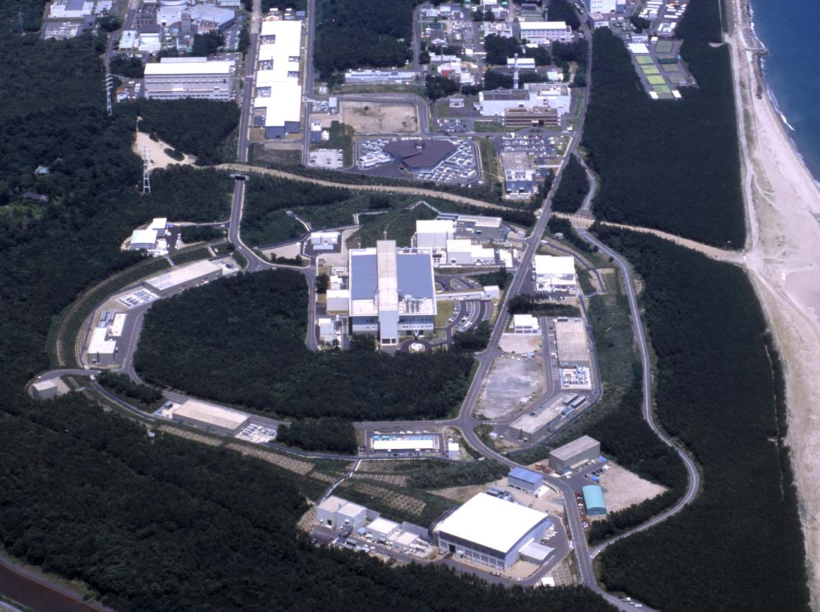
Linac
Rapid Cycling Synchrotron
To Kamioka
Neutrino
Main Ring
Bird’s eye view of J-PARC
July. 2009

Slide 8
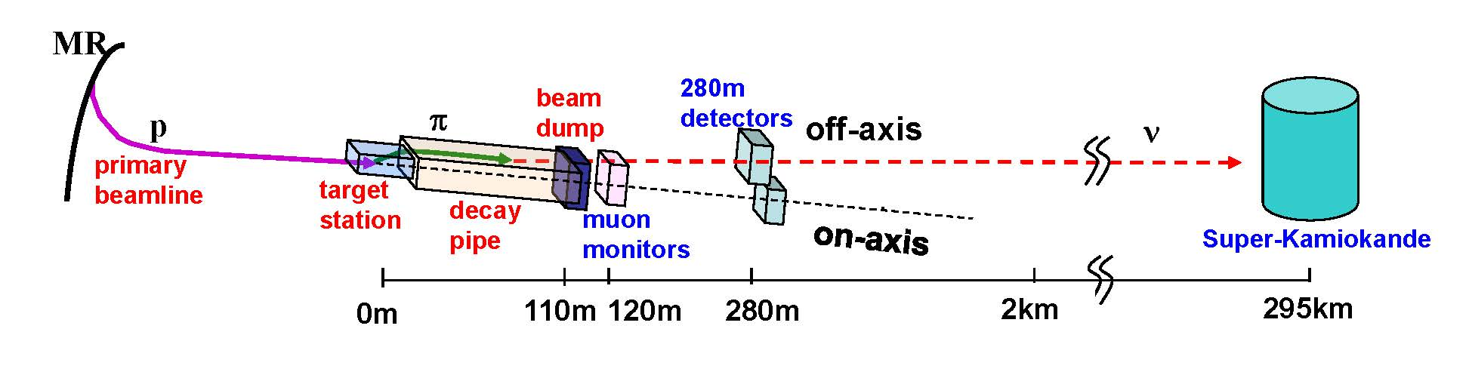
T2K Beam line and Detectors
Far detector
volume
Beamline
Detectors
Primary beamline
Target station
Decay Volume
Beam dump @ ~110 m downstream
Muon monitors@ ~120 m downstream
Near detectors@ ~280 m downstream.
Far detector@ 295 km downstream (Super-Kamiokande)
Off-axis beam : the center of the beam direction is adjusted to be 2.5º off from the SK direction.

Slide 9
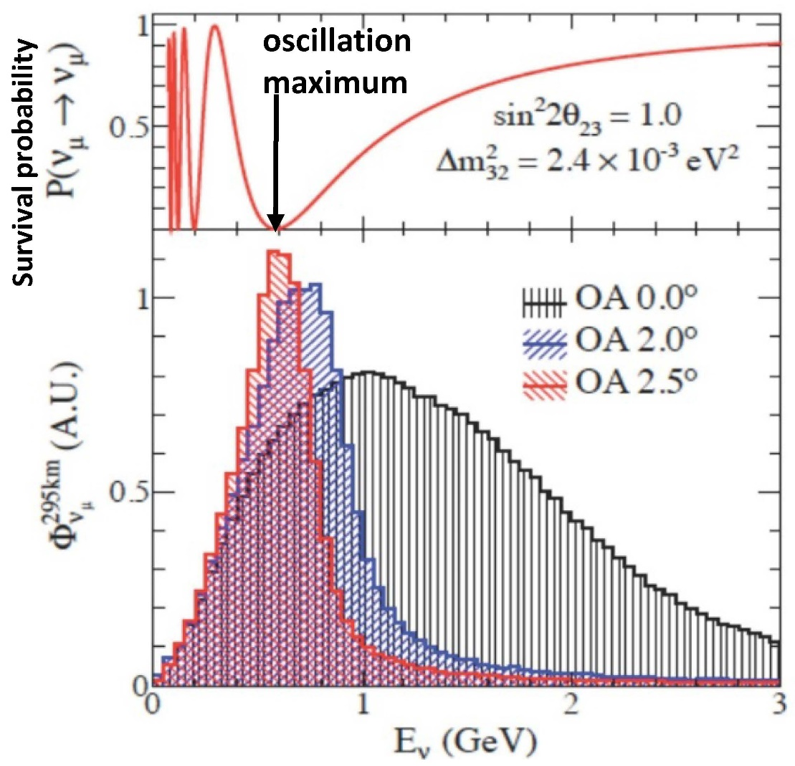
Off-axis beam
The center of the beam direction is adjusted to be 2.5º off from the SK direction. Neutrino energy spectrum becomes quasi-monochromatic. The peak energy is ~0.6 GeV.
Merits of the off-axis beam are:
The neutrino energy peak agrees with the oscillation maximum.
Because of the suppression of high energy (> 1 GeV) neutrinos, non-CCQE background events (including NCπ⁰ events) are reduced.
Water Cherenkov detector has better performance for single charged particle events.

Slide 10
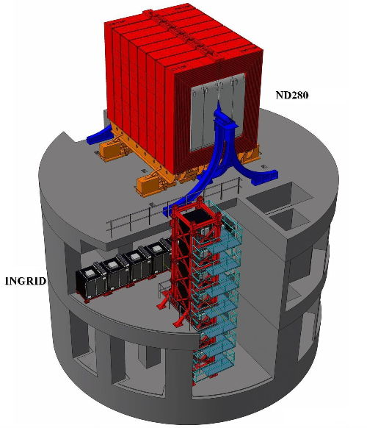
Near Detectors at 280m downstream
Two detectors were installed; they are On-axis Detector in the direction of the neutrino beam center, and Off-axis detector in the direction of Super-Kamiokande.
Off-axis detector
off-axis 2.5º
On-axis detector
ν beam
on-axis

Slide 11
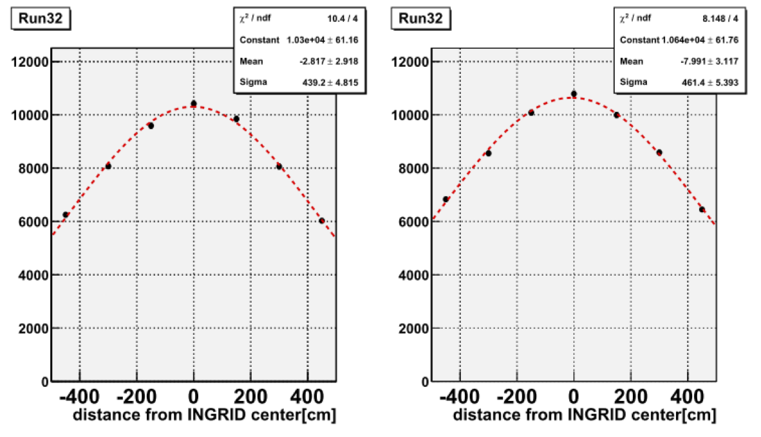
On-axis detector (INGRID)
Consists of 16 modules; 7 horizontal, 7 vertical, and 2 off-diagonal. Each module is 1m x 1m x 1m cube.
Each module is “sandwich” of 11 scintillator layers and 10 iron layers. They are surrounded by 4 veto planes.
The neutrino beam center is obtained from horizontal/vertical distribution of the neutrino event rate. The nominal accuracy is ~0.1 mrad.
INGRID event view
Number of event distribution
10mrad
10mrad
Horizontal
Vertical
Notes:
2020/2/26
11

Slide 12
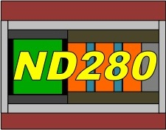
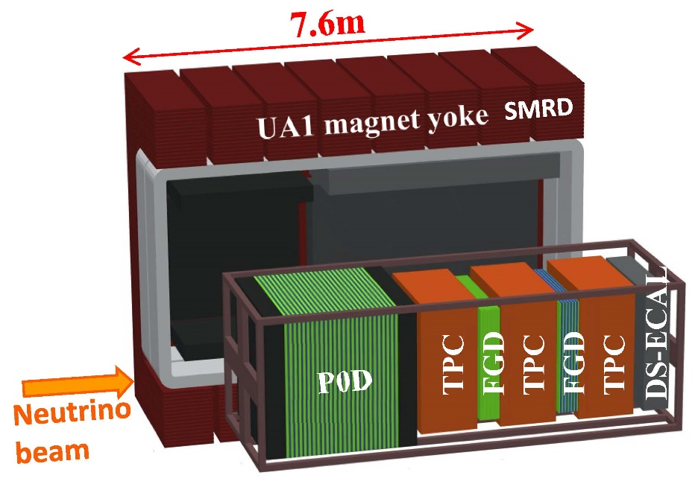
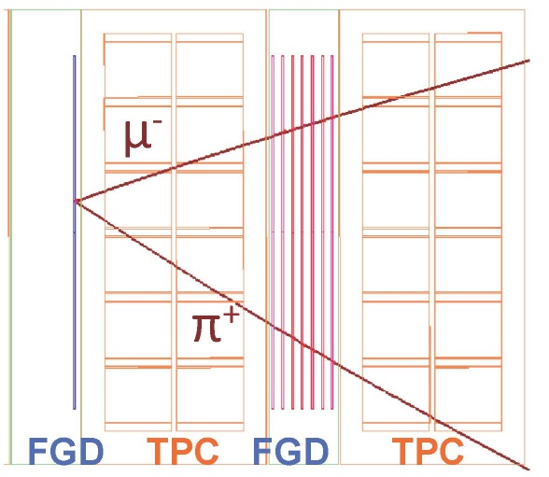
Off-axis detector (ND280)
ND280 is made from following components. -2 FGDs (Fine-Grained Detectors) -3 TPCs (Time Projection Chambers) -P0D (π⁰ detector) -ECAL (Electromagnetic CALorimeters) -SMRD(Side Muon Range Detector). All components are in 0.2 T of magnetic field.
Neutrino flux as well as neutrino interactions can be studied from the reconstructed track information.
CC1π
Notes:
12

Slide 13
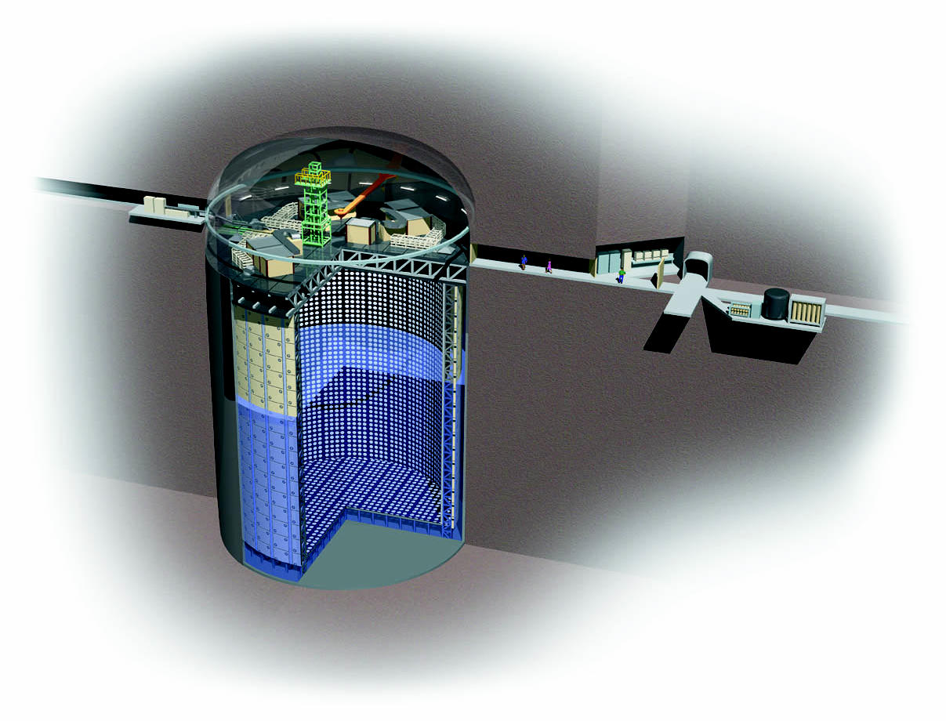
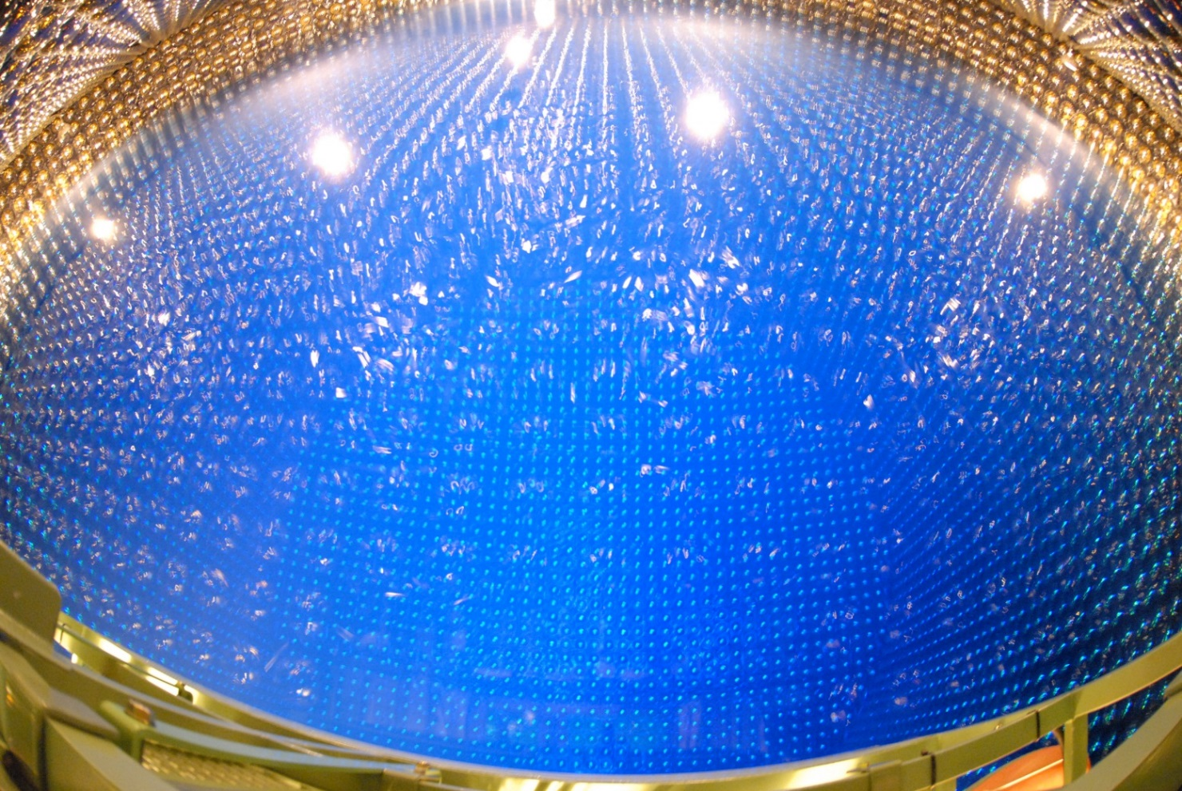
Far detector : Super-Kamiokande (SK)
50kt water Cherenkov detector. The fiducial volume of the inner detector is 22.5 kton, and is viewed by 11129 20-inch diameter PMTs. Outer water layer surrounding the inner volume is viewed by 1885 8-inch diameter PMTs.
Located at 1000 m underground in Kamioka mine, Japan. The distance from J-PARC is 295 km.

Slide 14
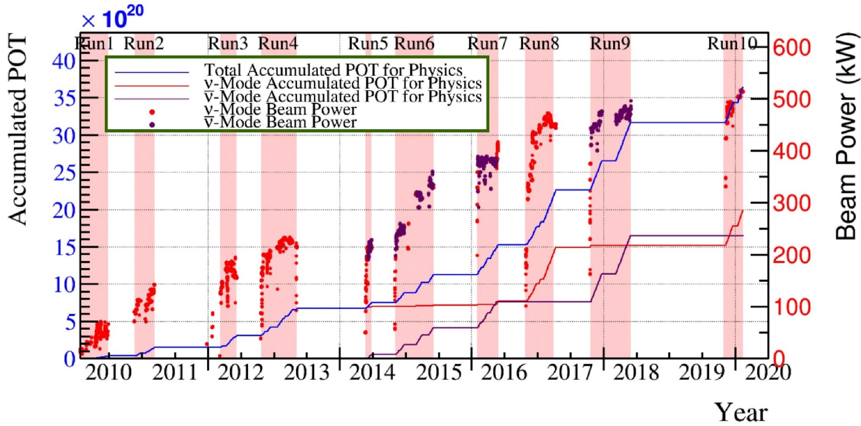
History of the T2K neutrino beam until February 2020
Physics run started in January 2010. Anti-neutrino beam running (reverse horn current direction) started in June 2014. At middle of February 2020, the maximum beam power achieved is 523kW.
Integrated POT (protons on target) until middle of February 2020: 1.99x10²¹ (ν) + 1.65x10²¹ (ν) = 3.64x10²¹ (total).

Slide 15
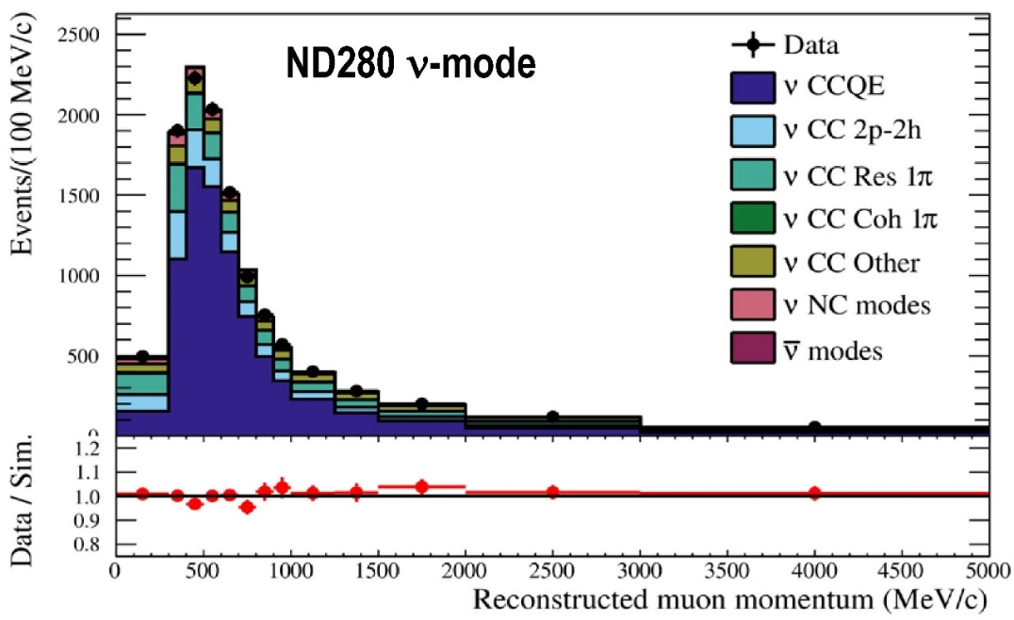
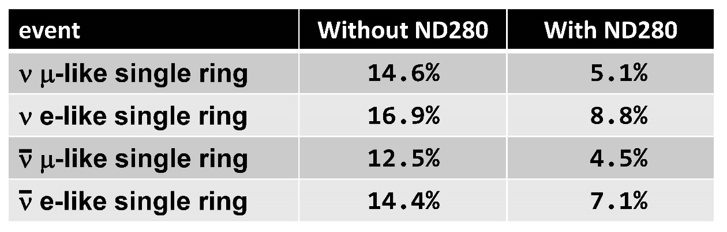
Systematic errors on expected number of events
Neutrino oscillation parameters are extracted from a comparison of SK data and expectations. The systematic error on the expectation is very important.
The expectations are constrained to be consistent with ND280. This reduces the neutrino flux and cross section uncertainties and the systematic error on the expectation at SK.
An example of data-expectation comparison in ND280

Slide 16
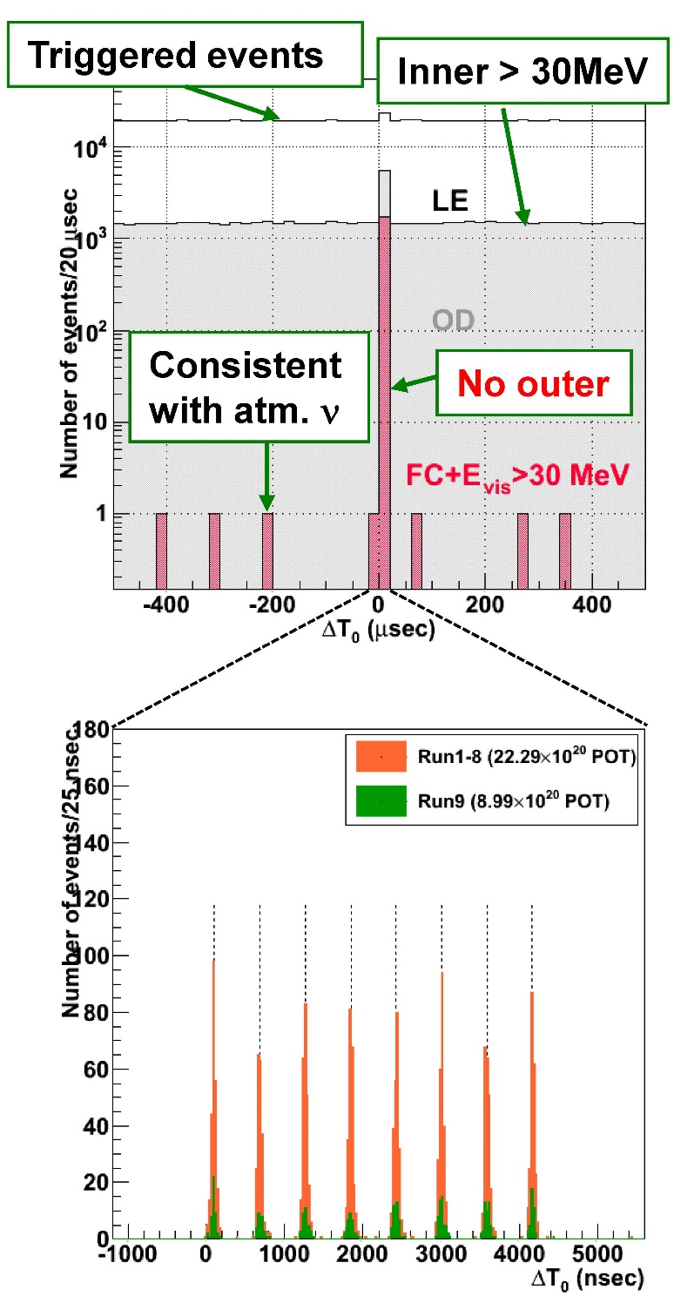
Super-Kamiokande Event Selection
Data recorded between Jan. 2010 and May 2018 are used. It corresponds to 1.49x10²¹ (ν) + 1.64x10²¹ (ν).
Event Selection Criteria
Total energy deposit in the inner detector is larger than 30 MeV equivalent.
No outer detector activity
The event time agrees with ~5 μsec beam period in 2.48 sec accelerator cycle. (8 bunch structure can be found.)
1 Ring events → μ/e particle identification is applied

Slide 17
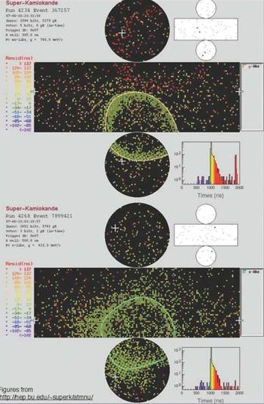
μ/e identification in Super-Kamiokande
μ
ν_{μ} μ
Only direct Cherenkov light from μ Clear Cherenkov ring edge
ν_{μ}
Monte Carlo
ν_{e} e
Cherenkov light from e-m shower. Electrons and positrons are heavily scattered. Cherenkov ring edge is fuzzy.
e
ν_{e}
●
μ/e misidentification probability is less than 1 %.
Monte Carlo

Slide 18
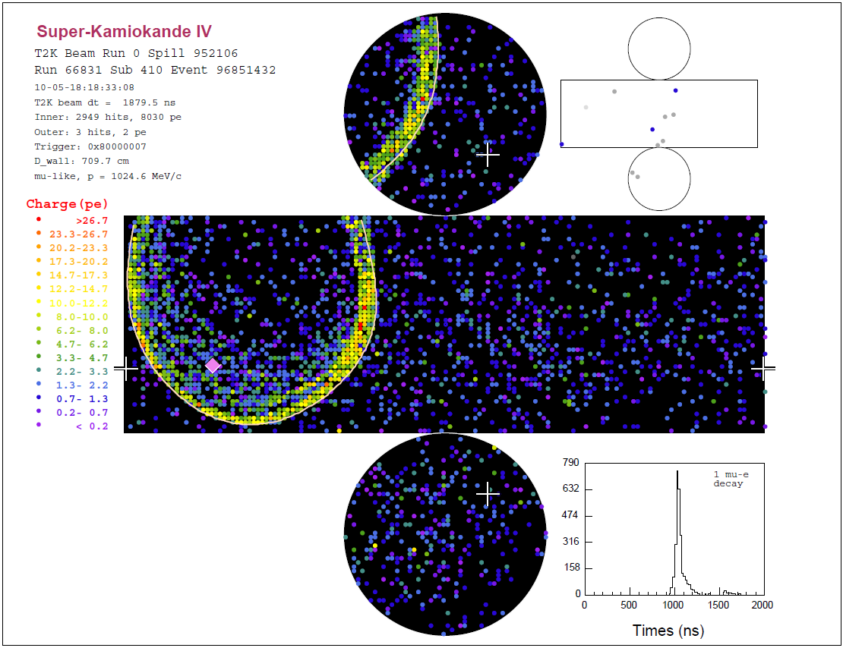
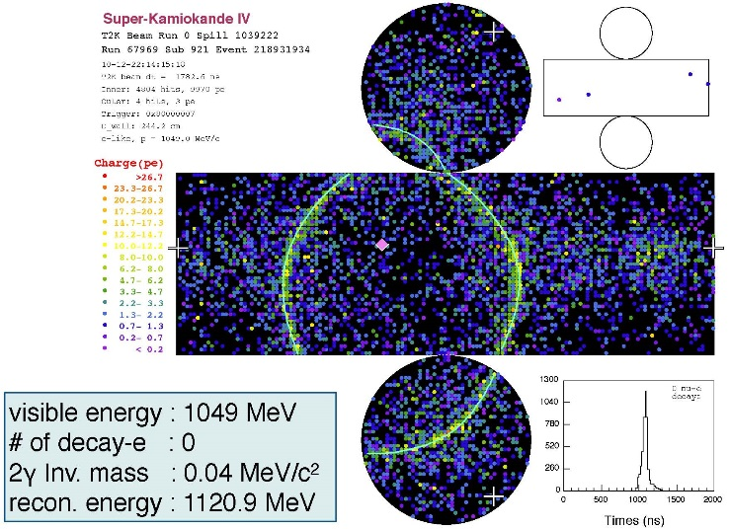
Event Selection
Examine Particle ID of 1 ring events
ν_{μ} selection
ν_{e} selection
μ-like PID
p_{μ} > 200 MeV/c
Michel electron 1 or 0
e-like PID
p_{e} > 100 MeV/c
E_{rec} < 1250 MeV
π⁰ rejection
π⁰ rejection : Forced 2nd ring is assumed. Invariant mass and likelihood for π⁰ are examined.

Slide 19
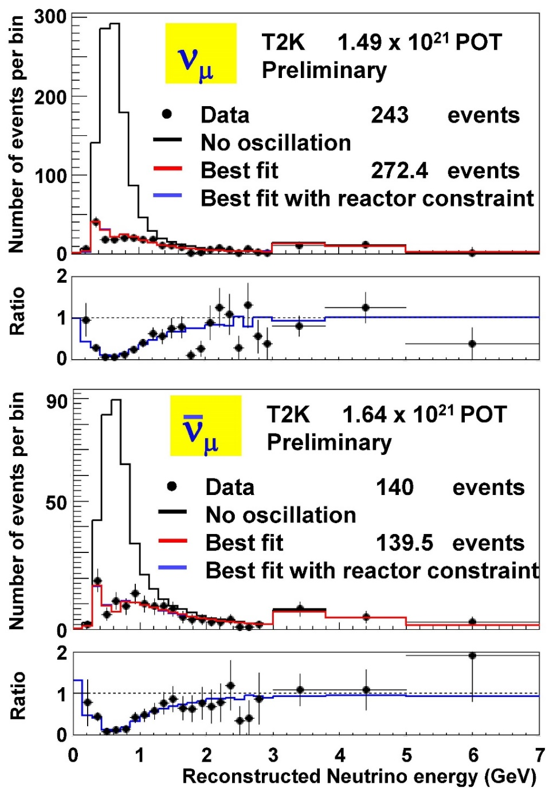
Results of ν_{μ} and ν_{μ} disappearance
Disappearance of muon neutrino events as well as a distortion of neutrino energy spectrum is obvious for both ν_{μ} and ν_{μ}.
Oscillation parameters for anti-neutrinos well agree with the parameters for neutrinos within statistical errors.
These results are updates of past publications.
PRL 112, 181801(2014), PRD 91, 072010(2015) for 6.57x10²⁰ POT, 120 ν_{μ} data
PRL 116, 181801(2016) for 4.01x10²⁰ POT, 34 ν_{μ} data

Slide 20
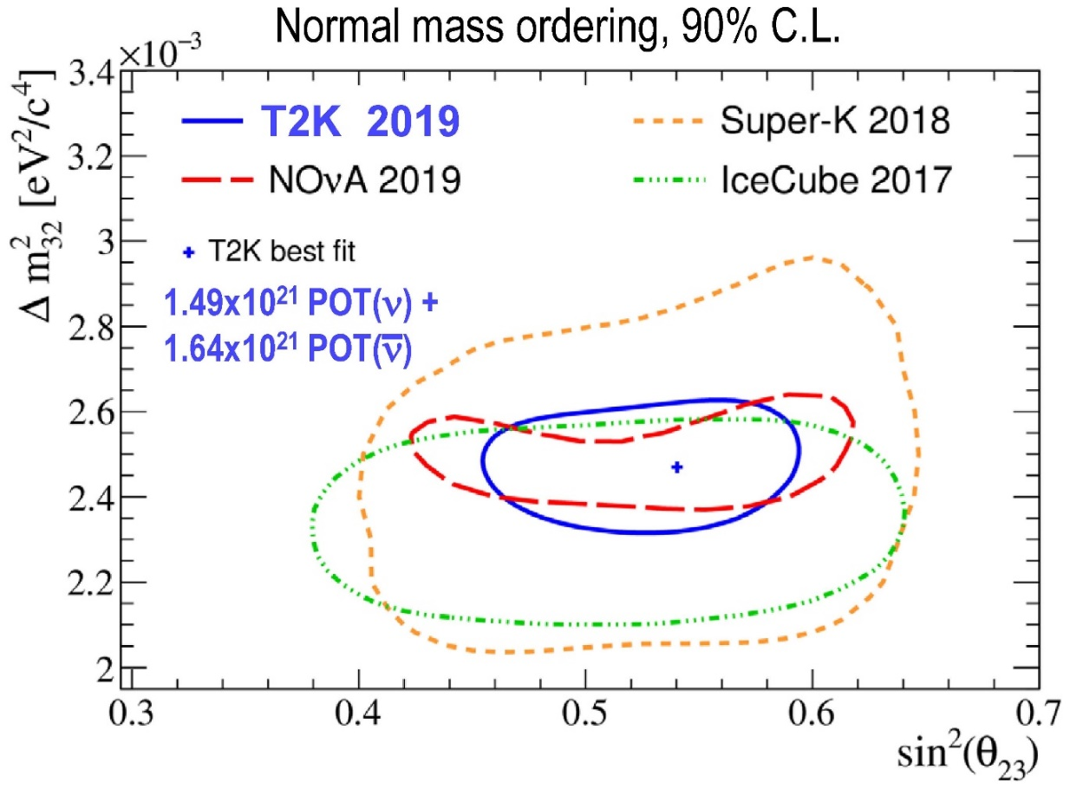
Constraints on sin²θ₂₃ - |Δm²₃₂| plane
Constraints on |Δm²₃₂| and sin²θ₂₃ are obtained.
The best fit parameters are
The T2K results well agree with other experiments, and give most stringent constraints on sin²θ₂₃. It does not contradict with the maximal mixing (sin²θ₂₃=0.5).
The constraint for inverted mass ordering is almost similar to that for normal mass ordering.
|Δm²₃₂| = 2.47 x 10⁻³ eV²
sin²θ₂₃ = 0.541

Slide 21
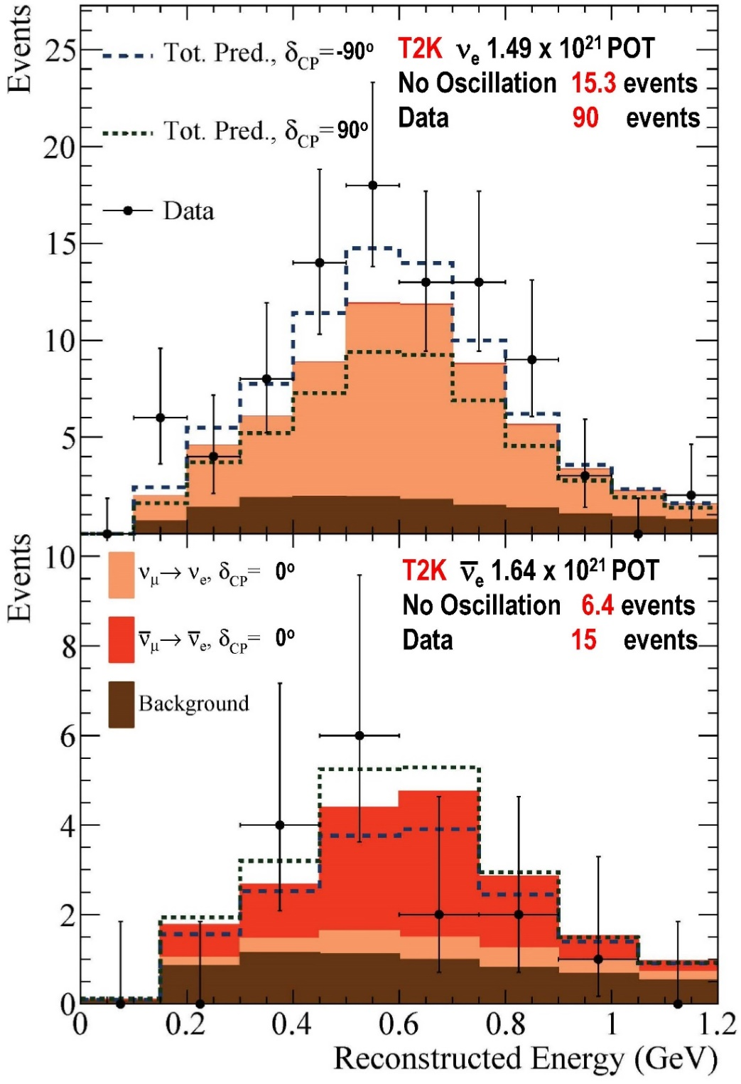
Results of ν_{e} and ν_{e} appearance
For ν_{e} appearance, 90 events are found where expectation for no oscillation is 15.3. It is certainly ν_{e} appearance signal. (In addition to 75 CCQE events, 15 CC1π⁺ events are also employed in the ν_{e} analysis to improve the statistics.)
For ν_{e} appearance, 15 events are found where expectation for no oscillation is 6.4. To claim a significant appearance signal, more statistics is needed.

Slide 22
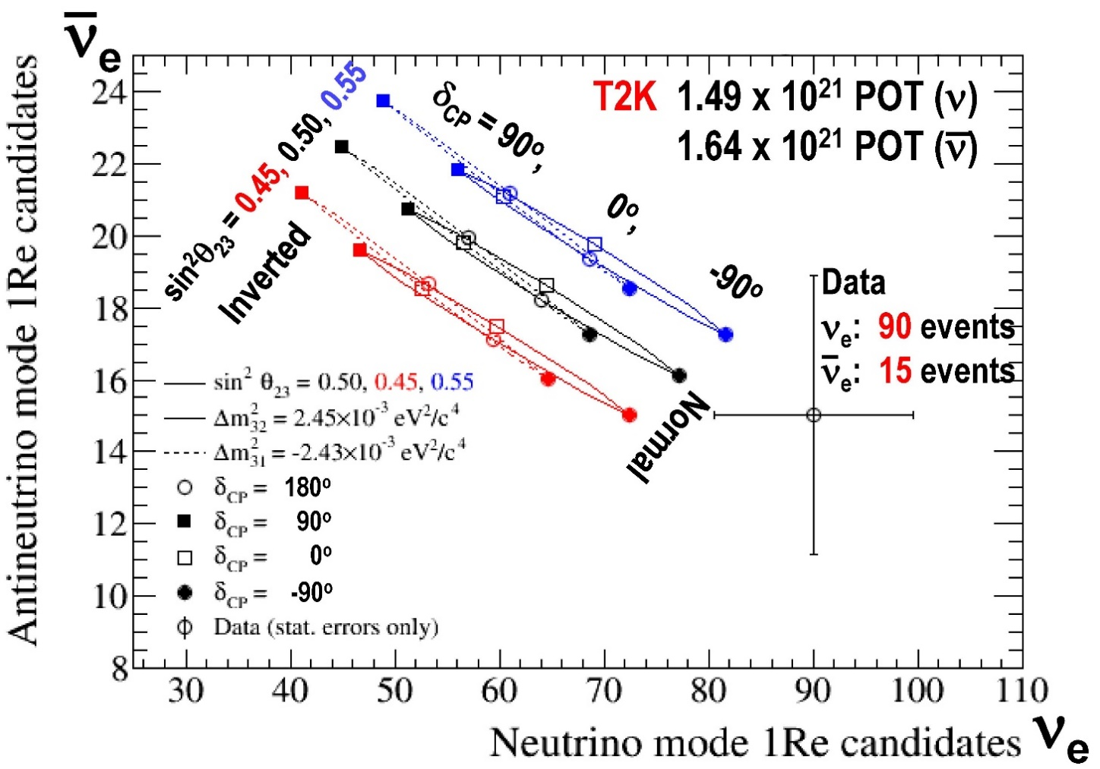
ν_{e} vs ν_{e}
Number of ν_{e} and ν_{e} signals are compared with expectations in the 2-dimensional plane.
More electron neutrinos, and less electron anti-neutrinos are observed.
Negative δ_{CP} (δ_{CP} ~ -90º) is favored over positive δ_{CP}.
Normal mass ordering is favored over Inverted mass ordering.

Slide 23
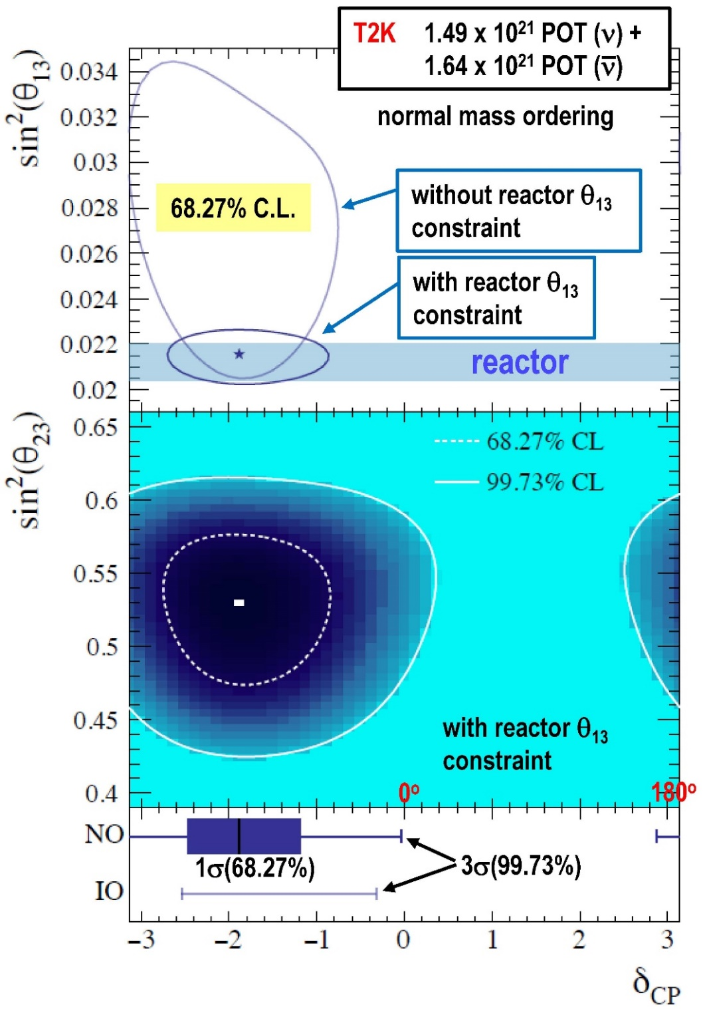
Constraints on δ_{CP} and the mass ordering
Constraints on δ_{CP} are calculated.
The statistical probability of normal mass ordering (NO) is 88.9%, and that of inverted mass ordering (IO) is 11.1%. NO is favored over IO.
The best fit value for NO with 1σ error is -108º .
The 3σ allowed intervals are -195º < δ_{CP} < -2º for NO and -145º < δ_{CP} < -18º for IO.
For CP-conserving cases, (NO,0º),(IO,0º) and (IO,180º) are outside of 3σ region. (NO,180º) is outside of 2σ region. All CP-conserving cases are excluded with more than 2σ.
+40º
-33º
=165º

Slide 24
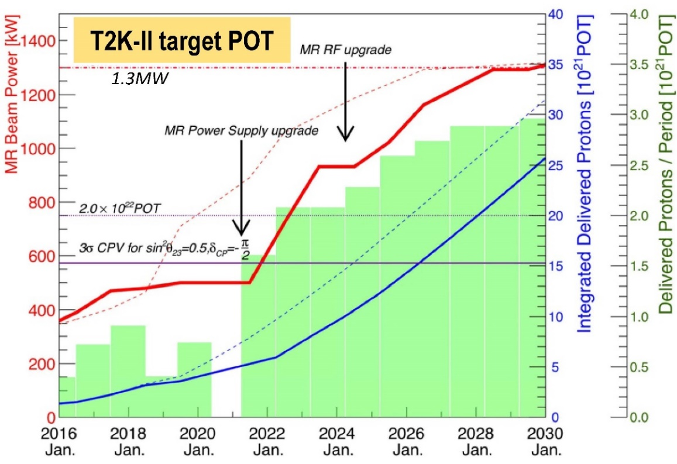
Future (beam upgrade)
Upgrades of the J-PARC Main Ring components as well as the neutrino beamline components are in progress. Most of the work will be done in the long shutdown in 2021.
The beam power will be upgraded from ~500kW to >1000kW around 2025. After all upgrades are completed, 30x10²⁰ POT data will be stably accumulated every year. Note that accumulated POT between 2010 and 2020 was 36x10²⁰ POT.

Slide 25
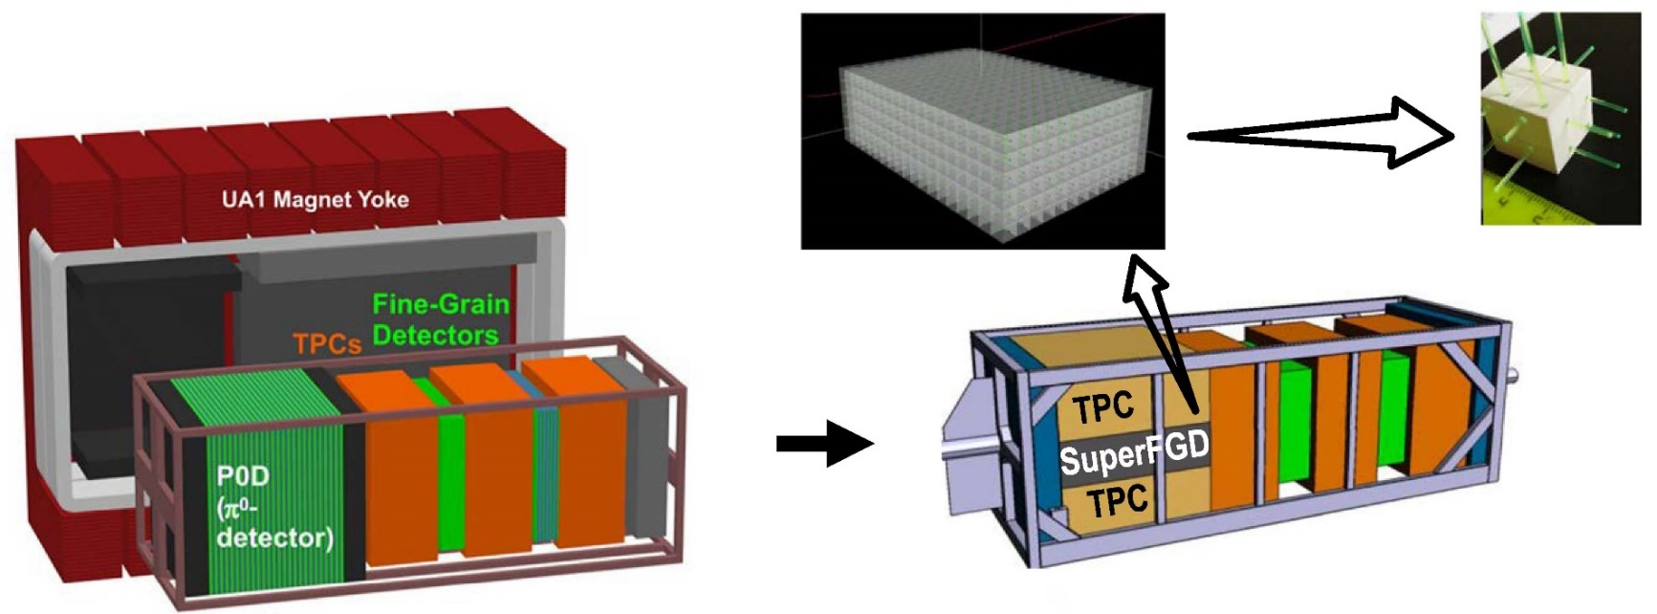
Future (ND280 upgrade)
Upgrade of the near detector (ND280) is also planned during the long accelerator shutdown in 2021.
The main component of the upgrade is SuperFGD, that will be installed in the center of the ND280 detector.
It is consist of ~2 million optically independent 1cm x 1cm x 1cm plastic scintillator cubes. The signal is read out along three orthogonal directions by wavelength shifting fibers.
This high granularity detector will improve the understanding of the neutrino-nucleus interaction as well as the neutrino flux. And it will contribute to a reduction of the systematic errors.

Slide 26
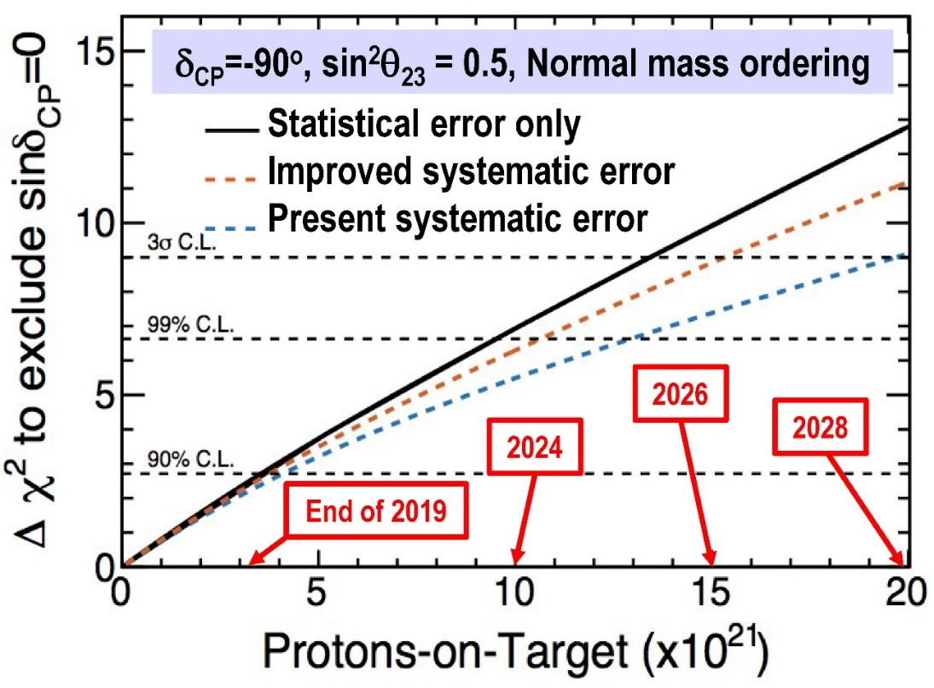
Future (sensitivity)
Potential capability for the discovery of CP violation is estimated as a function of Protons of Target.
At present the statistical error for the appearance signals is dominant. However, the reduction of systematic error will become important after a large accumulation of POT.
The statistical errors will be improved by the beam power upgrade. The systematic errors will be improved by the near detector upgrade. And we hope that we can discover the CP violation in 2020s.

Slide 27
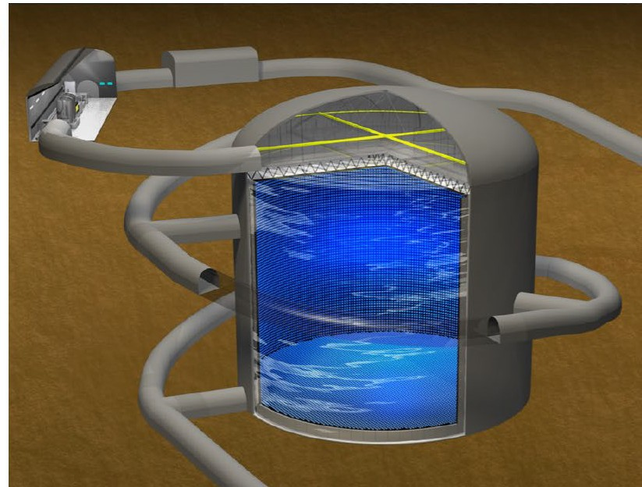
Future (Far detector)
Hyper-Kamiokande is the next generation far detector (from a viewpoint of T2K experiment). It has ~186 ktons of fiducial volume which is about 8 times larger than Super-Kamiokande.
Because of a political reason, some T2K upgrade in Tokai site is a part of Hyper-Kamiokande project. It includes IWCD (Intermediate Water Cherenkov Detector, ~1km downstream from the target). (A small fraction of the very big money is reasonably large money.)
A part (~5%) of total budget was approved by the Japanese Diet in January 2020, and will be used in the coming fiscal year. Since the Japanese budget is year-by-year basis, approval of ~5% in the first year certainly means GREEN LIGHT.
More about Hyper-Kamiokande project will be reported by Dr. Federico Nova this afternoon.

Slide 28
Summary
At middle of February 2020, the maximum beam power achieved is 523kW, and total POT is 3.64x10²¹. Analysis based on 1.49x10²¹ (ν) + 1.64x10²¹ (ν) is obtained.
Results from ν_{μ}/ν_{μ} disappearance well agree with other experiments. It does not contradict with the maximal mixing (sin²θ₂₃=0.5).
From ν_{e}/ν_{e} appearance analysis, normal mass ordering is favored over inverted mass ordering. Negative δ _{CP} is favored.
The best fit value for δ_{CP} with 1σ error is -108º (normal mass ordering).
All CP-conserving cases are excluded with more than 2σ.
The beam power upgrade as well as the near detector upgrade are in progress. We hope that we can discover the CP violation in 2020s.
+40º
-33º

Slide 29
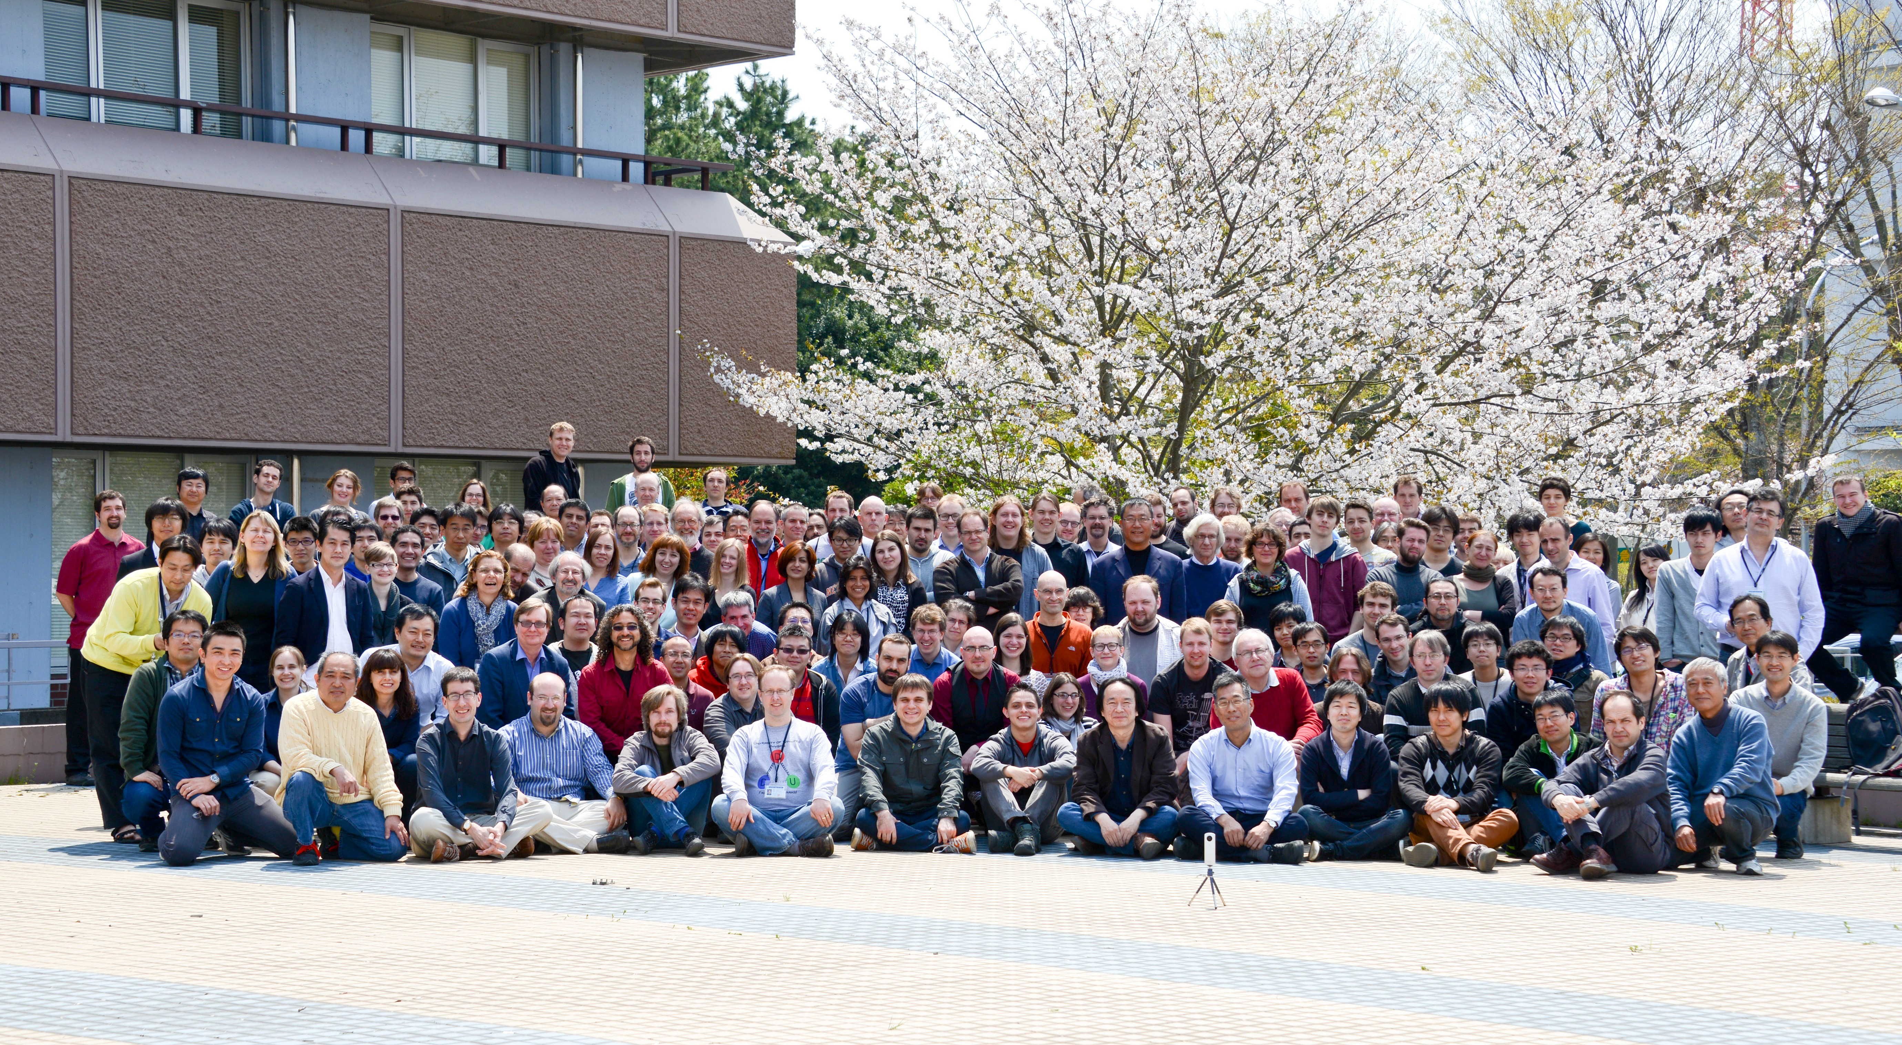
Thank you very much
The T2K collaboration
The T2K collaboration includes about 500 physicists from 12 countries (Canada, France, Germany, Italy, Japan, Poland, Russia, Spain, Switzerland, UK, USA, Vietnam).

Slide 30
Backup

Slide 31



The T2K collaboration
The T2K collaboration includes about 500 physicists from 12 countries (Canada, France, Germany, Italy, Japan, Poland, Russia, Spain, Switzerland, UK, USA, Vietnam).

Slide 32
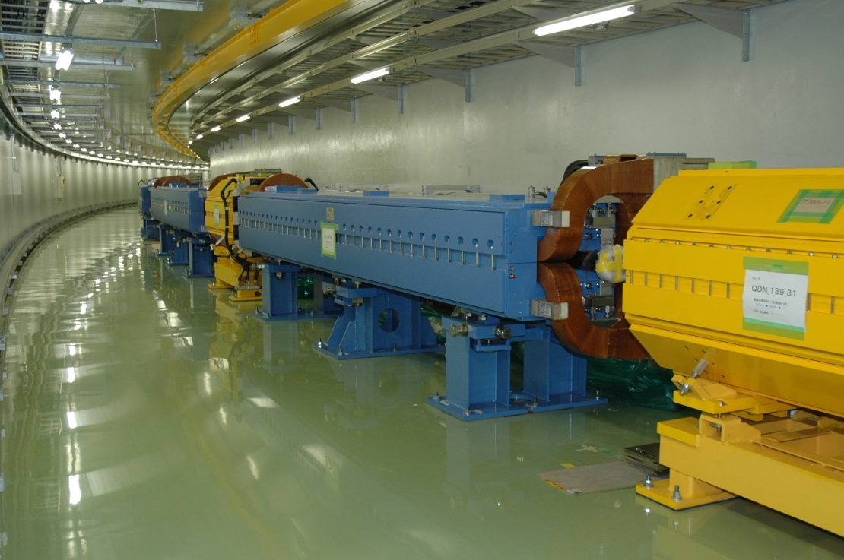
Main Ring
●
Third (and final) stage accelerator. Proton Synchrotron of 1568m circumference.
●
The 30 GeV proton beam is extracted to the neutrino beamline.
Proton beam from J-PARC
●
The design value of the proton beam from J-PARC is as follows;
E_{proton} : 30GeV
Beam power: 750kW
Proton per Second: 1.6x10¹⁴

Slide 33
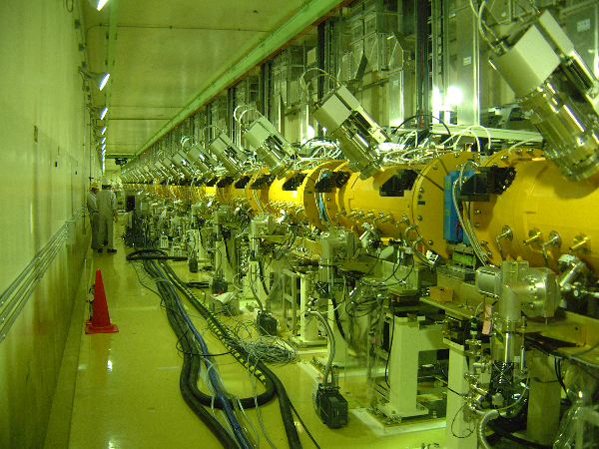
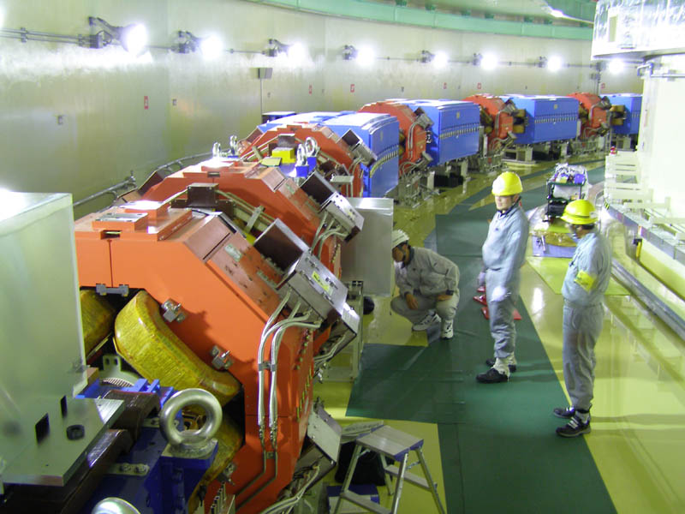
Linac
First stage accelerator, 330m in length.
Protons are accelerated to 400 MeV.
RCS
(Rapid Cycling Synchrotron)
Second stage accelerator, Proton Synchrotron of 348m circumference.
Protons are accelerated up to 3 GeV.

Slide 34
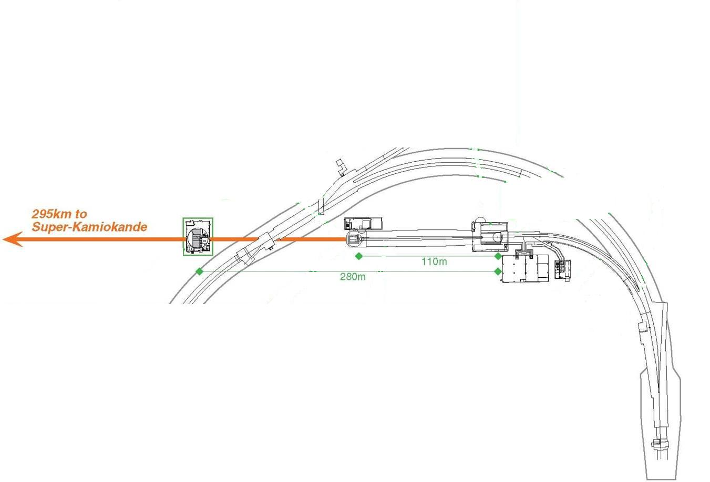
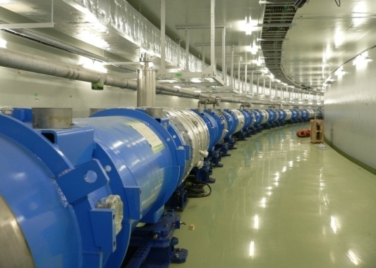
Primary Proton beam line
neutrino beamline
Superconducting magnet in Arc section
Arc section
Magnets in Preparation section
Normal-conducting magnet in Preparation section

Slide 35
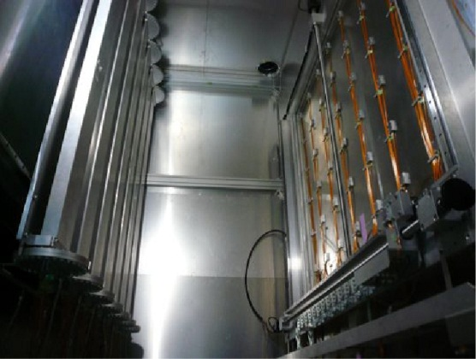
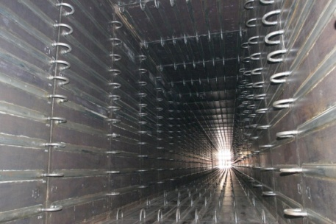
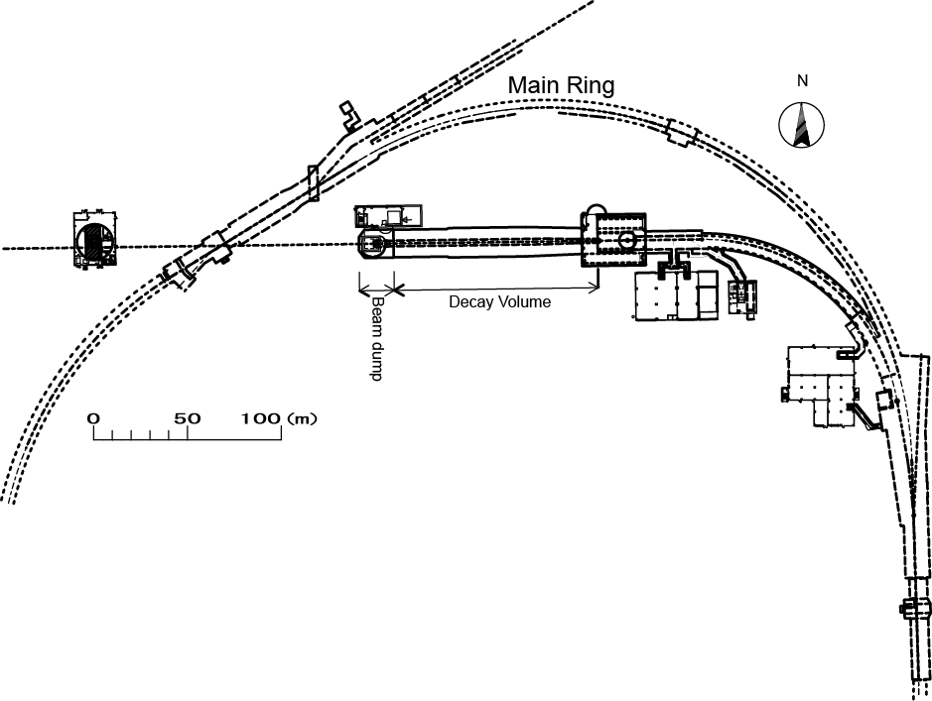
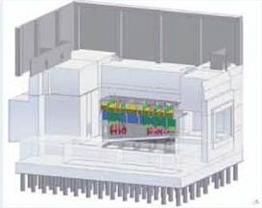
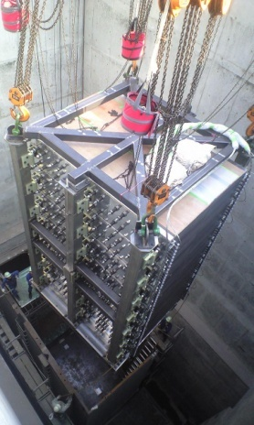
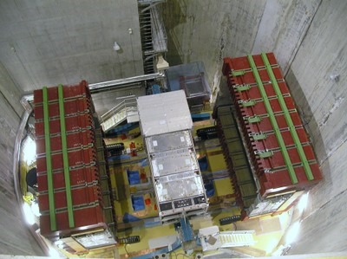
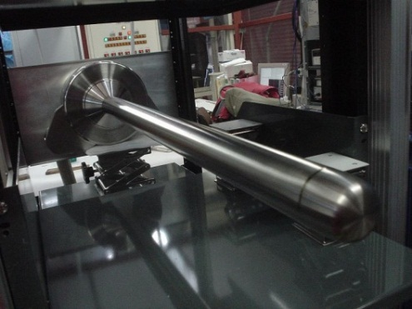
Neutrino beam line and components
decay volume
superconducting magnet
muon monitors
π
ν
to Kamioka
p
target station
Near detectors
beam dump
magnetic horn
carbon target

Slide 36
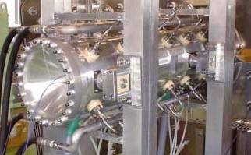
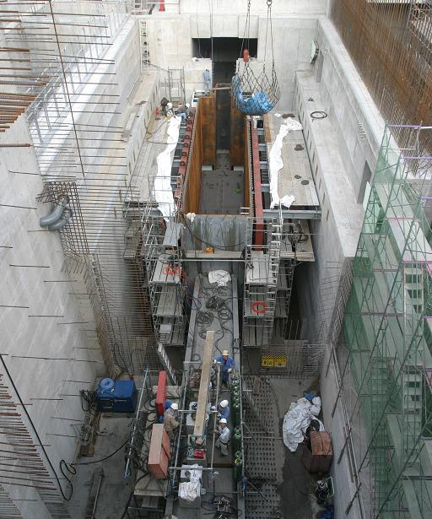
Target Station
neutrino beamline
Magnetic horn
Schematic view of target station
2nd horn
Baffle
3rd horn
BEAM
Target &
1st horn
Civil construction of target station

Slide 37




Decay pipe and Beam dump
neutrino beamline
Muon monitors in Muon Pit
Graphite core
of the
Beam dump
Beam
Installation of decay pipe
Inside of decay pipe
(rectangular shape)

Slide 38


Off-axis beam
oscillation maximum
The center of the beam direction is adjusted to be 2.5º off from the SK direction.
Neutrino energy spectrum becomes quasi-monochromatic. The peak energy is ~0.6 GeV.
Survival probability
Merits of the off-axis beam are:
The neutrino energy peak agrees with the oscillation maximum.
High energy (> 1 GeV) neutrinos are suppressed.
Neutrino energy spectrum is calculated from CCQE events; ν_{μ} + n ⇢ μ + p. Fraction of CCQE events is small in high energy range and some of non-CCQE events are serious background for the CCQE selection.
Neutral Current (NC) π⁰ events are background for the ν_{e} appearance search. NCπ⁰ events are reduced by the suppression of high energy neutrinos.
Water Cherenkov detector has better performance for single charged particle events.

Slide 39



Muon monitors
Two types of muon monitors are installed downstream of the beam dump for redundancy.
Semiconductor array
Ionization chamber
1.7m
7x7 channels
Ar+2%N₂gas (~Mar. 2015)
He+1%N₂gas (May~ 2015)
7 x 7 channels of Silicon PIN photo diode
2.5m
4.3m
beam
Confirm the position of the beam center with < 3cm resolution on a bunch by bunch basis. This corresponds to < 0.3mrad beam direction accuracy.

Slide 40

Stability of event rate and beam direction
Event rate is stable over neutrino and anti-neutrino periods.
Beam direction is much stable than our requirement, 1mrad.

Slide 41

ND280 detector
neutrino beam

Slide 42


Off-axis detector (ND280)
ND280 is made from several components.
2 FGDs (Fine-Grained Detectors) consist of scintillator bars and one has water as a target material.
3 gas-filled TPCs (Time Projection Chambers) track charged particles.
All components are in 0.2 T of magnetic field. The magnets were previously used in UA1 and NOMAD.
Charged particles are deflected by the magnetic field. The curvature of the track recorded by TPC are used to determine the momentum of the particles.
Neutrino flux as well as neutrino interactions can be studied from the reconstructed track information.
Other components are P0D (π⁰ detector), ECAL(Electromagnetic CALorimeter) and SMRD(Side Muon Range Detector).
SMRD
TPC FGD TPC FGD TPC
DS-ECAL
Neutrino beam
CC1π
Notes:
42

Slide 43
μ/e identification in Super-Kamiokande
SK atmospheric neutrino data (single ring, 1489.2 days, Sub-GeV)
"PID likelihood" is defined, and is applied to atmospheric neutrino events. The separation is clear.
e
μ
●
The excellent (>99 %) particle identification capability was also confirmed by a beam test using KEK 12GeV Proton Synchrotron. S.Kasuga et al., PL.B374,238(1996)
●
μ
p
μ
12GeV PS
1kt water Cherenkov
PID Likelihood

Slide 44


Expected number of neutrino events
Calculation of expected number of events in Super-Kamiokande is essentially important. It is because neutrino oscillations are examined from a comparison between data and expectations.
Monte Carlo simulation and their systematic errors are:
Simulation of event generation is affected by systematic errors related to neutrino interactions.
Neutrino flux calculation has systematic errors due to uncertainty of π/K productions at the target
ν
π/K
p
Data and expectation are compared at ND280, and systematic errors in neutrino flux and neutrino interactions can be reduced. The reduced systematic errors can be applied to calculations in the far detector.
Notes:
44

Slide 45


π/K production measurement
Some of T2K members join CERN NA61/SHINE : “Study of hadron productions in hadron-nucleus and nucleus-nucleus collisions at CERN SPS”
The energy of the proton beam is adjusted to the T2K proton beam, 30 GeV. Thin (2 cm) carbon plate is used as target. The carbon material is same as T2K
Production of pions and kaons are precisely measured by TPC and TOF. Their fluxes are measured as a function of momemtum and angle.
p_{π,Κ}
π/Κ
p
θ

Slide 46



Expected neutrino fluxes at SK and ND280
From p/K production data, neutrino flux at Far(SK) and Near(ND280) detectors can be calculated from decay kinematics.
Systematic errors of neutrino flux @SK
@Far(SK)
Positive Focusing Mode, ν_{μ}
@Near(ND280)
Systematic errors on neutrino fluxes @SK in 0.1GeV~5GeV range are 10~15%.
However, fluxes at two detectors are highly correlated, and the some of the systematic errors are common.
An extrapolation of ND280 analysis can reduce systematic errors in SK.

Slide 47



Neutrino Interactions
In the neutrino interaction simulation, model parameters, such as axial vector mass, are tuned by using external neutrino data. Results from MiniBooNe are used as primary inputs.
Neutrino cross section
T2K range
In the T2K neutrino energy range, contributions from CCQE and CC1π interactions are dominant.
Charged Current
Quasi-Elastic
Charged Current 1π Resonant Production
At present, nominal systematic errors for the neutrino cross section are larger than ~10%.

Slide 48



ND280 analysis
CCQE events, CC1π events, and CC_{dis} events are selected based on track topologies in ND280 FGD/TPC.
p_{μ} and cosθ_{μ} distribution are carefully compared between the data and the simulation. All systematic errors related to cross sections and neutrino fluxes are adjusted from the comparison.
CCQE : Charged Current Quasi Elastic CC1π : Charged Current 1π resonant production CC_{dis} : Charged Current Deep Inelastic Scattering
CCQE
The agreements are excellent after the parameter adjustment. The adjusted parameters can be also applied for SK.
CCQE
CCQE

Slide 49
Typical single muon ring event
Pμ = 1025 MeV/c
1 decay-e

Slide 50



Possible electron neutrino candidate(1)

Slide 51

Possible electron neutrino candidate(2)

Slide 52

First anti-neutrino beam event

Slide 53
End

