Slide 1
Recent status of the tritium problem at J-PARC neutrino beamline
Yuichi Oyama (KEK/J-PARC)
Sep-21-2022
NBI2022@Abingdon,Oxfordshire
1

Slide 2
Overview
As reported in NBIs and US-Japan workshop, the most serious problem in the radioactive waste treatment in J-PARC neutrino beamline is ³H from cooling water.
Please visit following pages for my presentation in the past workshops.
J-PARC Nu Radioactive Waste Treatment (NBI2017)
https://conference-indico.kek.jp/indico/event/16/session/6/contribution/12
https://www-nu.kek.jp/~oyama/nbi2017.oyama.ppt
Tritium problems in the J-PARC neutrino beamline (NBI2019)
https://indico.fnal.gov/event/21143/contributions/61129/
https://www-nu.kek.jp/~oyama/nbi2019.oyama.ppt
Tritium problems in the J-PARC neutrino beamline
(US-Japan workshop on Tritium Transport Studies 2020)
https://www-nu.kek.jp/~oyama/FermiWS2020.oyama.200626.pptx
In my talk, I would like to focus on the ³H issue again.
The topics addressed in my talk are:
New disposal tanks
Permission for the beam power upgrade and recalculation of ³H production
2

Slide 3
New disposal tanks
3

Slide 4
Drainage of radioactive water
Currently, the maximum POT and ³H disposal in a year are:
In FY2017, 69 times of radioactive water drainage were done with
2 x 50 m³ disposal tanks. Since 3 business days are needed for one drainage cycle, it was almost our limit.
Our official goal about the POT in a year is ~48 x 10²⁰ (1.3 MW x 208 days).
Obviously, a drastic improvement of the ³H disposal procedure is needed.
We discussed a possibility of confinement of ³H rich water in the cooling water circuit (as reported in previous NBIs). However, we concluded that the confinement is dangerous and is not realistic.
We decided to construct new larger disposal tanks.
POT: 6.55 x 10²⁰ (430kW x 84 days) (FY2016)
³H disposal: 195.4 GBq (FY2017)
208 days (=5000 hours) is maximum beam operation time of the main ring in a year. When the hadron facility is in a long shutdown, the neutrino facility hope to accept the all beam time.
4

Slide 5
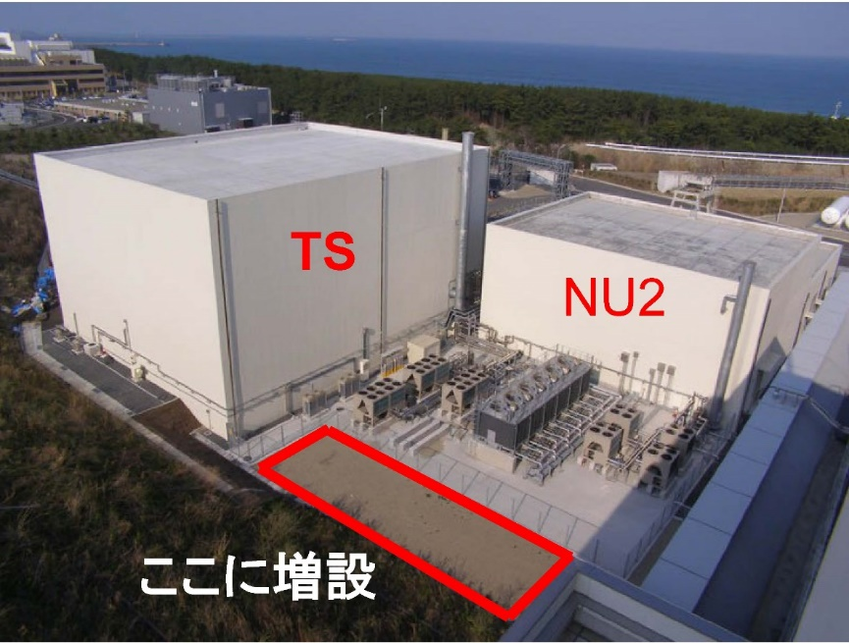
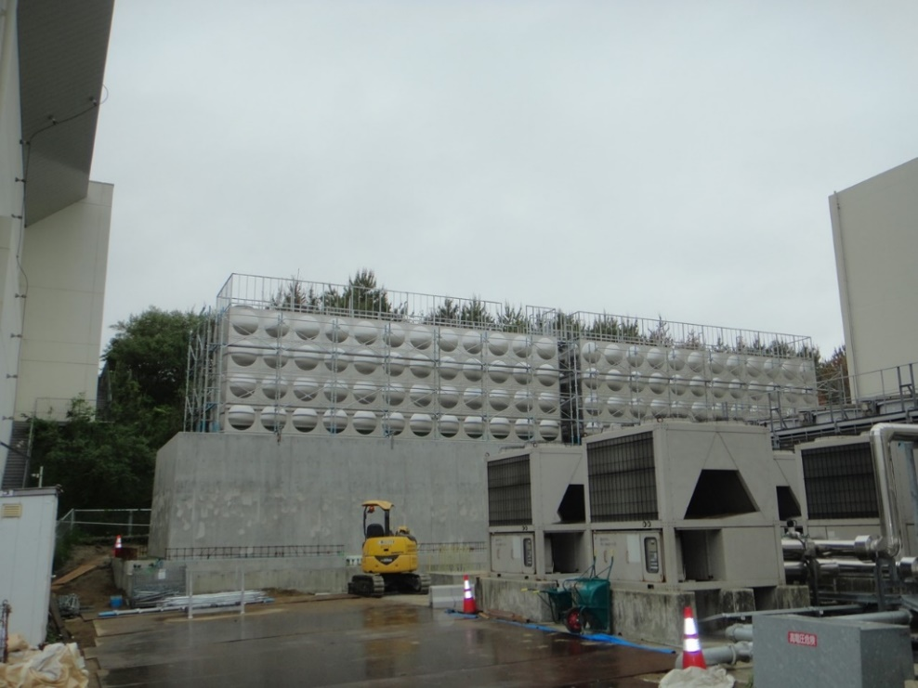
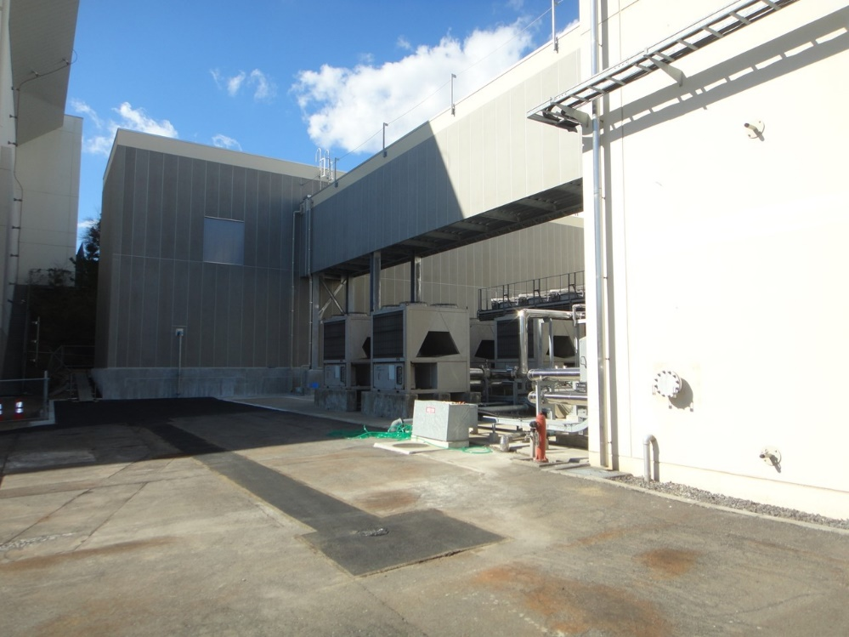
New disposal tanks
The construction of new disposal tanks (2 x 252m³) for radioactive water was completed in February 2022.
The capacity of these tanks will be enough for > 2MW beam operation.
Construct here
May 2021
Feb. 2022, completed
5
5

Slide 6
Permission for the beam power upgrade
and
recalculation of ³H production
6

Slide 7
Permission for the 1.3MW beam
Since J-PARC is a radiation facility, permissions for the neutrino beam operation by government and local government are required.
The permission by Ibaraki prefecture is critical. The latest official permission from the prefecture was obtained in 2009, when the T2K experiment started.
The maximum beam power in the 2009 permission was 750 kW. A new permission is definitely needed for the beam power upgrade up to
1.3 MW.
The most serious problem in the new permission is the ³H production and disposal. In the 2009 document, we wrote that 120 GBq ³H will be produced in the cooling water for 750 kW x 208 days beam operation. However, the ³H in a year already exceed 120 GBq. The maximum ³H in a year was 195.4 GBq.The real ³H production is larger by factor ~8.
The J-PARC internal review committee for the 1.3MW upgrade requested the thorough recalculation of the total ³H production.
7

Slide 8
Recalculation of the ³H production
The ³H production in cooling water was calculated again in 2020 (namely, 2020 calculation).
The distribution of cooling water in the beamline was carefully inputted, and neutron flux at the position was calculated from the MARS simulation.
The total ³H production scaled from 2009 calculation is 208 GBq/year,
but the result from 2020 calculation is 650 GBq/year.
(All numbers are normalized to 1.3 MW x 208 days beam).
The difference is mainly due to the last minute change of the design of the cooling water circuit after the 2009 calculation. The volume of the real cooling water was larger by factor ~3.
We regret that the estimation of the cooling water volume in 2009 was poor.
Real ³H production obtained from 10 years of drainage history is
1700 GBq/year. Still there is a large discrepancy between
650 GBq/year and 1700 GBq/year.
8

Slide 9
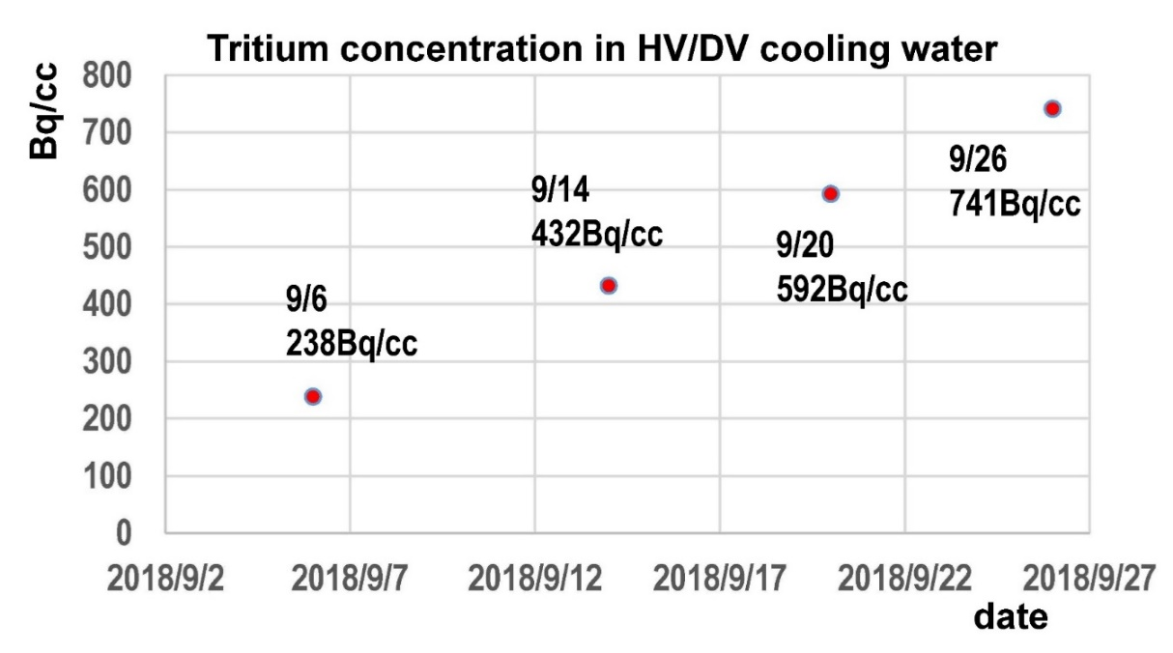
³H from steel wall to cooling water
"The ³H from steel wall to cooling water" might explain the discrepancy.
In 2018, we found a new
phenomena that the ³H
concentration of TS
cooling water
continuously increased
by ~25Bq/cc/day even
after the beam stop.
In NBI2017 and “the
beamline upgrade TDR
review committee”,
NuMI group pointed out that they have a new ³H problem.
Inspired by the NuMI experience, we suspect that ³H came out from the steel wall. It is estimated to 7.8m³ x (25Bq/cc)/day = 0.195GBq/day.
In fact, the MARS calculation shows that 5600 GBq of ³H are expected to
be produced in steel wall for 1.3 MW x 208 days.
“NuMI experience says majority of the tritium produced in the steel shielding can come out, when shielding gets hot at high beam power”
9

Slide 10
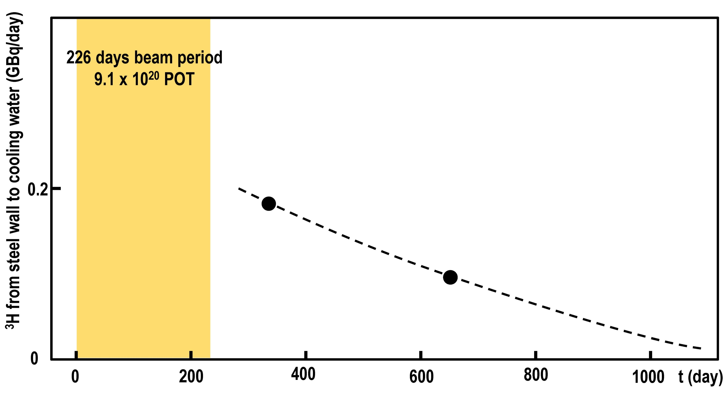
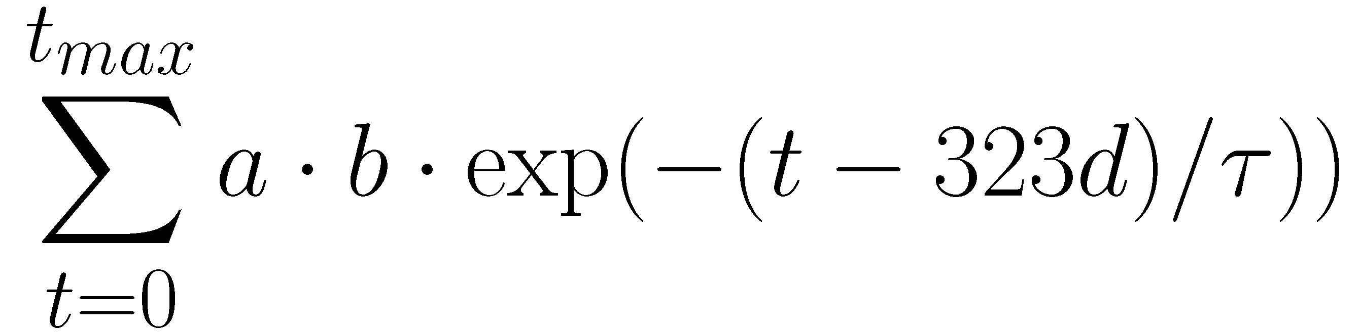
³H from steel wall to cooling water
³H from steel wall to cooling water was calculated using 2017-2018 run.
Exponential decay is assumed, and total ³H from the steel wall is estimated.
³H(total) = 950 GBq for 1.3MW x 208 days is obtained by simple scaling.
From 2017/10/17 (t=0d) to 2018/05/31 (t=226d), 9.1x10²⁰ protons are delivered to the neutrino beam line.
At t=323d, ³H from steel wall to cooling water was 0.195GBq/day
At t=647d, ³H from steel wall to cooling water was 0.094GBq/day
³H(total)=
= 178 GBq
a = 0.195GBq
b = (t/226) x 2.5 for t ≦ 226d
(during beam period, iron temperature is
high and ³H from steel is enhanced)
= 1 for t ＞ 226d
t_{max} = 226d+1000d : 1000d from end of beam
is assumed
10

Slide 11
Summary of ³H production
The summary of ³H production is as follows.
All numbers are normalized to (1.3 MW x 208 days).
The real data (b) and the calculation (f) are consistent with each other.
Surprisingly, ³H from steel wall is larger than direct ³H from the cooling water.
We employ the number 1700 GBq/yr for (1.3 MW x 208 days) as our official estimation.
 | Calculation and data (normalized to 1.3 MW x 208 days) | ³H(GBq)
(a) | ³H produced in cooling water (2009 calculation) | 208
(b) | Data from 10 years of history | 1700
(c) | ³H produced in cooling water (2020 calculation) | 650
(d) | ³H produced in steel wall (2020 calculation) | 5600
(e) | Steel wall to cooling water | 980
(f) | Total ³H from calculations (=(c)+(e)) | 1630
11

Slide 12


Negotiation with Ibaraki Prefecture
To win the permission from Ibaraki prefecture, the most serious problem is the total ³H in the drainage.
If we hope to change the agreement in 2002, we need very tough negotiation with the prefecture. A committee to discuss this problem will be formed. The committee members are not scientists, but local prominent persons such as the head of the fishermen's union.
The reputational damage caused by the drainage of ³H
water from the Fukushima Daiichi Nuclear Power Plant,
destroyed by the big tsunami, is a big social issue.
The head of the fishermen’s union will never agree with
additional drainage of the J-PARC ³H water to the
Pacific Ocean. The negotiation will be quite difficult
and needs long time.
We need…..
The agreement in 20 years ago is…
For 1.3MW x 208 days beam in a year is assumed, we need to dispose 1700 GBq/yr ³H.
When J-PARC project was planned in 2002, J-PARC and Ibaraki prefecture agreed that total ³H in the drainage must be less than 1300 GBq/yr.
12

Slide 13
Request for permission was submitted!
We decided to make a compromise that the maximum ³H from J-PARC, 1300 GBq/year, should be kept as it is. Among 1300 GBq/yr,
1100 GBq/yr is assigned to the neutrino facility.
We submitted the “Request for permission for 1.3 MW beam operation” to Ibaraki Prefecture in February 2022.
By considering the ³H disposal limit (1100GBq/yr), the beam conditions in the request are
We hope that the new permission will be given in this autumn.
Probably we need further very tough negotiation about the ³H disposal limit within ~10 years when new beam upgrade is planned.
1100 GBq/year
208 days x = 134 days
1700 GBq/year
Beam power < 1.3MW and
Total POT < 31x10²⁰ /yr (1.3 MW x 134 days equivalent).
13

Slide 14
Summary
The construction of the new disposal tanks (2 x 252m³) was completed.
Their capacity is enough for > 2 MW beam.
The large discrepancy of ³H production between the 2009 calculation and the result from 10 years beam operation are explained by the volume of the cooling water and ³H from steel wall.
Request for the 1.3 MW beam permission was submitted to Ibaraki prefecture in February 2022. Although we need to dispose 1700 GBq/yr ³H, we made a compromise with 1100 GBq/yr. Accordingly, the limit on the neutrino beam operation is
Beam power < 1.3MW and
Total POT < 31x10²⁰ /yr (1.3 MW x 134 days equivalent).
14

Slide 15
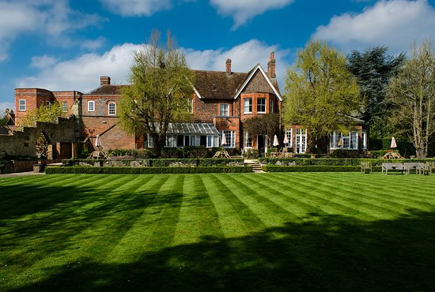

Thank you very much!
15

